Slide 1
Quality of Tests
Further Statistics 1 Chapter 8
Westie's Workshop

Slide 2
Teachings for Exercise 8D

Slide 3
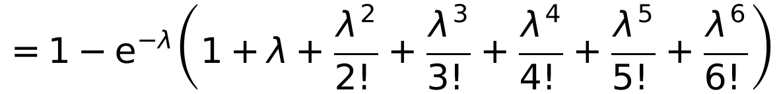
The Power Function
You need to be able to draw a graph of the power function for a test
The power function of a test is the function of the parameter θ which gives the probability that the test statistic will fall in the critical region of the test if θ is the true value of the parameter
You usually do not know the true value of the parameter, so the power function is given in terms of it
Past experience has shown that the number of accidents that take place at a road junction has a Poisson distribution with an average of 3.5 accidents per month. A trading estate is built along one of the roads leading away from the junction and the local council is anxious that this may have increased the accident rate. To see if the number of accidents had increased, a test was set up with the null hypothesis H₀: λ = 3.5 and with the alternative hypothesis being accepted if the number of accidents X within the first month after the alteration was ≥ 7.
a) Find the size of the test.
b) Find the power function for the test and sketch the graph of the power function.
a) Size = P(reject H₀ when it is true)
= P(X ≥ 7 | X ~ Po(3.5))
= 1 − 0.9347
= 0.0653
b) Power function = P(reject H₀ when it is false)
= P(X ≥ 7 | X ~ Po(λ))
= 1 − P(X ≤ 6 | X ~ Po(λ))
Add P(X = x) for x = 0, 1, …, 6
8D

Slide 4
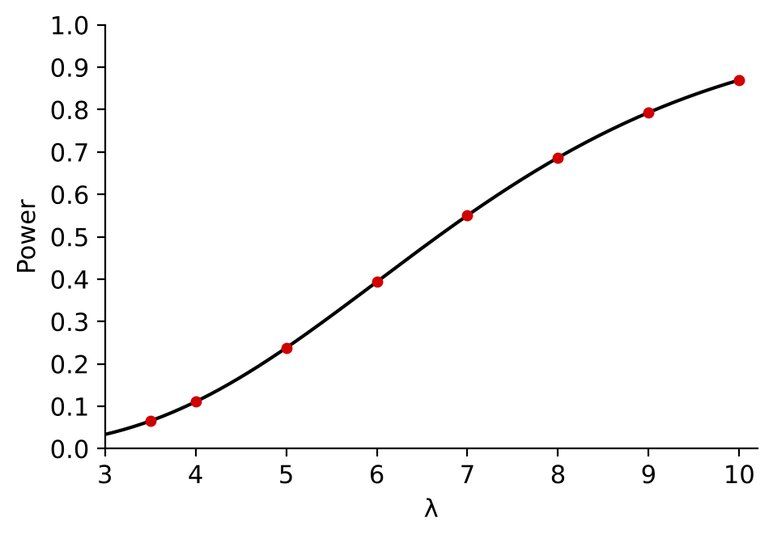
The Power Function
Use the power function to find the power for different values of the parameter, then plot power against the parameter
In an exam you are often given a partially completed table
The power increases as λ increases: the test is better at detecting bigger increases in the accident rate
b) (continued) Find values of the power and sketch the graph of the power function.
λ
4
5
6
7
8
9
10
Power
0.1107
0.2378
0.3937
0.5503
0.6866
0.7932
0.8699
8D

Slide 5
The Power Function
Power functions are particularly useful when comparing two different tests
When comparing two tests of comparable size, you should recommend the test with the higher power within the likely range of the parameter
A manufacturer of sweets supplies a mixed assortment of chocolates in a jar. He claims that 40% of the chocolates have a ‘hard centre’, the remainder being ‘soft centred’.
A shopkeeper does not believe the manufacturer’s claim and proposes to test it using the hypotheses H₀: p = 0.4, H₁: p < 0.4, where p is the proportion of ‘hard centres’ in the jar. Two tests are proposed.
In test A he takes a random sample of 10 chocolates from the jar and rejects H₀ if the number of ‘hard centres’ is less than 2.
a) Find the size of test A.
b) Show that the power function of test A is given by (1 − p)¹⁰ + 10p(1 − p)⁹.
a) Size of test A = P(X ≤ 1 | X ~ B(10, 0.4))
= 0.0464 (4 d.p.)
‘Less than 2’ means X ≤ 1
b) Power of test A = P(X ≤ 1 | X ~ B(10, p))
= P(X = 0) + P(X = 1)
= (1 − p)¹⁰ + 10p(1 − p)⁹
Could also be written (1 − p)⁹(1 + 9p)
8D

Slide 6
The Power Function
For a two-stage test, list every way that H₀ can be rejected
Test B rejects H₀ if:
there are no hard centres in the first 5
or
there is at least one in the first 5 and none in the second 5
In test B he takes a random sample of 5 chocolates from the jar and if there are no ‘hard centres’ he rejects H₀, otherwise he takes a second sample of 5 chocolates and H₀ is rejected if there are no further ‘hard centres’ on this second occasion.
c) Find the size of test B.
d) Find an expression for the power function of test B.
Let Y = number of hard centres in a sample of 5, Y ~ B(5, p)
c) Size = P(Y = 0) + (1 − P(Y = 0)) × P(Y = 0), with p = 0.4
= 0.6⁵ + (1 − 0.6⁵) × 0.6⁵
= 0.1495 (4 d.p.)
d) Power = P(0 in first 5) + P(> 0 in first 5) × P(0 in second 5)
= (1 − p)⁵ + (1 − (1 − p)⁵)(1 − p)⁵
= (1 − p)⁵(2 − (1 − p)⁵)
= 2(1 − p)⁵ − (1 − p)¹⁰
8D

Slide 7
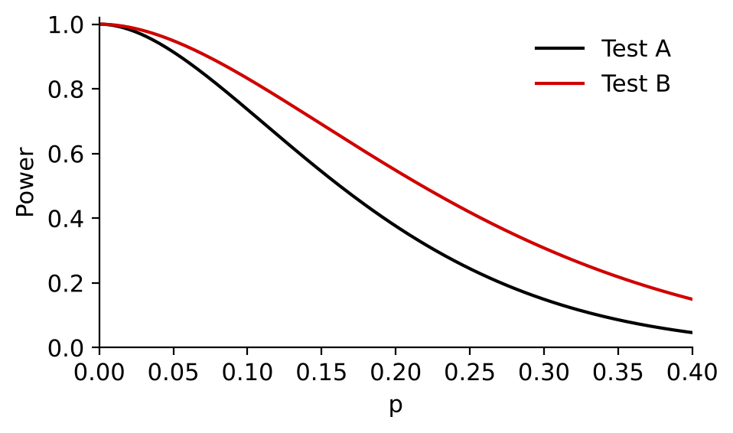
The Power Function
Your reason for recommending a test should be based on your calculations of the power
Check the sizes too: the comparison is fairest when the sizes are similar
The powers for test A and test B for various values of p are given in the table.
p
0.1
0.2
0.25
0.3
0.35
Power for test A
0.74
r
0.38
0.24
s
0.15
0.09
Power for test B
0.83
0.54
0.42
0.31
0.22
e) Calculate values for r and s.
f) State, giving a reason, which of the two tests the shopkeeper should use.
e) p = 0.2: (0.8)¹⁰ + 10(0.2)(0.8)⁹ = 0.3758…
r = 0.38
p = 0.3: (0.7)¹⁰ + 10(0.3)(0.7)⁹ = 0.1493…
s = 0.15
f) The power of test B is greater than the power of test A for all the given values of p,
so he should use test B
But note: test B also has a larger size (0.1495 v 0.0464), so it is more likely to make a Type I error
8D

Slide 8
The Power Function
You can find power functions for other distributions too
If X ~ Geo(p):
P(X > x) = (1 − p)ˣ
The power function of a test on a geometric distribution is a function of p
A local park believes the fox population in the area has decreased. They want to test for the probability, p, that a fox will be observed on any given day. They count the number of days, X, that pass until the first observation of a fox. They test H₀: p = 0.1 against H₁: p < 0.1 and reject H₀ if X > 30.
a) Find the size of this test.
b) Find the power function for the test.
a) Size = P(X > 30 | X ~ Geo(0.1))
= (1 − 0.1)³⁰ = 0.9³⁰
= 0.0424 (4 d.p.)
b) Power function = P(X > 30 | X ~ Geo(p))
= (1 − p)³⁰
The power gets bigger as p gets smaller
8D

