Slide 1
Quality of Tests
Further Statistics 1 Chapter 8
Westie's Workshop

Slide 2
Teachings for Exercise 8B

Slide 3
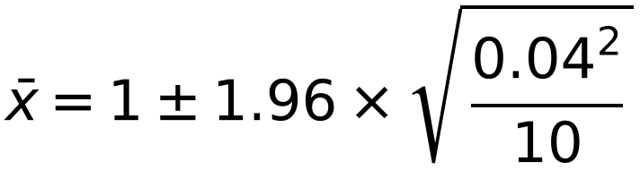
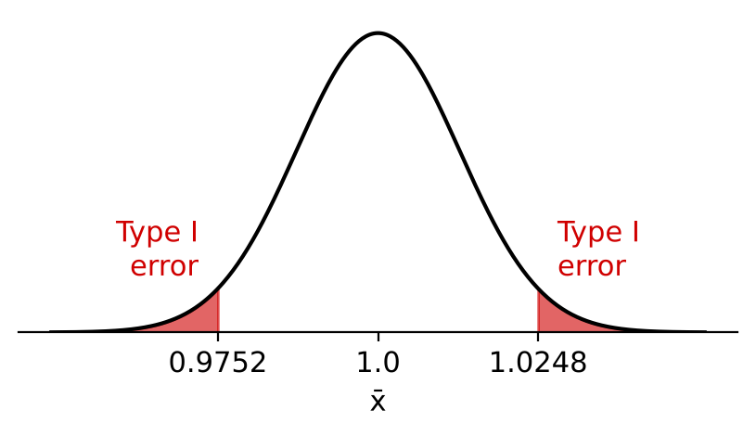
Finding Type I and Type II Errors Using the Normal Distribution
You need to be able to find Type I and Type II errors using the normal distribution
When a continuous distribution such as the normal distribution is used, P(Type I error) is equal to the significance level of the test
For a random sample of size n from N(μ, σ²):
X̄ ~ N(μ, σ²/n)
Critical values for X̄ are μ ± z × σ/√n
Bags of sugar having a nominal weight of 1 kg are filled by a machine. From past experience it is known that the weight, X kg, of sugar in the bags is normally distributed with a standard deviation of 0.04 kg. At the beginning of each week a random sample of 10 bags is taken in order to see if the machine needs to be reset. A test is then done at the 5% significance level with H₀: μ = 1.00 kg and H₁: μ ≠ 1.00 kg. Find:
a) the critical region for this test b) P(Type I error) for this test.
Assuming that the mean weight has in fact changed to 1.02 kg, c) find P(Type II error) for this test.
a) Under H₀, X̄ ~ N(1.0, 0.04²/10)
Two-tailed: critical region for Z is Z ≥ 1.96 or Z ≤ −1.96
2.5% in each tail
= 0.9752 and 1.0248
Critical region: X̄ ≤ 0.9752 or X̄ ≥ 1.0248
b) P(Type I error) = significance level
= 0.05
8B

Slide 4
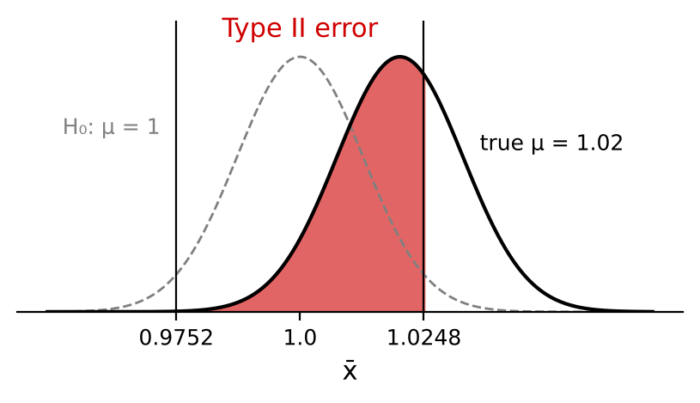
Finding Type I and Type II Errors Using the Normal Distribution
To find P(Type II error), use the critical region found under H₀ with the true value of μ
Use the normal cumulative distribution function on your calculator
Critical region: X̄ ≤ 0.9752 or X̄ ≥ 1.0248
Assuming that the mean weight has in fact changed to 1.02 kg,
c) find P(Type II error) for this test.
A Type II error happens when X̄ is between 0.9752 and 1.0248 but μ = 1.02
X̄ ~ N(1.02, 0.04²/10)
σ/√n = 0.01249…
P(Type II error) = P(0.9752 < X̄ < 1.0248 | μ = 1.02)
= 0.6476
8B

Slide 5
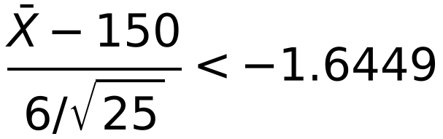
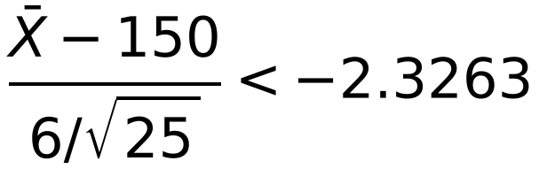
Finding Type I and Type II Errors Using the Normal Distribution
You want P(Type I error) and P(Type II error) to be as small as possible
For a one-tailed test, the whole significance level goes in one tail
The weight of jam in a jar, measured in grams, is distributed normally with a mean of 150 g and a standard deviation of 6 g. The production process occasionally leads to a change in the mean weight of jam per jar but the standard deviation remains unaltered.
The manager monitors the production process and for every new batch takes a random sample of 25 jars and weighs their contents to see if there has been any reduction in the mean weight of jam per jar.
Find the critical values for the test statistic X̄, the mean weight of jam in a sample of 25 jars, using:
a) a 5% level of significance b) a 1% level of significance.
Given that the true value of μ for the new batch is in fact 147,
c) find the probability of a Type II error for each of the above critical regions.
H₀: μ = 150 H₁: μ < 150
‘Reduction’, so a one-tailed test
X̄ ~ N(150, 6²/25), so σ/√n = 1.2
a) 5%: critical region for Z is Z < −1.6449
X̄ < 150 − 1.6449 × 1.2
Critical value 148.03 (X̄ < 148.026…)
b) 1%: critical region for Z is Z < −2.3263
X̄ < 150 − 2.3263 × 1.2
Critical value 147.21 (X̄ < 147.208…)
8B

Slide 6
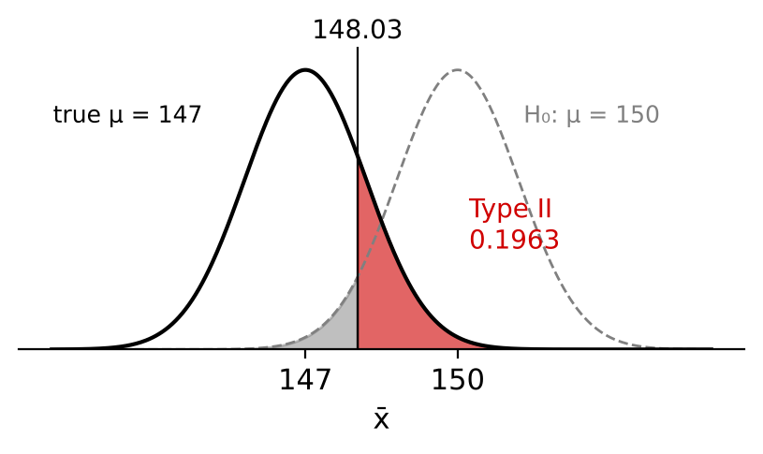
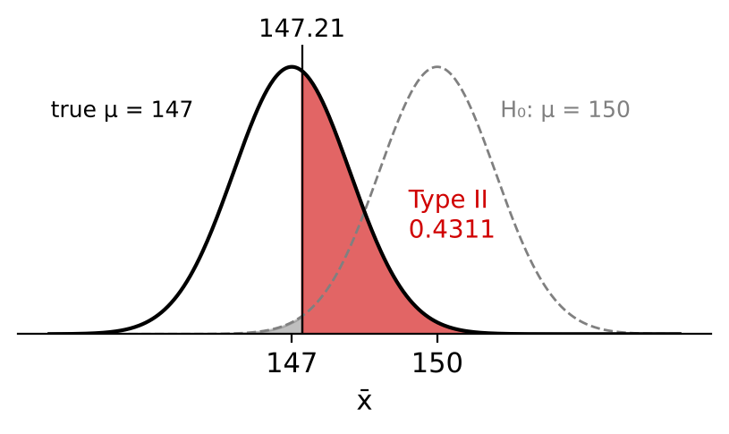
Finding Type I and Type II Errors Using the Normal Distribution
Reducing P(Type I error) increases P(Type II error)
This is one reason why we do not always use a very small significance level: 5% is the usual choice if none is given
To reduce both, increase the sample size n (but this can increase the cost or time taken)
Critical values: 148.026… (5%) and 147.208… (1%)
Given that the true value of μ for the new batch is in fact 147,
c) find the probability of a Type II error for each of the above critical regions.
5% test: P(Type II error) = P(X̄ > 148.026… | μ = 147)
= 0.1963 (4 d.p.)
1% test: P(Type II error) = P(X̄ > 147.208… | μ = 147)
= 0.4311 (4 d.p.)
Smaller P(Type I error) means larger P(Type II error)
8B

