Slide 1
Probability Generating Functions
Further Statistics 1 Chapter 7
Westie's Workshop

Slide 2
Teachings for Exercise 7D

Slide 3
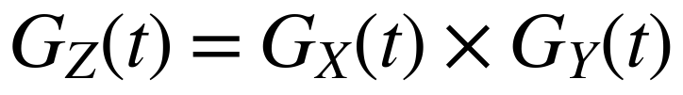
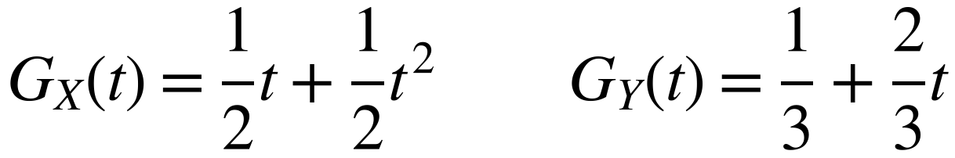
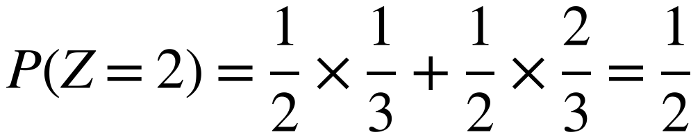
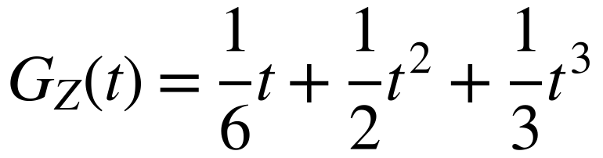
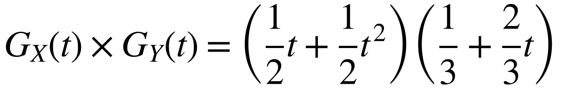
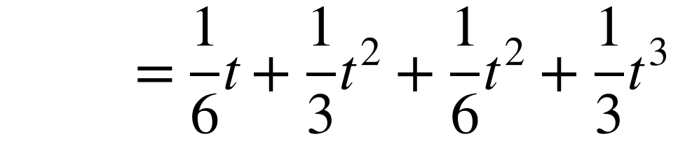
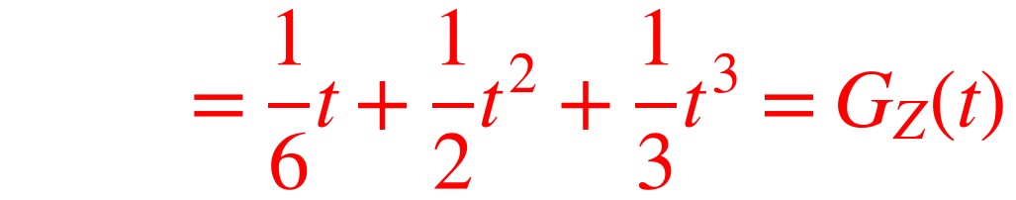
Sums of Independent Random Variables
If X and Y are independent random variables with p.g.f.s G_{X}(t) and G_{Y}(t), the p.g.f. of Z = X + Y is
Dice A has three faces showing 1 and three faces showing 2. Dice B has two faces showing 0 and four faces showing 1. X and Y are the scores on dice A and dice B, and the outcomes are independent.
x
1
2
y
0
1
You will not need to prove this result in your exam
P(X = x)
½
½
P(Y = y)
⅓
⅔
Z = 2 when X = 2, Y = 0 or X = 1, Y = 1
z
1
2
3
P(Z = z)
⅙
½
⅓
The product of the p.g.f.s is the p.g.f. of the sum
7D

Slide 4
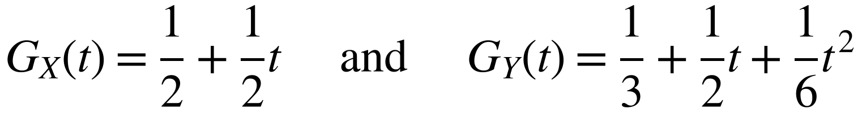
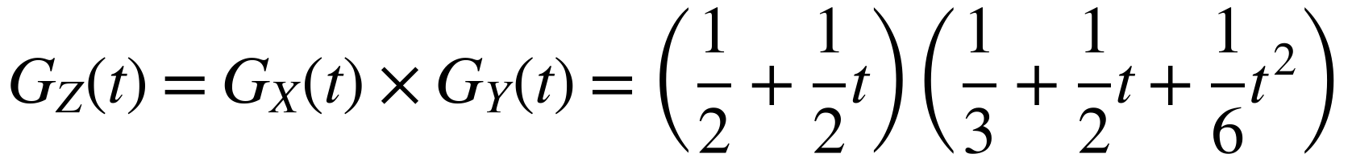
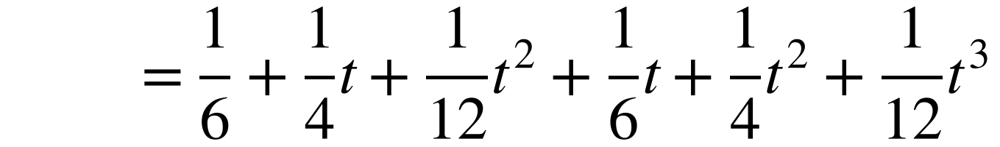
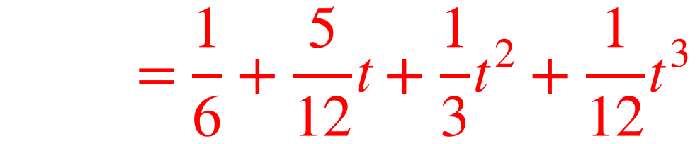
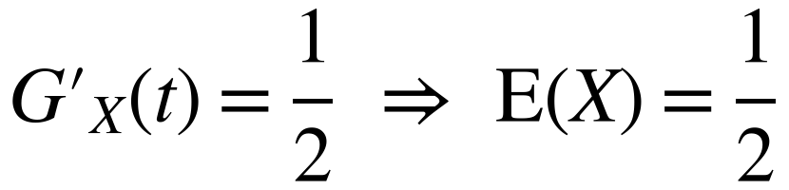
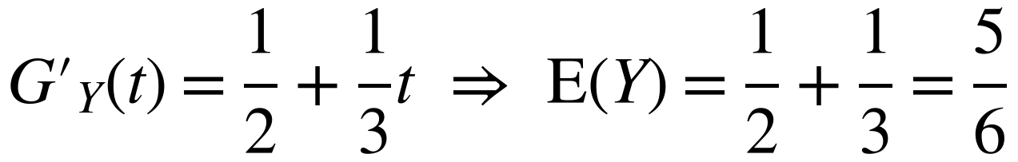
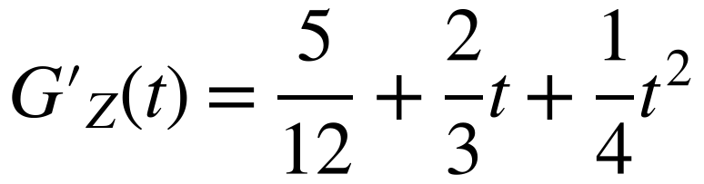
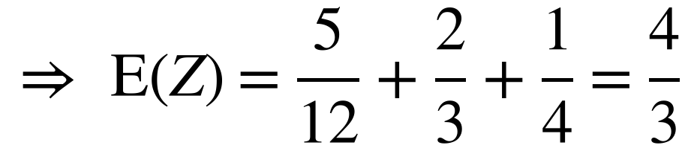
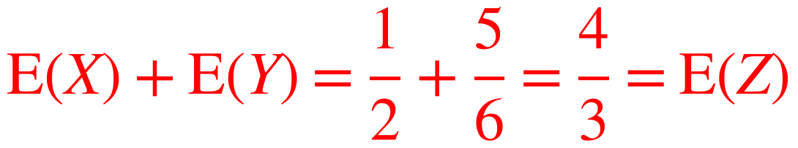
Sums of Independent Random Variables
If X and Y are independent random variables with p.g.f.s G_{X}(t) and G_{Y}(t), the p.g.f. of Z = X + Y is
Two independent discrete random variables X and Y have probability generating functions
a) Find the probability generating function of the random variable Z = X + Y.
b) Use probability generating functions to show that E(Z) = E(X) + E(Y).
You will not need to prove this result in your exam
a)
Remember E(X) = G′_{X}(1)
Expand and simplify
b)
Differentiate the answer to part a
7D

Slide 5
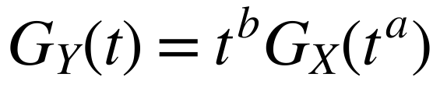
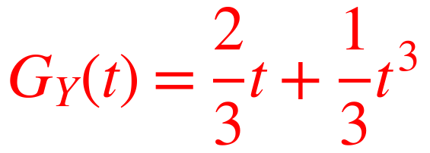
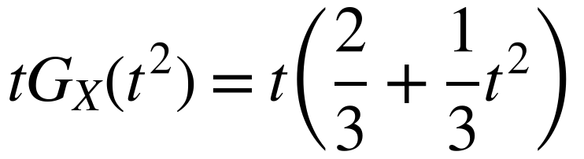
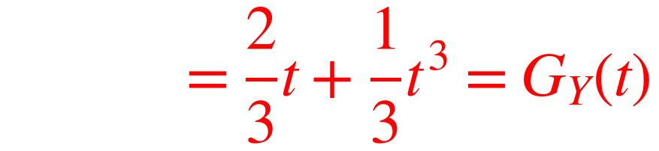
Sums of Independent Random Variables
If X has p.g.f. G_{X}(t), then the p.g.f. of Y = aX + b, where a and b are positive integers, is
A random variable X has a probability generating function G_{X}(t) = ²⁄₃ + ¹⁄₃t
a) Write down the probability distribution of X.
b) Y = 2X + 1. Write down the probability distribution of Y and hence find the probability generating function of Y.
c) Verify that G_{Y}(t) = tG_{X}(t²).
This result is not given in the formulae booklet, so you need to learn it
a)
x
0
1
Use the p.g.f. to write down the probabilities
P(X = x)
⅔
⅓
b)
y
1
3
X = 0 gives Y = 1 and X = 1 gives Y = 3
P(Y = y)
⅔
⅓
c)
Replace t with t² in G, then multiply by t
7D

