Slide 1
Probability Generating Functions
Further Statistics 1 Chapter 7
Westie's Workshop

Slide 2
Teachings for Exercise 7C

Slide 3
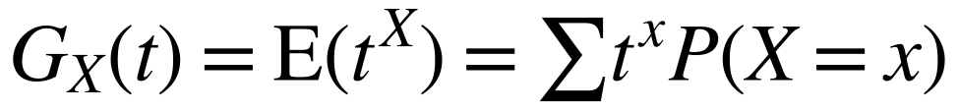
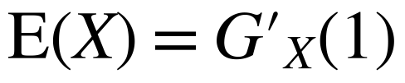
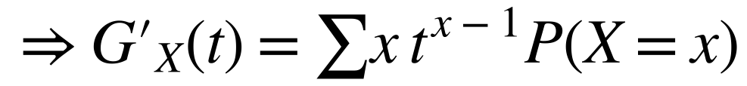
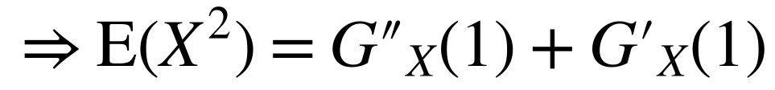
Mean and Variance of a Distribution
You can find the mean and variance of a distribution by differentiating its p.g.f.
Proving the results
Differentiate term by term, then put t = 1
You may be asked to prove these two standard results in your exam
Differentiate again and put t = 1
Var(X) = E(X²) − (E(X))²
Use Var(X) = E(X²) − (E(X))²
7C

Slide 4
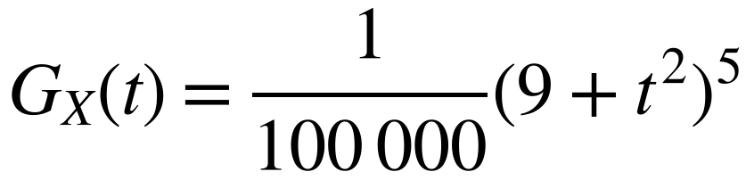
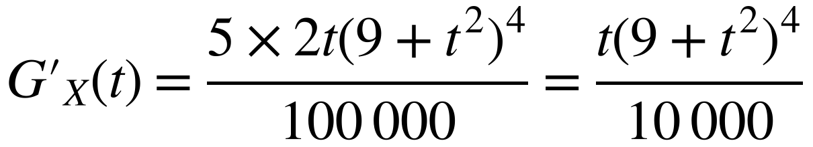
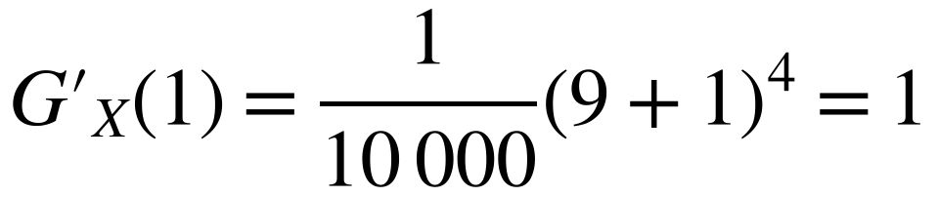
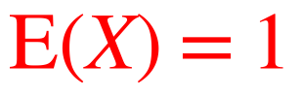
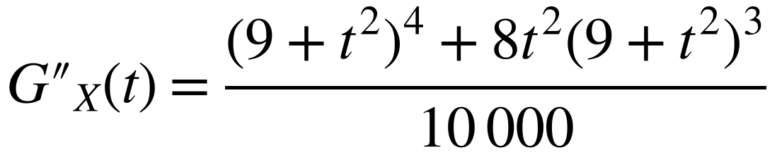
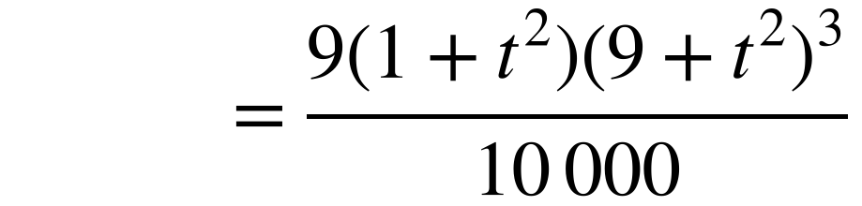
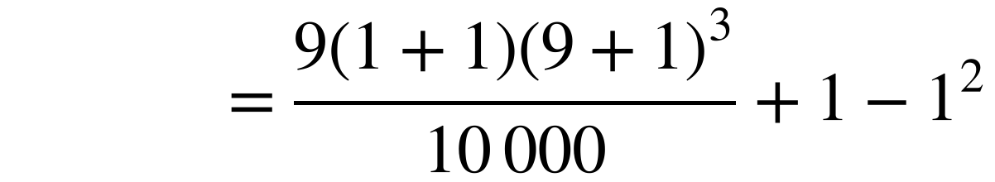
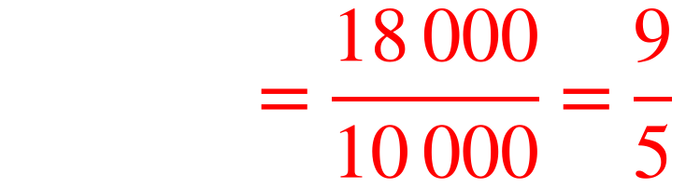
Mean and Variance of a Distribution
You can find the mean and variance of a distribution by differentiating its p.g.f.
The discrete random variable X has a probability generating function given by
Find: a) E(X) b) Var(X)
Use the chain rule (and product rule) to differentiate
a)
Use the chain rule
State the value of E(X) clearly
b)
Product rule, then take out the common factor (9 + t²)³
Use the value of G′(1) found in part a
7C

Slide 5
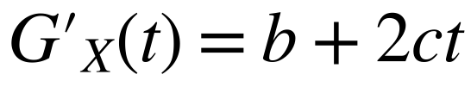
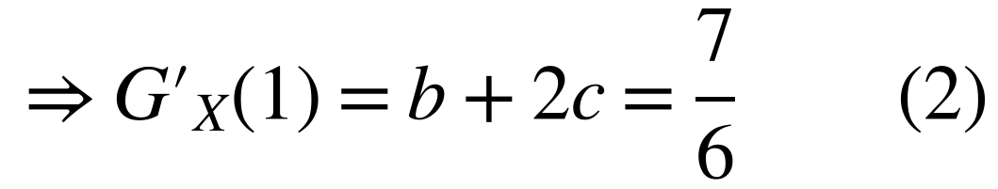
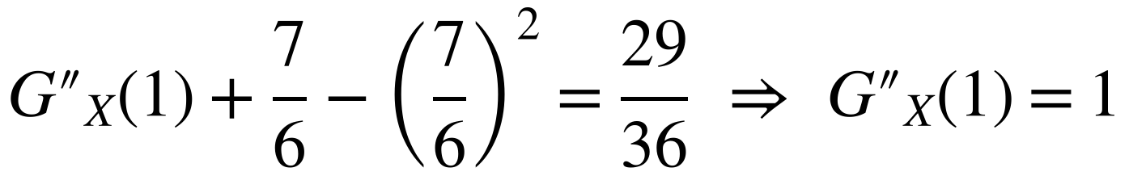
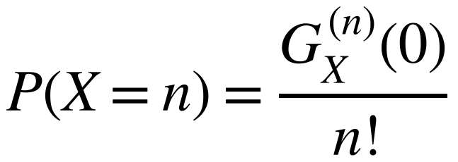
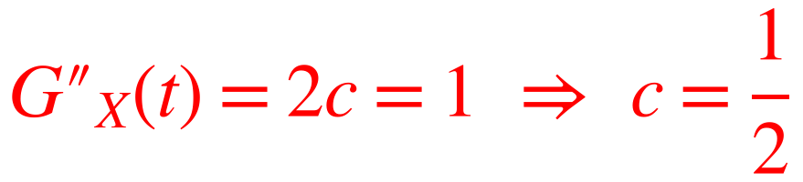
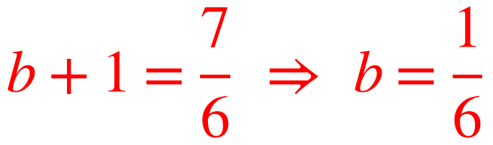
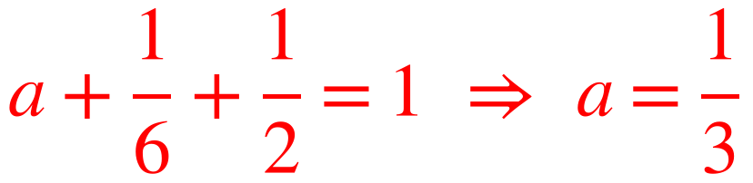
Mean and Variance of a Distribution
You can find the mean and variance of a distribution by differentiating its p.g.f.
A discrete random variable X has a probability generating function given by G_{X}(t) = a + bt + ct² where a, b and c are constants. Given that the expected value of X is ⁷⁄₆ and the variance of X is ²⁹⁄₃₆, find the values of a, b and c.
ΣP(X = x) = 1
Use G_{X}(1) = 1 together with the formulae for E(X) and Var(X) to form equations for unknown constants
Use the formula for the expected value
Differentiating term by term shows that
Use the formula for the variance
so G(0) = P(X = 0), G′(0) = P(X = 1), G″(0) = 2P(X = 2)
Substitute into (2)
Substitute into (1)
7C

