Slide 1
Probability Generating Functions
Further Statistics 1 Chapter 7
Westie's Workshop

Slide 2
Teachings for Exercise 7B

Slide 3
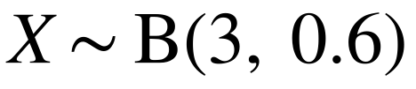
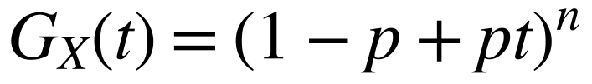
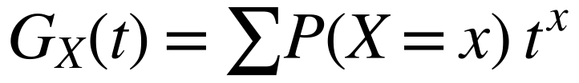
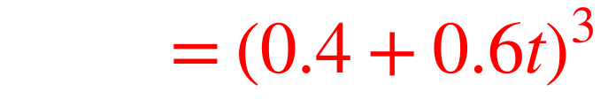
Probability Generating Functions of Standard Distributions
The standard distributions have simple p.g.f.s
An archer hits the bullseye with probability 0.6. She fires three shots at a target. The random variable X represents the number of times she hits the bullseye. Find the probability generating function of X.
They are given in the formulae booklet, but you should be able to derive them in simple cases
Assume each shot is independent
x
0
1
2
3
If X ~ B(n, p)
P(X = x)
0.4³
3 × 0.4² × 0.6
3 × 0.4 × 0.6²
0.6³
If a question asks you to ‘write down’ or ‘find’ the p.g.f. of a standard distribution, you can quote the formula without proof
A binomial expansion (a + b)ⁿ with a = 0.4 and b = 0.6t
This agrees with G_{X}(t) = (1 − p + pt)^{n} with n = 3 and p = 0.6
7B

Slide 4
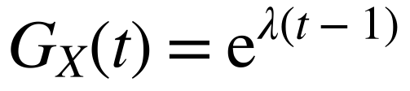
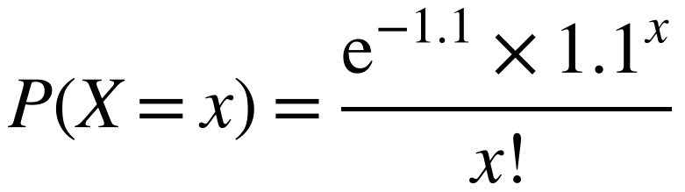
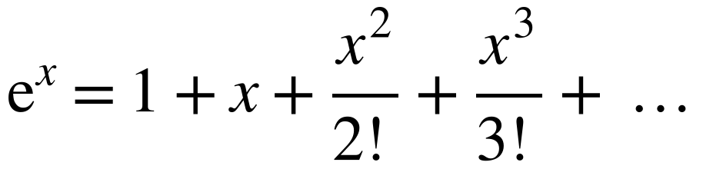
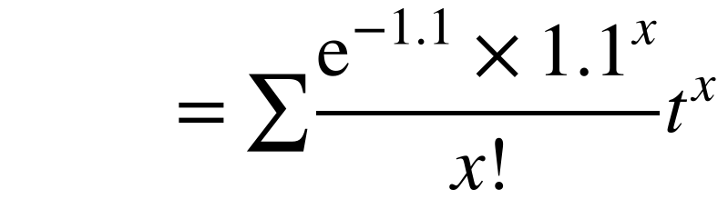
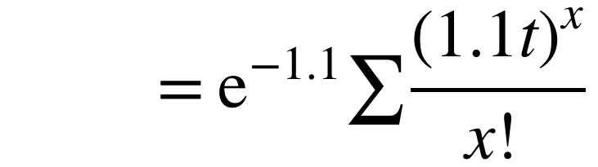
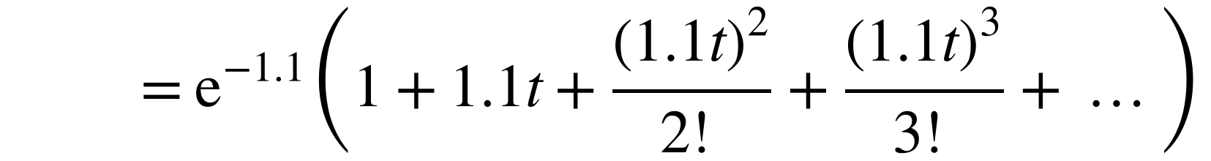
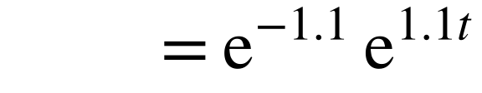
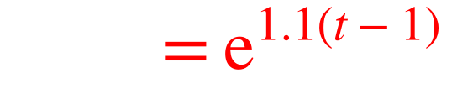
Probability Generating Functions of Standard Distributions
If X ~ Po(λ)
X is a discrete random variable such that X ~ Po(1.1). Show, from first principles, that the probability generating function of X is given by G_{X}(t) = e^{1.1(t−1)}
The Poisson distribution is infinite, so the p.g.f. is derived using an infinite series
Write down the probability distribution of X
Maclaurin series:
‘From first principles’ means you cannot quote the standard result from the formulae booklet
e⁻¹·¹ is constant, so it comes outside the sum
The bracket is the Maclaurin series of eˣ with x = 1.1t
7B

Slide 5
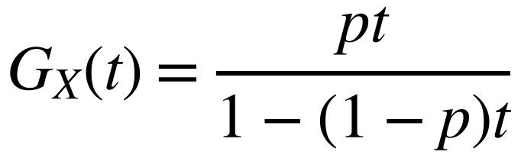
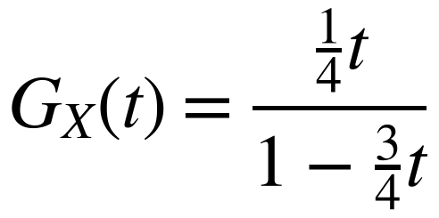
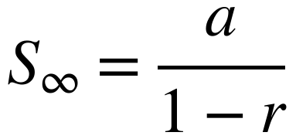
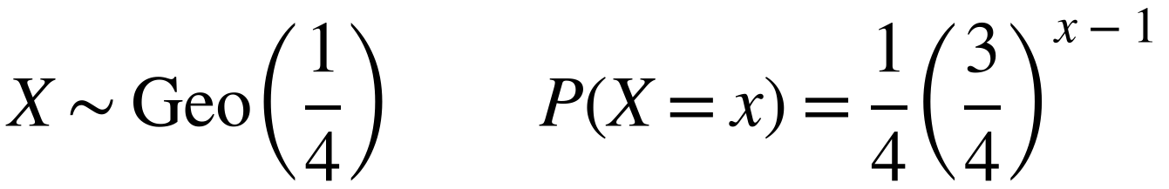
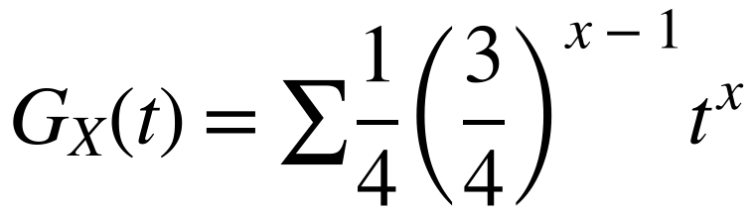
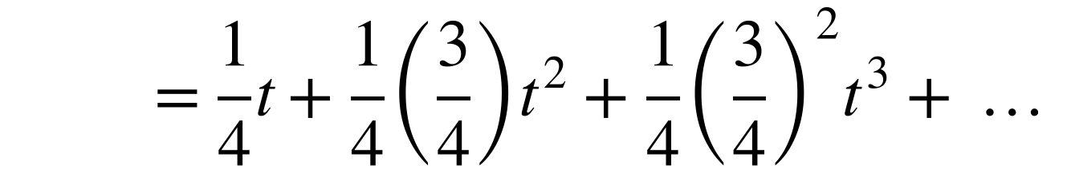
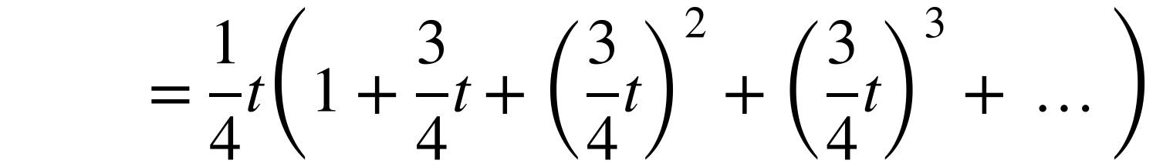
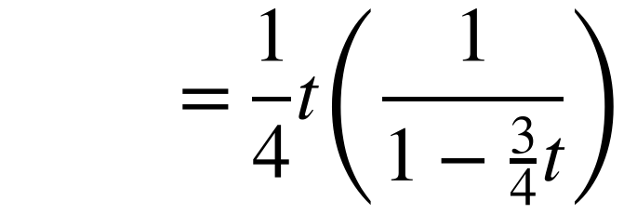
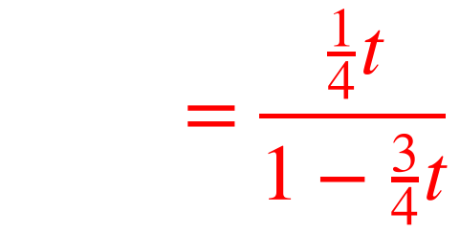
Probability Generating Functions of Standard Distributions
If X ~ Geo(p)
A fair tetrahedral dice is rolled until the dice shows a four. The discrete random variable X represents the number of rolls up to and including the first instance of a four. Show, from first principles, that the probability generating function for X is given by
Sum to infinity of a geometric series with first term a and common ratio r, where |r| < 1:
The distribution is geometric with p = ¼
A geometric series with first term 1 and common ratio ¾t
Could simplify to t/(4 − 3t), but this form shows p clearly
7B

Slide 6
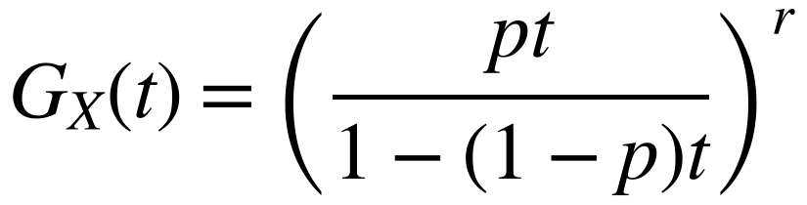
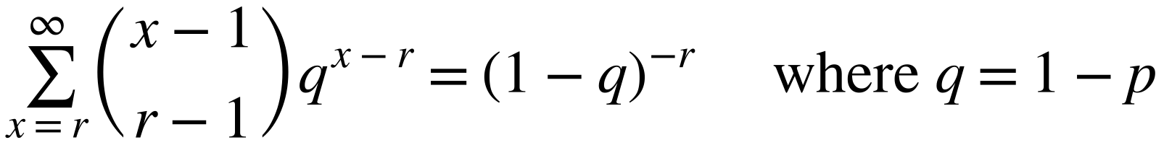
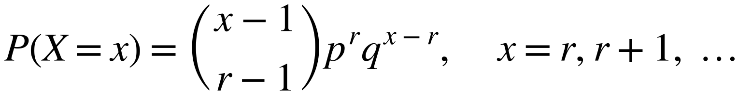
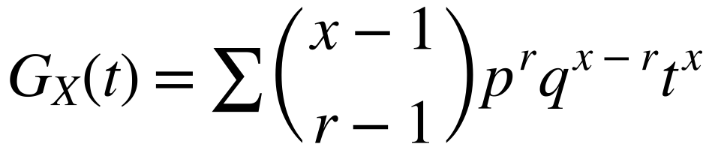
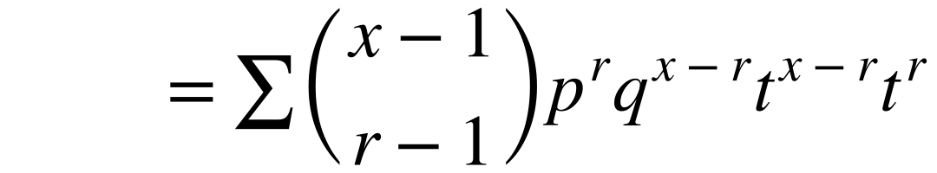
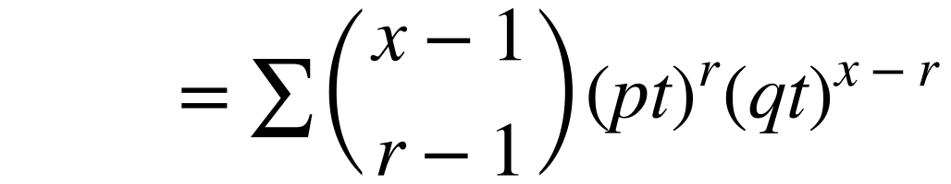
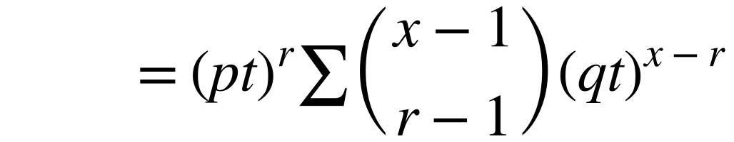
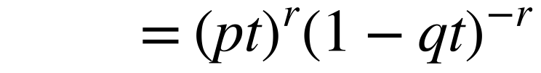
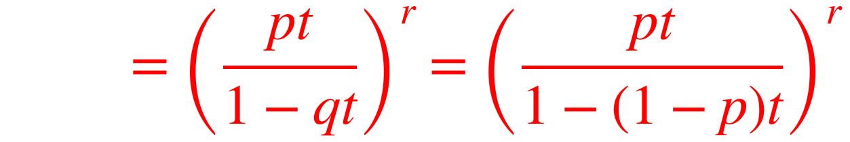
Probability Generating Functions of Standard Distributions
If X ~ Negative B(r, p)
X ~ Negative B(r, p). Prove, from first principles, that the probability generating function of X can be written as
Notice this is the p.g.f. of Geo(p) raised to the power r
You may quote without proof:
X is an infinite discrete random variable, so you need the infinite sum of the binomial coefficients given in the question
Write down the distribution, using q = 1 − p
Split tˣ into two parts that match the powers of p and q
(pt)ʳ does not depend on x, so it comes outside the sum
Use the given result with qt in place of q
7B

