Slide 1
Probability Generating Functions
Further Statistics 1 Chapter 7
Westie's Workshop

Slide 2
Teachings for Exercise 7A

Slide 3
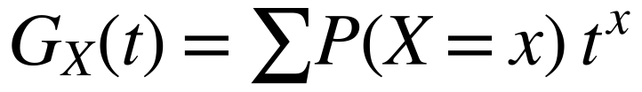
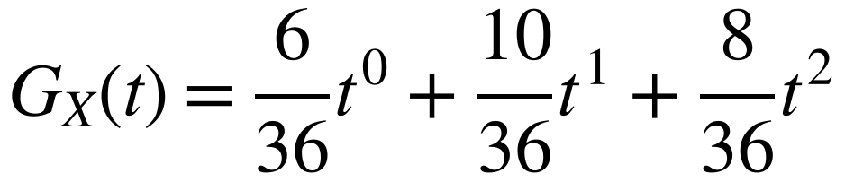
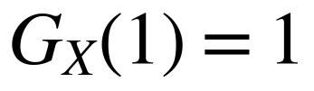
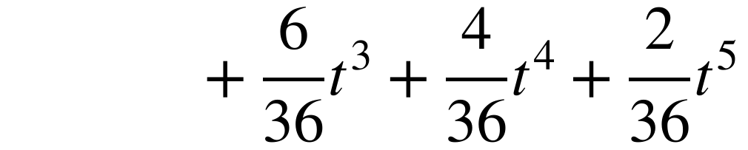
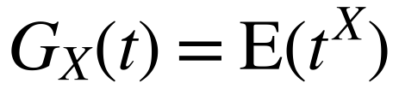
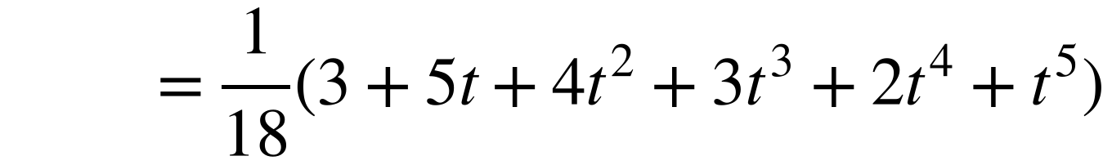
Probability Generating Functions
A probability generating function (p.g.f.) stores the details of a probability distribution
X is the discrete random variable that denotes the absolute difference of the scores when two fair dice are thrown. Construct the probability distribution of X and write down the probability generating function.
It can only be used with a discrete distribution that takes non-negative integer values, such as the binomial or Poisson distributions
1
2
3
4
5
6
1
0
1
2
3
4
5
2
1
0
1
2
3
4
Use a sample space diagram to find the 36 equally likely outcomes
If X has probability mass function P(X = x), the p.g.f. of X is
3
2
1
0
1
2
3
4
3
2
1
0
1
2
5
4
3
2
1
0
1
6
5
4
3
2
1
0
where t is a dummy variable. The coefficient of t^{x} is P(X = x)
x
0
1
2
3
4
5
P(X = x)
6/36
10/36
8/36
6/36
4/36
2/36
Since ΣP(X = x) = 1, for any p.g.f.
The x values are the powers of t and the probabilities are the coefficients
In the formulae booklet the p.g.f. is given as
Check that the probabilities add up to 1, and do not simplify each probability separately
7A

Slide 4
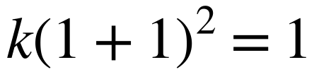
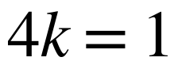
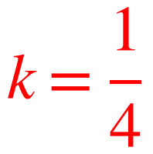
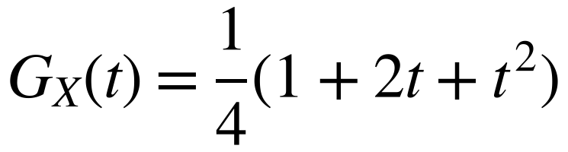
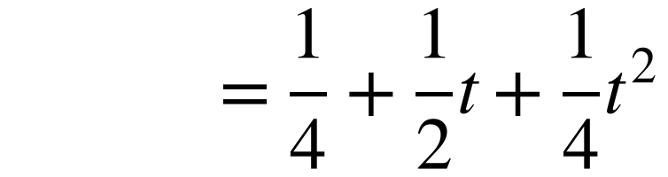
Probability Generating Functions
You can use the property G_{X}(1) = 1 to find unknown constants in a p.g.f.
The probability generating function of the discrete random variable X is given by G_{X}(t) = k(1 + t)²
a) Find the value of k.
b) Write down the probability distribution of X.
Substitute t = 1 into the expression for G_{X}(t), set it equal to 1 and solve
a)
Substitute t = 1 and set equal to 1
To write down the probability distribution from a p.g.f., expand it fully:
the powers of t are the values of x, and the coefficients are the probabilities
b)
Expand with k = ¼
The powers of t are the values of x
x
0
1
2
P(X = x)
¼
½
¼
7A

