Slide 1
Hypothesis Testing
Further Statistics 1 Chapter 4
Westie's Workshop

Slide 2
Teachings for Exercise 4B

Slide 3
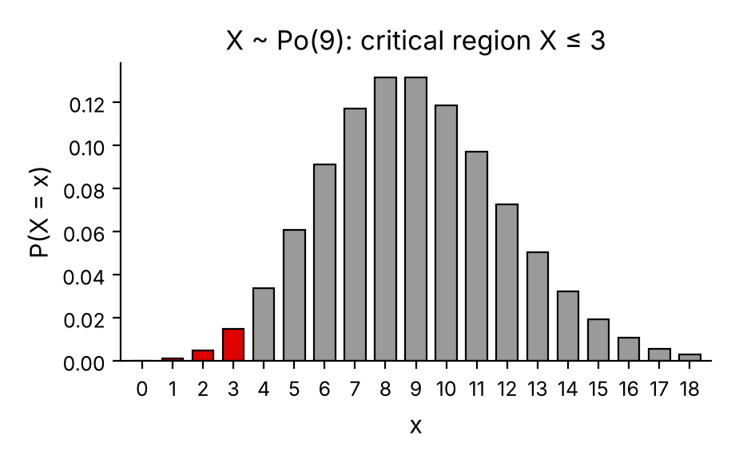
Finding Critical Regions for a Poisson Distribution
The critical region is the range of values of the test statistic that would lead to you rejecting H₀
The value(s) on the boundary of the critical region are the critical value(s)
One-tailed test (H₁: λ < m or λ > m): one critical value
The actual significance level is the probability of incorrectly rejecting H₀
An estate agent has been selling houses at a rate of 9 per month. He believes that the rate of sales will decrease in the next month.
a) Using a 5% level of significance, find the critical region for a one-tailed test of the hypothesis that the rate of sales will decrease from 9 per month.
b) Write down the actual significance level of the test in part a.
a) Let X = the number of house sales in a month
Define the test statistic
H₀: λ = 9 H₁: λ < 9
Assume H₀, so that X ~ Po(9)
Require the greatest c with P(X ≤ c) < 0.05
5% is the nominal significance level
From tables:
P(X ≤ 3) = 0.0212 < 0.05
P(X ≤ 4) = 0.0550 > 0.05
Look for values close to 0.05
So the critical value is 3: the critical region is X ≤ 3
b) Actual significance level = P(X ≤ 3) = 0.0212
P(rejecting H₀ when it is true)
4B

Slide 4
Finding Critical Regions for a Poisson Distribution
Make sure the mean matches the interval you are counting over
0.7 goals per game, so in 10 games the mean is 0.7 × 10 = 7
For an upper tail, find the least c with P(X ≥ c) < 0.05
Look in the λ = 7 table for values close to 1 − 0.05 = 0.95
Leonora Metti is regarded as a super striker who plays for Statistics All Stars. The mean number of goals she has scored over the several years she has been with the club is 0.7 goals per game. She has now been transferred to Mechanics Ladies. The management at Mechanics Ladies wish to see if the rate at which she scores goals has now increased. They monitor the number of goals that she scores in her first 10 games.
Assuming a Poisson distribution,
a) use a 5% level of significance to find the critical region for a one-tailed test of the hypothesis that Leonora has increased her rate of scoring from 0.7 goals per game
b) write down the actual significance level of the test in part a.
Leonora scores 11 goals in her first 10 games for Mechanics Ladies.
c) Comment on this observation in light of your critical region.
a) Let X = the number of goals scored in 10 games
Define the test statistic
H₀: λ = 0.7 H₁: λ > 0.7 (per game)
Assume H₀, so that X ~ Po(7)
0.7 × 10 = 7
P(X ≥ 12) = 1 − P(X ≤ 11) = 1 − 0.9467 = 0.0533
P(X ≥ 13) = 1 − P(X ≤ 12) = 1 − 0.9730 = 0.0270
0.0533 > 0.05 but 0.0270 < 0.05
So the critical value is 13: the critical region is X ≥ 13
4B

Slide 5
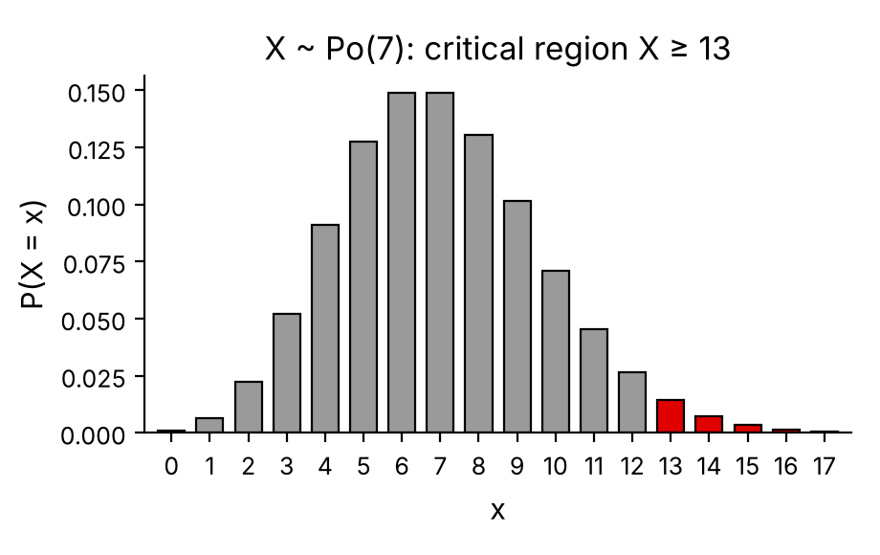
Finding Critical Regions for a Poisson Distribution
If the observed value is not in the critical region, there is insufficient evidence to reject H₀
The actual significance level is P(X in the critical region) assuming H₀ is true
b) write down the actual significance level of the test in part a.
Leonora scores 11 goals in her first 10 games for Mechanics Ladies.
c) Comment on this observation in light of your critical region.
a) Critical region is X ≥ 13 for X ~ Po(7)
b) Actual significance level = P(X ≥ 13) = 0.0270
P(rejecting H₀)
c) X = 11 does not lie in the critical region, so there is insufficient evidence to reject H₀.
11 < 13
There is no evidence that Leonora has increased her goal-scoring rate.
Conclusion in context
4B

Slide 6
Finding Critical Regions for a Poisson Distribution
A two-tailed test (H₁: λ ≠ m) has two parts to the critical region and two critical values
Find each tail separately
Here the probability in each tail has to be as close to 2.5% as possible, but it does not have to be less than 2.5%
An office finds that, over a long period of time, incoming calls from customers occur at a rate of 0.325 per minute. They believe that the rate of calls has changed recently. To test this, the number of incoming calls during a random 20-minute interval is recorded.
a) Find the critical region for a two-tailed test of this hypothesis. The probability in each tail should be as close to 2.5% as possible.
b) Write down the actual significance level of the test.
The actual number of calls recorded in the 20-minute period was 13.
c) Comment on this observation in light of your critical region.
a) Let X = the number of incoming calls in a 20-minute interval
Define the test statistic
20 × 0.325 = 6.5, so H₀: λ = 6.5 H₁: λ ≠ 6.5
Assume H₀, so that X ~ Po(6.5)
Could also use λ = 0.325 per minute
Lower tail: want P(X ≤ c₁) as close as possible to 0.025
P(X ≤ 1) = 0.0113 P(X ≤ 2) = 0.0430
0.0113 is closer to 0.025, so the lower critical region is X ≤ 1
4B

Slide 7
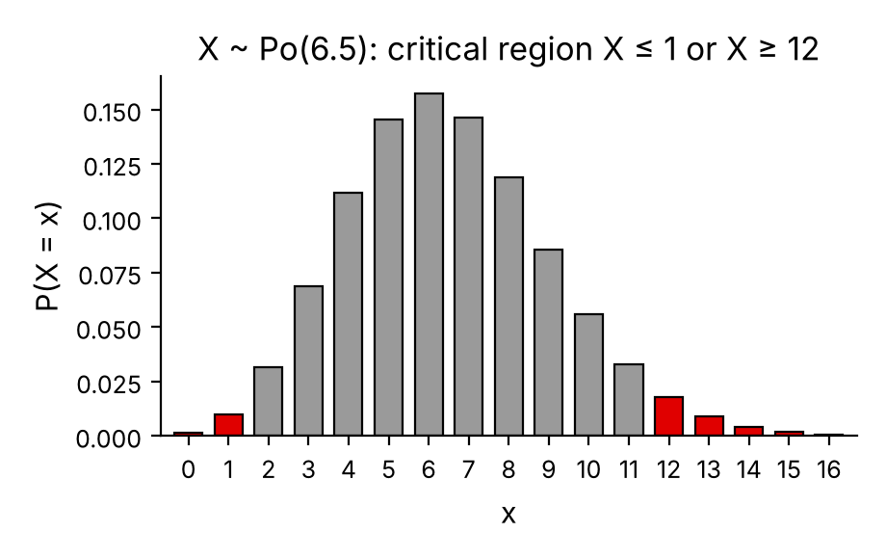
Finding Critical Regions for a Poisson Distribution
The actual significance level of a two-tailed test is the sum of the actual probabilities in each tail
a) Find the critical region for a two-tailed test of this hypothesis. The probability in each tail should be as close to 2.5% as possible.
b) Write down the actual significance level of the test.
The actual number of calls recorded in the 20-minute period was 13.
c) Comment on this observation in light of your critical region.
Upper tail: want P(X ≥ c₂) as close as possible to 0.025
P(X ≥ 12) = 1 − P(X ≤ 11) = 1 − 0.9661 = 0.0339
P(X ≥ 13) = 1 − P(X ≤ 12) = 1 − 0.9840 = 0.0160
0.0339 is 0.0089 away; 0.0160 is 0.0090 away
0.0339 is closer to 0.025, so the upper critical region is X ≥ 12
Critical region is X ≤ 1 or X ≥ 12
b) Actual significance level = P(X ≤ 1) + P(X ≥ 12) = 0.0113 + 0.0339 = 0.0452
Add the two tails
c) X = 13 is in the critical region, so reject H₀: there is evidence that the rate of incoming calls has changed.
Conclusion in context
4B

