Slide 1
Geometric and Negative Binomial Distributions
Further Statistics 1 Chapter 3
Westie's Workshop

Slide 2
Teachings for Exercise 3D

Slide 3
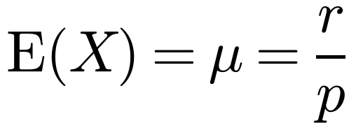
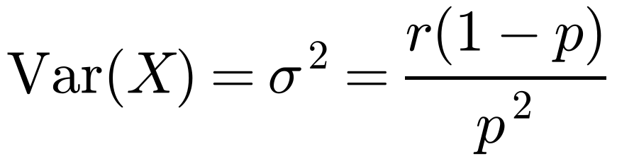
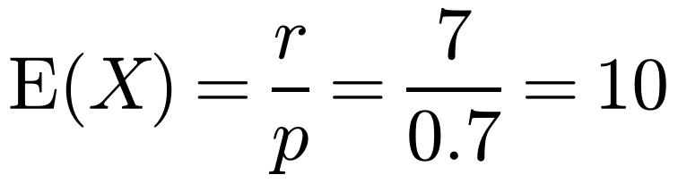
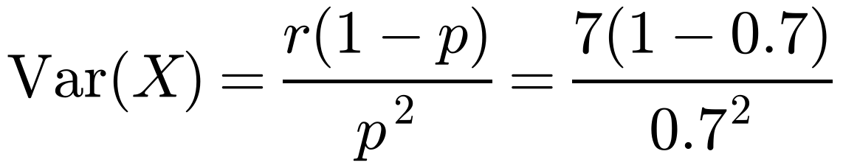
Mean and Variance of the Negative Binomial Distribution
You need to be able to use the mean and variance of a negative binomial distribution
If X ~ Negative B(r, p), then:
Iona and Juan play noughts and crosses. The probability that Iona wins is 0.7. The random variable X represents the number of games that they need to play for Iona to win seven times.
a Find E(X) and Var(X).
They change games and start playing chess. The random variable Y represents the number of games that they need to play for Juan to win twice. Given that the mean of Y is 6, find:
b Juan’s probability of winning any single game of chess
c the standard deviation of Y.
a X ~ Negative B(7, 0.7)
Use the standard formulae with r = 7 and p = 0.7
When r = 1 these give the mean and variance of the geometric distribution
The standard deviation is the square root of the variance
= 4.286 (3 d.p.)
3D

Slide 4
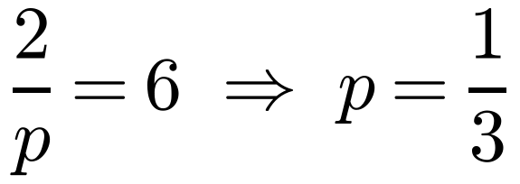
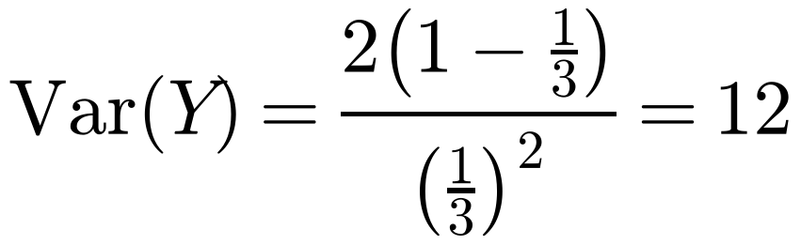
Mean and Variance of the Negative Binomial Distribution
You need to be able to use the mean and variance of a negative binomial distribution
If X ~ Negative B(r, p), then:
Iona and Juan play noughts and crosses. The probability that Iona wins is 0.7. The random variable X represents the number of games that they need to play for Iona to win seven times.
a Find E(X) and Var(X).
They change games and start playing chess. The random variable Y represents the number of games that they need to play for Juan to win twice. Given that the mean of Y is 6, find:
b Juan’s probability of winning any single game of chess
c the standard deviation of Y.
b Y ~ Negative B(2, p)
Use the fact that E(Y) = r/p = 6
When r = 1 these give the mean and variance of the geometric distribution
The standard deviation is the square root of the variance
Juan’s probability of winning a game of chess is 1/3
c
Remember the standard deviation is the square root of the variance
Standard deviation = √12 = 3.46 (3 s.f.)
3D

