Slide 1
Geometric and Negative Binomial Distributions
Further Statistics 1 Chapter 3
Westie's Workshop

Slide 2
Teachings for Exercise 3C

Slide 3
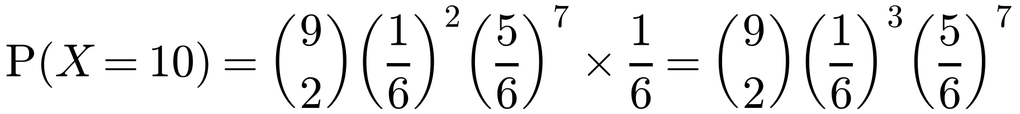
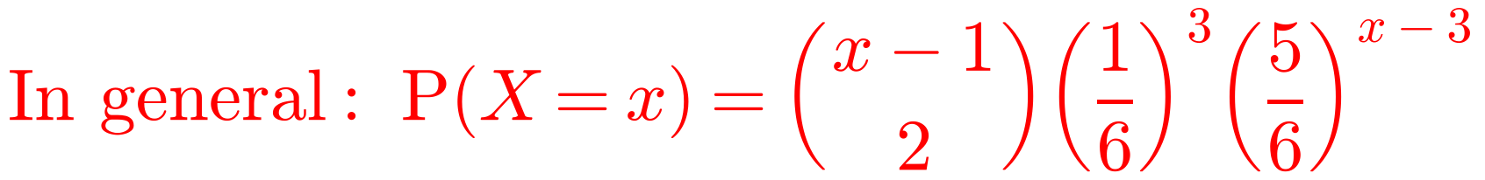
The Negative Binomial Distribution
The binomial distribution, B(n, p), models the number of successes in a fixed number of trials, n
Instead, you might want the number of trials, X, needed to achieve a fixed number of successes, r
If you need r successes, X can take any integer value greater than or equal to r
As before, the trials are independent and the probability of success, p, is constant
A fair dice is rolled repeatedly until a total of three sixes have been rolled. X is the number of rolls needed. Find P(X = 10).
P(X = 10) is the probability that the third six occurs on the 10th roll
The number of sixes in 9 rolls is B(9, 1/6)
So exactly 2 sixes are rolled in the first 9 rolls…
…and then a six is rolled on the 10th roll
This is an example of a negative binomial distribution
3C

Slide 4
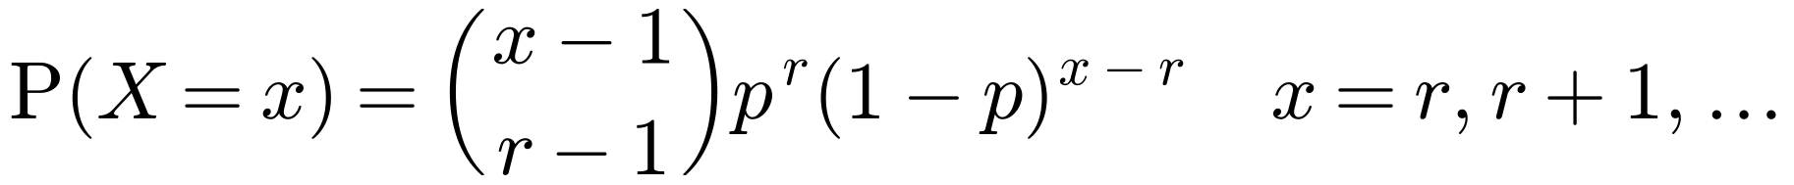
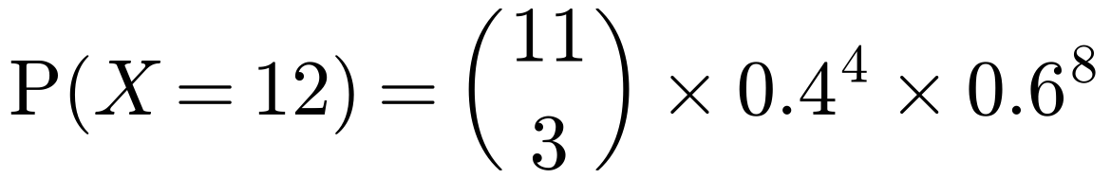
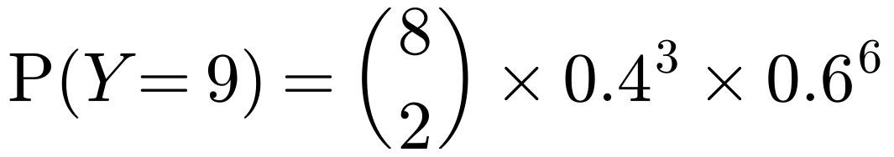
The Negative Binomial Distribution
For successive independent trials, each with constant probability of success, p, the number of trials needed to get r successes, X, has the negative binomial distribution:
Philomena is practising her piano scales. The probability that she completes a scale correctly on any one attempt is 0.4. She continues practising until she has completed four scales correctly.
a Find the probability that she completes her fourth correct scale on her 12th attempt.
b Find the probability that she completes her fourth correct scale on her 10th attempt, given that her first scale was correct.
a X = number of attempts needed to complete four scales correctly
This is the probability of r − 1 successes in x − 1 trials, multiplied by the probability of success on the xth trial
There is no standard notation, but you can write X ~ NB(r, p) or X ~ Negative B(r, p)
X ~ Negative B(4, 0.4)
Model the number of attempts as negative binomial
= 0.0709 (4 d.p.)
b Y = number of attempts needed after the first attempt
Y ~ Negative B(3, 0.4)
She now needs 3 more correct scales in exactly 9 more attempts
2 correct in the next 8 attempts, then the final one correct
= 0.0836 (4 d.p.)
3C

