Slide 1
Geometric and Negative Binomial Distributions
Further Statistics 1 Chapter 3
Westie's Workshop

Slide 2
Teachings for Exercise 3A

Slide 3
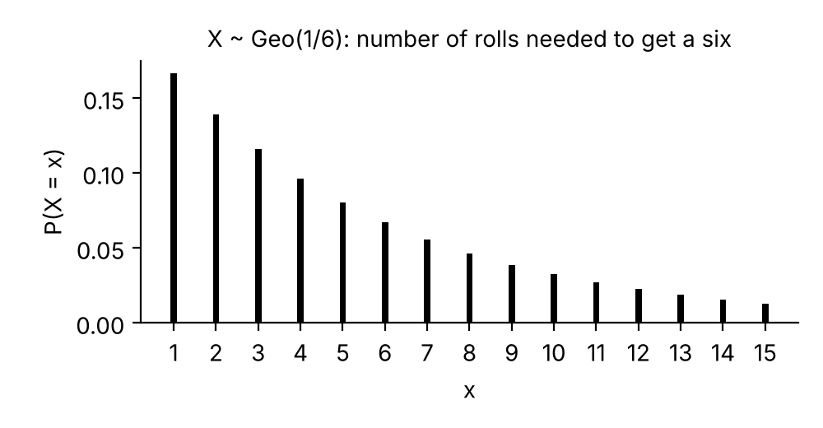
The Geometric Distribution
If you carry out successive, independent trials, each with the same probability of success, p, the number of trials needed to get one success can be modelled by the geometric distribution
You write X ~ Geo(p)
X can take any positive integer value 1, 2, 3, …
The probabilities form a geometric sequence with first term p and common ratio (1 − p)
As x gets large, P(X = x) gets smaller and tends towards 0
A fair dice is rolled repeatedly. X is the number of rolls needed to obtain a six. Find the probability distribution of X.
x
1
2
3
4
…
P(X = x)
1/6
5/6 × 1/6
5/6 × 5/6 × 1/6
5/6 × 5/6 × 5/6 × 1/6
…
(x − 1) failures, then one success
P(X = x) → 0 as x gets large, but X can take any positive integer value
3A

Slide 4
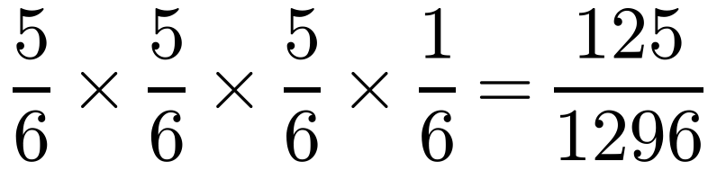
The Geometric Distribution
For successive independent trials, each with constant probability of success, p, the number of trials needed to get one success, X, has the geometric distribution, with probability function:
Johan is playing a board game where he has to roll a six to start. Find the probability that Johan starts the board game on his fourth roll.
P(six) = 1/6 P(not six) = 5/6
P(first six occurs on fourth roll)
P(X = x) is the probability of (x − 1) failures, each with probability (1 − p), followed by one success, with probability p
=
Three ‘failures’ then one success: (1 − p)³ × p
= 0.0965 (4 d.p.)
Using X ~ Geo(1/6): P(X = 4) = (5/6)³ × 1/6
3A

Slide 5
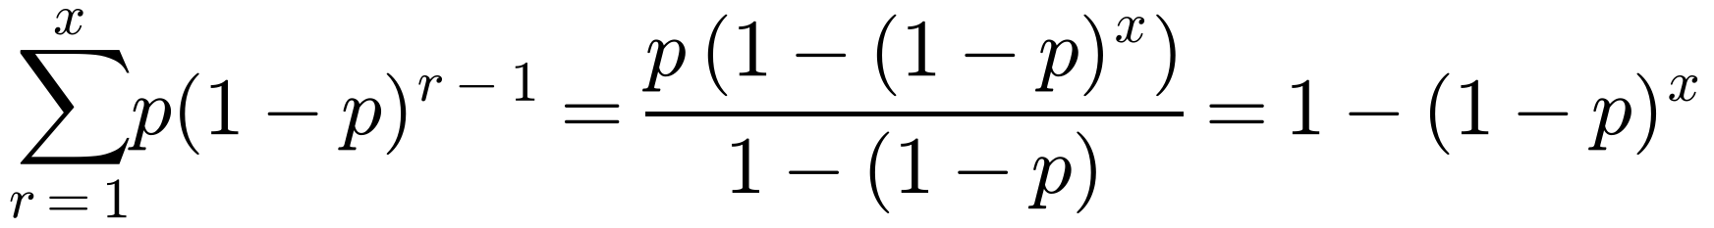
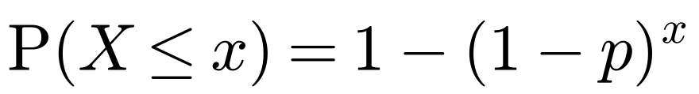
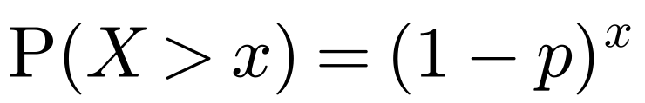
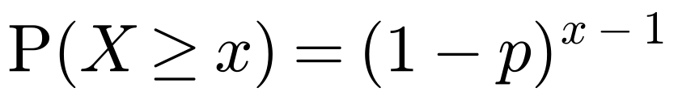
The Geometric Distribution
The cumulative geometric distribution
comes from the sum of a geometric series:
The probability that Genevieve passes her driving test on any one attempt is 0.6.
a Find the probability that:
i she passes on her fifth attempt
ii she needs five or fewer attempts to pass
iii she needs more than five attempts to pass.
b State two assumptions you have used in your calculations.
If X ~ Geo(p), then:
a i Let X = number of attempts needed.
X ~ Geo(0.6)
X can be modelled by a geometric distribution with p = 0.6
P(X = 5) = 0.6 × (1 − 0.6)⁴
= 0.01536
Use P(X = x) = p(1 − p)ˣ⁻¹
since the first x trials are all failures. This can also be written
ii P(X ≤ 5) = 1 − (1 − 0.6)⁵
= 0.98976
Use P(X ≤ x) = 1 − (1 − p)ˣ
iii P(X > 5) = 1 − P(X ≤ 5)
= 1 − 0.98976
= 0.01024
This is the probability of failing the first five attempts: (1 − 0.6)⁵
Remember ‘at least 5’ means X ≥ 5 and ‘more than 5’ means X > 5
b Each attempt is independent and has the same probability of success.
3A

