Slide 1
Poisson Distributions
Further Statistics 1 Chapter 2
Westie's Workshop

Slide 2
Teachings for Exercise 2G

Slide 3
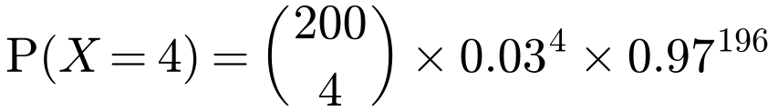
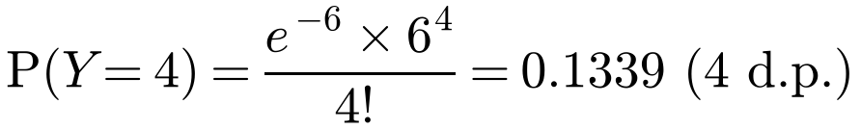
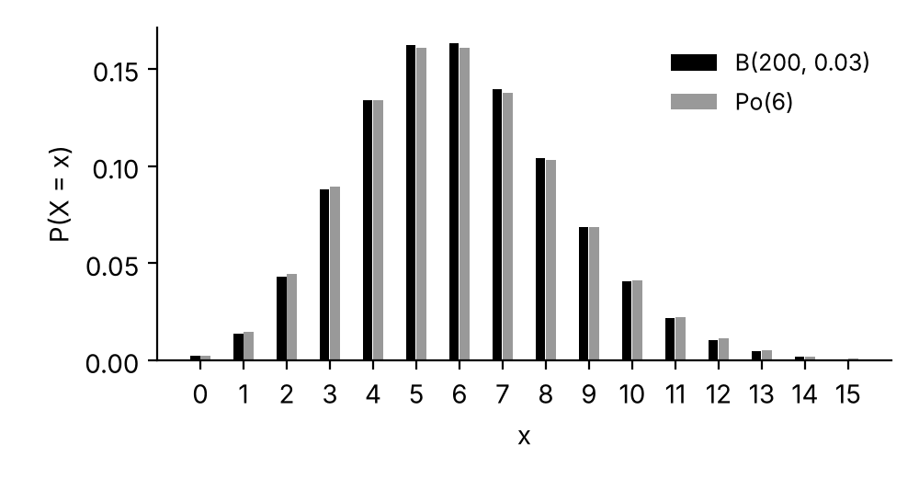
Using the Poisson Distribution to Approximate the Binomial Distribution
If X ~ B(n, p) and
n is large and p is small
then X can be approximated by Po(λ), where λ = np
There is no fixed rule, but usually np ≤ 10. The larger n and the smaller p, the better the approximation
When p is small, 1 − p ≈ 1, so Var(X) = np(1 − p) is close to E(X) = np: just like a Poisson distribution
The random variable X ~ B(200, 0.03).
a) Find P(X = 4).
A Poisson variable Y ~ Po(λ) is used to approximate X.
b) Write down the value of λ and justify the use of a Poisson approximation in this context.
c) Find P(Y = 4) and comment on the accuracy of the approximation.
a)
= 0.1338 (4 d.p.)
b) Y ~ Po(200 × 0.03), so λ = 6
As n is large and p is small, X can be approximated by Po(np)
c)
The answer from the Poisson approximation is close to the value from the binomial distribution, so the approximation is accurate.
2G

Slide 4
Using the Poisson Distribution to Approximate the Binomial Distribution
In general, a question will tell you when to use a Poisson approximation
Define the random variable and state the binomial model first
Then state the approximating Poisson distribution, with λ = np
To justify the approximation, say that n is large and p is small
The probability of a component produced by a certain machine being faulty is 0.007. The number of faulty components in a batch of 1000 components is noted.
a) Find the probability that exactly 6 components are faulty.
b) Use a Poisson approximation to find the probability that more than 7 components are faulty.
c) Explain why the approximation in part b is valid.
a) X = the number of faulty components in a batch of 1000
X ~ B(1000, 0.007)
b) Y ~ Po(1000 × 0.007), i.e. Y ~ Po(7)
P(Y > 7) = 1 − P(Y ≤ 7)
Tables or calculator with λ = 7
= 1 − 0.5987 = 0.4013
c) The approximation is valid as n is large and p is small.
2G

