Slide 1
Integration Techniques
Further Pure 2 Chapter 6
Westie's Workshop

Slide 2
Teachings for Exercise 6C

Slide 3
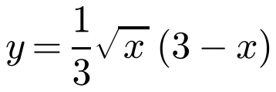
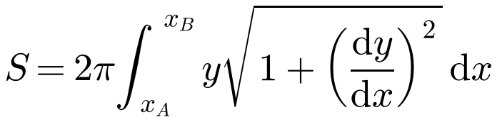
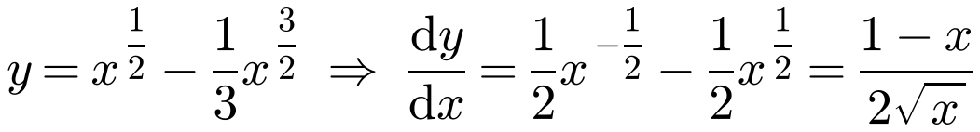
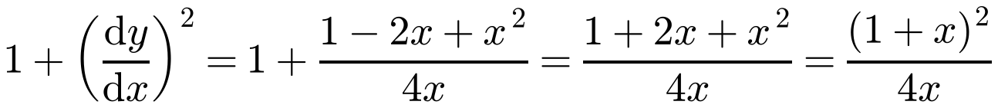
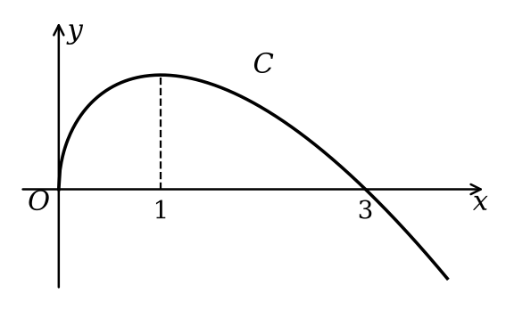
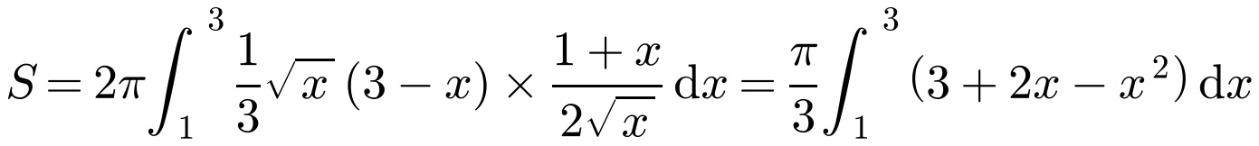
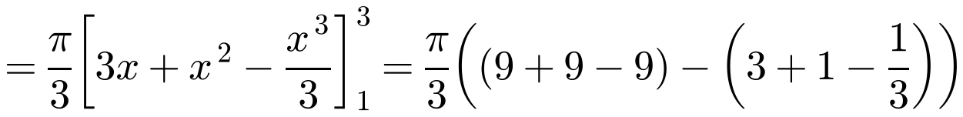
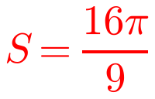
Area of a Surface of Revolution
Rotating a small arc δs about the x-axis gives a thin band of radius y, with area δS ≈ 2πy δs
Using ds/dx from arc length, for y = f(x) rotated through 2π about the x-axis:
The curve C has equation
The arc of the curve between the points with x-coordinates 1 and 3 is completely rotated about the x-axis. Find the area of the surface generated.
Simplify to a perfect square before taking the square root
6C

Slide 4
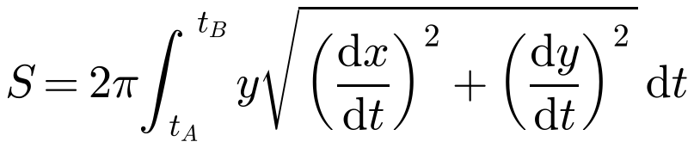
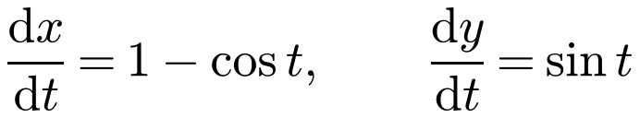
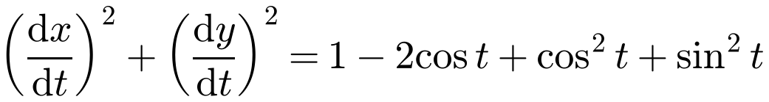
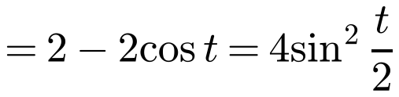
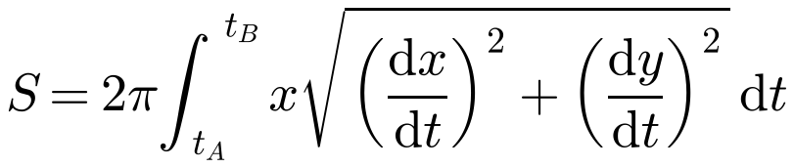
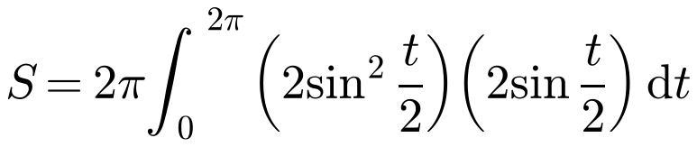
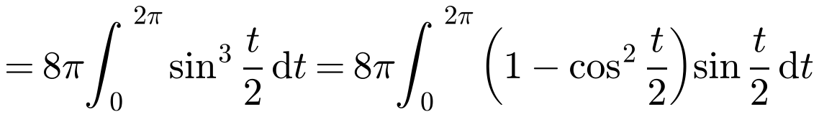
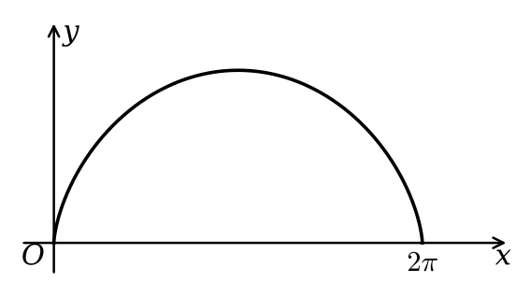
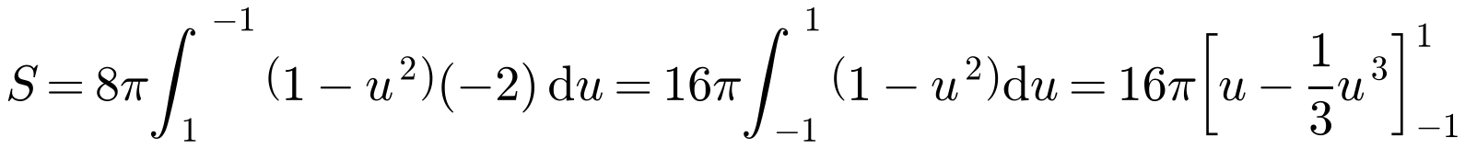
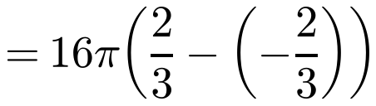
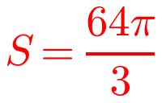
Area of a Surface of Revolution
For a curve given parametrically, x = f(t), y = g(t):
The curve with parametric equations
About the x-axis:
is rotated through 360° about the x-axis. Find the area of the surface generated.
About the y-axis:
cos t = 1 − 2sin²(t/2)
y = 1 − cos t = 2sin²(t/2)
The textbook prints [u + ⅓u³] here: the antiderivative of 1 − u² is u − ⅓u³
6C

Slide 5
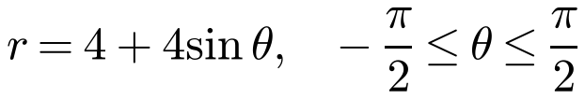
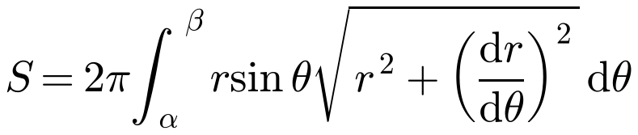
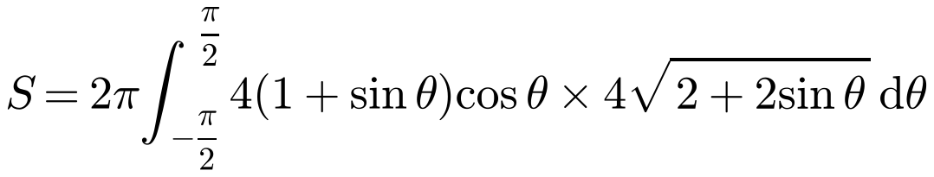
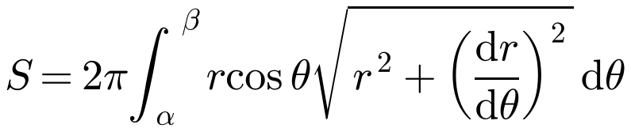
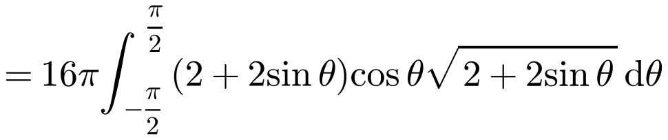
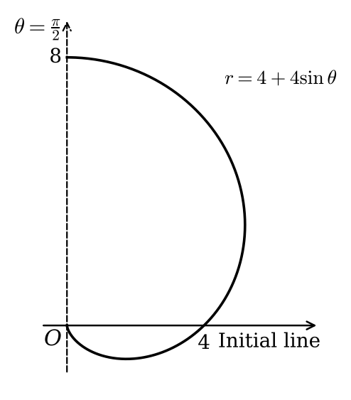
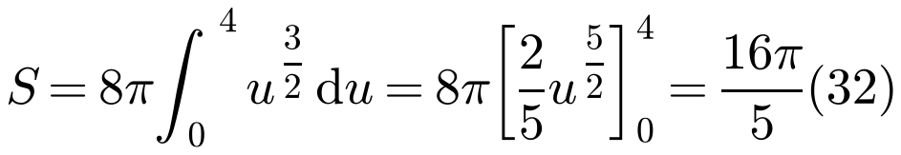
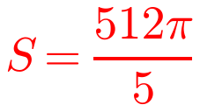
Area of a Surface of Revolution
For a curve with polar equation r = f(θ):
The graph of the polar equation
About the initial line θ = 0:
is rotated through 2π radians about the vertical line θ = π/2, forming a surface of revolution. Find the exact area of the surface.
r cos θ is the distance from the line θ = π/2
About the line θ = π/2:
6C

Slide 6
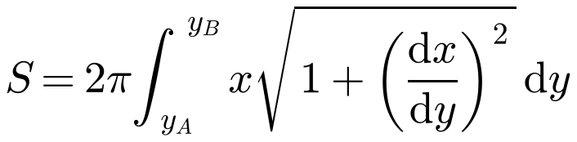
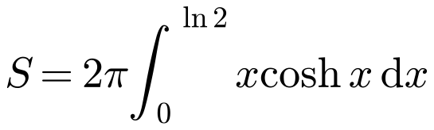

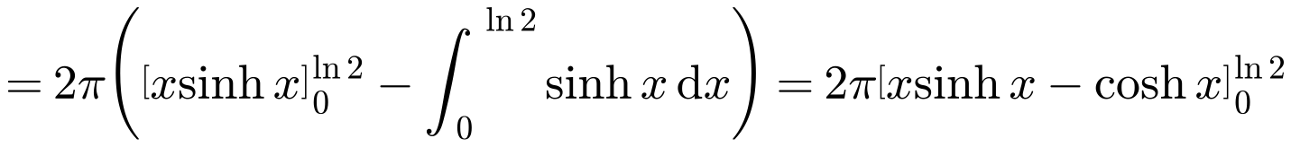
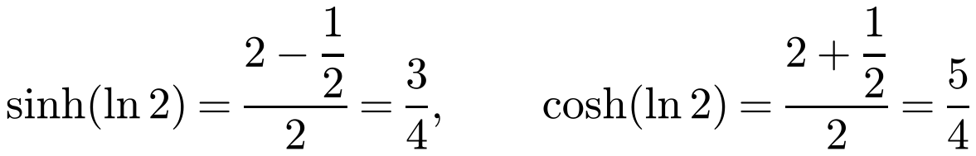
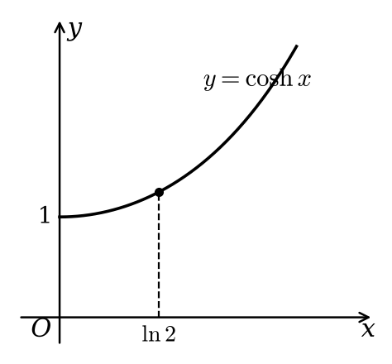
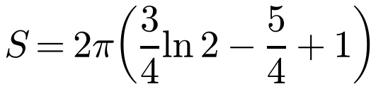
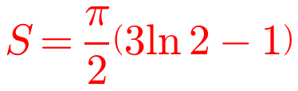
Area of a Surface of Revolution
For a Cartesian curve rotated through 2π about the y-axis:
The arc of the curve with equation y = cosh x, from the point (0, 1) to (ln 2, 5/4), is rotated completely about the y-axis. Find the area of the surface generated.
or
Integrate by parts: u = x, dv/dx = cosh x
When the curve is given as y = f(x), the second form is usually easiest
6C

