Slide 1
Integration Techniques
Further Pure 2 Chapter 6
Westie's Workshop

Slide 2
Teachings for Exercise 6B

Slide 3
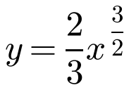
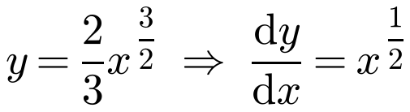
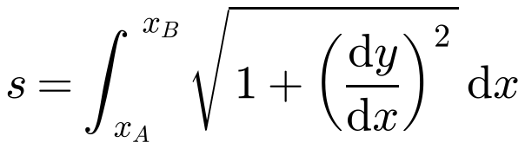
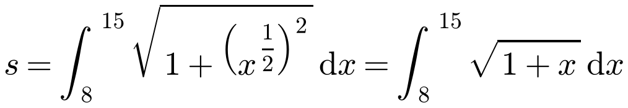
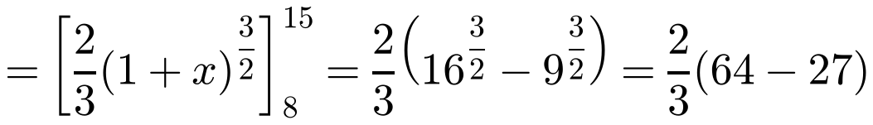
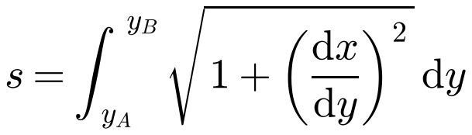
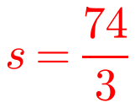
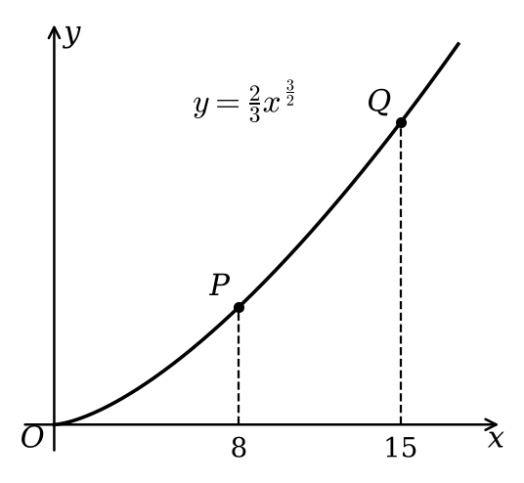
Arc Length
For the curve y = f(x), a small arc δs is approximately a straight line, so (δs)² ≈ (δx)² + (δy)²
Divide by (δx)² and let δx → 0, then integrate with respect to x:
or, dividing by (δy)² instead:
Find the length of the arc PQ on the curve with equation
where the x-coordinates of P and Q are 8 and 15 respectively.
Use the formula with respect to x
Check: the straight-line distance PQ ≈ 24.66, a little less than 74/3 ≈ 24.67
6B

Slide 4
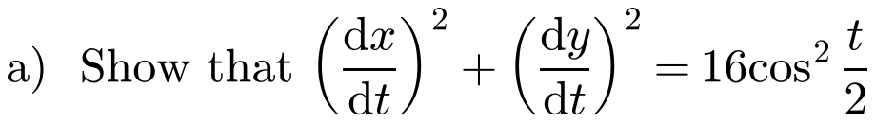
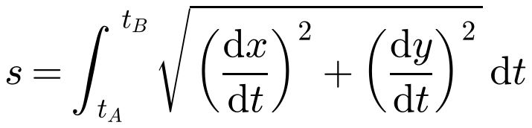
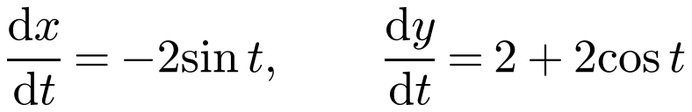
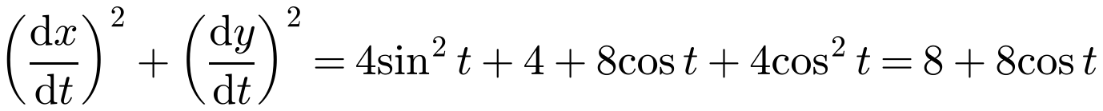
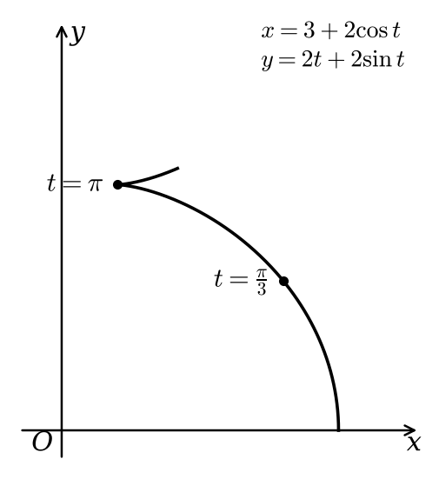
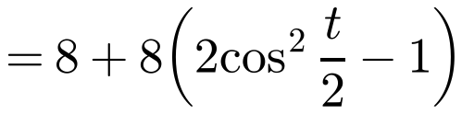
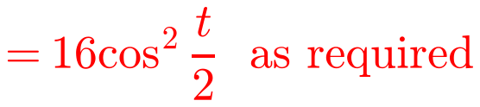
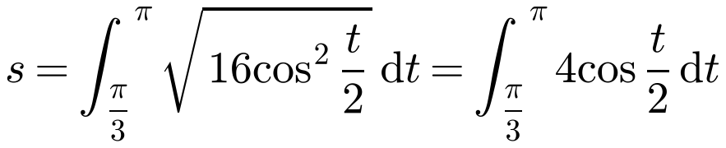
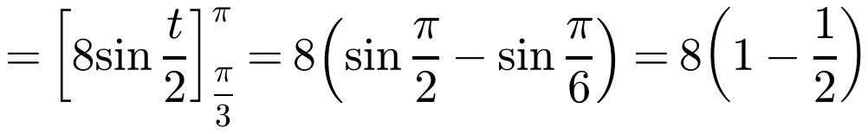

Arc Length
For a curve given parametrically, x = f(t), y = g(t):
Use the double angle formula cos t = 2cos²(t/2) − 1 to make a perfect square
A curve is defined by the parametric equations
b) Find the exact length of this curve between the points where t = π/3 and t = π.
a)
b)
cos(t/2) ≥ 0 for these values of t
6B

Slide 5

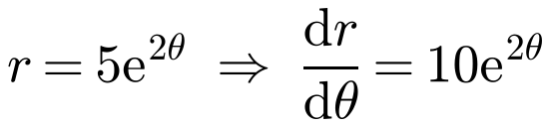
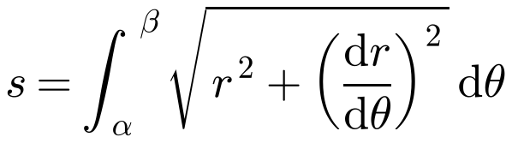
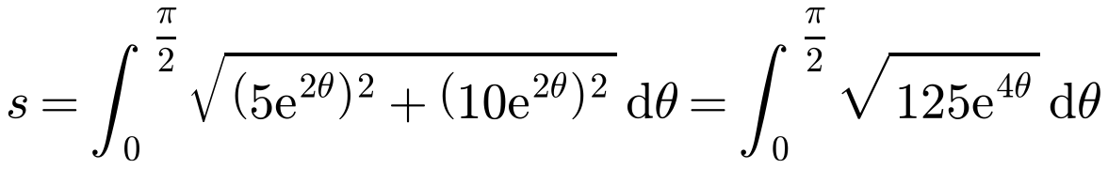
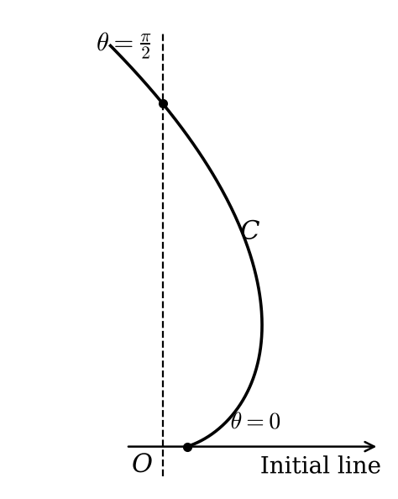
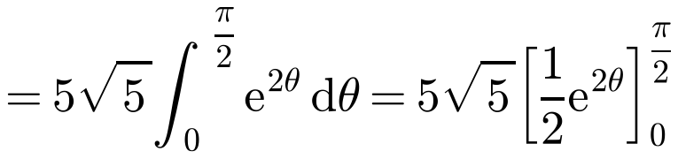
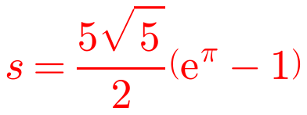
Arc Length
For a curve with polar equation r = f(θ), between the half-lines θ = α and θ = β:
For a small change δθ, (δs)² ≈ (rδθ)² + (δr)²
The curve C shown in the diagram has polar equation
Find the length of the arc of C between the points on the curve with θ = 0 and θ = π/2.
√125 = 5√5 and √(e⁴ᶿ) = e²ᶿ
6B

Slide 6
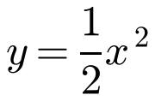
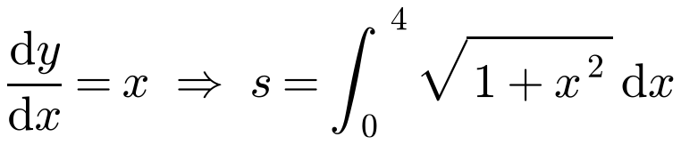
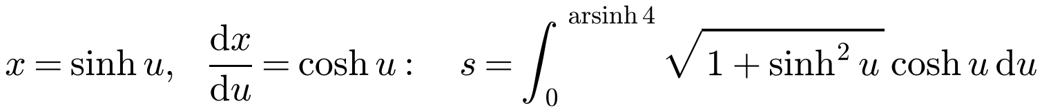
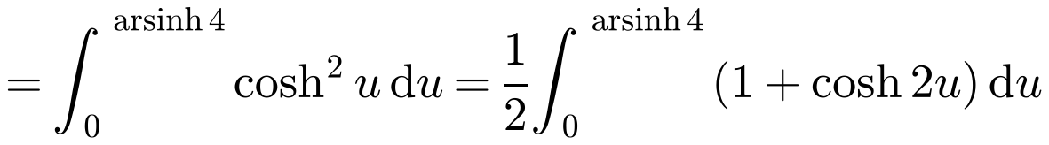
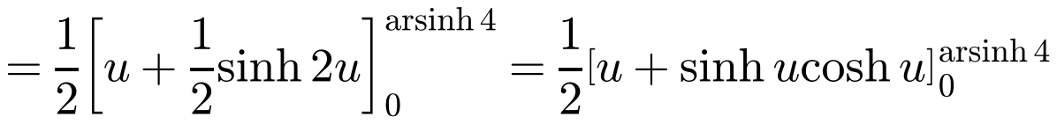
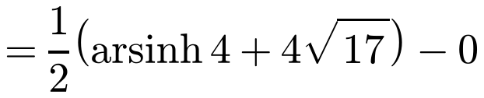
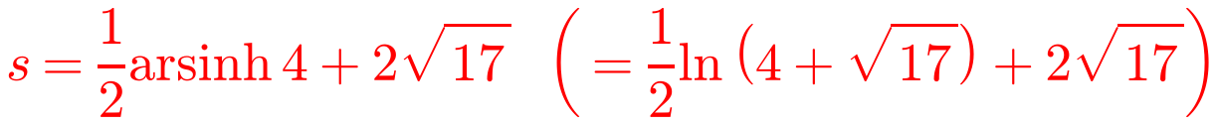
Arc Length
Sometimes the integral needs a substitution
∫√(1 + x²) dx: use x = sinh u, since 1 + sinh²u = cosh²u
Then cosh²u = ½(1 + cosh 2u) and sinh 2u = 2 sinh u cosh u
Change the limits: x = 0 → u = 0, x = 4 → u = arsinh 4
cosh(arsinh 4) = √(1 + 4²) = √17
Find the exact length of the arc on the parabola with equation
from the origin to the point P(4, 8).
6B

