Slide 1
Integration Techniques
Further Pure 2 Chapter 6
Westie's Workshop

Slide 2
Teachings for Exercise 6A

Slide 3

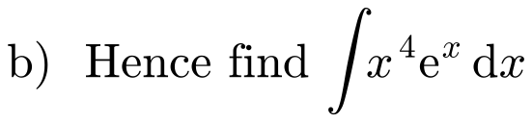
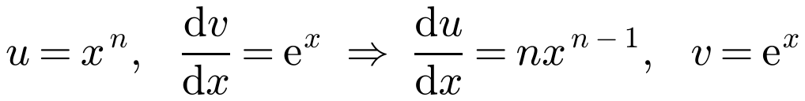
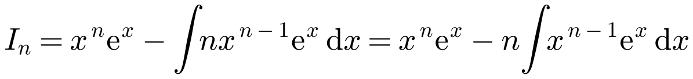

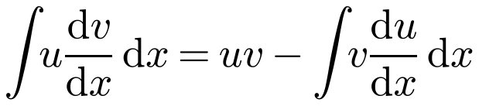


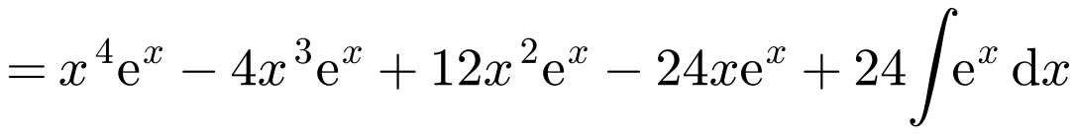
Reduction Formulae
A reduction formula lets you write an integral Iₙ = ∫f(x, n) dx in terms of related integrals Iₙ₋₁, Iₙ₋₂, …
Usually the parameter n is a power
Applying the formula repeatedly reduces the power until you reach an integral you can find directly
Integration by parts:
a)
xⁿ reduces in power when differentiated
b)
n = 3
n = 2
n = 1
I₀ = ∫eˣ dx
6A

Slide 4
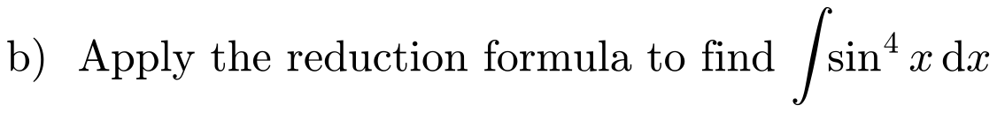
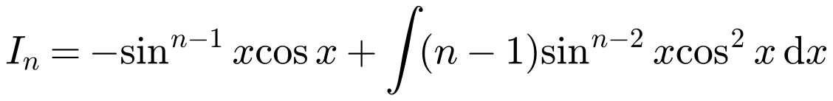
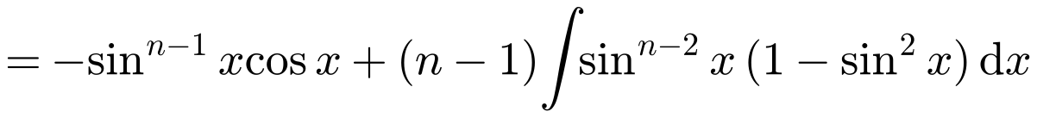
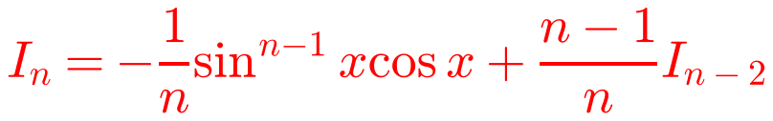
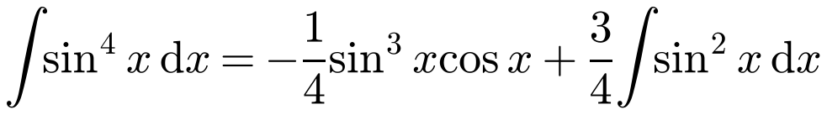
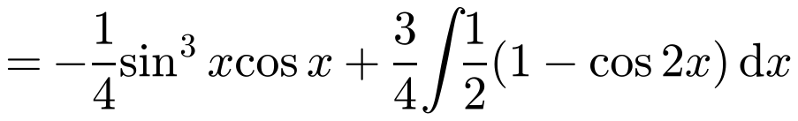
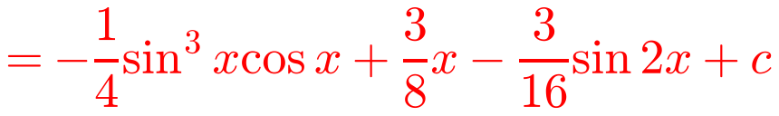
Reduction Formulae
To use integration by parts you need a product:
write sinⁿx as sinⁿ⁻¹x sin x
Differentiate sinⁿ⁻¹x using the chain rule, and be careful with negative signs
Use cos²x = 1 − sin²x to write the new integral in powers of sin x only
Iₙ appears on both sides: collect the Iₙ terms on the left
a)
b)
n = 4
sin²x = ½(1 − cos 2x)
6A

Slide 5
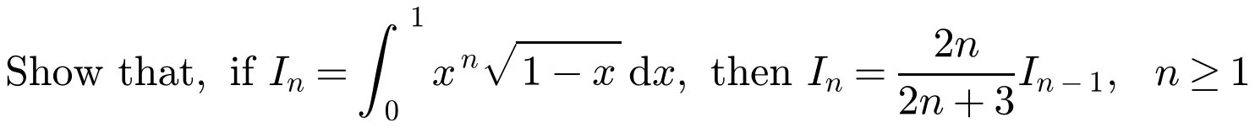
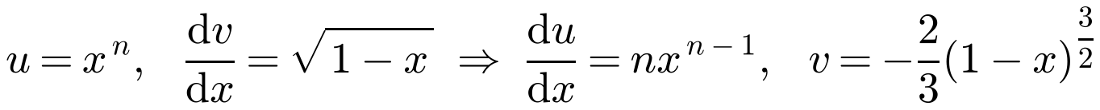
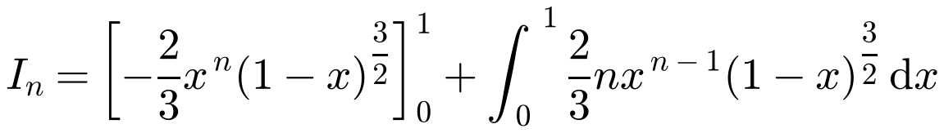
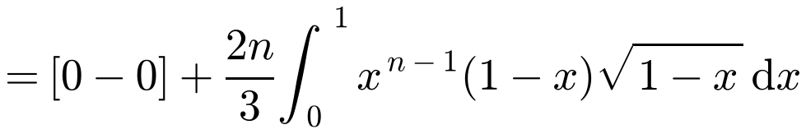
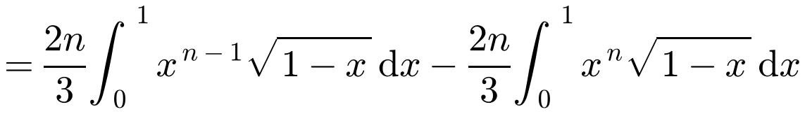
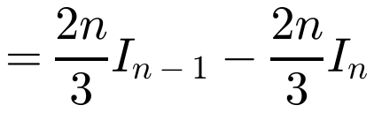

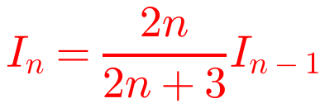
Reduction Formulae
Sometimes, after integrating by parts, you need an algebraic or trigonometric identity to produce the reduction formula
Watch out: for a definite integral, evaluate uv between the limits
Here (1 − x)^(3/2) = (1 − x)√(1 − x) brings back the √(1 − x) term
For n ≥ 1 the bracket is 0 at both limits
6A

Slide 6
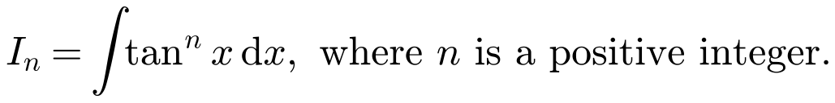
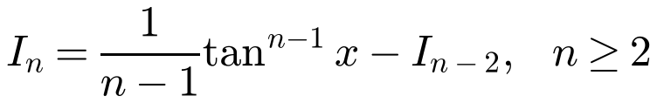
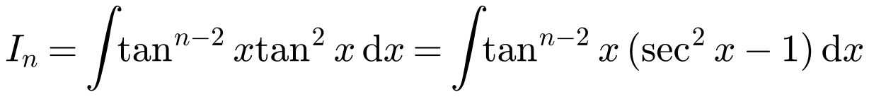
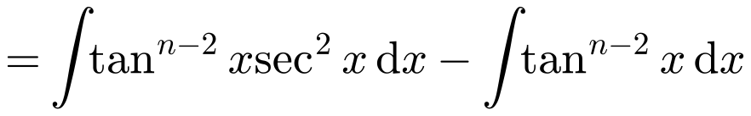
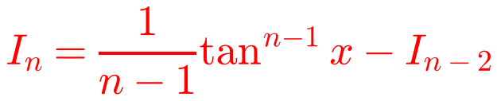
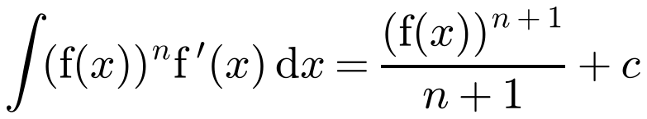
Reduction Formulae
Look for a way to split the integrand so that one part can be integrated directly
tan²x = sec²x − 1
Then ∫tanⁿ⁻²x sec²x dx is of the form ∫(f(x))ⁿ f′(x) dx
By writing tanⁿx as tanⁿ⁻²x tan²x, and using 1 + tan²x ≡ sec²x, establish the reduction formula
Use ∫(f(x))ⁿf′(x) dx = (f(x))ⁿ⁺¹/(n + 1) + c
6A

Slide 7
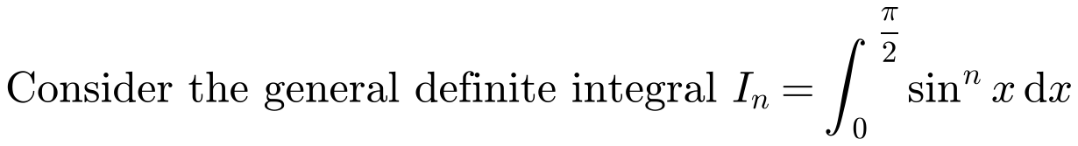
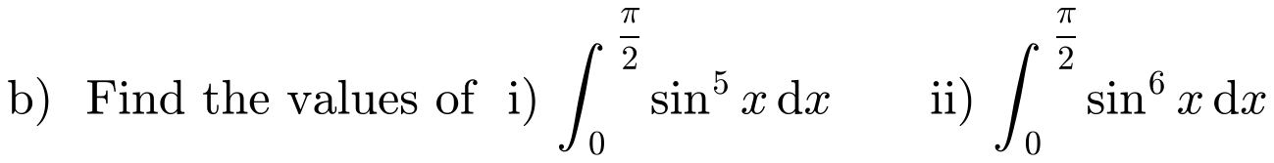
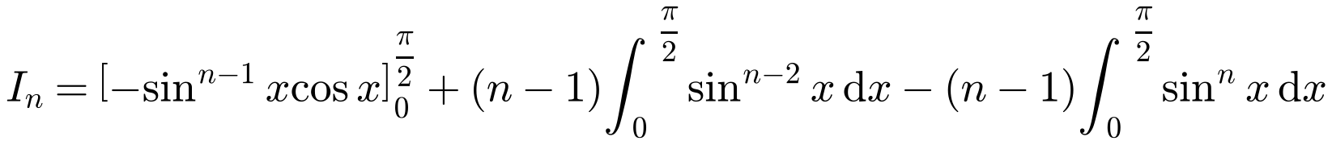

Reduction Formulae
The working from Example 2 can be applied with limits 0 and π/2
These are definite integrals, so the answers are numbers, not functions of x
At both limits, sinⁿ⁻¹x cos x = 0
a)
6A

Slide 8
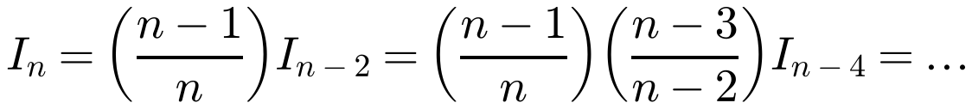
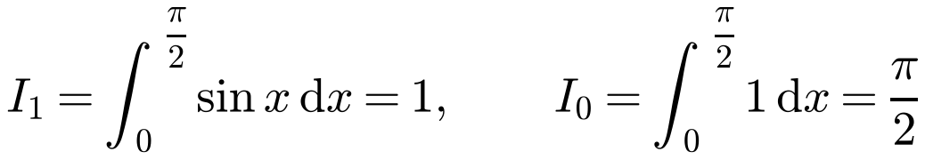
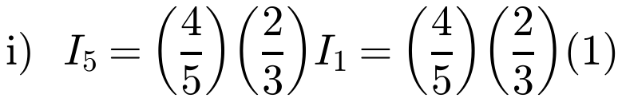
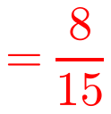
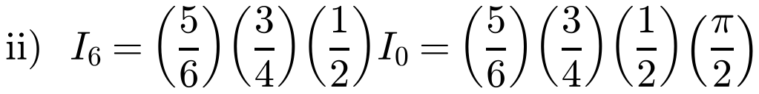
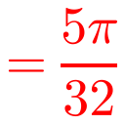
Reduction Formulae
Use the reduction formula repeatedly until you reach I₁ or I₀
Odd n ends at I₁ = 1; even n ends at I₀ = π/2
b)
6A

Slide 9
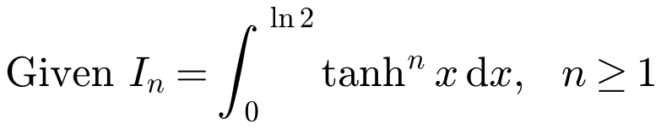
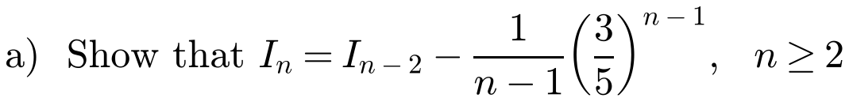
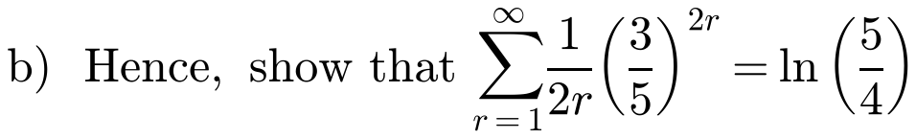
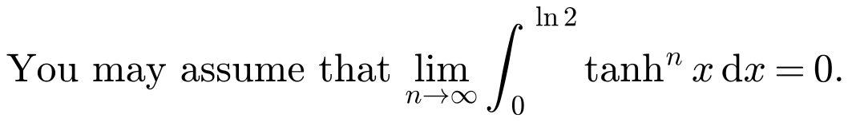
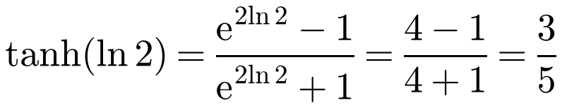
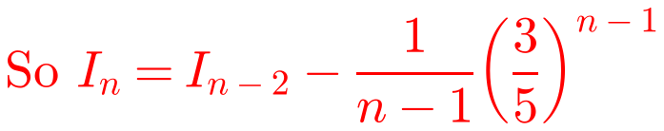
Reduction Formulae
Use the same approach as Example 4 (∫tanⁿx dx)
Write tanhⁿx = tanhⁿ⁻²x tanh²x and use tanh²x = 1 − sech²x
d/dx(tanh x) = sech²x
tanh x = (e²ˣ − 1)/(e²ˣ + 1)
a)
6A

Slide 10
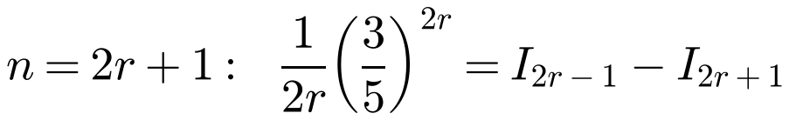
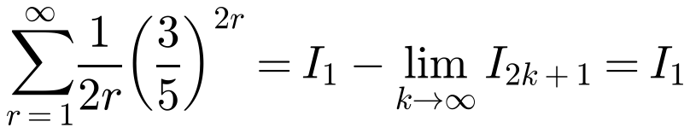
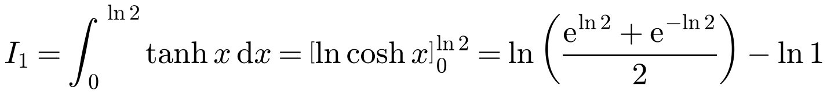
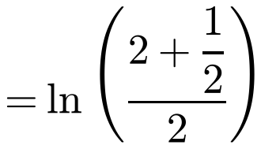
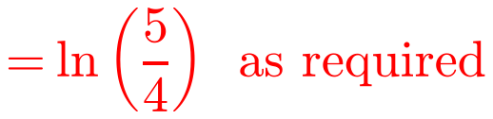
Reduction Formulae
Substitute n = 2r + 1 to write each term of the series as a difference
Use the method of differences: most terms cancel
Then let the number of terms tend to infinity
b)
The limit is 0
6A

Slide 11
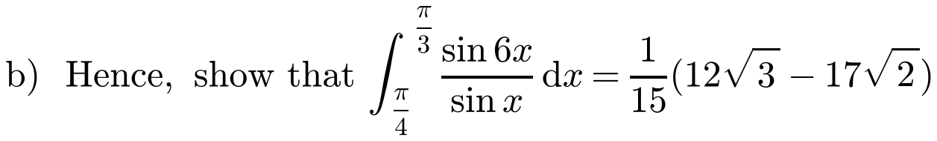
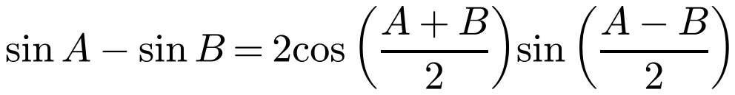
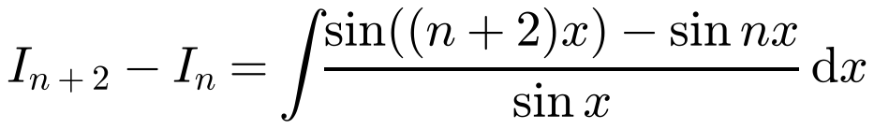
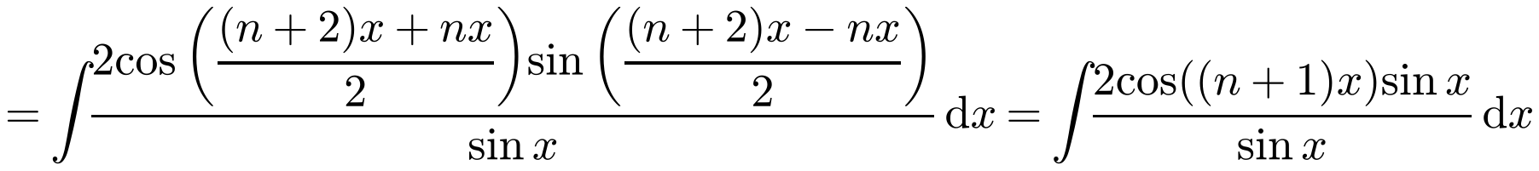
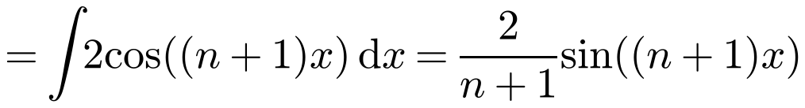

Reduction Formulae
Some reduction formulae need clever substitutions or algebra: the question will usually guide you
Use the identity from the formula booklet
a)
6A

Slide 12





Reduction Formulae
Apply the formula with n = 4, then n = 2, then n = 0
I₀ = ∫(sin 0 / sin x) dx = ∫0 dx, a constant, which cancels in a definite integral
Then substitute the limits
6A

