Slide 1
Matrix Algebra
Further Pure 2 Chapter 5
Westie's Workshop

Slide 2
Teachings for Exercise 5D

Slide 3
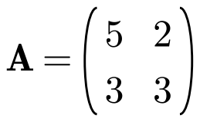
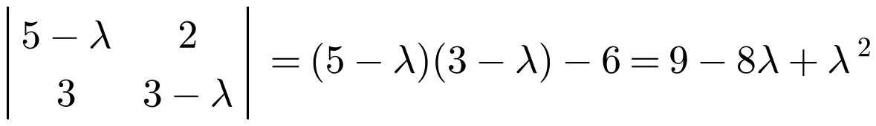
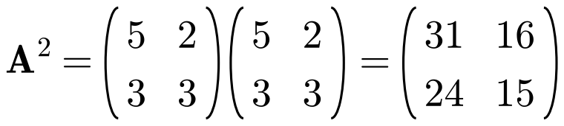
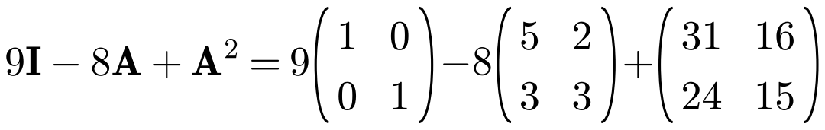
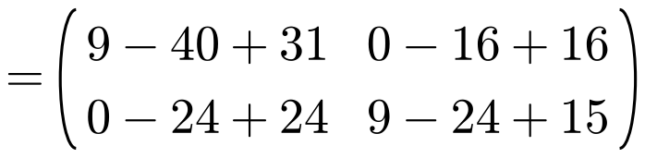
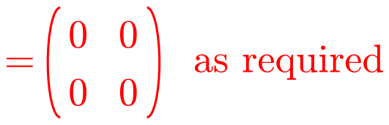
The Cayley–Hamilton Theorem
The Cayley–Hamilton theorem states that every square matrix M satisfies its own characteristic equation
If the characteristic equation is λ² + aλ + b = 0, then
M² + aM + bI = 0
(the zero matrix)
The constant term b becomes bI, since 0 must be a matrix
Demonstrate that the matrix
satisfies its own characteristic equation.
Find the characteristic equation
5D

Slide 4
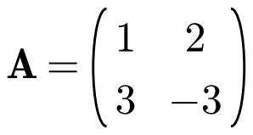
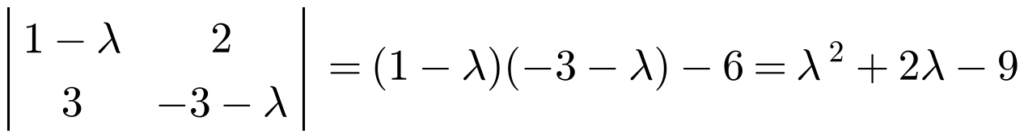




The Cayley–Hamilton Theorem
You can use the Cayley–Hamilton theorem to write higher powers of a matrix in terms of lower powers
Rearrange to make the highest power the subject
Multiply both sides by A to get the next power, then substitute for A² again
a) find the characteristic equation of A.
b) Hence show that A³ = 13A − 18I.
a)
b) By the Cayley–Hamilton theorem,
Multiply both sides of (1) by A
Substitute (1) into (2)
5D

Slide 5
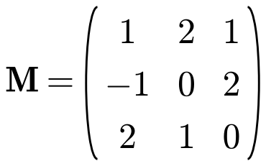
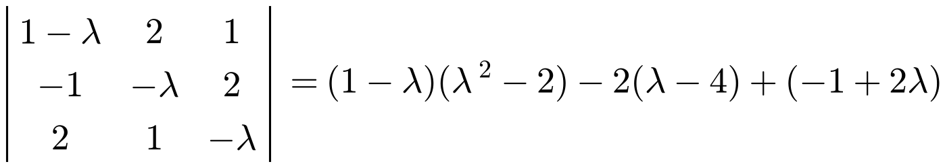




The Cayley–Hamilton Theorem
The theorem works for 3 × 3 matrices too
To find an inverse: write the theorem as an equation in M and I
Multiply through by M⁻¹, remembering that MM⁻¹ = I and IM⁻¹ = M⁻¹
Then work out M² and solve for M⁻¹
a) find the characteristic equation of M.
b) Hence, by using the Cayley–Hamilton theorem, find M⁻¹.
a)
b) By the Cayley–Hamilton theorem,
Multiply by M⁻¹
5D

Slide 6
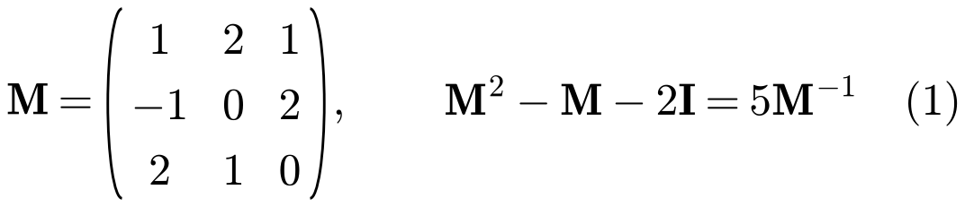
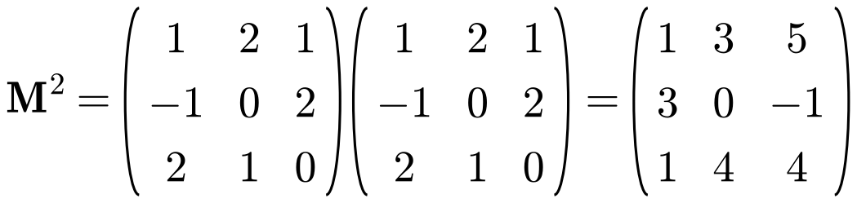
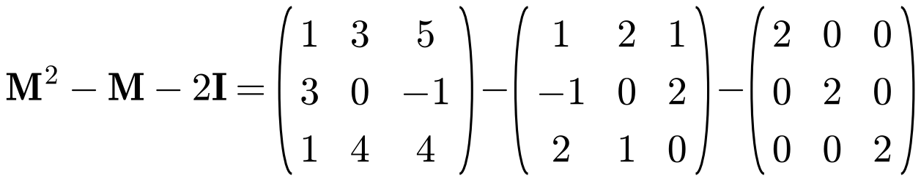
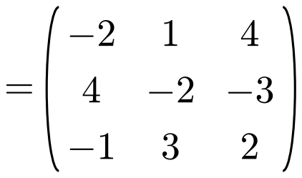
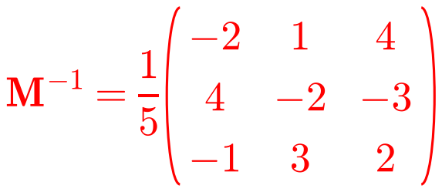
The Cayley–Hamilton Theorem
Find M², substitute into equation (1) and solve for M⁻¹
Check: MM⁻¹ should give I
5D

