Slide 1
Matrix Algebra
Further Pure 2 Chapter 5
Westie's Workshop

Slide 2
Teachings for Exercise 5C

Slide 3
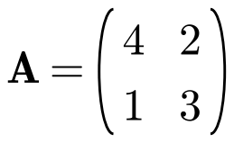
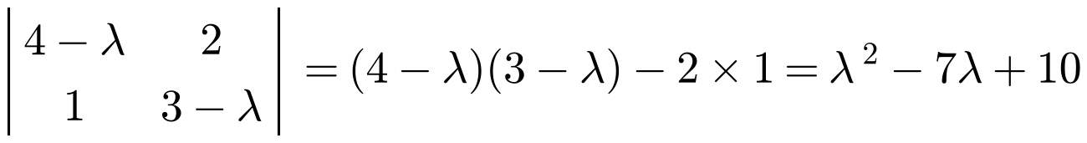
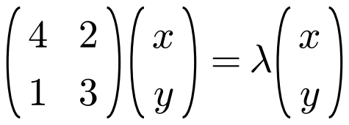
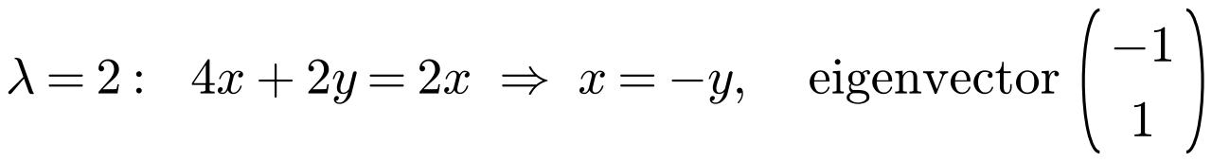
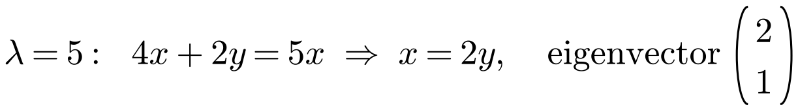
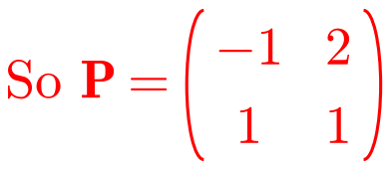
Reducing Matrices to Diagonal Form
A diagonal matrix is a square matrix in which every element not on the leading diagonal is zero
The leading diagonal runs from the top left to the bottom right
To reduce A to diagonal form:
• Find the eigenvalues and eigenvectors of A
• Form a matrix P whose columns are the eigenvectors of A
• Find P⁻¹
• A diagonal matrix D is given by P⁻¹AP
a) Find a matrix P such that D = P⁻¹AP is diagonal.
b) Write down the diagonal matrix D.
a)
The columns of P are the eigenvectors
5C

Slide 4
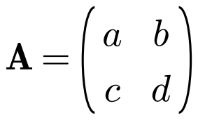
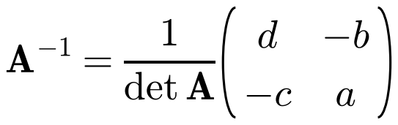
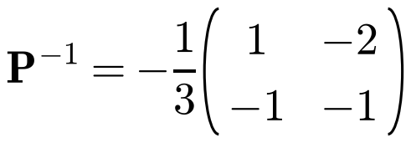
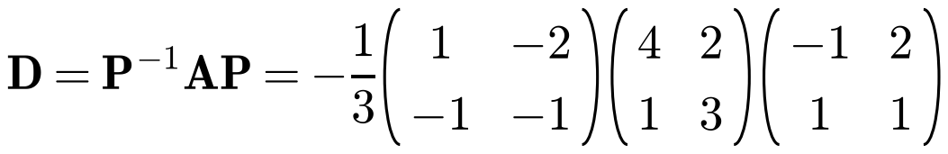
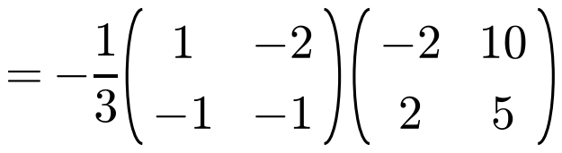
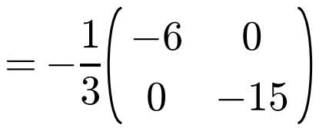
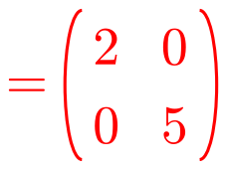
Reducing Matrices to Diagonal Form
For any non-singular 2 × 2 matrix
a) Find a matrix P such that D = P⁻¹AP is diagonal.
b) Write down the diagonal matrix D.
b)
Swap a and d, change the signs of b and c, divide by det P
The elements on the leading diagonal of D are the eigenvalues of A, in the same order as the eigenvectors in P
5C

Slide 5
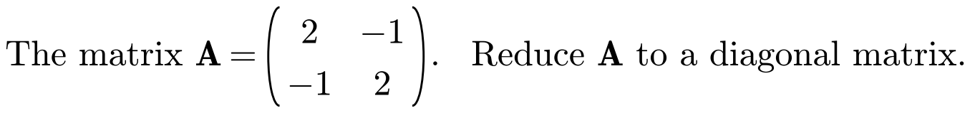
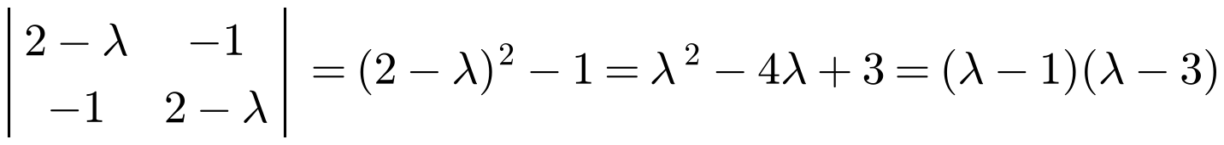
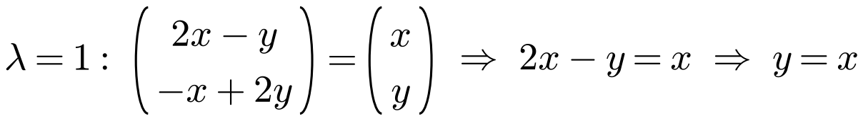
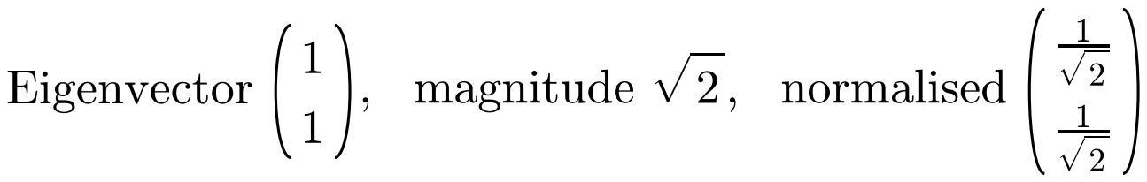
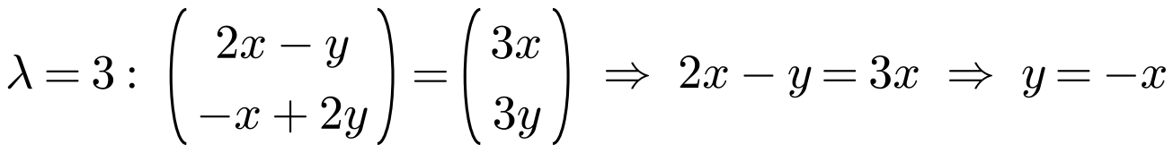
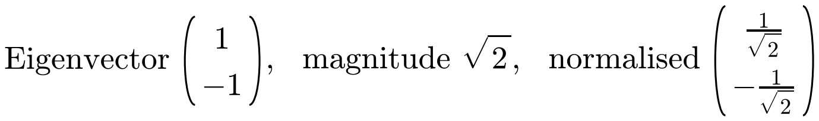
Reducing Matrices to Diagonal Form
A matrix A is symmetric if A = Aᵀ
(the elements are symmetric about the leading diagonal)
Orthogonal diagonalisation of a symmetric matrix A:
• Find the normalised eigenvectors of A
• Form a matrix P from the normalised eigenvectors
• Write down Pᵀ
• D = PᵀAP
For a symmetric matrix the normalised eigenvectors are perpendicular, so P⁻¹ = Pᵀ
A matrix with P⁻¹ = Pᵀ is called orthogonal
Eigenvalues 1 and 3
Divide by the magnitude to normalise
5C

Slide 6
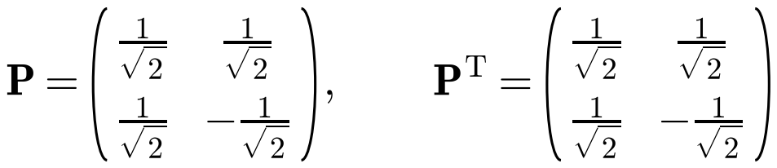
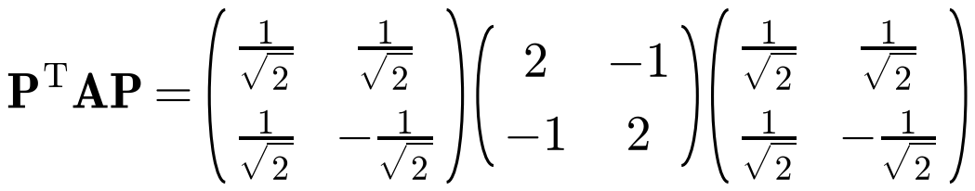
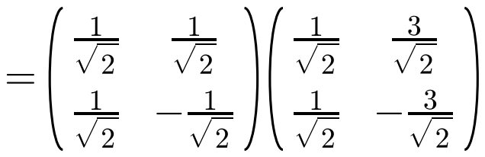
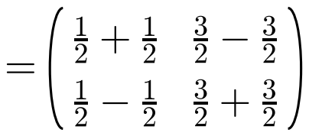
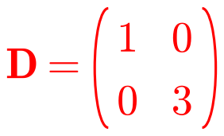
Reducing Matrices to Diagonal Form
Use the normalised eigenvectors as the columns of P
The negative of a normalised eigenvector would be just as good
The order of the eigenvectors in P fixes the order of the eigenvalues in D
If P had its columns the other way round, D would be diag(3, 1)
Here P is symmetric, so Pᵀ = P
5C

Slide 7
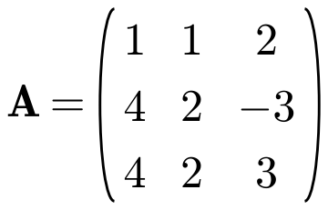
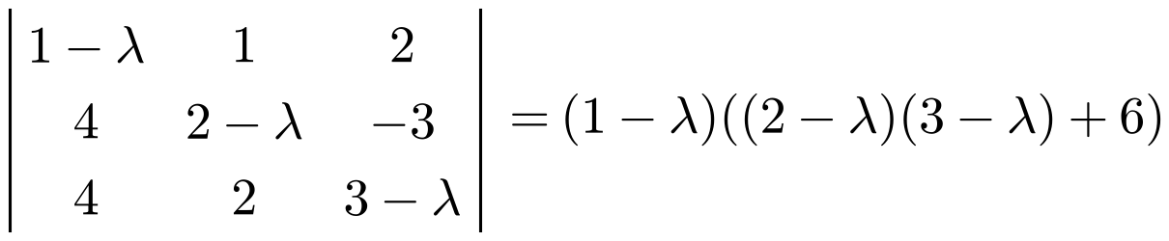

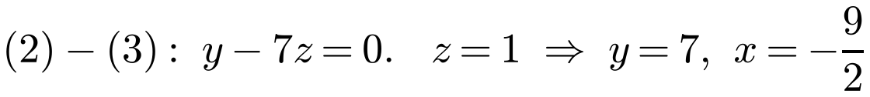
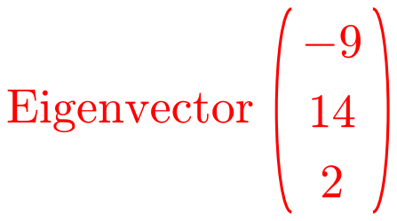
Reducing Matrices to Diagonal Form
The process of diagonalising is the same for 3 × 3 matrices
Find the three eigenvalues and an eigenvector for each
Each eigenvalue gives three equations; one is usually a combination of the other two
It is conventional to give eigenvectors with integer elements
Find a matrix P and a diagonal matrix D such that D = P⁻¹AP.
Eigenvalues −1, 3 and 4
λ = −1:
(1) is a multiple of (3), so use (2) and (3). Multiply by 2 to clear the fraction
5C

Slide 8
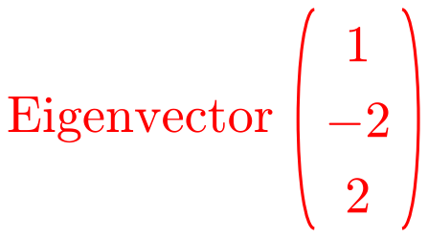
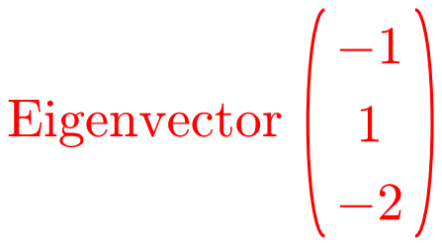
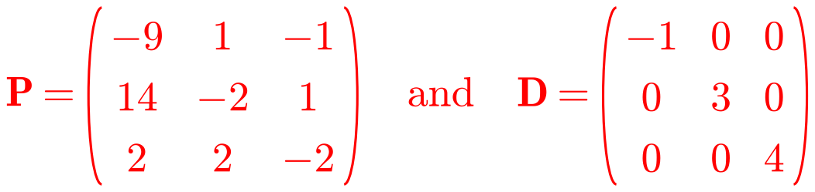
Reducing Matrices to Diagonal Form
Repeat for each of the other eigenvalues
Write down D by putting the eigenvalues on the leading diagonal in the same order as the eigenvectors in P
You can check your answer by finding P⁻¹ on your calculator and working out P⁻¹AP
Find a matrix P and a diagonal matrix D such that D = P⁻¹AP.
λ = 3:
λ = 4:
5C

Slide 9
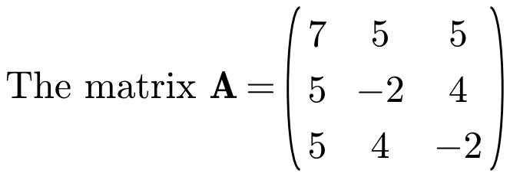
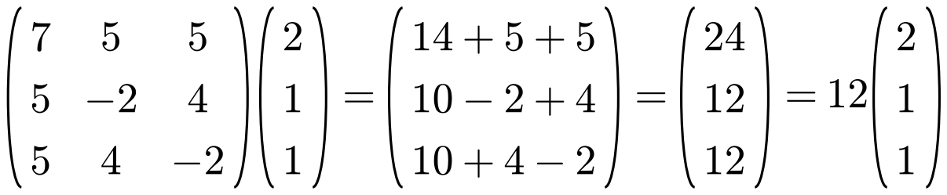
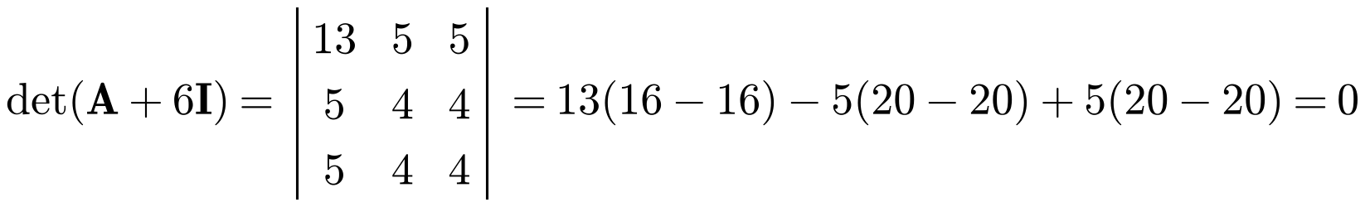
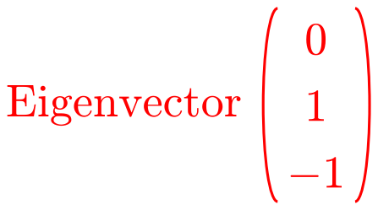
Reducing Matrices to Diagonal Form
To show x is an eigenvector, find a scalar λ with Ax = λx
To show a value is an eigenvalue, show that det(A − λI) = 0 for that value
PᵀAP in the question tells you to use orthogonal diagonalisation: this works because A is symmetric
a) Verify that (2, 1, 1)ᵀ is an eigenvector of A and find the corresponding eigenvalue.
b) Show that −6 is another eigenvalue of A and find the corresponding eigenvector.
a)
So (2, 1, 1)ᵀ is an eigenvector with eigenvalue 12
b)
5C

Slide 10
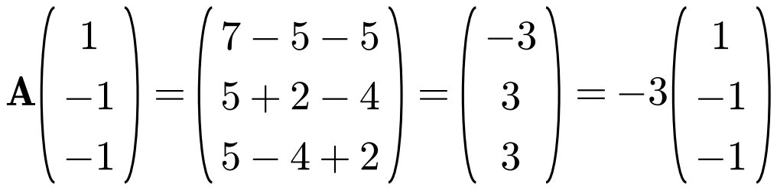
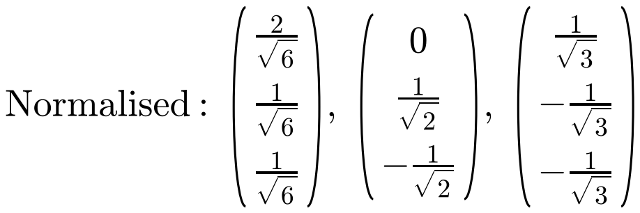
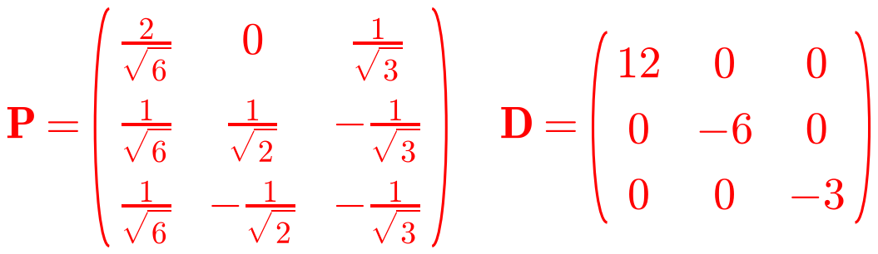
Reducing Matrices to Diagonal Form
Normalise each eigenvector by dividing by its magnitude
P has the normalised eigenvectors as its columns; D has the corresponding eigenvalues on its leading diagonal
P is orthogonal, so Pᵀ = P⁻¹: multiplying out PᵀAP is not needed unless the question asks for it
c) Third eigenvector (1, −1, −1)ᵀ. Find P and D such that PᵀAP = D.
Third eigenvalue −3
5C

Slide 11
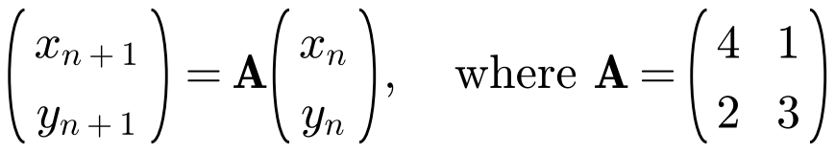
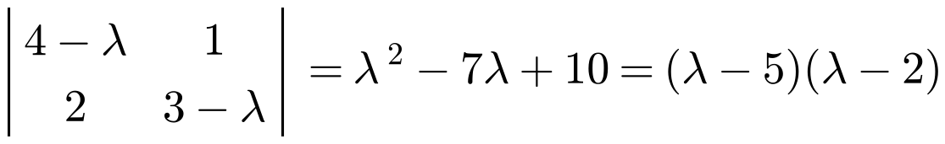
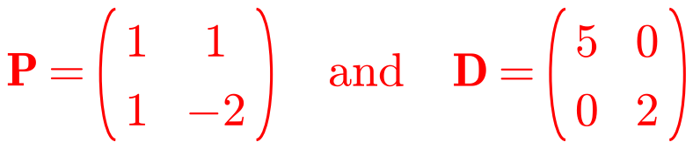
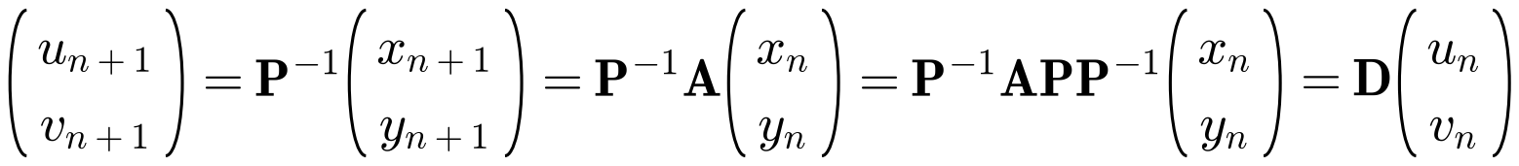
Reducing Matrices to Diagonal Form
Diagonalisation can be used to solve coupled recurrence relations (and coupled differential equations)
Changing variables with P⁻¹ uncouples the sequences:
each new sequence depends only on itself
In part c, replace (xₙ₊₁, yₙ₊₁) with A(xₙ, yₙ), insert PP⁻¹ = I, then use P⁻¹AP = D
The two sequences xₙ and yₙ satisfy the recurrence relations
a) Find the eigenvalues and corresponding eigenvectors of A. b) Hence write down matrices P and D such that P⁻¹AP = D.
New sequences uₙ and vₙ are formed by (uₙ, vₙ)ᵀ = P⁻¹(xₙ, yₙ)ᵀ.
c) Show that (uₙ₊₁, vₙ₊₁)ᵀ = D(uₙ, vₙ)ᵀ. d) Hence find closed form expressions for xₙ and yₙ.
a)
Eigenvalues 5 and 2
b)
c)
5C

Slide 12
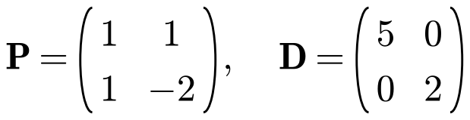
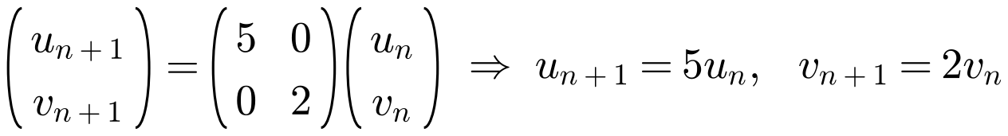
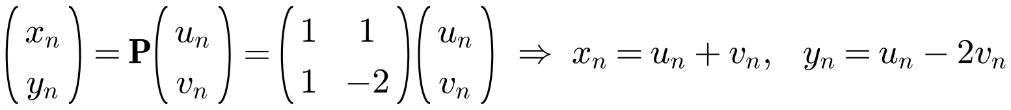
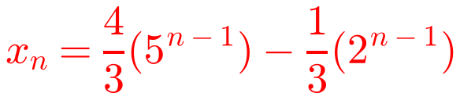
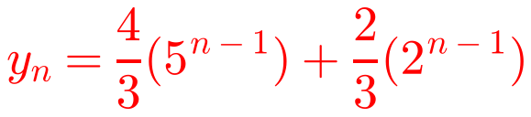
Reducing Matrices to Diagonal Form
Closed form means xₙ and yₙ in terms of n only
uₙ₊₁ = 5uₙ is geometric, so uₙ = u₁ × 5ⁿ⁻¹
Watch out: you know x₁ and y₁, but you need to find u₁ and v₁
d) Hence find closed form expressions for xₙ and yₙ. (x₁ = 1, y₁ = 2)
5C

Slide 13
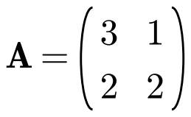
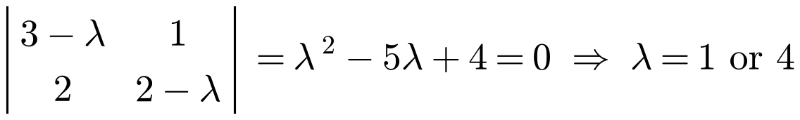
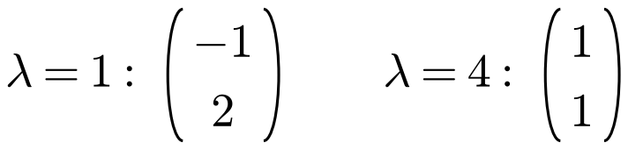






Reducing Matrices to Diagonal Form
Diagonalisation can be used to find large powers of matrices efficiently
For a diagonal matrix, raise each diagonal element to the power k
If P⁻¹AP = D then A = PDP⁻¹, so
Aᵏ = (PDP⁻¹)(PDP⁻¹)…(PDP⁻¹)
= PD(P⁻¹P)D(P⁻¹P)…DP⁻¹
Aᵏ = PDᵏP⁻¹
a) Find a matrix P and a diagonal matrix D such that P⁻¹AP = D.
b) Hence find A⁶.
a)
b)
5C

