Slide 1
Matrix Algebra
Further Pure 2 Chapter 5
Westie's Workshop

Slide 2
Teachings for Exercise 5A

Slide 3
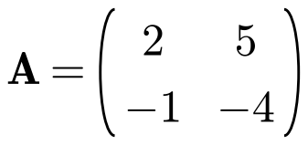
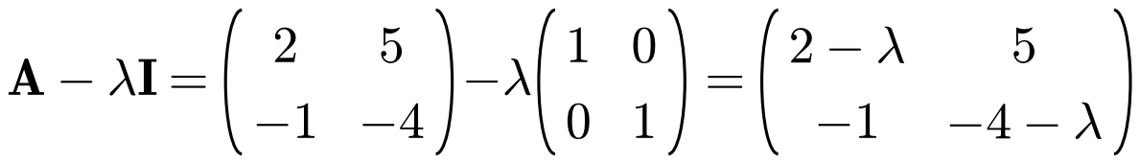
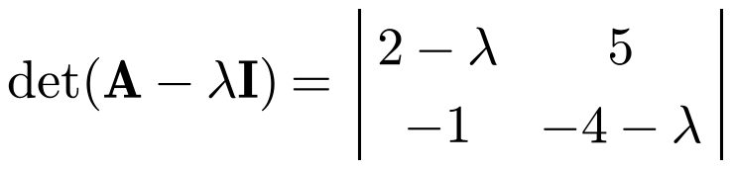


Eigenvalues and Eigenvectors
An eigenvector of a matrix A is a non-zero column vector x which satisfies
Ax = λx
where λ is a scalar
λ is the eigenvalue corresponding to the eigenvector x
Ax − λIx = 0 ⇒ (A − λI)x = 0
As x ≠ 0, the matrix A − λI is singular, so
det(A − λI) = 0
This is the characteristic equation of A. Its solutions are the eigenvalues of A
For a 2 × 2 matrix the characteristic equation is a quadratic
Find the eigenvalues and corresponding eigenvectors of the matrix
This is the characteristic equation of A
The eigenvalues of A are 1 and −3
5A/B

Slide 4
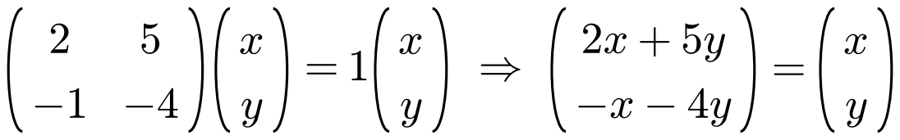
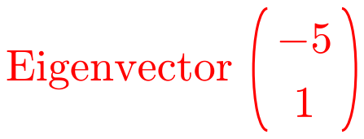
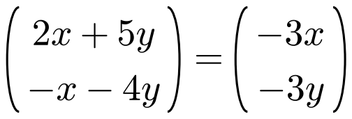
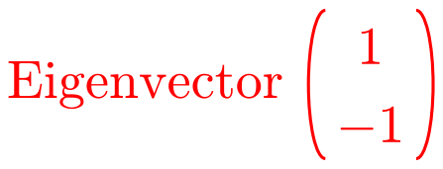
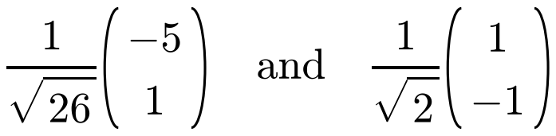
Eigenvalues and Eigenvectors
To find an eigenvector, solve Ax = λx for each eigenvalue λ
With a 2 × 2 matrix, equating one pair of elements gives all the information you need
You have a free choice of one variable: choose a value that avoids fractions
Any non-zero multiple of an eigenvector is also an eigenvector
A normalised eigenvector is a unit vector:
divide the eigenvector by its magnitude
Find the eigenvalues and corresponding eigenvectors of the matrix
Eigenvalues: 1 and −3
λ = 1:
Equating the upper elements: 2x + 5y = x ⇒ x = −5y
Let y = 1, then x = −5
λ = −3:
Equating the upper elements: 2x + 5y = −3x ⇒ y = −x
Let x = 1, then y = −1
Normalised eigenvectors:
5A/B

Slide 5
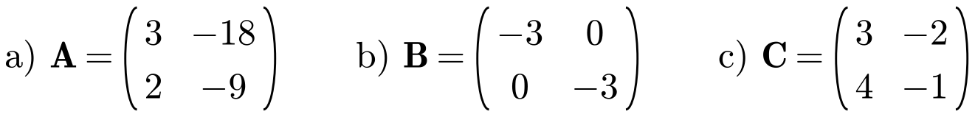
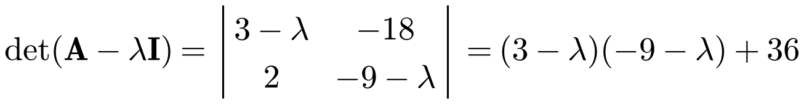

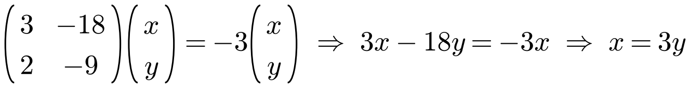
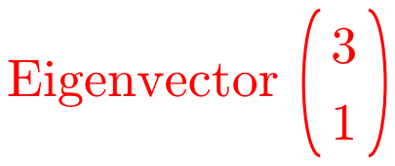
Eigenvalues and Eigenvectors
Sometimes the characteristic equation has a repeated root, or no real roots
This gives repeated eigenvalues or complex eigenvalues
A set of vectors is linearly independent if no vector in the set can be written as a linear combination of the others
For two vectors: one is not a scalar multiple of the other
Find the eigenvalues and corresponding eigenvectors for these matrices:
a)
λ = −3 is a repeated eigenvalue
Only one eigenvector direction for this repeated eigenvalue
5A/B

Slide 6
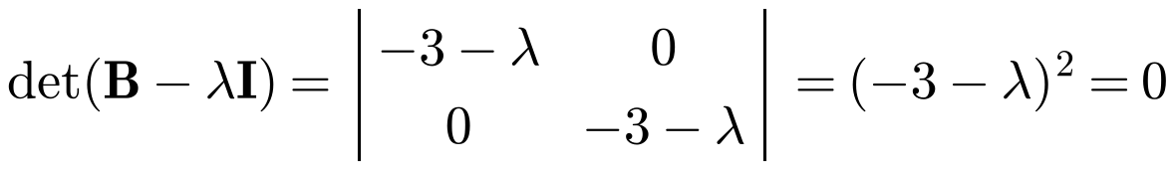
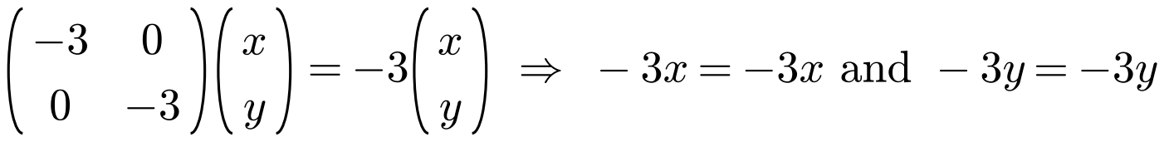
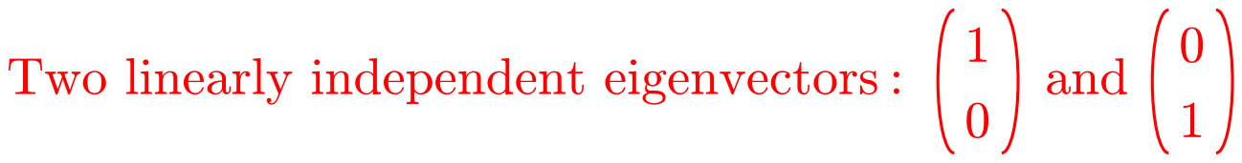
Eigenvalues and Eigenvectors
When every vector is an eigenvector, give two linearly independent ones
You could give any two linearly independent vectors, but it is conventional to choose the two shown
A repeated eigenvalue may give one eigenvector direction (part a) or two independent directions (part b)
Find the eigenvalues and corresponding eigenvectors for these matrices:
b)
λ = −3 is a repeated eigenvalue
No relationship between x and y: every vector is an eigenvector of B
5A/B

Slide 7
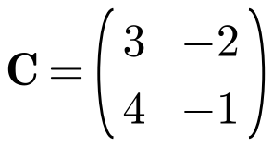
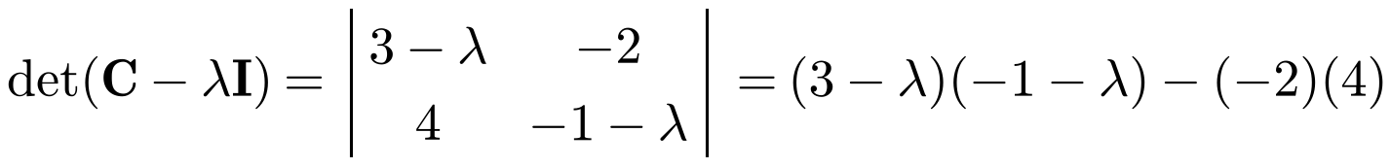

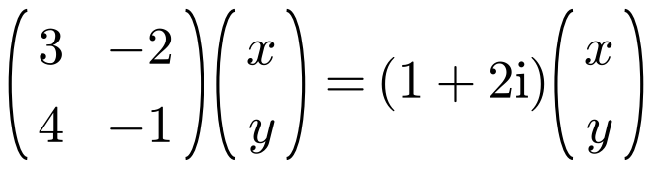

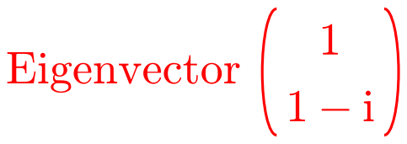
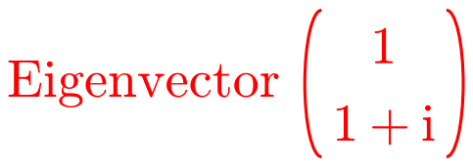
Eigenvalues and Eigenvectors
If a matrix with real elements has complex eigenvalues, they occur as a complex conjugate pair
Find the eigenvectors in exactly the same way, using complex arithmetic
Write each eigenvector with one real element: the complex elements of the two eigenvectors are then conjugates of each other
c) Find the eigenvalues and corresponding eigenvectors of
λ = 1 + 2i:
λ = 1 − 2i:
5A/B

Slide 8
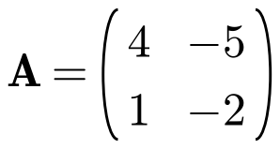
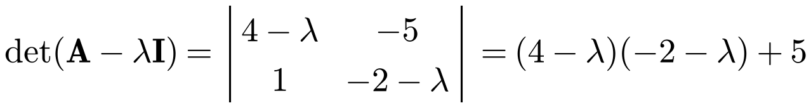
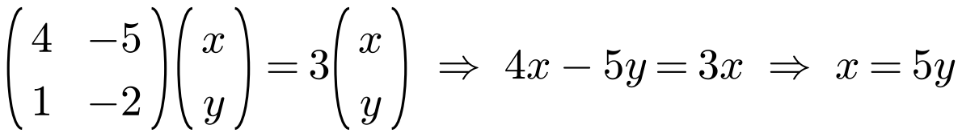
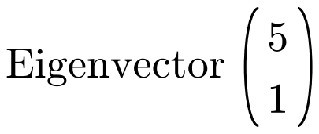
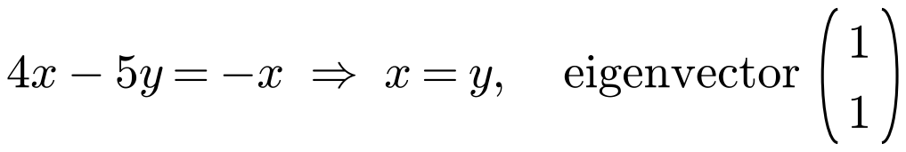
Eigenvalues and Eigenvectors
If x is an eigenvector of a matrix M representing a linear transformation, then the line through the origin in the direction of x is an invariant line
The direction of an eigenvector is unchanged by the transformation; the eigenvalue is the scale factor along that line
If the eigenvalue is 1, every point on the line is an invariant point
A transformation T: ℝ² → ℝ² is represented by the matrix
a) Find the eigenvalues of A.
b) Find Cartesian equations of the two lines passing through the origin which are invariant under T.
a)
The eigenvalues of A are 3 and −1
b) λ = 3:
Invariant line: y = ⅕x
λ = −1:
Each eigenvector gives an invariant line through the origin
Invariant line: y = x
5A/B

Slide 9
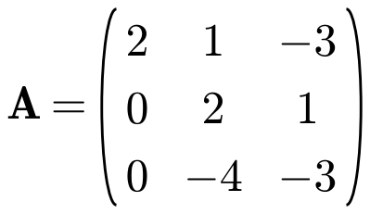
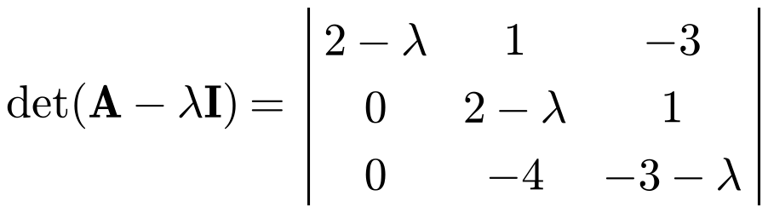
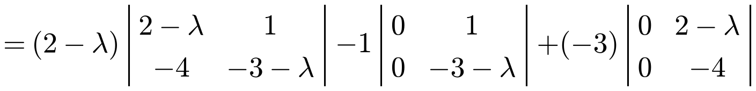
Eigenvalues and Eigenvectors
You can also find the eigenvalues and eigenvectors of a 3 × 3 matrix
The characteristic equation det(A − λI) = 0 is a cubic
Questions often give a hint to help you factorise; otherwise use the factor theorem to search for a root
A 3 × 3 matrix always has at least one real eigenvalue, since a cubic always has at least one real root
Find the eigenvalues and corresponding eigenvectors of the matrix
The eigenvalues of A are −2, 1 and 2
5A/B

Slide 10
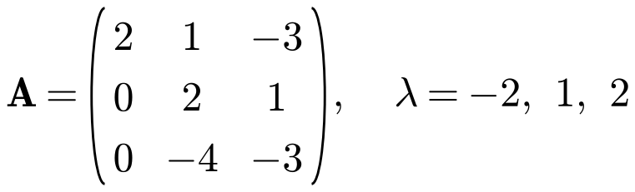
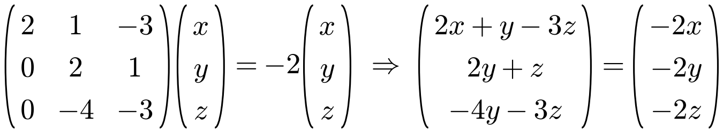
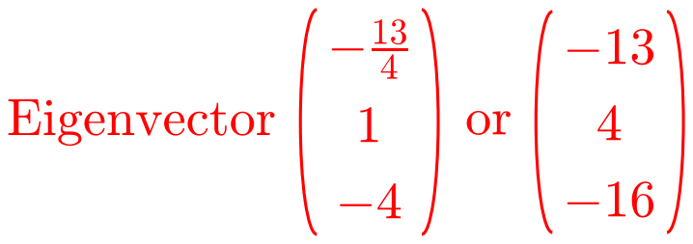






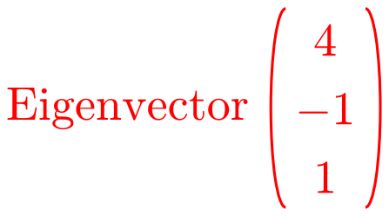
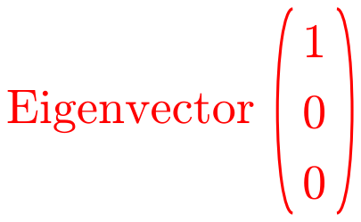
Eigenvalues and Eigenvectors
Solve Ax = λx for each eigenvalue
With a 3 × 3 matrix, two of the three equations usually give you all the information you need
Choose one variable freely, then find the others
Scale to remove fractions if you wish
Eigenvectors of
λ = −2:
λ = 1:
λ = 2:
5A/B

Slide 11
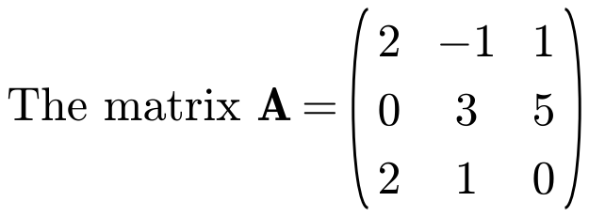
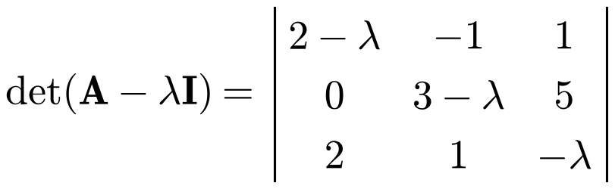

Eigenvalues and Eigenvectors
If you are told one eigenvalue, use it to factorise the cubic
λ = −2 is a root, so (λ + 2) is a factor
To show there is only one real eigenvalue, show that the quadratic factor has a negative discriminant
a) Show that −2 is the only real eigenvalue of A.
b) Find a normalised eigenvector of A corresponding to the eigenvalue −2.
a)
Equate coefficients or use polynomial division
The quadratic has no real roots, so −2 is the only real eigenvalue
5A/B

Slide 12
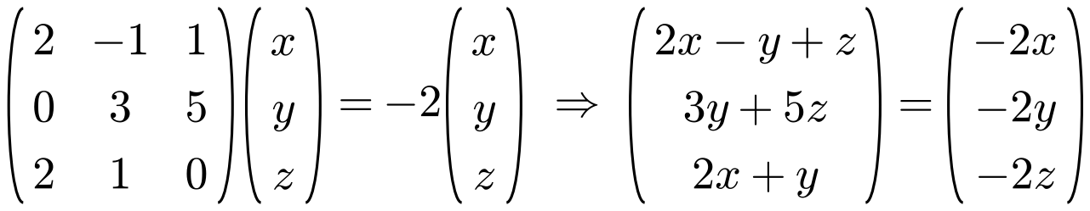
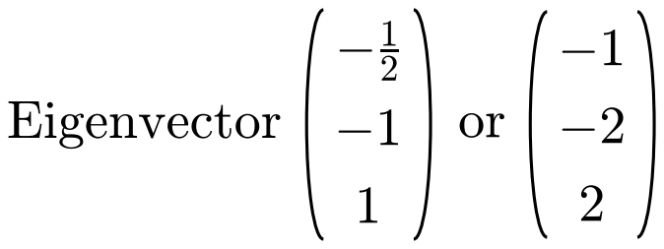

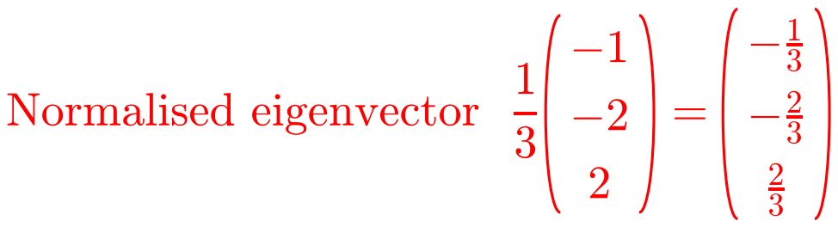
Eigenvalues and Eigenvectors
A normalised eigenvector has magnitude 1
Divide each element of the eigenvector by its magnitude
If x is a normalised eigenvector then so is −x
a) Show that −2 is the only real eigenvalue of A.
b) Find a normalised eigenvector of A corresponding to the eigenvalue −2.
b)
5A/B

Slide 13
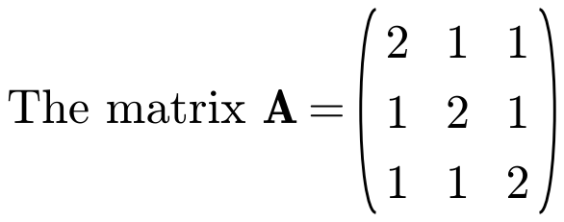
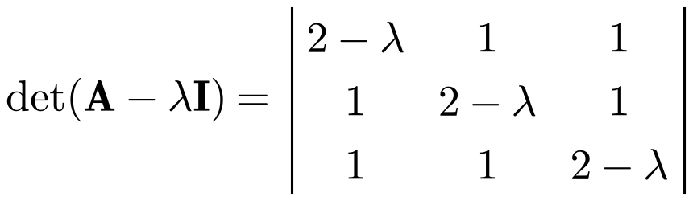
Eigenvalues and Eigenvectors
A 3 × 3 matrix can have a repeated eigenvalue
You know λ = 1 is a root, so look for the factor (λ − 1)
Not every repeated eigenvalue gives two linearly independent eigenvectors
Here the three equations reduce to one, so two of x, y, z can be chosen freely
a) Show that 1 is a repeated eigenvalue of A and find the other distinct eigenvalue.
b) Find two linearly independent eigenvectors corresponding to the eigenvalue 1.
a)
1 is a repeated eigenvalue; the other eigenvalue is 4
5A/B

Slide 14
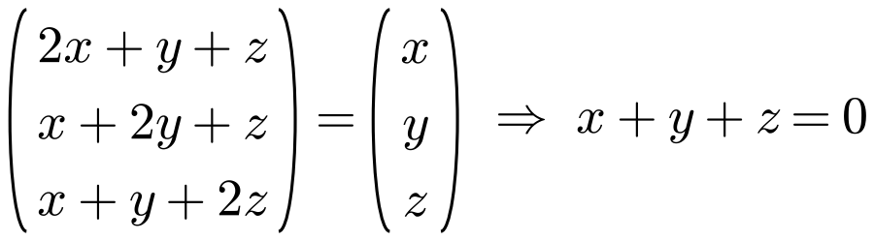
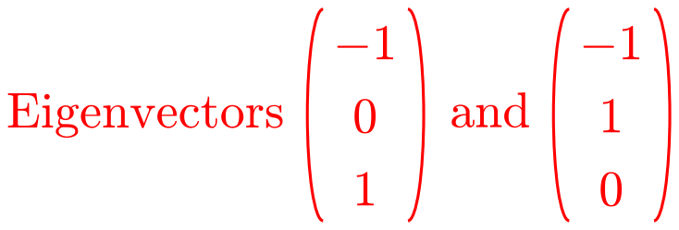
Eigenvalues and Eigenvectors
For λ = 1, solve Ax = x
Here all three equations reduce to the same equation, x + y + z = 0
So two of x, y, z can be chosen freely
The choices y = 0, z = 1 and y = 1, z = 0 are arbitrary but guarantee that the eigenvectors are linearly independent
a) Show that 1 is a repeated eigenvalue of A and find the other distinct eigenvalue.
b) Find two linearly independent eigenvectors corresponding to the eigenvalue 1.
b)
All three equations give x + y + z = 0
5A/B

