Slide 1
Recurrence Relations
Further Pure 2 Chapter 4
Westie's Workshop

Slide 2
Teachings for Exercise 4D

Slide 3
Proving Closed Forms
You can prove that a closed form satisfies a recurrence relation by mathematical induction
Basis step:
show the closed form is true for the first value of n (from the initial condition)
Assumption step:
assume it is true for n = k
Inductive step:
use the recurrence relation to show it is then true for n = k + 1
Conclusion:
true for n = k ⇒ true for n = k + 1, and true for the first value, so true for all n by induction
The minimum number of moves, d_{n}, needed to transfer n disks from one peg to another in the Tower of Hanoi problem is given by the recurrence relation d_{n} = 2d_{n−1} + 1, with d₁ = 1.
Prove, by induction, that d_{n} = 2^{n} − 1.
Basis step:
When n = 1, d₁ = 2¹ − 1 = 1, so the closed form is true for n = 1
Assumption step:
Assume the closed form is true for n = k: d_{k} = 2^{k} − 1
Inductive step:
Replace d_{k} with 2^{k} − 1
d_{k+1} = 2d_{k} + 1 = 2(2^{k} − 1) + 1
Aim: d_{k+1} = 2^{k+1} − 1
= 2 × 2^{k} − 2 + 1 = 2^{k+1} − 1
So true for n = k ⇒ true for n = k + 1, and true for n = 1.
Therefore, by induction, d_{n} = 2^{n} − 1 is true for all n ∈ ℤ⁺.
4D

Slide 4
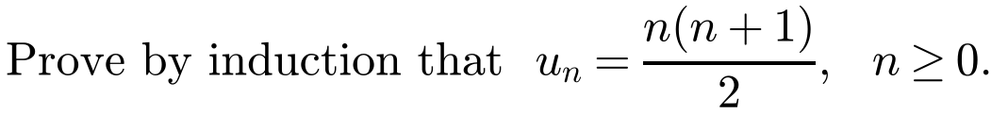
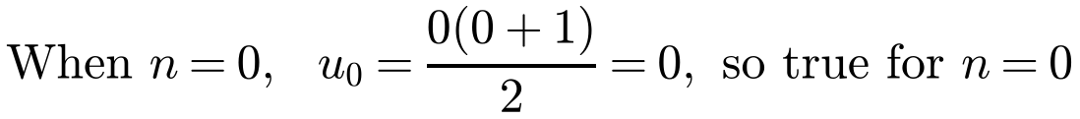
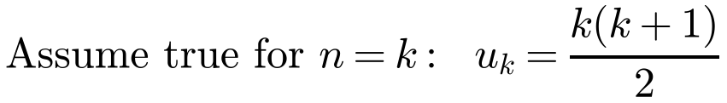
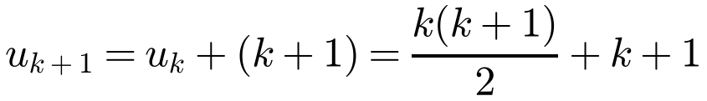
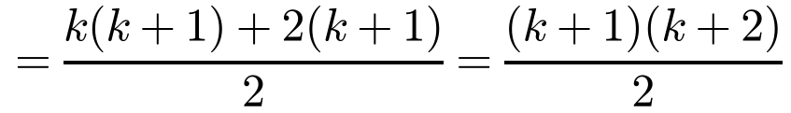
Proving Closed Forms
You can prove that a closed form satisfies a recurrence relation by mathematical induction
Basis step:
show the closed form is true for the first value of n (from the initial condition)
Assumption step:
assume it is true for n = k
Inductive step:
use the recurrence relation to show it is then true for n = k + 1
Conclusion:
true for n = k ⇒ true for n = k + 1, and true for the first value, so true for all n by induction
A sequence u_{n} satisfies the recurrence relation u_{n} = u_{n−1} + n, with u₀ = 0.
Basis step:
Assumption step:
u₀ = 0 is given, so start at n = 0
Inductive step:
This is the formula with n = k + 1
So true for n = k ⇒ true for n = k + 1, and true for n = 0.
Therefore, by induction, u_{n} = n(n + 1)/2 for all integers n ≥ 0.
4D

Slide 5
Proving Closed Forms
For a second-order recurrence relation:
Basis step:
show the closed form is true for two consecutive values of n
Assumption step:
assume it is true for n = k and n = k − 1
Inductive step:
show it is true for n = k + 1
Keep in mind what you are aiming to show
Always write a conclusion that says you have used induction
A sequence a_{n} satisfies the recurrence relation a_{n} = 2a_{n−1} + 8a_{n−2}, with a₀ = 4, a₁ = 10. Prove by induction that a_{n} = 3(4^{n}) + (−2)^{n} for all non-negative integers n.
Basis step:
n = 0: a₀ = 3 × 4⁰ + (−2)⁰ = 3 + 1 = 4
n = 1: a₁ = 3 × 4¹ + (−2)¹ = 12 − 2 = 10
So the closed form is true for n = 0 and n = 1
Assumption step:
a_{k} = 3(4^{k}) + (−2)^{k} and a_{k−1} = 3(4^{k−1}) + (−2)^{k−1}
Inductive step:
a_{k+1} = 2a_{k} + 8a_{k−1} = 2(3(4^{k}) + (−2)^{k}) + 8(3(4^{k−1}) + (−2)^{k−1})
= 6(4^{k}) + 2(−2)^{k} + 24(4^{k−1}) + 8(−2)^{k−1}
2(−2)^{k} = −(−2)^{k+1}; 8(−2)^{k−1} = 2(−2)^{k+1}
= 6(4^{k}) − (−2)^{k+1} + 6(4^{k}) + 2(−2)^{k+1}
= 12(4^{k}) + (−2)^{k+1} = 3(4^{k+1}) + (−2)^{k+1}
So true for n = k and n = k − 1 ⇒ true for n = k + 1, and true for n = 0 and n = 1.
Therefore, by induction, a_{n} = 3(4^{n}) + (−2)^{n} for all non-negative integers n.
4D

Slide 6
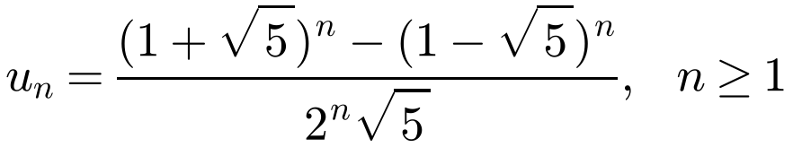
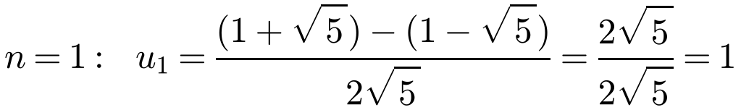
Proving Closed Forms
For a second-order recurrence relation:
Basis step:
show the closed form is true for two consecutive values of n
Assumption step:
assume it is true for n = k and n = k − 1
Inductive step:
show it is true for n = k + 1
Keep in mind what you are aiming to show
Always write a conclusion that says you have used induction
The Fibonacci sequence is defined recursively by u_{n} = u_{n−1} + u_{n−2}, n > 2, with u₁ = u₂ = 1. Show that the closed form for the nth term of the Fibonacci sequence is given by
Basis step:
So the closed form is true for n = 1 and n = 2
Assumption step: assume true for n = k − 1 and n = k:
Aim: show that u_{k+1} = [(1 + √5)^{k+1} − (1 − √5)^{k+1}] / (2^{k+1}√5)
4D

Slide 7
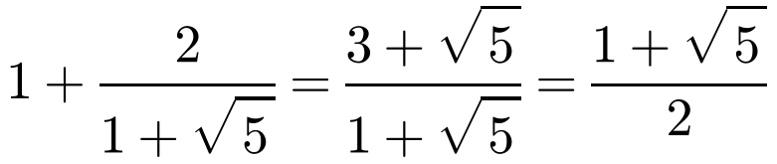
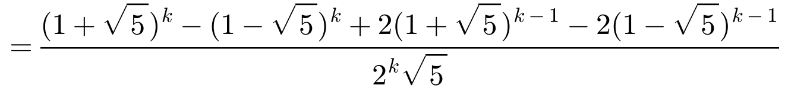
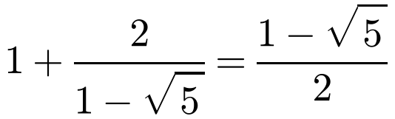
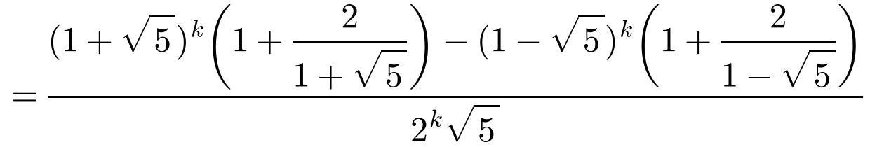
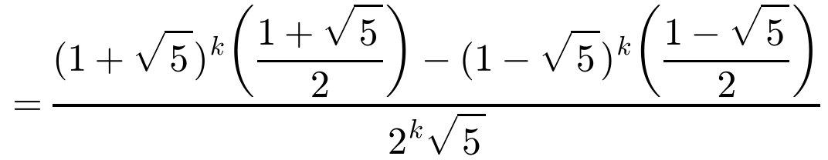
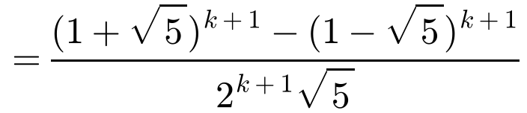
Proving Closed Forms
Look for factors of (1 + √5)^{k} and (1 − √5)^{k}
Useful result:
The Fibonacci sequence is defined recursively by u_{n} = u_{n−1} + u_{n−2}, n > 2, with u₁ = u₂ = 1. Show that the closed form for the nth term of the Fibonacci sequence is given by
Inductive step: u_{k+1} = u_{k} + u_{k−1}
So true for n = k − 1 and n = k ⇒ true for n = k + 1, and true for n = 1 and n = 2.
Therefore, by induction, the closed form is true for all n ∈ ℤ⁺.
4D

