Slide 1
Complex Numbers
Further Pure 2 Chapter 3
Westie's Workshop

Slide 2
Teachings for Exercise 3C

Slide 3
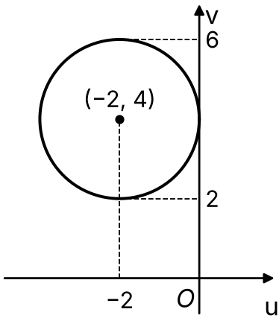
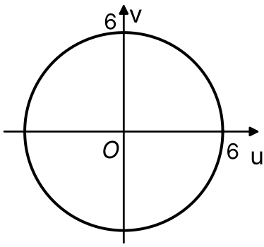
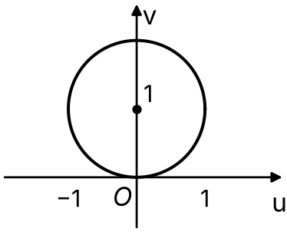
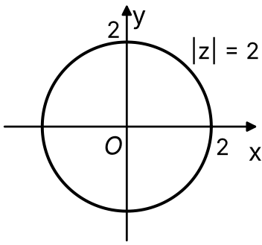
Transformations of the Complex Plane
A transformation maps z = x + iy in the z-plane to w = u + iv in the w-plane
Make z the subject, then substitute into the equation of the locus of z
w = z + a + ib: translation by vector (a, b)
w = kz (k real): enlargement, scale factor k, centre O
w = iz: rotation through π/2 anticlockwise about O
w = kz + a + ib: enlargement, scale factor k, then translation (a, b)
The point P represents z on an Argand diagram, where |z| = 2. T₁, T₂ and T₃ represent transformations from the z-plane, where z = x + iy, to the w-plane, where w = u + iv. Describe the locus of the image of P under the transformations:
a) T₁: w = z − 2 + 4i b) T₂: w = 3z c) T₃: w = ½z + i
a)
b)
c)
w + 2 − 4i = z
|w + 2 − 4i| = |z|
|w + 2 − 4i| = 2
|w| = |3z|
|w| = |3||z|
|w| = 3(2) = 6
w − i = ½z
|w − i| = ½|z|
|w − i| = ½(2) = 1
Circle, centre (−2, 4), radius 2
Circle, centre (0, 0), radius 6
Circle, centre (0, 1), radius 1
Translation by vector (−2, 4)
Enlargement, scale factor 3, centre O
Enlargement, scale factor ½, centre O, then translation (0, 1)
The locus of P in the z-plane: |z| = 2
3C

Slide 4
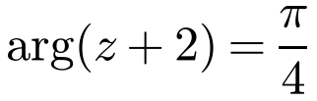
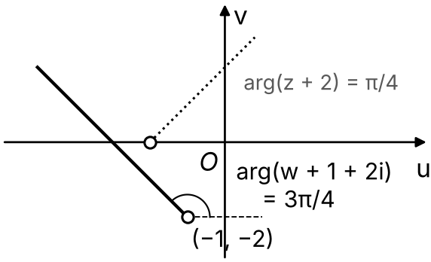
Transformations of the Complex Plane
To find the image of a half-line, make z the subject and use the arg rules
arg(z₁ z₂) = arg z₁ + arg z₂
arg(−i) = −π/2
w = iz − 1 is a rotation through π/2 anticlockwise about O, followed by a translation by (−1, 0)
So the half-line from −2 at angle π/4 becomes a half-line from −1 − 2i at angle 3π/4
For the transformation w = iz − 1, find the locus of w when z lies on the half-line
w = iz − 1 ⇒ iz = w + 1 ⇒ z = (w + 1)/i = −iw − i
Substitute −iw − i for z
arg(−iw − i + 2) = π/4
Take out a factor of −i: −i × 2i = 2
arg(−i(w + 1 + 2i)) = π/4
arg(−i) + arg(w + 1 + 2i) = π/4
−π/2 + arg(w + 1 + 2i) = π/4
arg(w + 1 + 2i) = 3π/4
A half-line from (−1, −2), not including (−1, −2), at an angle of 3π/4 to the positive u direction
3C

Slide 5
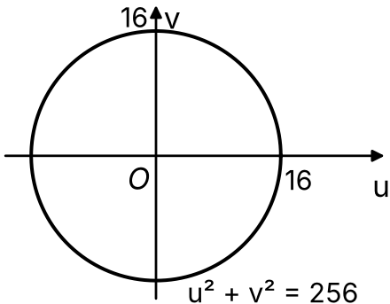
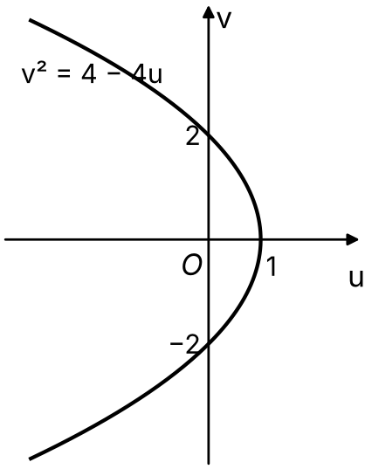
Transformations of the Complex Plane
A Cartesian equation in the w-plane uses u and v
|z₁ z₂| = |z₁||z₂|, so |z²| = |z|²
For a line such as x = 1, write z = 1 + iy and find u and v in terms of the parameter y
Then eliminate y
A transformation from the z-plane to the w-plane is given by w = z², where z = x + iy and w = u + iv. Describe the locus of w and give its Cartesian equation when z lies on:
a) a circle with equation x² + y² = 16 b) the line with equation x = 1
a) |z| = 4
|w| = |z²| = |z||z| = 4 × 4 = 16
Circle, centre (0, 0), radius 16:
u² + v² = 256
b) z = 1 + iy
w = (1 + iy)² = (1 − y²) + 2yi
u = 1 − y² and v = 2y
y = v/2, so u = 1 − v²/4
v² = 4 − 4u
A parabola, symmetrical about the real axis, vertex (1, 0)
3C

Slide 6
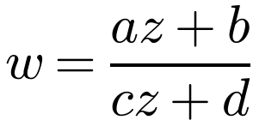
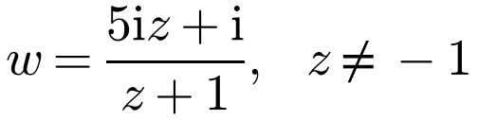
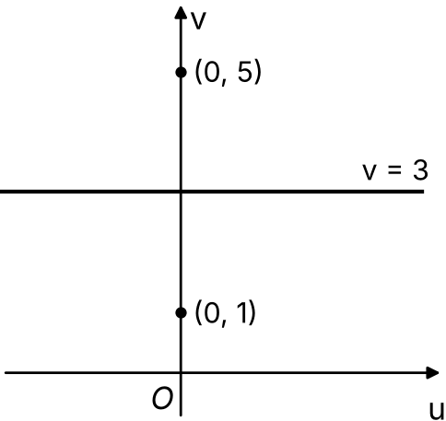
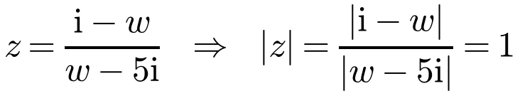
Transformations of the Complex Plane
Möbius transformations have the form
The transformation T from the z-plane, where z = x + iy, to the w-plane, where w = u + iv, is given by
a) Show that the image, under T, of the circle |z| = 1 in the z-plane is a line l in the w-plane.
b) Sketch l on an Argand diagram.
where a, b, c, d ∈ ℂ
They map circles and lines to circles or lines
Rearrange to make z the subject, then substitute into the equation of the z locus
|z₁/z₂| = |z₁|/|z₂|
|w − w₁| = |w − w₂| is the perpendicular bisector of w₁ and w₂
a) w(z + 1) = 5iz + i
wz − 5iz = i − w
z(w − 5i) = i − w
|w − 5i| = |i − w| = |−1||w − i| = |w − i|
Perpendicular bisector of (0, 1) and (0, 5):
the line l is v = 3
3C

Slide 7
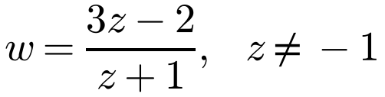
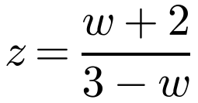
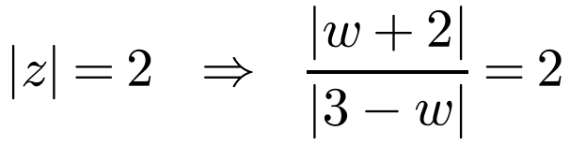
Transformations of the Complex Plane
For a circle in the z-plane such as x² + y² = 4, write it as |z| = 2
Rearrange the transformation to make z the subject
Take the modulus of both sides and use |z| = 2
If you get |w − a| = k|w − b| with k ≠ 1, the image is a circle (section 3.1)
The transformation T from the z-plane to the w-plane is given by
Show that the image, under T, of the circle with equation x² + y² = 4 in the z-plane is a circle C in the w-plane. State the centre and radius of C.
w(z + 1) = 3z − 2
wz + w = 3z − 2
w + 2 = 3z − wz = z(3 − w)
|w + 2| = 2|3 − w| = 2|−1||w − 3| = 2|w − 3|
This is of the form |w − a| = k|w − b| with k = 2, so its image is a circle. Now find its Cartesian equation...
3C

Slide 8
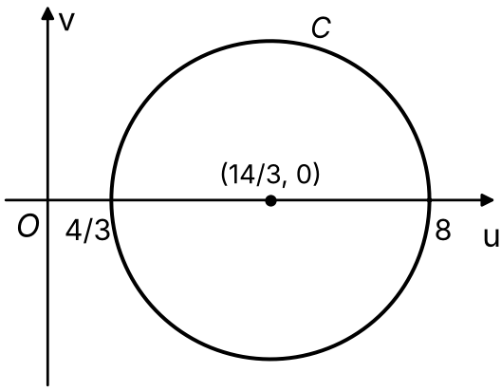
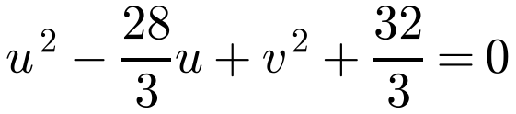
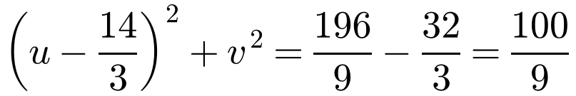
Transformations of the Complex Plane
|w − a| = k|w − b|, k ≠ 1, is a circle
Write w = u + iv, square both sides, then complete the square to find the centre and radius
The transformation T from the z-plane to the w-plane is given by
Show that the image, under T, of the circle with equation x² + y² = 4 in the z-plane is a circle C in the w-plane. State the centre and radius of C.
|w + 2| = 2|w − 3|
|(u + 2) + iv| = 2|(u − 3) + iv|
Square both sides
(u + 2)² + v² = 4[(u − 3)² + v²]
u² + 4u + 4 + v² = 4u² − 24u + 36 + 4v²
3u² − 28u + 3v² + 32 = 0
Complete the square
C has centre (14/3, 0) and radius 10/3
3C

Slide 9
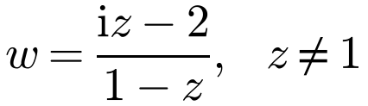
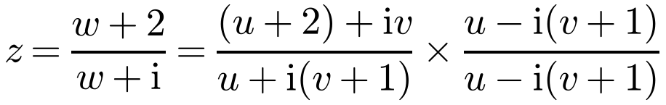
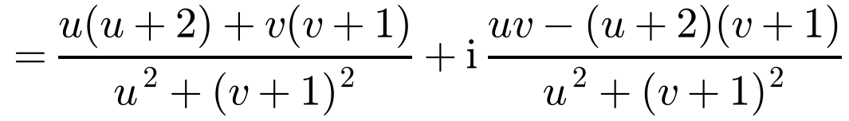
Transformations of the Complex Plane
z lies on the real axis means Im(z) = 0
Make z the subject, write w = u + iv, then multiply the numerator and denominator by the complex conjugate of the denominator
Then set the imaginary part equal to 0
A transformation T of the z-plane to the w-plane is given by
Show that as z lies on the real axis in the z-plane, then w lies on a line l in the w-plane. Sketch l on an Argand diagram.
w(1 − z) = iz − 2
w − wz = iz − 2
w + 2 = z(w + i)
Multiply out the numerator: the i terms are −i(u + 2)(v + 1) + iuv
3C

Slide 10
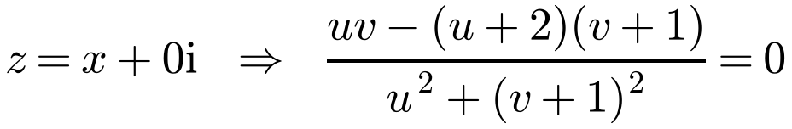
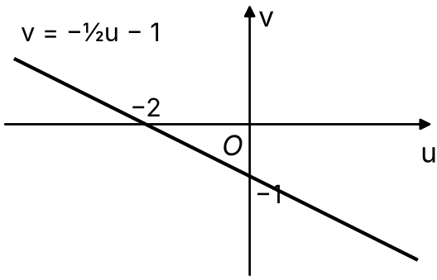
Transformations of the Complex Plane
Equate the imaginary parts
z = x + 0i, so the imaginary part of the expression for z must be 0
Plot v against u: the result is a straight line
A transformation T of the z-plane to the w-plane is given by
Show that as z lies on the real axis in the z-plane, then w lies on a line l in the w-plane. Sketch l on an Argand diagram.
uv − (u + 2)(v + 1) = 0
uv − uv − u − 2v − 2 = 0
2v = −u − 2
l: v = −½u − 1
The line cuts the axes at (−2, 0) and (0, −1). (Strictly, the point w = −i is never reached: it would need z to be infinite)
3C

