Slide 1
Complex Numbers
Further Pure 2 Chapter 3
Westie's Workshop

Slide 2
Teachings for Exercise 3B

Slide 3
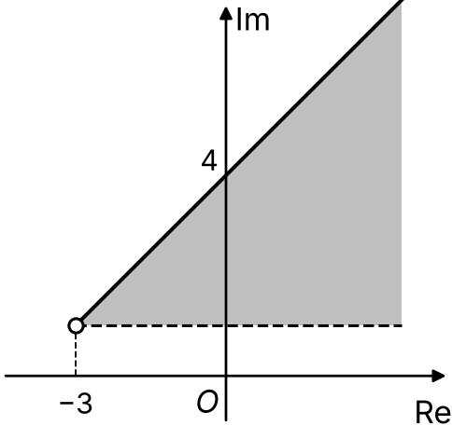
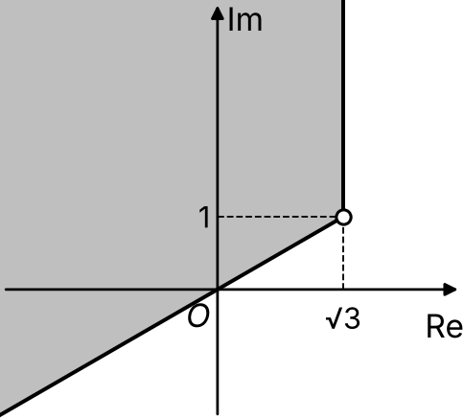
Regions in an Argand Diagram
θ₁ ≤ arg(z − z₁) ≤ θ₂ is the region between the half-lines arg(z − z₁) = θ₁ and arg(z − z₁) = θ₂
Think of rotating the first half-line anticlockwise about z₁ until it reaches the second
≤ : the half-line is included (solid line)
< : the half-line is not included (dashed line)
Arguments are usually given with −π < θ ≤ π, but you can use e.g. 7π/6 so that θ₂ > θ₁
|z − z₁| ≤ r is a circle and its interior
∩ means the intersection: points in both sets
Describe algebraically, in terms of z, the region shown in each Argand diagram.
a)
Both half-lines start at −3 + i
Initial: horizontal, dashed, so arg(z + 3 − i) = 0 is not included
Terminal: through (0, 4), gradient 1, so θ₂ = π/4 (solid)
0 < arg(z + 3 − i) ≤ π/4
b)
Both half-lines start at √3 + i
Vertical upwards: arg = π/2
Through O (direction −√3 − i): arg = −5π/6, or 7π/6
Rotate anticlockwise from π/2 to 7π/6
π/2 ≤ arg(z − √3 − i) ≤ 7π/6
3B

Slide 4
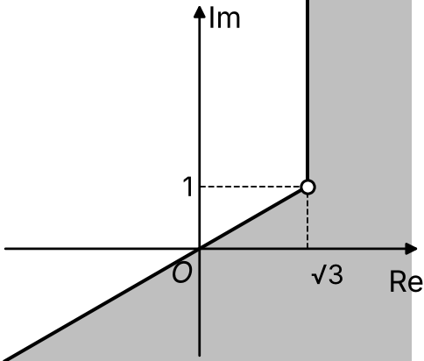
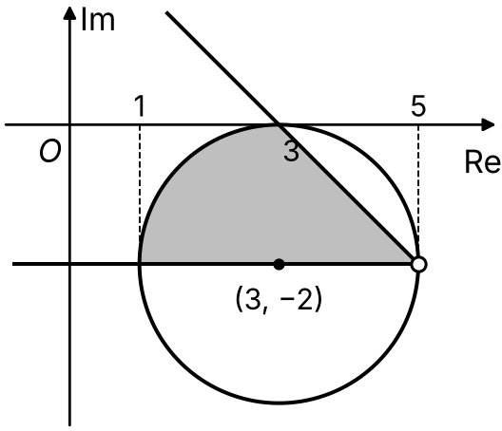
Regions in an Argand Diagram
θ₁ ≤ arg(z − z₁) ≤ θ₂ is the region between the half-lines arg(z − z₁) = θ₁ and arg(z − z₁) = θ₂
Think of rotating the first half-line anticlockwise about z₁ until it reaches the second
≤ : the half-line is included (solid line)
< : the half-line is not included (dashed line)
Arguments are usually given with −π < θ ≤ π, but you can use e.g. 7π/6 so that θ₂ > θ₁
|z − z₁| ≤ r is a circle and its interior
∩ means the intersection: points in both sets
Describe algebraically, in terms of z, the region shown in each Argand diagram.
c)
The same two half-lines as b)
This time rotate anticlockwise from −5π/6 to π/2
−5π/6 ≤ arg(z − √3 − i) ≤ π/2
d)
Circle centre 3 − 2i, radius 2, and its interior: |z − 3 + 2i| ≤ 2
Half-lines from 5 − 2i: through (3, 0), gradient −1, so arg = 3π/4; horizontally to the left, arg = π
{z ∈ ℂ : |z − 3 + 2i| ≤ 2} ∩ {z ∈ ℂ : 3π/4 ≤ arg(z − 5 + 2i) ≤ π}
3B

Slide 5
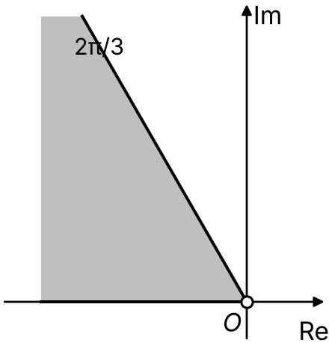
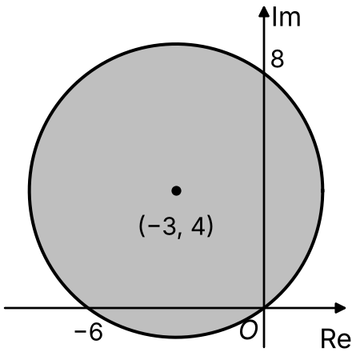
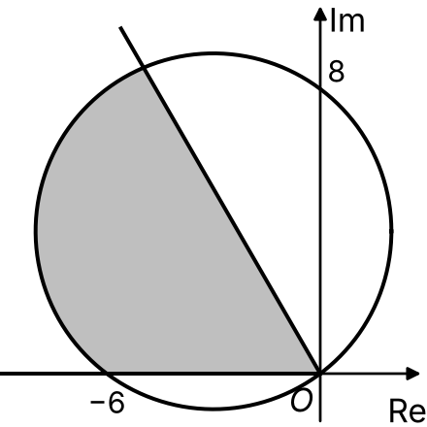
Regions in an Argand Diagram
To sketch an intersection (or union) of regions, sketch each region separately first
Then shade only the points that are in both regions
2π/3 ≤ arg z ≤ π is between the half-lines arg z = 2π/3 and arg z = π (the negative real axis)
|z + 3 − 4i| ≤ 5 is the circle centre −3 + 4i, radius 5, and its interior
This circle passes through O, −6 and 8i
On separate Argand diagrams, shade the region satisfied by each set of points:
b) {z ∈ ℂ : 2|z − 4| ≤ |z|} ∩ {z ∈ ℂ : 4 ≤ Re(z) ≤ 6}
2π/3 ≤ arg z ≤ π
|z + 3 − 4i| ≤ 5
Intersection: in both
All the boundaries are included (≤), so draw them as solid lines
3B

Slide 6
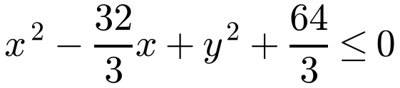
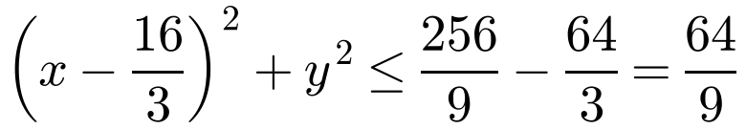
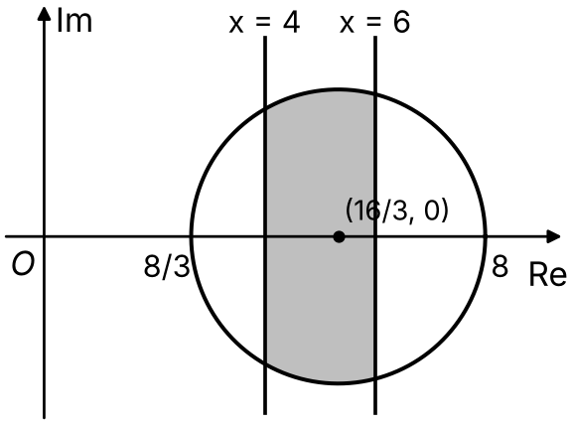
Regions in an Argand Diagram
2|z − 4| = |z| is a circle, so 2|z − 4| ≤ |z| is either the circle and its inside, or the circle and its outside
Use algebra to find the centre and radius, then keep the inequality sign to see which
Re(z) = 4 is the vertical line x = 4
4 ≤ Re(z) ≤ 6 is the strip between, and including, x = 4 and x = 6
b) {z ∈ ℂ : 2|z − 4| ≤ |z|} ∩ {z ∈ ℂ : 4 ≤ Re(z) ≤ 6}
2|x − 4 + iy| ≤ |x + iy|
2√((x − 4)² + y²) ≤ √(x² + y²)
Square both sides (both are positive)
4(x² − 8x + 16 + y²) ≤ x² + y²
3x² + 3y² − 32x + 64 ≤ 0
Complete the square
Circle centre (16/3, 0), radius 8/3, and its interior
4 ≤ Re(z) ≤ 6: between the lines x = 4 and x = 6
Shade the part of the strip inside the circle
3B

