Slide 1
Complex Numbers
Further Pure 2 Chapter 3
Westie's Workshop

Slide 2
Teachings for Exercise 3A

Slide 3
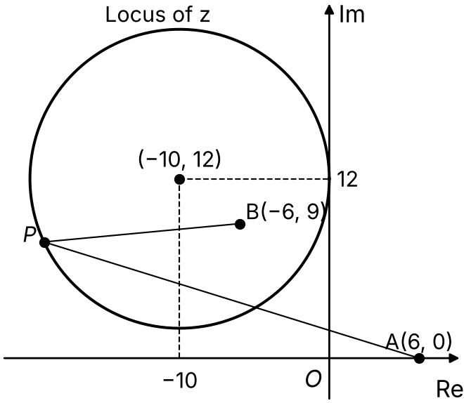
Loci in an Argand Diagram
|z − z₁| = r is a circle with centre z₁ and radius r
|z − z₁| = |z − z₂| is the perpendicular bisector of the line segment joining z₁ and z₂
|z − a| = k|z − b|, where k > 0 and k ≠ 1, is a circle
Write z = x + iy and find the Cartesian equation, then complete the square to find the centre and radius
Given that |z − 6| = 2|z + 6 − 9i|,
a) use algebra to show that the locus of z is a circle, stating its centre and its radius
b) sketch the locus of z on an Argand diagram.
a) |x + iy − 6| = 2|x + iy + 6 − 9i|
|(x − 6) + iy| = 2|(x + 6) + i(y − 9)|
Group real and imaginary parts, then square: |a + ib|² = a² + b²
(x − 6)² + y² = 4[(x + 6)² + (y − 9)²]
x² − 12x + 36 + y² = 4x² + 48x + 144 + 4y² − 72y + 324
3x² + 60x + 3y² − 72y + 432 = 0
x² + 20x + y² − 24y + 144 = 0
Complete the square for x and for y
(x + 10)² − 100 + (y − 12)² − 144 + 144 = 0
(x + 10)² + (y − 12)² = 100
So the locus of z is a circle with centre (−10, 12) and radius 10
b) See the sketch: the circle touches the Im axis at 12i and passes through −10 + 2i
A(6, 0) and B(−6, 9): every point P on the circle has AP = 2BP. One of A and B is always inside the circle, the other outside
3A

Slide 4
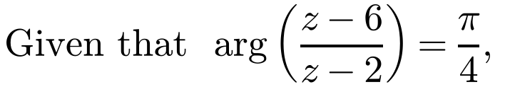
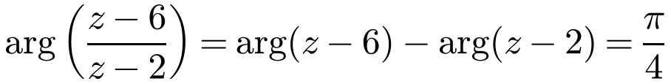
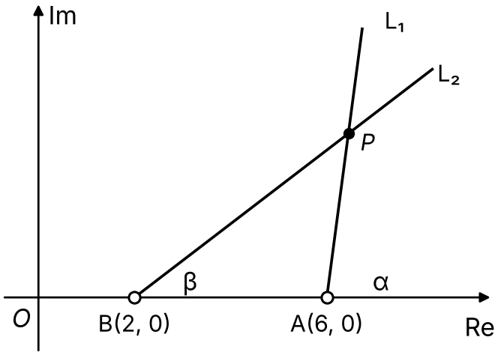
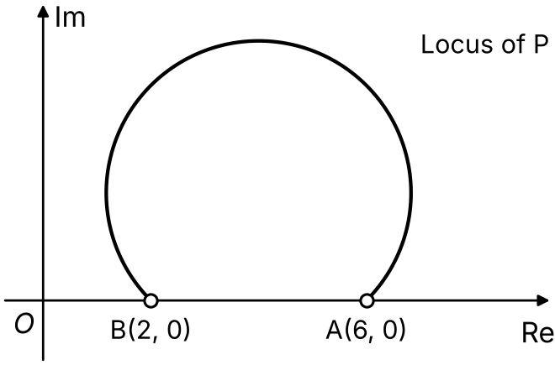
Loci in an Argand Diagram
arg(z − z₁) = θ is a half-line from z₁ (not included) at angle θ to the positive real direction
arg((z − a)/(z − b)) = θ, θ > 0, is an arc of a circle from A(a) to B(b), drawn anticlockwise
θ < π/2: major arc
θ = π/2: semicircle
θ > π/2: minor arc
The endpoints A and B are not included (open circles)
This uses “angles in the same segment are equal”
a) sketch the locus of P(x, y) which is represented by z on an Argand diagram
b) find the Cartesian equation of this locus.
Let arg(z − 6) = α and arg(z − 2) = β, so α − β = π/4
P lies on both half-lines.
Exterior angle of triangle ABP:
∠BPA + β = α
so ∠BPA = α − β = π/4
∠BPA is always π/4, so P moves on an arc of a circle through A and B
π/4 < π/2, so P lies on the major arc, anticlockwise from A(6, 0) to B(2, 0), not including A and B
3A

Slide 5
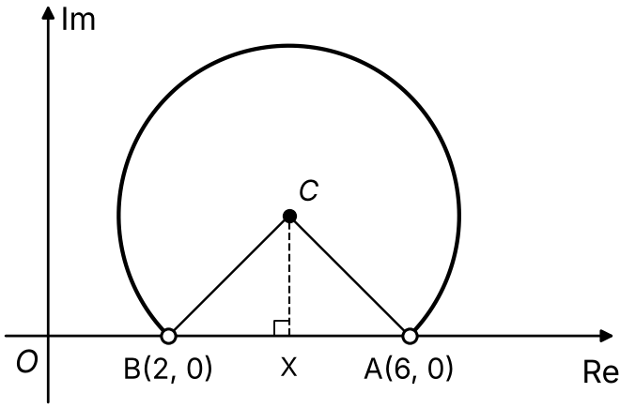
Loci in an Argand Diagram
Method 1: geometric
The angle at the centre is twice the angle at the circumference
Use the isosceles triangle ACB to find the centre C and radius r
The locus is only an arc, so give a condition on x or y
∠BPA = π/4 ⇒ ∠ACB = 2 × π/4 = π/2
CA = CB (radii), so triangle ACB is isosceles: ∠CAB = ∠CBA = π/4
X(4, 0) is the midpoint of AB, ∠CXA = π/2 and ∠XCA = π/4
So triangle CXA is isosceles: CX = AX = 2
C is (4, 2) and r = AC = √(2² + 2²) = 2√2
(x − 4)² + (y − 2)² = 8, y > 0
The arc is above the real axis
3A

Slide 6
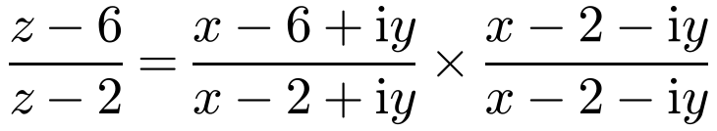
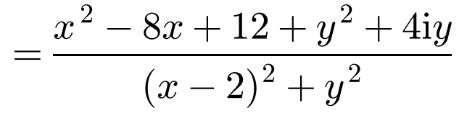
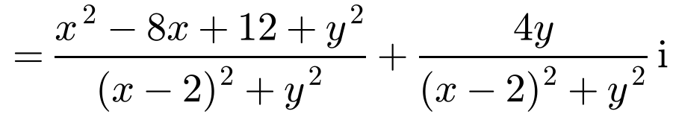
Loci in an Argand Diagram
Method 2: algebraic
Write z = x + iy and multiply the numerator and denominator by (z − 2)* to find the real and imaginary parts
If arg w = θ then Im(w)/Re(w) = tan θ
Here θ = π/4, so the real and imaginary parts are equal (and both positive)
You still need to think geometrically about which arc you have
arg = π/4, so Re = Im (with both positive):
x² − 8x + 12 + y² = 4y
x² − 8x + y² − 4y + 12 = 0
(x − 4)² − 16 + (y − 2)² − 4 + 12 = 0
(x − 4)² + (y − 2)² = 8, y > 0
Im > 0 means 4y > 0, so y > 0: the major arc above the real axis
3A

Slide 7
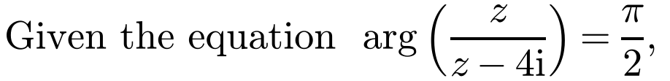
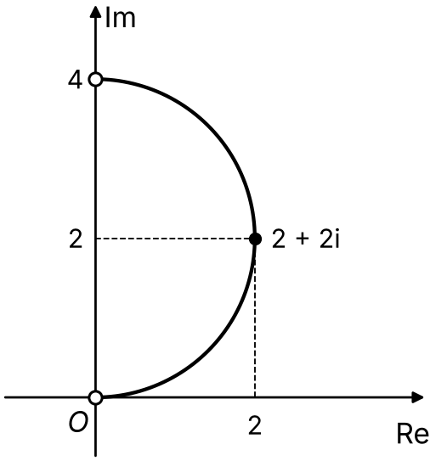
Loci in an Argand Diagram
When θ = π/2 the locus is a semicircle
The angle in a semicircle is a right angle, so AB is a diameter
Go anticlockwise from A to B to decide which half of the circle
The endpoints are not included, so use a strict inequality at that end of the range
a) sketch the locus of points z that satisfy the equation on an Argand diagram
b) hence write down the range of possible values of Re(z).
a) arg z − arg(z − 4i) = π/2
The angle at P is π/2, so P lies on a semicircle with diameter from 0 to 4i
Anticlockwise from A(0, 0) to B(0, 4): the right-hand half
Centre 2i, radius 2; (0, 0) and (0, 4) not included
Check: z = 2 + 2i gives z/(z − 4i) = (2 + 2i)/(2 − 2i) = i, and arg i = π/2 (correct)
b) The furthest right point is 2 + 2i, so the largest value of Re(z) is 2
0 < Re(z) ≤ 2
Strict: z = 0 is not on the locus
3A

