Slide 1
Groups
Further Pure 2 Chapter 2
Westie's Workshop

Slide 2
Teachings for Exercise 2B

Slide 3
Cayley Tables and Finite Groups
A finite group contains only a finite number of elements
A Cayley table fully describes the structure of a finite group by showing all possible products of elements of the group
All the elements are written as row and column headings, in the same order
Watch out
The row heading is always the first element in the operation and the column heading is the second
The entry in row c, column b is c ∗ b
The set {1, −1, i, −i}, where i² = −1, forms a group under multiplication.
a) Draw a Cayley table for this group.
b) Write down: i) the identity element ii) the inverse of i iii) the inverse of −1
×
1
−1
i
−i
1
1
−1
i
−i
−1
−1
1
−i
i
−1 × (−i) = i
i
i
−i
−1
1
All entries are in {1, −1, i, −i}, so the set is closed
−i
−i
i
1
−1
Row for 1 matches the column headings
b) i) 1 is the identity
Find the identity in the row for i
ii) −i
iii) −1
2B

Slide 4
Cayley Tables and Finite Groups
In a Cayley table for a group:
• all entries must be members of the group
• every entry appears exactly once in every row and every column (latin square property)
• the identity element must appear in every row and column (every element has an inverse)
• the identity elements are symmetric across the leading diagonal (a⁻¹ ∗ a = a ∗ a⁻¹)
×ₙ : the remainder when ab is divided by n
+ₙ : the remainder when a + b is divided by n
e.g. 4 × 3 ≡₁₀ 2 and 6 + 5 ≡₇ 4
The set S = {0, 1, 2, 3, 4}. Use the Cayley tables below to determine whether S forms a group under:
a) addition modulo 5 b) multiplication modulo 5
+₅
0
1
2
3
4
×₅
0
1
2
3
4
0
0
1
2
3
4
0
0
0
0
0
0
1
1
2
3
4
0
1
0
1
2
3
4
2
2
3
4
0
1
2
0
2
4
1
3
3
3
4
0
1
2
3
0
3
1
4
2
4
4
0
1
2
3
4
0
4
3
2
1
a) Closure: all entries are members of S, so S is closed under +₅
Identity: the identity element is 0
Inverses: 0 appears in every row and every column, so every element has an inverse (e.g. the inverse of 2 is 3)
Associativity: addition on the integers is associative, so +₅ is associative
Hence (S, +₅) is a group.
b) The identity element is 1.
Note: the set {1, 2, 3, 4} does form a group under multiplication modulo 5
1 does not appear in the 0 row, or the 0 column.
(S, ×₅) is not a group since 0 does not have an inverse.
2B

Slide 5
Cayley Tables and Finite Groups
To show a finite set is a group, construct a Cayley table and use it to check the axioms
For a small set you can write down all the inverses
Problem-solving
Under multiplication modulo n, an element (other than 1) that shares a factor with n cannot have an inverse
Work out a × 3 (mod 12) for every a ∈ S to show that no inverse exists
S = {1, 3, 7, 9}. Determine whether each of the following are groups. You may assume that the associative law holds in each case.
a) (S, ×₁₀) b) (S, ×₁₂)
a)
×₁₀
1
3
7
9
Closure: from the table, S is closed under ×₁₀
1
1
3
7
9
3
3
9
1
7
Identity: 1, since 1 × a = a × 1 = a for all a ∈ S
7
7
1
9
3
Inverses: 1 and 9 are self-inverse; 3 and 7 are inverses of each other
9
9
7
3
1
Associativity: assumed
Hence (S, ×₁₀) is a group.
b)
1 × 3 ≡₁₂ 3
3 × 3 ≡₁₂ 9
No product is 1, so 3 has no inverse
7 × 3 ≡₁₂ 9
9 × 3 ≡₁₂ 3
So 3 has no inverse, so S is not a group under ×₁₂.
2B

Slide 6
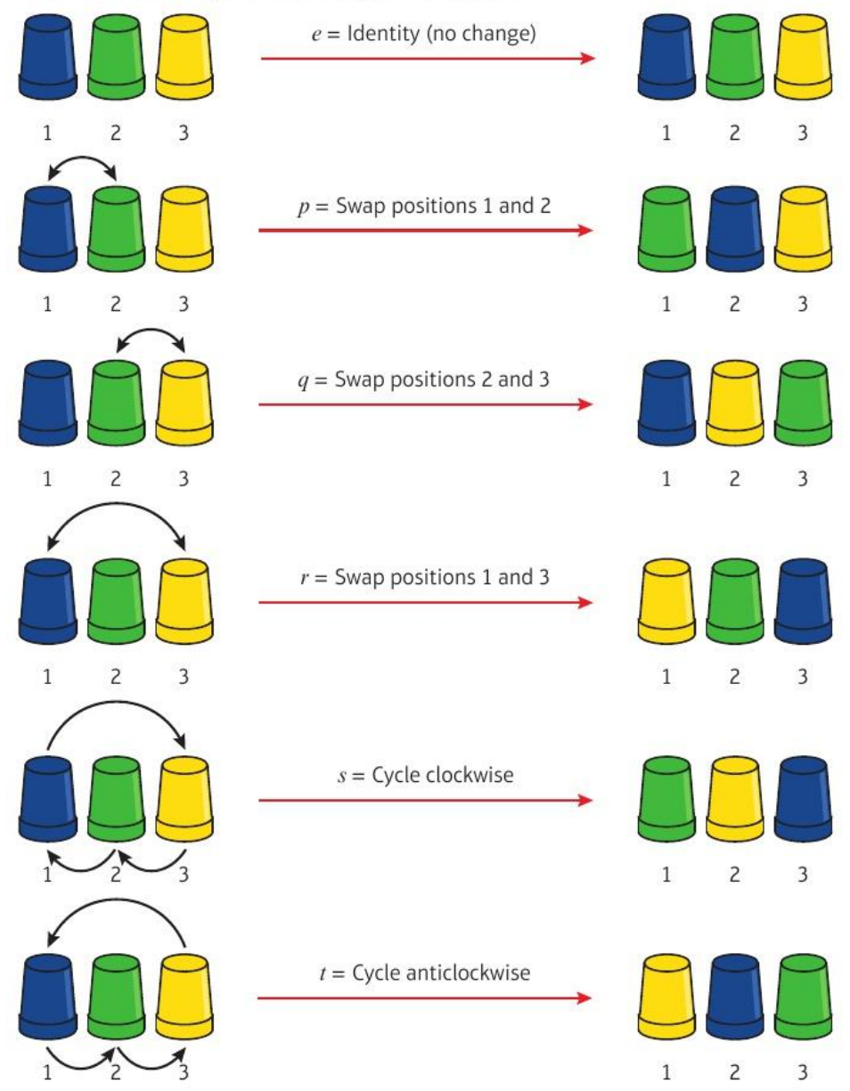
Cayley Tables and Finite Groups
A permutation is a way of rearranging objects
The 3 cups can be arranged in 6 ways. The cups move but the positions 1, 2, 3 stay the same
Composition
p ∘ q means do q first, then p (like functions)
e.g. p ∘ q = t
The symmetric group Sₙ
all possible permutations of n objects, together with composition
For the set of permutations of 3 cups, {e, p, q, r, s, t}, find: a) q ∘ p b) r ∘ r
a) BGY → GBY → GYB
apply p, then apply q
So q ∘ p = s
Note: q ∘ p ≠ p ∘ q (p ∘ q = t)
b) BGY → YGB → BGY
apply r, then apply r again
So r ∘ r = e
r ∘ r is the identity permutation, so r is self-inverse
B, G, Y = the colours of the cups in positions 1, 2, 3 at the start
2B

Slide 7
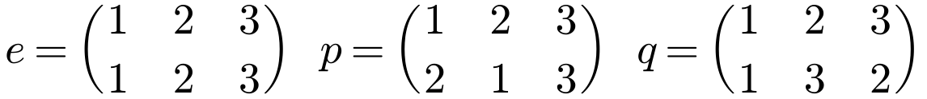
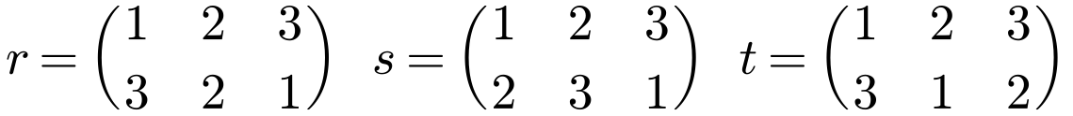
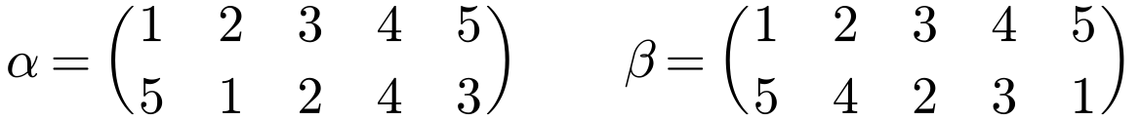
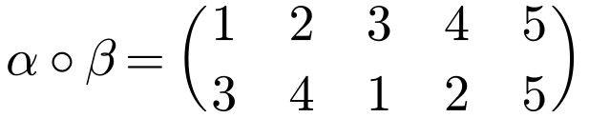
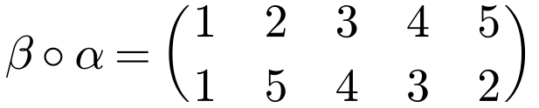
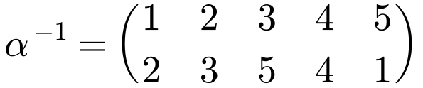
Cayley Tables and Finite Groups
Two-row notation
The top row lists the positions; the bottom row shows where each one goes
Composition α ∘ β
Do β first, then α: follow each number down through β, then through α
Inverse
Read from the bottom row to the top row: if 1 appears below 2 in α, then 2 appears below 1 in α⁻¹
The identity is the permutation that leaves every position the same
The permutations of 3 cups in two-row notation:
Two permutations on 5 objects:
1 → 5 under β, then 5 → 3 under α
In α, 1 is below 2, so in α⁻¹, 2 is below 1
2B

Slide 8
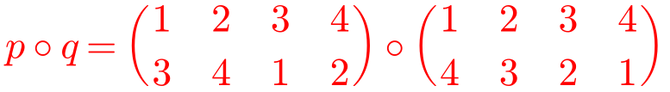
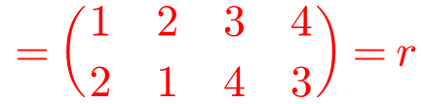
Cayley Tables and Finite Groups
Use the Cayley table to show that the four group axioms hold
Work out each composition in two-row notation (right-hand permutation first)
Notation
This group is called the Klein four-group, K₄
Show that the permutations
form a group under composition. You may assume the associativity axiom is satisfied.
∘
e
p
q
r
e
e
p
q
r
p
p
e
r
q
q
q
r
e
p
r
r
q
p
e
Closure: all entries are members of the set, so it is closed.
Identity: e is the identity element.
Inverses: e is in every row and column, so every element has an inverse (e∘e = p∘p = q∘q = r∘r = e).
Associativity: assumed.
Hence the set is a group under composition.
2B

Slide 9
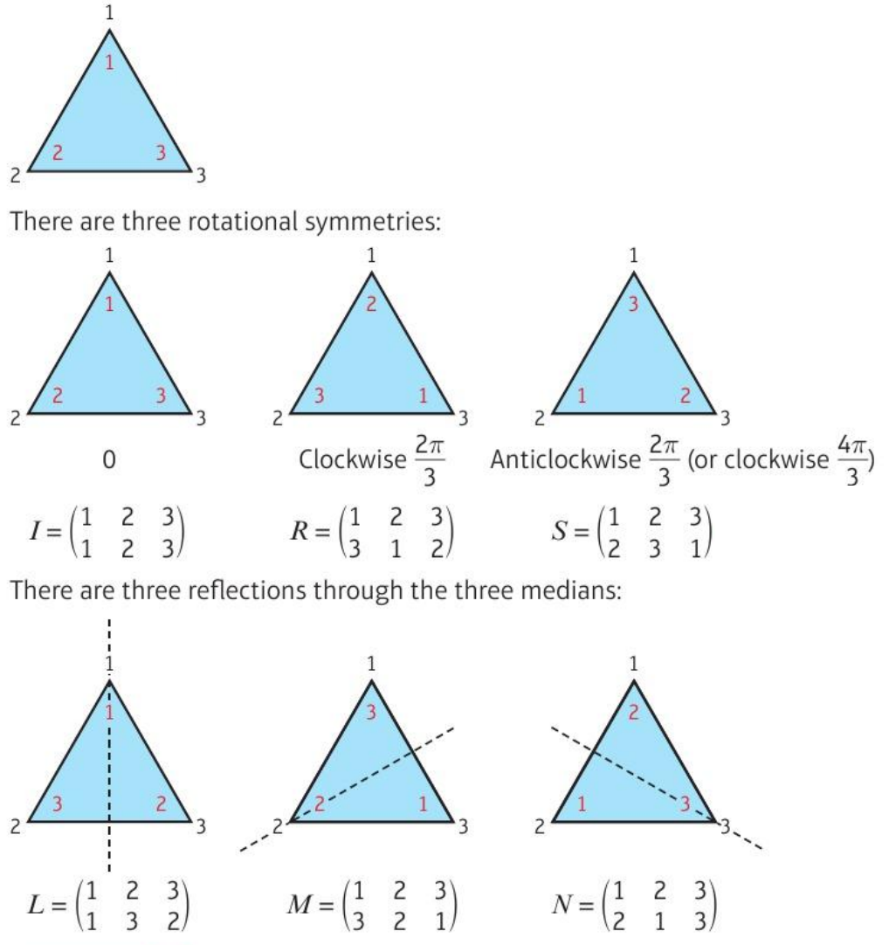
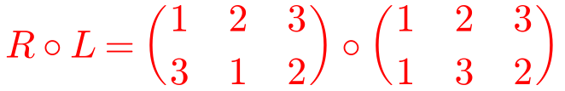
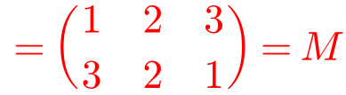
Cayley Tables and Finite Groups
Groups of symmetries: label the positions (outside) and the vertices (inside). The positions stay fixed; the vertices move
Show that G = {I, R, S, L, M, N} forms a group under composition of transformations. You may assume that the associative law holds.
∘
I
R
S
L
M
N
I
I
R
S
L
M
N
R
R
S
I
M
N
L
S
S
I
R
N
L
M
L
L
N
M
I
S
R
Do L first, then R
M
M
L
N
R
I
S
N
N
M
L
S
R
I
Closure: all entries are in G, so G is closed.
Identity: I is the identity element.
Inverses: I appears in every row and column, so every element has an inverse.
Associativity: assumed for composition of transformations.
So the symmetries of the equilateral triangle form a group under composition.
The symmetry group of a regular n-sided polygon is a dihedral group, D₂ₙ (it has 2n elements)
S is sometimes called R², because S = R ∘ R
2B

Slide 10
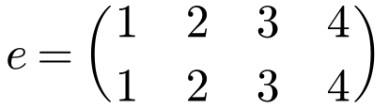
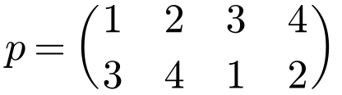
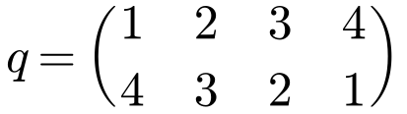
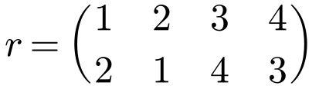
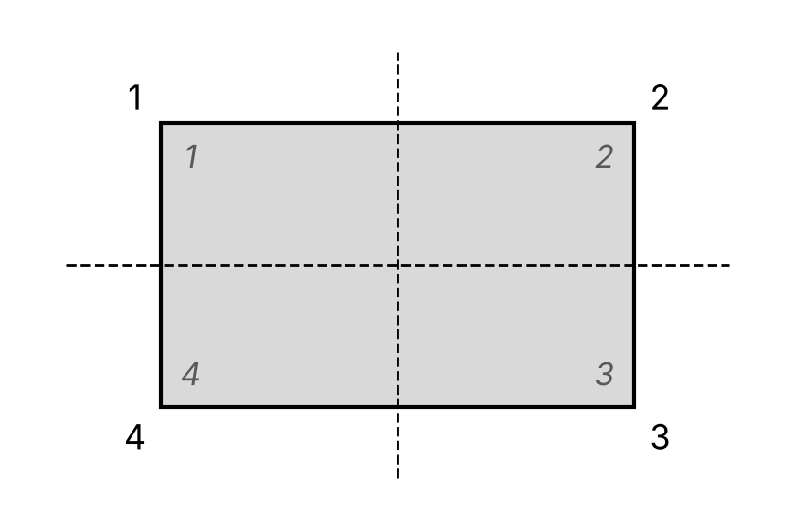
Cayley Tables and Finite Groups
Problem-solving
Label the positions of the vertices, and the vertices themselves, with integers
Use two-row notation to define the image of each transformation
Then compare with groups you already know
Show that the symmetries of a rectangle form a group under composition of transformations. You may assume that the associativity axiom holds.
Identity transformation:
Rotation π about the centre:
Reflection in the horizontal axis of symmetry:
Reflection in the vertical axis of symmetry:
These are the same permutations as in Example 13 (previous slide), so they form a group under composition.
This group is also the Klein four-group. It is not a dihedral group, because a rectangle is not a regular polygon.
2B

Slide 11
Cayley Tables and Finite Groups
A cyclic group is a group in which every element can be written in the form aᵏ, where a is the generator and k is a positive integer
aᵏ means applying the group operation k times, e.g. a³ = a ∘ a ∘ a
(ℤ, +) is cyclic: repeatedly adding 1 generates every element
{0, 1, 2, ..., n − 1} is cyclic under +ₙ, with generators 1 and n − 1. This group is sometimes written ℤₙ
The set S = {0, 1, 2, 3, 4, 5, 6, 7} is a group under addition modulo 8. Show that 3 is a generator of this group and write each element in terms of this generator.
3 ≡₈ 3
3² means 3 + 3, not 3 × 3
3² ≡₈ 6
3³ ≡₈ 1
3⁴ ≡₈ 4
3⁵ ≡₈ 7
3⁶ ≡₈ 2
3⁷ ≡₈ 5
3⁸ ≡₈ 0
All the elements of S can be written in the form 3ᵏ for some positive integer k, so 3 generates the group.
This group also has generators 1, 7 and 5.
2B

Slide 12
Cayley Tables and Finite Groups
To show a group is not cyclic, show that no element generates every element
Check each element in turn. If the powers start repeating before every element has appeared, that element is not a generator
Links
This is another example of the Klein four-group. It is the smallest non-cyclic group
The set {1, 3, 5, 7} forms a group under multiplication modulo 8.
Show that this group is not cyclic.
1 is the identity
1 can only generate 1.
3² ≡₈ 1, 3³ ≡₈ 3, ... so 3 can only generate 1 and 3.
5² ≡₈ 1, 5³ ≡₈ 5, ... so 5 can only generate 1 and 5.
7² ≡₈ 1, 7³ ≡₈ 7, ... so 7 can only generate 1 and 7.
There is no element that can generate every element of the group, so the group is not cyclic.
2B

