Slide 1
Number Theory
Further Pure 2 Chapter 1
Westie's Workshop

Slide 2
Teachings for Exercise 1G

Slide 3

Combinatorics
The product rule of counting
If you can choose one item in m different ways, and a second item in n different ways, then the total number of ways of choosing both items is m × n
If you need to choose k items, and the kth item can be chosen in n_{k} different ways, then the total number of ways of choosing all k items is n₁ × n₂ × … × n_{k}
e.g. 7 t-shirts and 3 pairs of jeans: 7 × 3 = 21 outfits
A number plate consists of two letters, followed by two digits, followed by three more letters. The letters can be chosen from the entire alphabet except the letters I, O, Q or Z, and the digits can be chosen from 0 up to 9.
a) Find the total number of different number plates that can be generated in this way.
All number plates registered in one particular region must start with the letter combinations CW or CX.
b) Find the total number of different number plates that can be generated in this way.
a) 26 − 4 = 22 letters can be used
You could not list all the plates: use the product rule of counting
22 × 22 × 10 × 10 × 22 × 22 × 22
= 515 363 200
b) 2 × 10 × 10 × 22 × 22 × 22
The first two letters can be chosen in one of two ways
= 2 129 600
1G

Slide 4
Combinatorics
Think about how many choices there are for each position in turn
The first digit of a number cannot be 0
An even number ends in 0, 2, 4, 6 or 8
Find the total number of 3-digit even numbers.
The first digit can be chosen in 9 different ways
The first digit cannot be 0, but the second digit can
The second digit can be chosen in 10 different ways
The third digit can be chosen in 5 different ways
0, 2, 4, 6 or 8
Total number of possibilities = 9 × 10 × 5 = 450
1G

Slide 5
Combinatorics
You can find the number of combinations in more complicated situations by adding or subtracting possibilities
Consider each possible position of the 5 separately
If a 3-digit number is _5_, the first digit cannot be 0 or 5, so there are 8 × 1 × 9 possibilities
There are 999 positive integers less than 1000: count those that do not contain 5 and subtract
Find the total number of positive integers less than 1000 that contain the digit 5
a) exactly once b) at least once
a) 1-digit: 1 possibility
b) Not containing the digit 5:
2-digit: 1 × 9 + 8 × 1 = 17
1-digit: 8
3-digit: 1 × 9 × 9 + 8 × 1 × 9
2-digit: 8 × 9 = 72
+ 8 × 9 × 1 = 225
3-digit: 8 × 9 × 9 = 648
In total, 1 + 17 + 225 = 243
In total, 8 + 72 + 648 = 728
So 999 − 728 = 271 contain
the digit 5 at least once
Or, allowing 0 in the first or second digit:
a) 1 × 9 × 9 + 9 × 1 × 9 + 9 × 9 × 1 = 243
b) 9 × 9 × 9 − 1 = 728 do not contain a 5 (removing 000)
1G

Slide 6
Combinatorics
If a set S contains n elements, then the total number of possible subsets of S is 2^{n}
A subset of S is a set whose elements are all contained in S, e.g. {2, 4, 6} and {3}
S itself and the empty set, {}, are also subsets of S
A set S = {1, 2, 3, 4, 5, 6}. Find the total number of possible subsets of S.
S contains 6 elements
Each element can be either selected for the subset or not selected
So the total number of possible subsets is given by:
2 × 2 × 2 × 2 × 2 × 2 = 2⁶ = 64
1G

Slide 7
Combinatorics
Each subset represents a different possible group
Watch out: subtract 1 if the empty set (nobody selected) is not allowed
A group of 10 students are being selected to clean up a local park. Given that at least one student must be selected, how many different groups of students could be selected to clean up the park?
There are 10 students
So there are 2¹⁰ = 1024 possible subsets of the group of students
Each subset is a possible group
At least one student must be selected, so the total number of possible groups is
2¹⁰ − 1 = 1023
1G

Slide 8
Combinatorics
There are n! different ways of placing n items in order
This is the number of permutations of n items
e.g. 5 different books on a shelf: 5 × 4 × 3 × 2 × 1 = 5! = 120 ways
To keep some items together, treat them as a single block, then multiply by the number of ways of arranging the block
Consider the letters ABCDEF.
a) Find the number of different strings of length 6 that can be written using these letters exactly once each.
b) Find the number of these strings that contain:
i) the substring DEF ii) the letters DEF together in any order.
a) 6! = 720
b) i) Consider 4 items: A, B, C and DEF
DEF must appear in this order: treat it as one block
Permutations of these four items:
4! = 24
There are 24 strings containing DEF
ii) 4! = 24 permutations contain
the string DEF in order
DEF can be arranged in 3! = 6 ways
Use the product rule
So there are 4! × 3! = 144 strings
1G

Slide 9
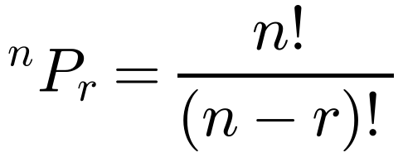
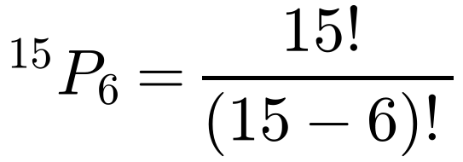
Combinatorics
The number of possible permutations of r items taken from a set of n items, where n ≥ r, is
15 runners compete in a cross-country race.
Find the number of different ways the top 6 positions can be filled.
The runners are all different and the order matters
A permutation of 6 items taken from a set of 15 items
^{n}P_{r}, or ‘n permute r’, is sometimes written _{n}P_{r} or P(n, r)
e.g. shelving 3 of 5 books: 5 × 4 × 3 = 5! ÷ 2! = 60 ways
= 15 × 14 × 13 × 12 × 11 × 10
= 3 603 600
1G

Slide 10
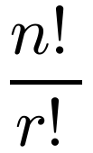
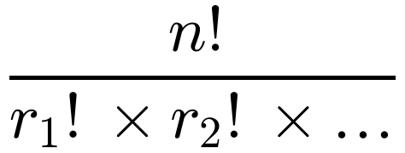
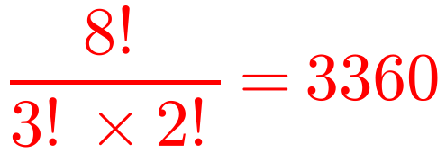
Combinatorics
The number of permutations of n items, of which r are identical, is
Find the number of possible different permutations of the letters in the word WINNINGS.
This is a set of 8 items in which:
n = 8, r₁ = 2, r₂ = 3. There are no other repeated letters
2 are identical (I)
If r₁ are identical, r₂ are identical, and so on, it is
3 are identical (N)
So the total number of permutations is
e.g. CARRIER has three Rs, so it has 7! ÷ 3! = 840 different permutations
1G

Slide 11
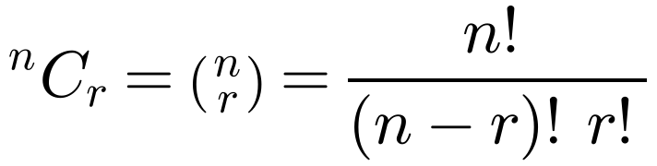
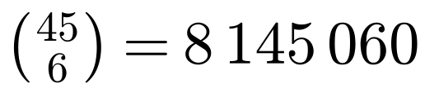
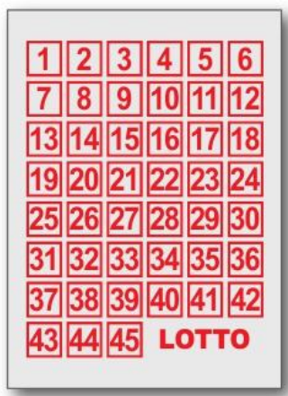
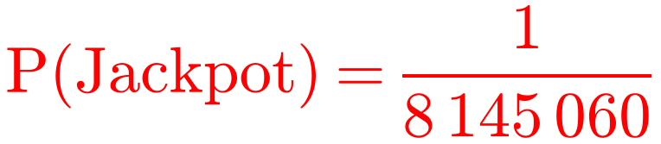
Combinatorics
The number of possible combinations of r items (in any order) taken from a set of n items, where n ≥ r, is
In a lottery game you choose 6 numbers from a choice of 45 by shading in a grid.
6 numbers are selected at random and if you match all six you win a jackpot prize.
Find the probability of winning a jackpot prize.
This is the number of ways of choosing r items in order divided by the number of possible orderings of those r items
^{n}C_{r}, or ‘n choose r’, is sometimes written _{n}C_{r} or C(n, r)
Order is not important, and you need the exact combination to win
1G

Slide 12
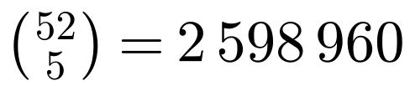
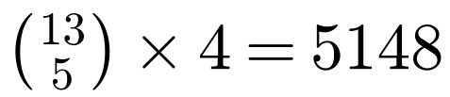
Combinatorics
A hand of cards is a combination: the order of the cards does not matter
Count in stages and use the product rule of counting
In poker, a deck of 52 different cards is used. There are 13 cards in each of four suits. A hand is made up of five cards, arranged in any order.
a) Work out the total number of different hands that are possible.
A flush is a hand containing five cards of the same suit.
b) Work out the number of hands containing five cards of the same suit.
Four-of-a-kind is a hand containing four cards of the same value, such as four 7s, or four queens.
c) Work out the number of four-of-a-kind hands.
a)
The player can arrange their cards in any order, so work out ⁵²C₅
b)
¹³C₅ ways to get a flush in each suit, and four suits
13 values for the four-of-a-kind; the fifth card can be any of the other 52 − 4 = 48
c) 13 × 48 = 624
1G

Slide 13
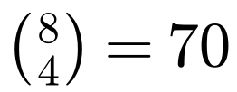

Combinatorics
Decide whether order matters
A subset: order is not important, so use ^{n}C_{r}
A number: the order of the digits matters, so use ^{n}P_{r}
The set S = {1, 2, 3, 4, 5, 6, 7, 8}. Find:
a) the number of subsets of S containing exactly 4 elements
b) the number of different 4-digit numbers that can be made using the elements of S. (Each element can be used only once.)
a)
Order is not important in a subset, so use ⁸C₄
Each element is distinct and you need to choose 4 of them in order
b)
1G

