Slide 1
Dynamics
Further Mechanics 2 Chapter 5
Westie's Workshop

Slide 2
Teachings for Exercise 5E

Slide 3
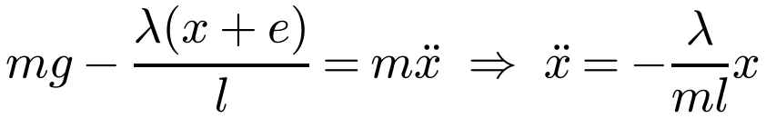
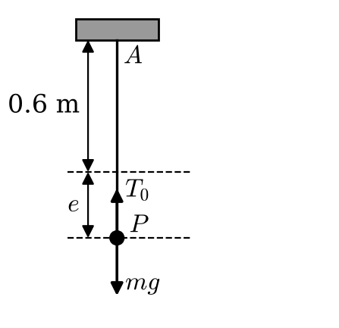
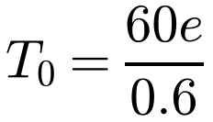
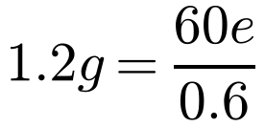
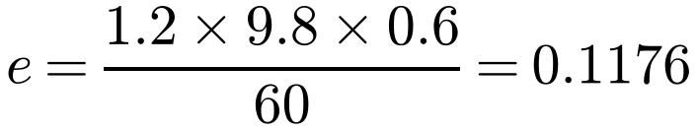
Vertical Oscillation
A particle hanging on a spring or string, pulled down and released, oscillates about its equilibrium position
In equilibrium the extension e satisfies mg = λe/l
Taking down as positive, x below the equilibrium position:
A particle P of mass 1.2 kg is attached to one end of a light elastic spring of modulus of elasticity 60 N and natural length 60 cm. The other end of the spring is attached to a fixed point A on a ceiling. The particle hangs in equilibrium at the point B.
a) Find the extension of the spring.
The particle is now raised vertically a distance 15 cm and released from rest.
b) Prove that P will move with simple harmonic motion.
c) Find the period and amplitude of the motion.
d) Find the speed of P as it passes through B.
e) Find the speed of P at the instant when the spring has returned to its natural length.
Spring: complete S.H.M. about the equilibrium position
String: S.H.M. while taut; if the amplitude is greater than e the particle moves freely under gravity while the string is slack
a)
Hooke’s law; 60 cm = 0.6 m
In equilibrium T₀ = weight
The extension is 0.118 m (11.8 cm) (3 s.f.)
5E

Slide 4
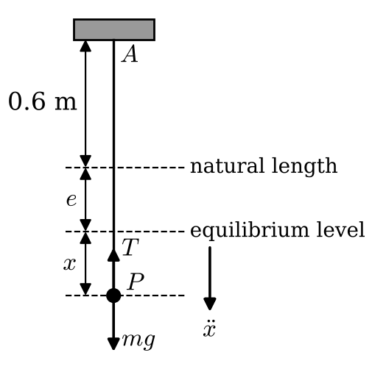
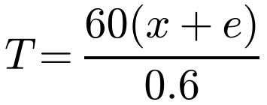

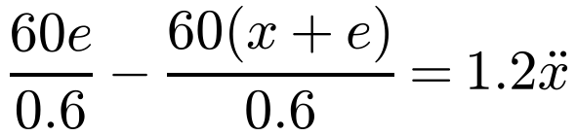
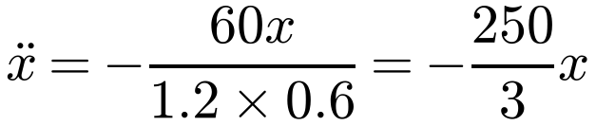
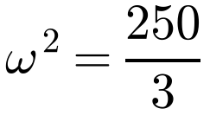
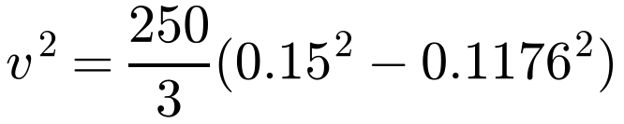
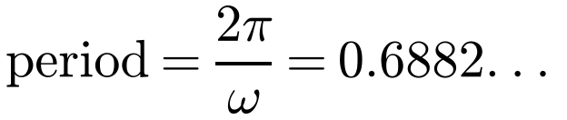

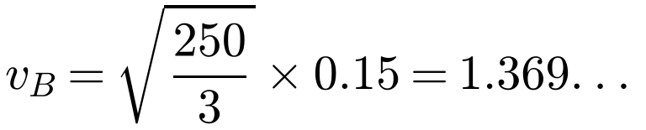
Vertical Oscillation
A particle P of mass 1.2 kg is attached to one end of a light elastic spring of modulus of elasticity 60 N and natural length 60 cm. The other end of the spring is attached to a fixed point A on a ceiling. The particle hangs in equilibrium at the point B.
a) Find the extension of the spring.
The particle is now raised vertically a distance 15 cm and released from rest.
b) Prove that P will move with simple harmonic motion.
c) Find the period and amplitude of the motion.
d) Find the speed of P as it passes through B.
e) Find the speed of P at the instant when the spring has returned to its natural length.
b)
Extension is x + e
Use mg = 60e/0.6 from a)
P moves with S.H.M.
c)
e) At the natural length x = −e:
0.850 m s⁻¹ (3 s.f.)
Period 0.688 s (3 s.f.); amplitude 15 cm
d) At B, x = 0:
1.37 m s⁻¹ (3 s.f.)
5E

Slide 5
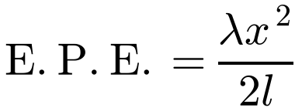
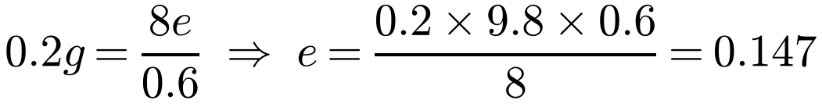
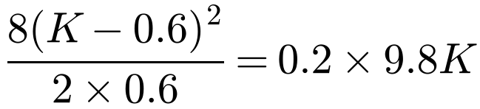
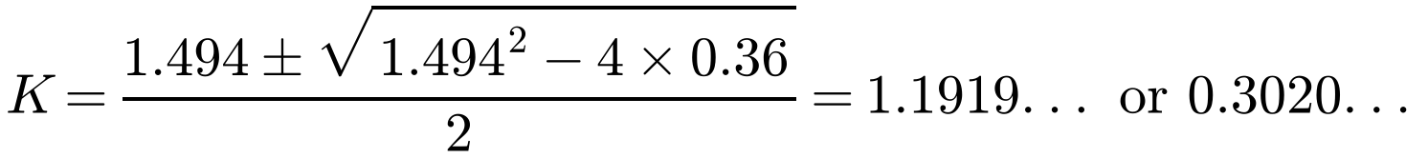
Vertical Oscillation
Energy considerations
A particle P of mass 0.2 kg is attached to one end of a light elastic string of natural length 0.6 m and modulus of elasticity 8 N. The other end of the string is fixed to a point A on a ceiling. When the particle is hanging in equilibrium the length of the string is L m.
a) Calculate the value of L.
The particle is held at A and released from rest. It first comes to instantaneous rest when the length of the string is K m.
b) Use energy considerations to calculate the value of K.
c) Show that while the string is taut, P is moving with simple harmonic motion.
The string becomes slack again for the first time T seconds after P was released from A.
d) Calculate the value of T.
Between two points where the kinetic energy is zero:
E.P.E. gained = G.P.E. lost
Until the string becomes taut, the particle falls freely under gravity (suvat)
a)
Tension = weight in equilibrium
L = 0.6 + 0.147 = 0.747
b) E.P.E. gained = G.P.E. lost
K.E. is zero at both points
K must be greater than the natural length
K = 1.19 (3 s.f.)
5E

Slide 6
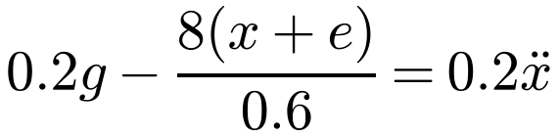
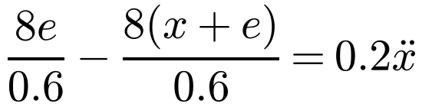
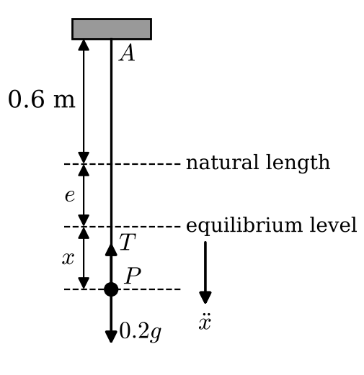
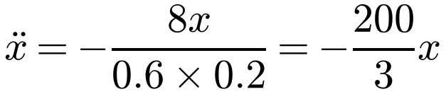
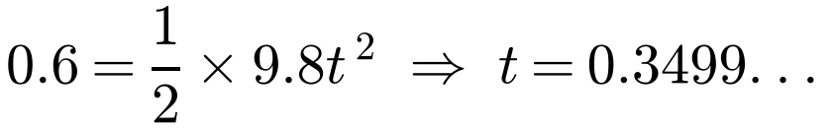
Vertical Oscillation
c) Show that while the string is taut, P is moving with S.H.M.
d) The string becomes slack again for the first time T seconds after P was released from A. Calculate T.
c)
Down is positive
Use 0.2g = 8e/0.6
∴ S.H.M.
d) Free fall for 0.6 m from rest:
S.H.M.: ω = √(200/3), amplitude a = K − L = 1.1920 − 0.747 = 0.4450
T = 0.817 (3 s.f.)
Note: the book rounds K to 1.191 and uses a = 0.444; the exact amplitude is 0.445 m. T is 0.817 either way.
5E

