Slide 1
Dynamics
Further Mechanics 2 Chapter 5
Westie's Workshop

Slide 2
Teachings for Exercise 5D

Slide 3
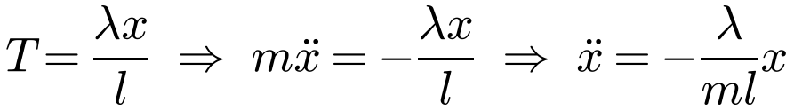
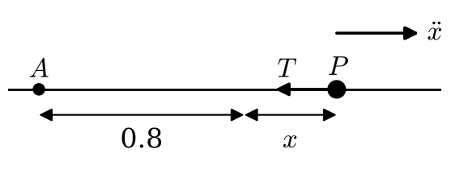
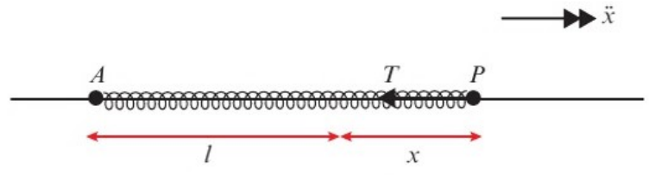
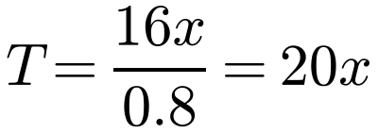
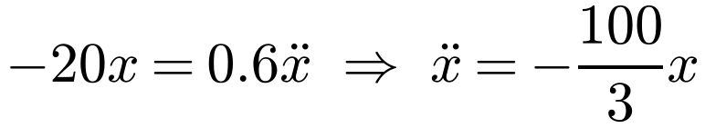
Horizontal Oscillation
Elastic springs and strings on a smooth horizontal surface
A particle P of mass 0.6 kg rests on a smooth horizontal floor attached to one end of a light elastic string of natural length 0.8 m and modulus of elasticity 16 N. The other end of the string is fixed to a point A on the floor. The particle is pulled away from A until AP measures 1.2 m and released.
a) Show that, while the string remains taut, P moves with simple harmonic motion.
b) Calculate the speed of P when the string returns to its natural length.
c) Calculate the time that elapses between the point where the string becomes slack and the point where it next becomes taut.
d) Calculate the time taken by the particle to return to its starting point for the first time.
so P moves with S.H.M. The initial extension is the amplitude
Spring: S.H.M. and complete oscillations (tension or thrust)
String: S.H.M. while taut; constant speed while slack
Hooke’s law → tension; F = ma → ω; question → amplitude
a)
Hooke’s law, λ = 16, l = 0.8
The tension acts towards A
The particle is moving with S.H.M.
5D

Slide 4
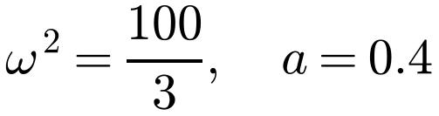
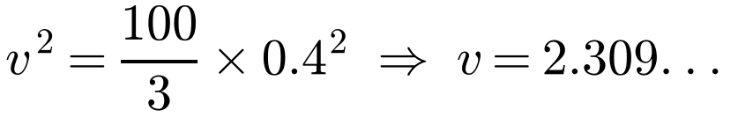


Horizontal Oscillation
A particle P of mass 0.6 kg rests on a smooth horizontal floor attached to one end of a light elastic string of natural length 0.8 m and modulus of elasticity 16 N. The other end of the string is fixed to a point A on the floor. The particle is pulled away from A until AP measures 1.2 m and released.
a) Show that, while the string remains taut, P moves with simple harmonic motion.
b) Calculate the speed of P when the string returns to its natural length.
c) Calculate the time that elapses between the point where the string becomes slack and the point where it next becomes taut.
d) Calculate the time taken by the particle to return to its starting point for the first time.
b)
Amplitude = initial extension
At the natural length x = 0
At the natural length P has speed 2.31 m s⁻¹ (3 s.f.)
c) P now moves 1.6 m at constant speed:
The string is slack
The string is slack for 0.693 s (3 s.f.)
d)
One complete oscillation and two slack intervals
The time taken is 2.47 s (3 s.f.)
5D

Slide 5
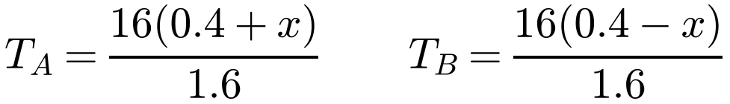
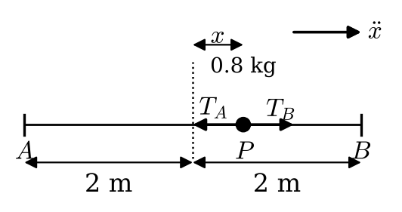
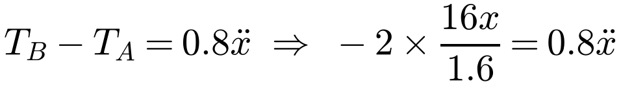

Horizontal Oscillation
Two springs or strings between two fixed points
Find the tension in each one, using your diagram to work out the extensions
Form the equation of motion and reduce it to ẍ = −ω²x
For identical springs the centre of the oscillation is the midpoint of AB
A particle P of mass 0.8 kg is attached to the ends of two identical light elastic springs of natural length 1.6 m and modulus of elasticity 16 N. The free ends of the springs are attached to two points A and B which are 4 m apart on a smooth horizontal surface. The point C lies between A and B such that ABC is a straight line and AC = 2.4 m. The particle is held at C and then released from rest.
a) Show that the subsequent motion is simple harmonic motion.
b) Find the period and amplitude of the motion.
c) Calculate the maximum speed of P.
a)
The motion is S.H.M.
Amplitude = initial displacement from the centre
b) ω² = 25, ω = 5, so the period is 2π/5 s; amplitude = 0.4 m
c)
P’s maximum speed is 2 m s⁻¹
5D

