Slide 1
Dynamics
Further Mechanics 2 Chapter 5
Westie's Workshop

Slide 2
Teachings for Exercise 5C

Slide 3

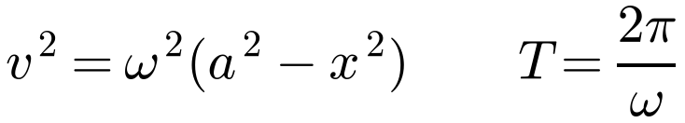
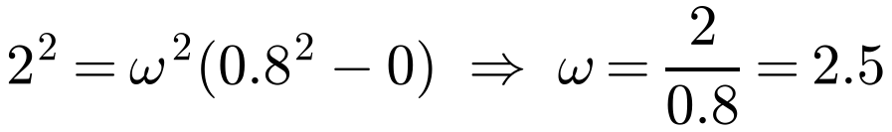
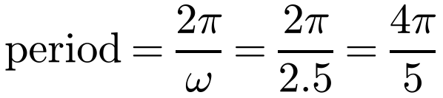
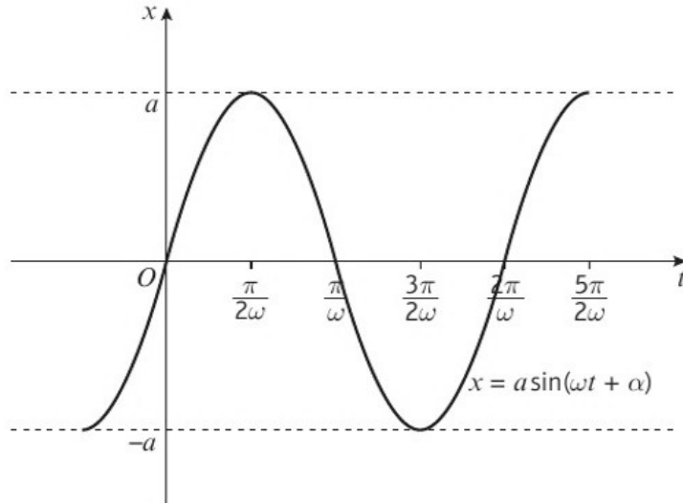
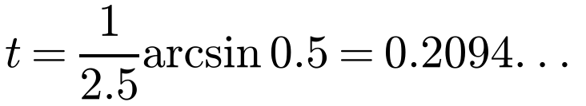
Simple Harmonic Motion
Simple harmonic motion (S.H.M.) is motion in which the acceleration of a particle P is always towards a fixed point O on the line of motion of P and has magnitude proportional to the displacement of P from O
A particle is moving along a straight line with S.H.M. The amplitude of the motion is 0.8 m. It passes through the centre of the oscillation O with speed 2 m s⁻¹. Calculate:
a) the period of the oscillation
b) the speed of the particle when it is 0.4 m from O
c) the time the particle takes to travel 0.4 m from O.
O is the centre of oscillation. For amplitude a:
a)
v² = ω²(a² − x²) with v = 2, a = 0.8, x = 0
Centre when t = 0: x = a sin ωt
End point when t = 0: x = a cos ωt
Otherwise: x = a sin(ωt + α)
The period is 4π/5 s
b)
The speed is 1.73 m s⁻¹ (3 s.f.)
c) x = a sin ωt
Take t = 0 at the centre
Calculator in radian mode!
The particle takes 0.209 s (3 s.f.)
5C

Slide 4
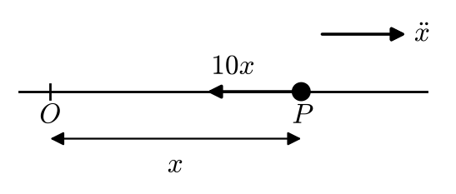
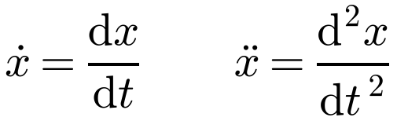



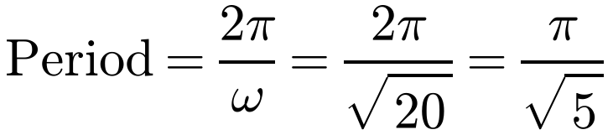
Simple Harmonic Motion
To show that a particle moves with S.H.M.
Use F = ma to show that the acceleration is of the form
A particle P of mass 0.5 kg is moving along a straight line. At time t seconds, the distance of P from a fixed point O on the line is x metres. The force acting on P has magnitude 10x and acts in the direction PO.
a) Show that P is moving with simple harmonic motion.
b) Find the period of the motion.
and state the conclusion
Then compare to find ω
Dot notation:
a) F = ma
The force acts towards O
∴ S.H.M.
b)
Compare with ẍ = −ω²x
The period is π/√5 s (1.40 s, 3 s.f.)
5C

Slide 5




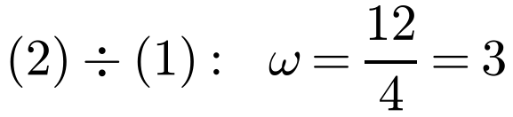
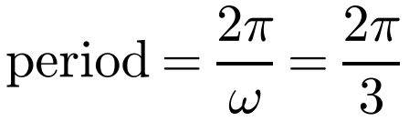
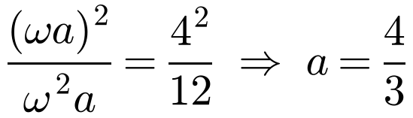
Simple Harmonic Motion
Maximum speed and maximum acceleration
v² = ω²(a² − x²) is greatest when x = 0:
A particle is moving in a straight line with simple harmonic motion. Its maximum acceleration is 12 m s⁻² and its maximum speed is 4 m s⁻¹. Calculate:
a) the period of the motion
b) the amplitude of the motion
c) the length of time, during one complete oscillation, that the particle is within ⅓ m of the centre of the oscillation.
|ẍ| = ω²|x| is greatest when |x| = a:
a) Max speed when x = 0:
Unless told the accuracy required, give the exact answer
Max acceleration when |x| = a:
The period is 2π/3 s (2.09 s, 3 s.f.)
b)
Square (1) and divide by (2)
The amplitude is 4/3 m (1.33 m, 3 s.f.)
5C

Slide 6
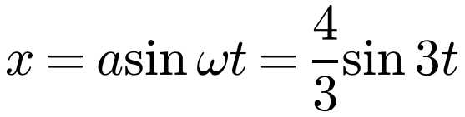
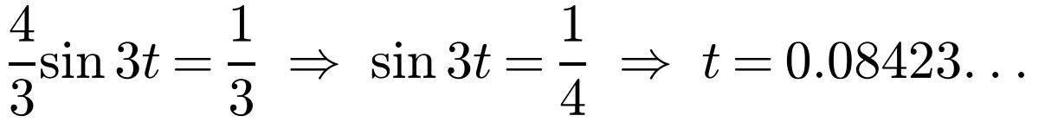
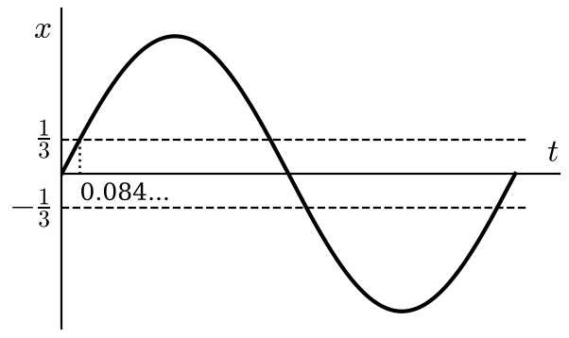

Simple Harmonic Motion
A particle is moving in a straight line with simple harmonic motion. Its maximum acceleration is 12 m s⁻² and its maximum speed is 4 m s⁻¹. Calculate:
a) the period of the motion
b) the amplitude of the motion
c) the length of time, during one complete oscillation, that the particle is within ⅓ m of the centre of the oscillation.
c) Take x = 0 when t = 0:
The starting point does not affect the answer
Need t such that −⅓ ≤ (4/3) sin 3t ≤ ⅓
First positive solution
By symmetry, in one complete oscillation the particle is within ⅓ m of O for 4 such intervals:
Total time within ⅓ m of O is 0.337 s (3 s.f.)
5C

Slide 7
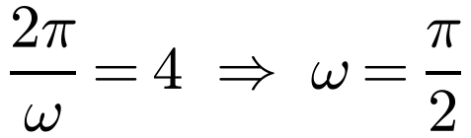
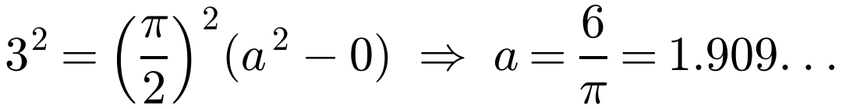
Simple Harmonic Motion
Modelling with S.H.M.
Highest point to lowest point takes half a period
Maximum speed occurs at the centre of the oscillation (x = 0)
Measuring time from an end point (here the lowest point), use x = a cos ωt
Use the exact values of a and ω for a more accurate answer
A small rowing boat is floating on the surface of the sea, tied to a pier. The boat moves up and down in a vertical line and it can be modelled as a particle moving with simple harmonic motion. The boat takes 2 s to travel directly from its highest point, which is 3 m below the pier, to its lowest point. The maximum speed of the boat is 3 m s⁻¹. Calculate:
a) the amplitude of the motion
b) the time taken by the boat to rise from its lowest point to a point 5 m below the pier.
a)
Half the period is 2 s
The amplitude is 1.91 m (3 s.f.)
5C

Slide 8
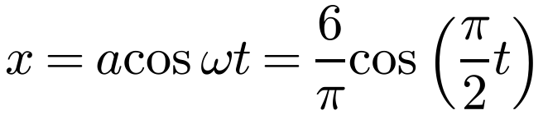
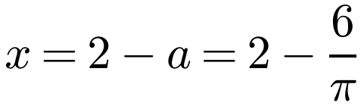
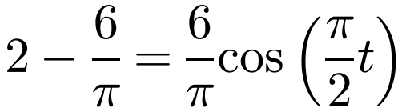
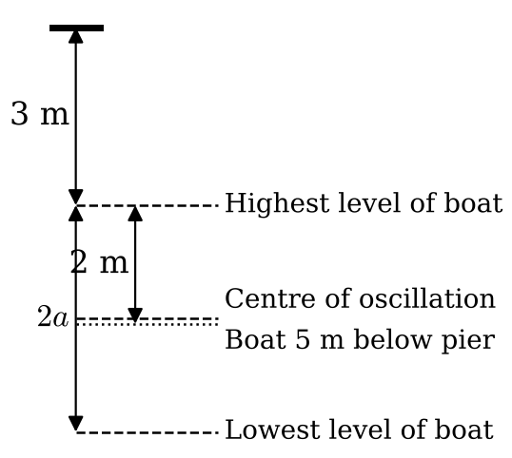
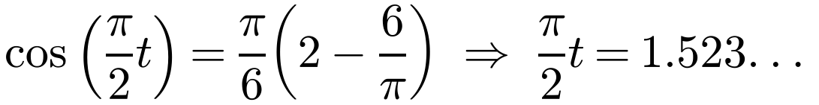
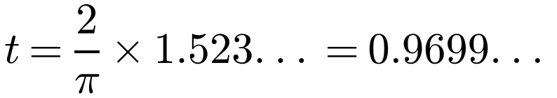
Simple Harmonic Motion
A small rowing boat is floating on the surface of the sea, tied to a pier. The boat moves up and down in a vertical line and it can be modelled as a particle moving with simple harmonic motion. The boat takes 2 s to travel directly from its highest point, which is 3 m below the pier, to its lowest point. The maximum speed of the boat is 3 m s⁻¹. Calculate:
a) the amplitude of the motion
b) the time taken by the boat to rise from its lowest point to a point 5 m below the pier.
b) Take down as positive and time from the lowest point:
5 m below the pier is 2 m below the highest point, so
x is measured from the centre
The time taken is 0.970 s (3 s.f.)
5C

Slide 9
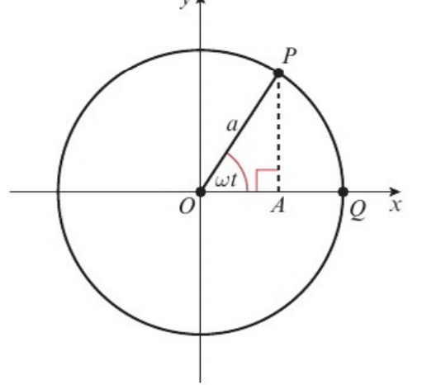
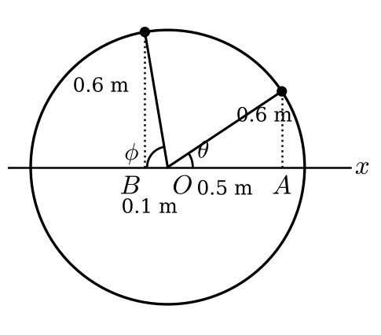
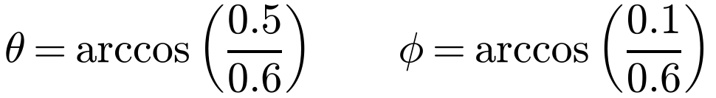
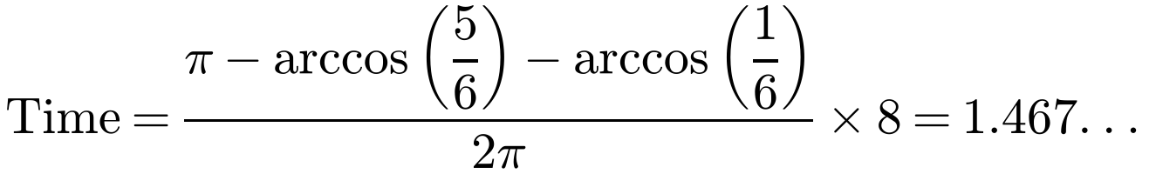
Simple Harmonic Motion
Geometrical method: the reference circle
P moves round a circle of radius a with constant angular speed ω. The foot A of the perpendicular from P to the x-axis moves with S.H.M., amplitude a, period 2π/ω
A particle P is moving with simple harmonic motion along a straight line. The centre of the oscillation is the point O, the amplitude is 0.6 m and the period is 8 s. The points A and B are points on the line of P’s motion and are on opposite sides of O. The distance OA is 0.5 m and OB is 0.1 m. Calculate the time taken by P to move directly from A to B.
Reference circle of radius 0.6 m; its diameter is the line of motion
An angle turned through at the centre corresponds to a time: 2π ↔ one period
From A to B the point on the circle turns through π − θ − φ
Proportion of the period
The time to travel from A to B is 1.47 s (3 s.f.)
5C

