Slide 1
Dynamics
Further Mechanics 2 Chapter 5
Westie's Workshop

Slide 2
Teachings for Exercise 5B

Slide 3
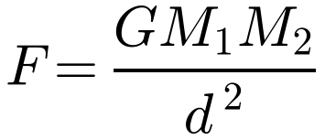
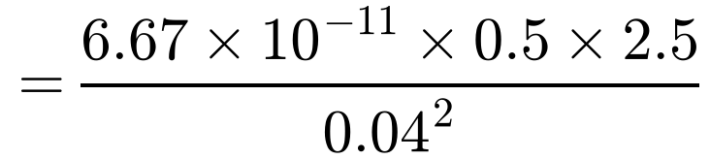

Newton’s Law of Gravitation
The force of attraction between two bodies of masses M₁ and M₂ is directly proportional to the product of their masses and inversely proportional to the square of the distance between them
Two particles of masses 0.5 kg and 2.5 kg are 4 cm apart. Calculate the magnitude of the gravitational force between them.
d = 4 cm = 0.04 m
G is the constant of gravitation: G = 6.67 × 10⁻¹¹ kg⁻¹ m³ s⁻²
This is the inverse square law. Use it for large changes in distance (e.g. a rocket); for small changes in height, gravity can be modelled as a constant force
The magnitude of the gravitational force is 5.21 × 10⁻⁸ N (3 s.f.)
This value is so small that it can be ignored in most calculations
5B

Slide 4
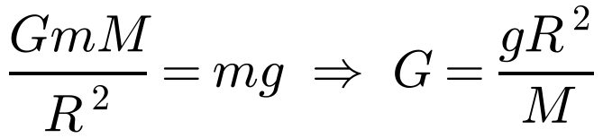
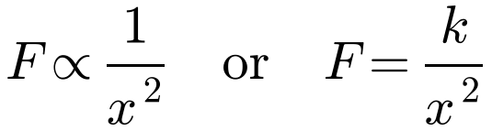
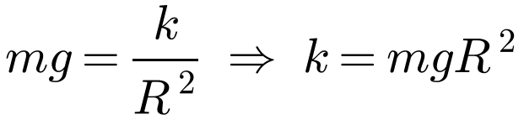
Newton’s Law of Gravitation
Relationship between G and g
Model the Earth as a sphere of mass M and radius R. On the surface:
Above the Earth’s surface, the magnitude of the force on a particle due to the Earth’s gravitational force is inversely proportional to the square of the distance of the particle from the centre of the Earth. The acceleration due to gravity on the surface of the Earth is g and the Earth can be modelled as a sphere of radius R. A particle P of mass m is a distance (x − R), (where x ≥ R), above the surface of the Earth.
The force is a function of the displacement x, so use F = ma with a = v dv/dx (as in 5A)
A spacecraft S is fired vertically upwards from the surface of the Earth. When it is at a height 2R above the surface of the Earth its speed is ½√(gR). Assuming that air resistance can be ignored and the rocket’s engine is turned off immediately after the rocket is fired,
b) find, in terms of g and R, the speed with which S was fired.
a)
On the surface of the Earth, x = R and the force is mg:
The force is the weight of the particle
So the magnitude of the gravitational force is mgR²/x²
5B

Slide 5
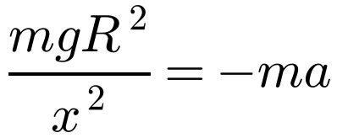
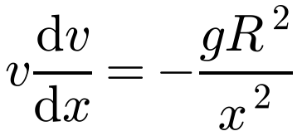
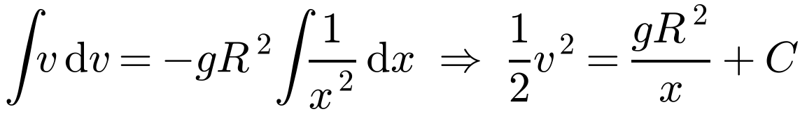
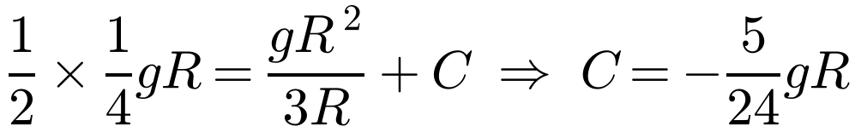
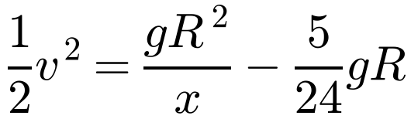
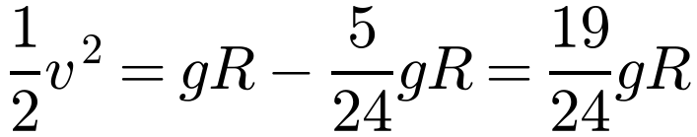
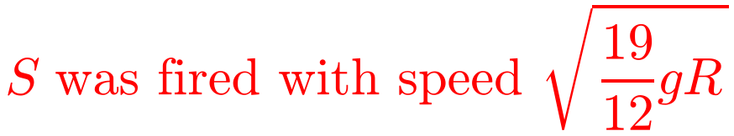
Newton’s Law of Gravitation
Above the Earth’s surface, the magnitude of the force on a particle due to the Earth’s gravitational force is inversely proportional to the square of the distance of the particle from the centre of the Earth. The acceleration due to gravity on the surface of the Earth is g and the Earth can be modelled as a sphere of radius R. A particle P of mass m is a distance (x − R), (where x ≥ R), above the surface of the Earth.
a) Prove that the magnitude of the gravitational force acting on P is mgR²/x²
A spacecraft S is fired vertically upwards from the surface of the Earth. When it is at a height 2R above the surface of the Earth its speed is ½√(gR). Assuming that air resistance can be ignored and the rocket’s engine is turned off immediately after the rocket is fired,
b) find, in terms of g and R, the speed with which S was fired.
b) F = ma
Up is positive; the force acts downwards
Replace a with v dv/dx
At height 2R, x = 3R and v = ½√(gR):
On the surface, x = R:
5B

