Slide 1
Dynamics
Further Mechanics 2 Chapter 5
Westie's Workshop

Slide 2
Teachings for Exercise 5A

Slide 3
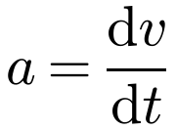
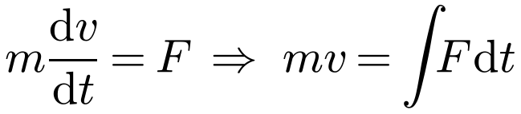

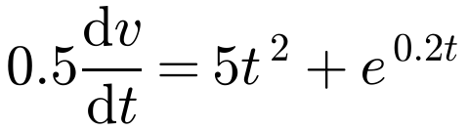
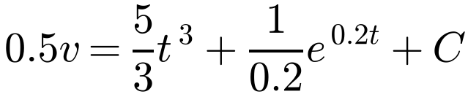
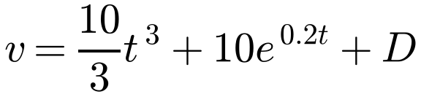
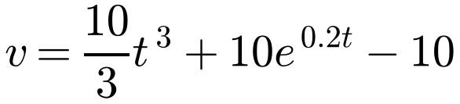
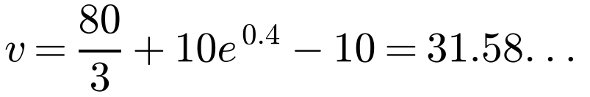
Motion in a Straight Line with Variable Force
You can use calculus to apply Newton’s second law F = ma when the force is variable
If F is a function of time, use
A particle P of mass 0.5 kg is moving along the x-axis. At time t seconds the force acting on P has magnitude (5t² + e^{0.2t}) N and acts in the direction OP. When t = 0, P is at rest at O. Calculate:
a) the speed of P when t = 2
b) the distance OP when t = 3.
a) F = ma
F = ma with m = 0.5
(the mass is assumed to be constant)
Remember the constant of integration, and use the boundary conditions to find it
Replace a with dv/dt
Divide by 0.5; call the new constant D
t = 0, v = 0 ⇒ 0 = 0 + 10 + D ⇒ D = −10
When t = 2:
When t = 2 the speed of P is 31.6 m s⁻¹ (3 s.f.)
5A

Slide 4
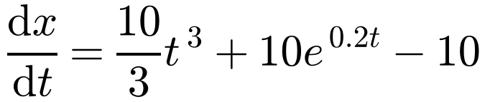
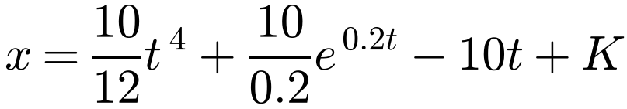
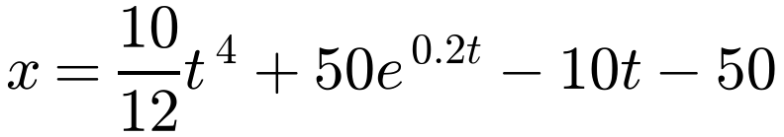
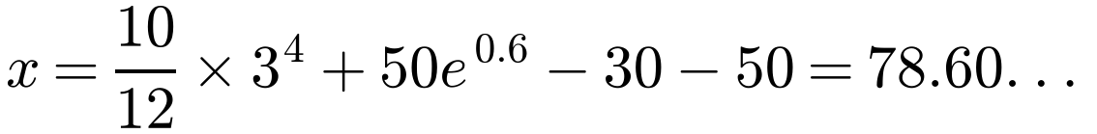
Motion in a Straight Line with Variable Force
A particle P of mass 0.5 kg is moving along the x-axis. At time t seconds the force acting on P has magnitude (5t² + e^{0.2t}) N and acts in the direction OP. When t = 0, P is at rest at O. Calculate:
a) the speed of P when t = 2
b) the distance OP when t = 3.
b)
Replace v with dx/dt
Use a different letter for the constant
t = 0, x = 0 ⇒ 0 = 0 + 50 − 0 + K ⇒ K = −50
When t = 3:
When t = 3, OP is 78.6 m (3 s.f.)
5A

Slide 5
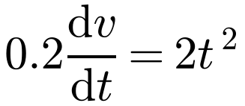
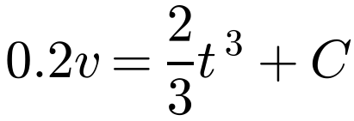
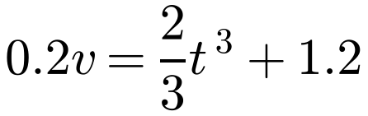
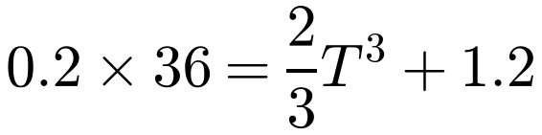
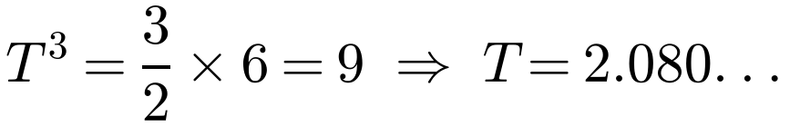
Motion in a Straight Line with Variable Force
Force as a function of time
Use F = ma with a = dv/dt, integrate with respect to t, and use the initial conditions to find the constant
Then substitute the given value and solve
A pebble of mass 0.2 kg is moving on a smooth horizontal sheet of ice. At time t seconds (where t ≥ 0) a horizontal force of magnitude 2t² N and constant direction acts on the pebble. When t = 0 the pebble is moving in the same direction as the force and has speed 6 m s⁻¹. When t = T the pebble has speed 36 m s⁻¹. Calculate the value of T.
F = ma
F = 2t², m = 0.2, a = dv/dt
t = 0, v = 6 ⇒ 0.2 × 6 = 0 + C ⇒ C = 1.2
t = T, v = 36:
Substitute t = T and solve for T
T = 2.08 (3 s.f.)
5A

Slide 6
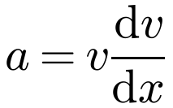
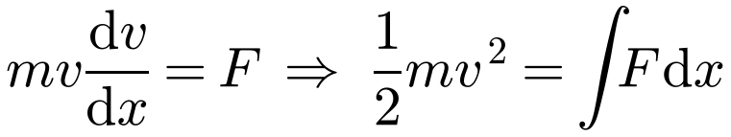
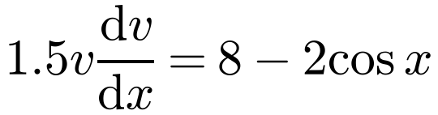
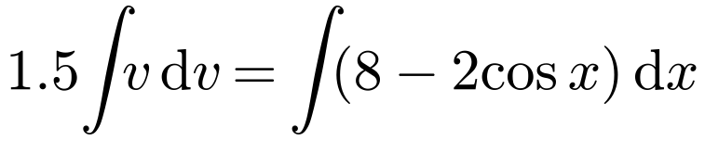
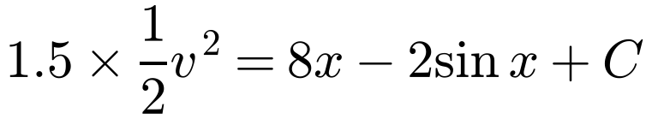
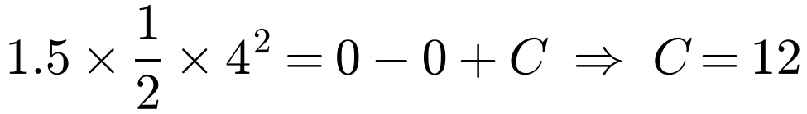

Motion in a Straight Line with Variable Force
If F is a function of displacement x, use
A particle P of mass 1.5 kg is moving in a straight line. The force acting on P has magnitude (8 − 2 cos x) N, where x metres is the distance OP, and acts in the direction OP. When P passes through O its speed is 4 m s⁻¹. Calculate the speed of P when x = 2.
F = ma
Separate the variables and integrate with respect to x
As calculus is being used, angles are in radians
F is a function of x, so a = v dv/dx
x = 0, v = 4:
x = 2:
Radians!
When x = 2 the speed of P is 5.91 m s⁻¹ (3 s.f.)
5A

Slide 7
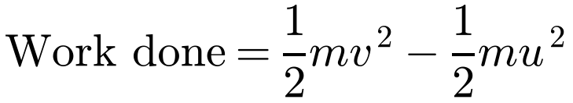
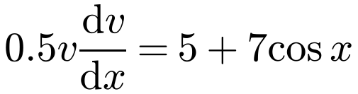
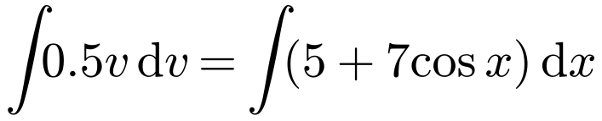
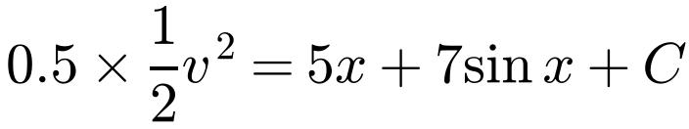
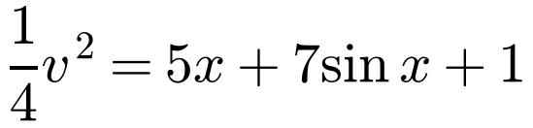
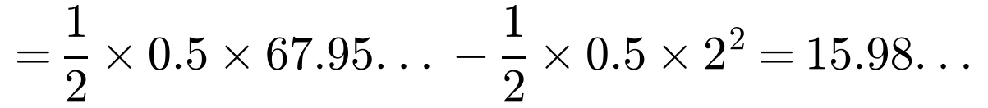
Motion in a Straight Line with Variable Force
Work–energy principle
The work done by a force is equal to the increase in kinetic energy
A stone S of mass 0.5 kg is moving in a straight line on a smooth horizontal floor. When S is a distance x metres from a fixed point on the line, A, a force of magnitude (5 + 7 cos x) N acts on S in the direction AS. Given that S passes through A with speed 2 m s⁻¹, calculate:
a) the speed of S as it passes through the point B, where x = 3
b) the work done by the force in moving S from A to B.
a)
x = 0, v = 2: 0.5 × ½ × 2² = C ⇒ C = 1
x = 3:
S passes through B with speed 8.24 m s⁻¹ (3 s.f.)
b) Work done = increase in K.E.
The work done is 16.0 J (3 s.f.)
5A

Slide 8
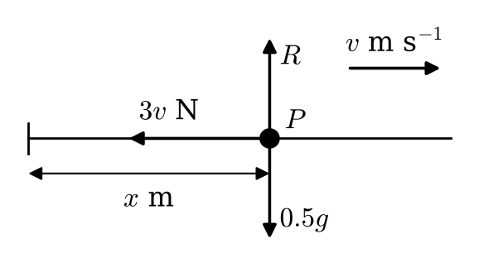
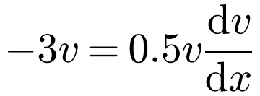
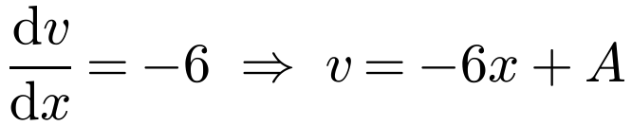
Motion in a Straight Line with Variable Force
Resistance that varies with speed
In forming an equation of motion, forces that tend to decrease the displacement are negative and forces that tend to increase the displacement are positive
When the question relates distance to speed, use a = v dv/dx
Measure x from the point where the given motion starts
A particle P of mass 0.5 kg moves in a straight horizontal line. When the speed of P is v m s⁻¹, the resultant force acting on P is a resistance of magnitude 3v N.
Find the distance moved by P as it slows down from 12 m s⁻¹ to 6 m s⁻¹.
x is measured from where the speed is 12 m s⁻¹
R(→): F = ma
Resistance opposes motion: negative
At x = 0, v = 12: A = 12, so v = 12 − 6x
When v = 6: 6 = 12 − 6x ⇒ x = 1
P moves 1 m as it slows from 12 m s⁻¹ to 6 m s⁻¹
5A

Slide 9
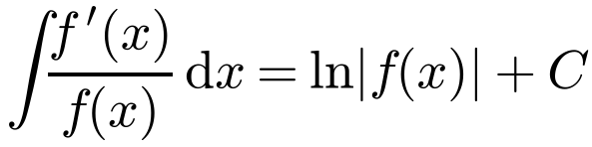
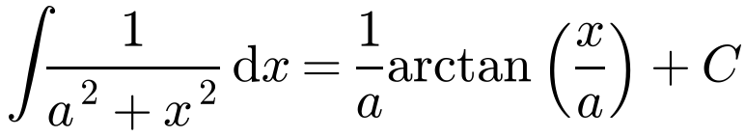
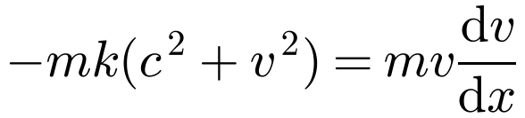
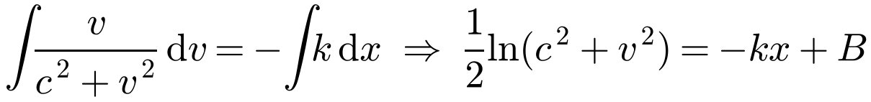
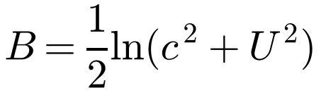
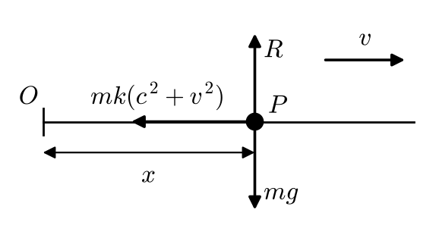
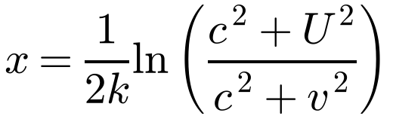
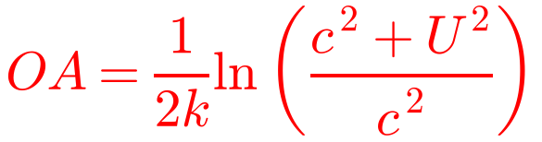
Motion in a Straight Line with Variable Force
Choosing the form of the acceleration
Distance, no time: a = v dv/dx
Time, no distance: a = dv/dt
A particle P of mass m is moving along Ox in the direction of x increasing. At time t, the only force acting on P is a resistance of magnitude mk(c² + v²), where v is the speed of P and c and k are positive constants. When t = 0, P is at O and v = U. The particle P comes to rest at the point A. Find:
a) the distance OA
b) the time P takes to travel from O to A.
a) R(→):
Time not involved, so a = v dv/dx
You need only put the arbitrary constant on one side of the equation
At x = 0, v = U:
At A, v = 0:
5A

Slide 10
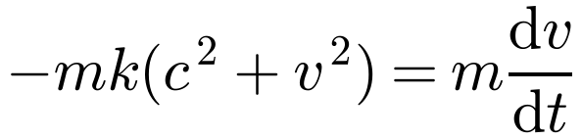
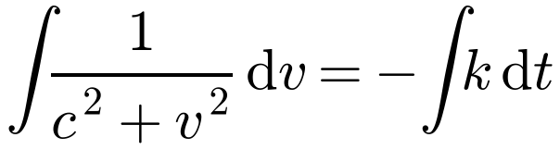
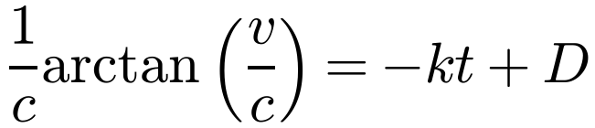
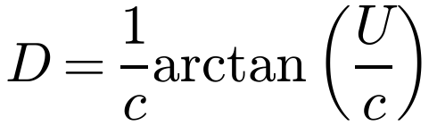
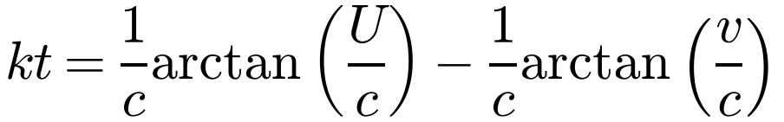
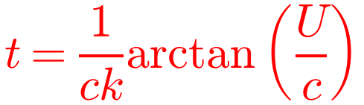
Motion in a Straight Line with Variable Force
A particle P of mass m is moving along Ox in the direction of x increasing. At time t, the only force acting on P is a resistance of magnitude mk(c² + v²), where v is the speed of P and c and k are positive constants. When t = 0, P is at O and v = U. The particle P comes to rest at the point A. Find:
a) the distance OA
b) the time P takes to travel from O to A.
b) R(→):
Distance not involved, so a = dv/dt
Formula booklet result
When t = 0, v = U:
When v = 0:
arctan 0 = 0
5A

Slide 11
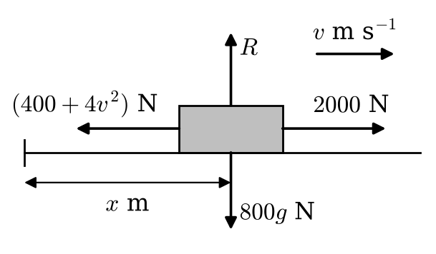
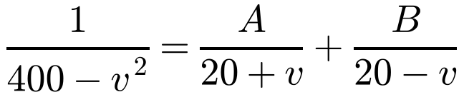
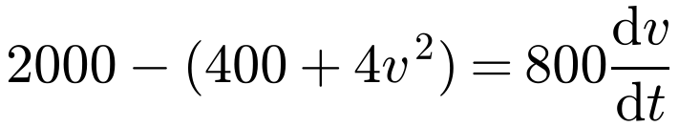
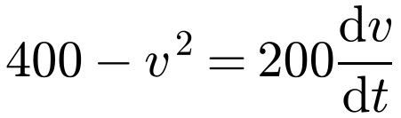
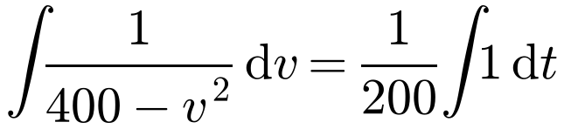
Motion in a Straight Line with Variable Force
Driving force and resistance
The driving force acts in the direction of x increasing, so it is positive
The resistance acts in the direction of x decreasing, so it is negative
Partial fractions:
A car of mass 800 kg travels along a straight horizontal road. The engine of the car produces a constant driving force of magnitude 2000 N. At time t seconds, the speed of the car is v m s⁻¹. As the car moves, the total resistance to the motion of the car is of magnitude (400 + 4v²) N. The car starts from rest.
a) Find v in terms of t.
b) Show that the speed of the car cannot exceed 20 m s⁻¹.
a) R(→):
Divide by 4
1 = A(20 − v) + B(20 + v): A = B = 1/40
5A

Slide 12





Motion in a Straight Line with Variable Force
A car of mass 800 kg travels along a straight horizontal road. The engine of the car produces a constant driving force of magnitude 2000 N. At time t seconds, the speed of the car is v m s⁻¹. As the car moves, the total resistance to the motion of the car is of magnitude (400 + 4v²) N. The car starts from rest.
a) Find v in terms of t.
b) Show that the speed of the car cannot exceed 20 m s⁻¹.
Replace e^{D} with a new constant F
When t = 0, v = 0: F = 1
b) For all real t, e^{t/5} − 1 < e^{t/5} + 1, so
20 m s⁻¹ is the terminal (limiting) speed
The speed of the car cannot exceed 20 m s⁻¹
5A

