Slide 1
Kinematics
Further Mechanics 2 Chapter 4
Westie's Workshop

Slide 2
Teachings for Exercise 4C

Slide 3
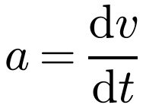
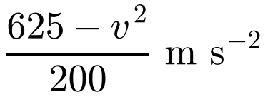
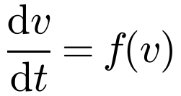
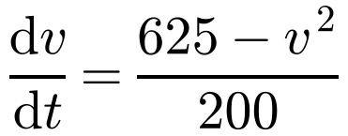
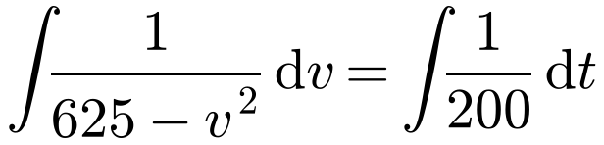
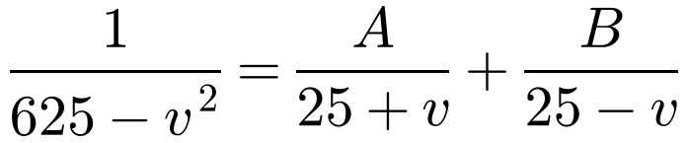

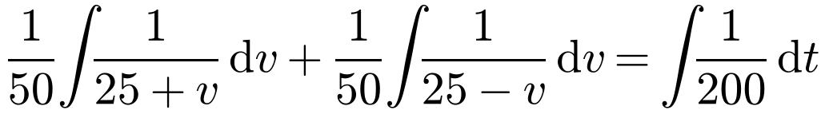
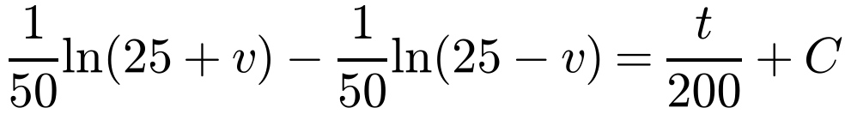
Acceleration Varying with Velocity
When the acceleration is a function of the velocity, a = f(v), use
A van moves along a straight horizontal road. At time t seconds, t ≥ 0, the acceleration of the van is
for questions which involve working with time
This gives a differential equation
where v m s⁻¹ is the velocity of the van. The van starts from rest.
a) Find v in terms of t.
b) Show that the speed of the van cannot exceed 25 m s⁻¹.
a)
which you solve by separating the variables
You may need partial fractions to integrate
Separate the variables
625 − v² = (25 + v)(25 − v)
v = 25: 1 = 50B ⇒ B = 1/50
v = −25: 1 = 50A ⇒ A = 1/50
4C

Slide 4
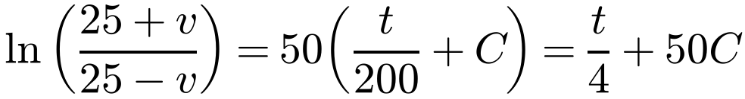
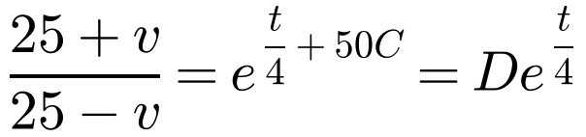
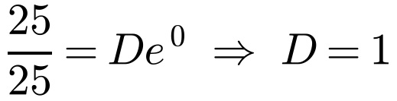
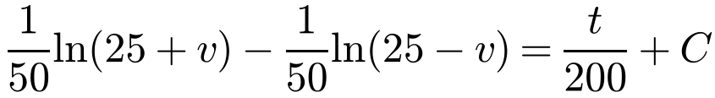
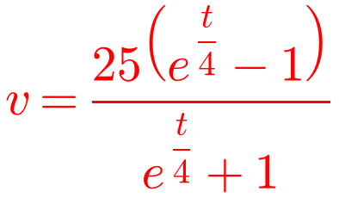
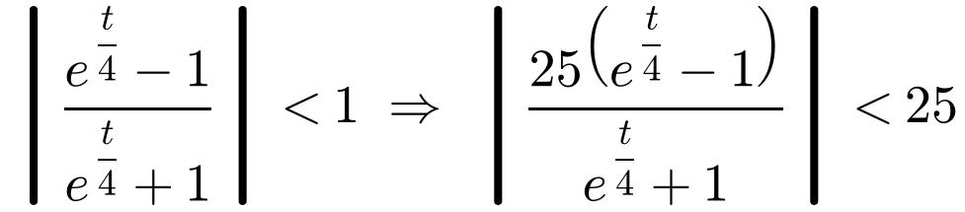
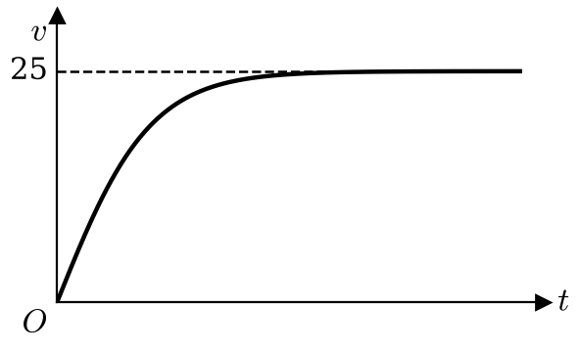
Acceleration Varying with Velocity
A van moves along a straight horizontal road. At time t seconds, t ≥ 0, the acceleration of the van is
ln a − ln b = ln(a/b)
Write D = e^{50C}
where v m s⁻¹ is the velocity of the van. The van starts from rest.
a) Find v in terms of t.
b) Show that the speed of the van cannot exceed 25 m s⁻¹.
When t = 0, v = 0:
Make v the subject
Terminal (limiting) speed
b) For all real t, e^{t/4} − 1 < e^{t/4} + 1
The speed approaches 25 m s⁻¹ but never reaches it
It occurs when a = 0: 625 − v² = 0 ⇒ v = 25
So the speed of the van cannot exceed 25 m s⁻¹
4C

Slide 5
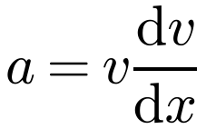

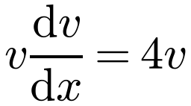
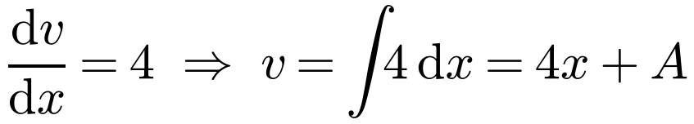

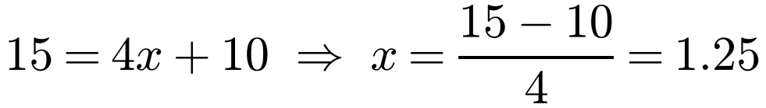
Acceleration Varying with Velocity
If you have to find distances when acceleration varies with velocity, use
A particle P moves in a straight line. When the velocity of the particle is v m s⁻¹, the acceleration of the particle is given by a = 4v m s⁻².
Find the distance moved by P as the velocity increases from 10 m s⁻¹ to 15 m s⁻¹.
Measure x from the point where the motion you want starts, so you know a value of v when x = 0
Watch out: solving dv/dt = 4v gives v = 10e^{4t}, but then the limits of integration would be values of t, not of v
A distance is wanted, so use a = v dv/dx
x is measured from where v = 10
When x = 0, v = 10: 10 = 0 + A ⇒ A = 10
When v = 15:
The distance moved by P is 1.25 m
4C

Slide 6
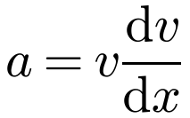
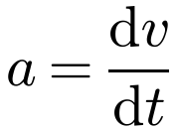
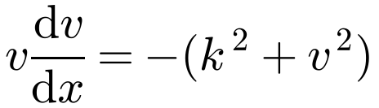
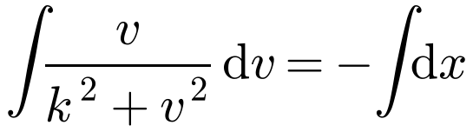
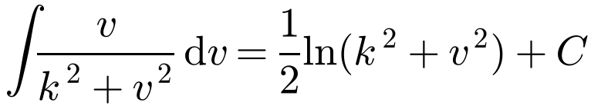
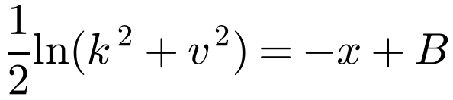
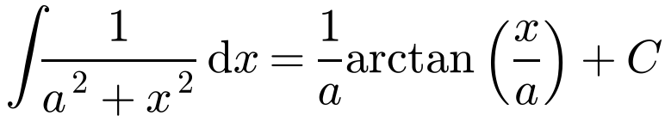
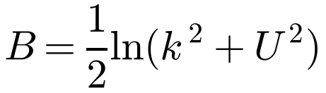
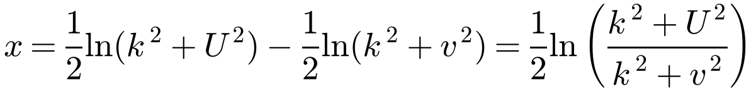
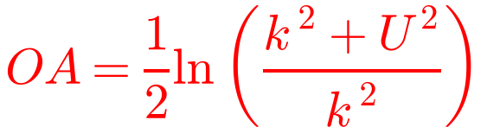
Acceleration Varying with Velocity
Choose the right form for the acceleration
Distance wanted:
A particle P moves along the positive x-axis. At time t seconds, the acceleration of the particle is −(k² + v²) where v m s⁻¹ is the velocity of the particle and k is a positive constant. When t = 0, P is at O and v = U. The particle comes to rest at the point A. Find, in terms of k and U:
a) the distance OA
b) the time P takes to travel from O to A.
Time wanted:
a)
Useful integrals:
Separate the variables
When x = 0, v = U:
The constant of integration may include the given constants
At A, v = 0 and x = OA:
4C

Slide 7
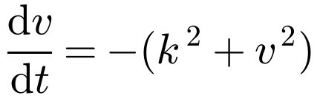
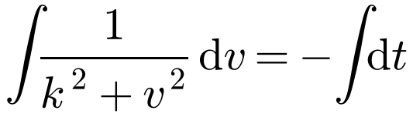
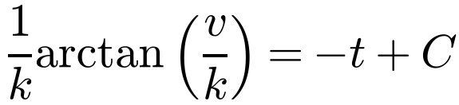
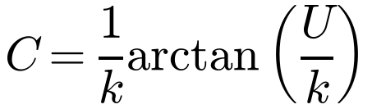
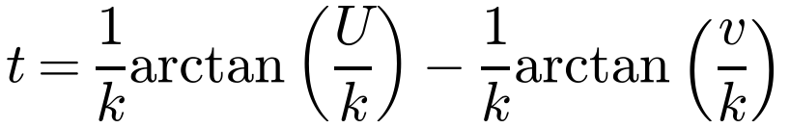
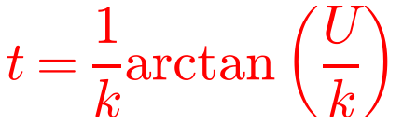
Acceleration Varying with Velocity
A particle P moves along the positive x-axis. At time t seconds, the acceleration of the particle is −(k² + v²) where v m s⁻¹ is the velocity of the particle and k is a positive constant. When t = 0, P is at O and v = U. The particle comes to rest at the point A. Find, in terms of k and U:
a) the distance OA
b) the time P takes to travel from O to A.
b)
Time wanted, so use a = dv/dt
Standard result from the formula booklet
When t = 0, v = U:
When v = 0:
arctan 0 = 0
P takes (1/k) arctan(U/k) seconds to travel from O to A
4C

