Slide 1
Kinematics
Further Mechanics 2 Chapter 4
Westie's Workshop

Slide 2
Teachings for Exercise 4B

Slide 3
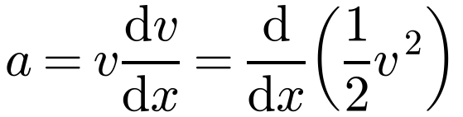

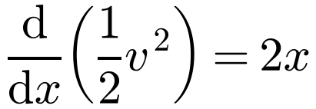
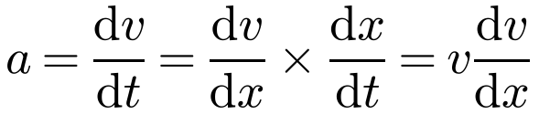
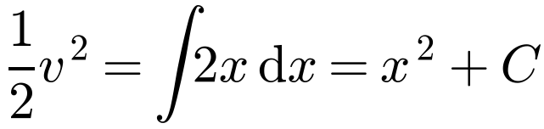
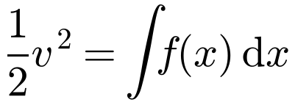
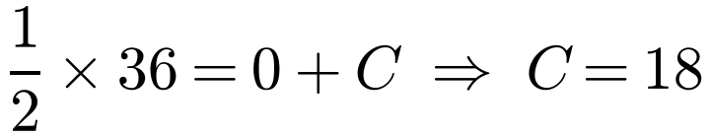
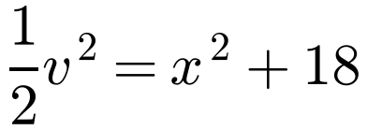

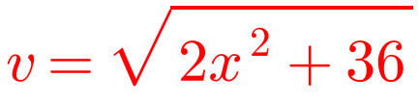
Acceleration Varying with Displacement
When acceleration is a function of displacement, a = f(x), use
A particle P is moving on the x-axis in the direction of x increasing. When the displacement of P from the origin O is x m and its speed is v m s⁻¹, the acceleration of P is 2x m s⁻². When P is at O, its speed is 6 m s⁻¹. Find v in terms of x.
This comes from the chain rule:
Use a = d/dx(½v²)
Then integrate both sides with respect to x:
Integrate both sides with respect to x
When x = 0, v = 6:
Remember the constant of integration
Multiply by 2 and make v the subject
P moves in the direction of x increasing, so take the positive root
4B

Slide 4
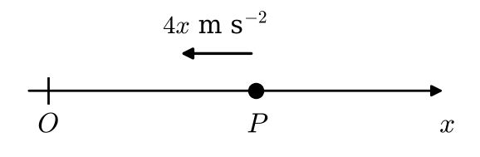

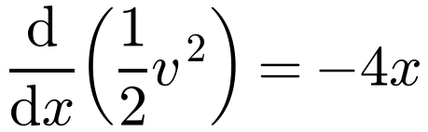
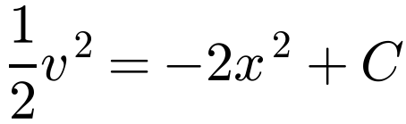
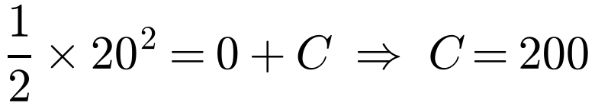

Acceleration Varying with Displacement
Watch the direction of the acceleration
Take the direction of x increasing as positive
An acceleration directed towards O when x > 0 is in the direction of x decreasing, so it is negative
Instantaneously at rest means v = 0
A particle P is moving along a straight line. The acceleration of P, when it has displacement x m from a fixed point O on the line and velocity v m s⁻¹, is of magnitude 4x m s⁻² and is directed towards O. At x = 0, v = 20. Find the values of x for which P is instantaneously at rest.
Towards O, so negative
At x = 0, v = 20:
When v = 0: 0 = 400 − 4x² ⇒ x² = 100
P reverses direction at these points and oscillates between them
x = ±10
P is instantaneously at rest when x = 10 and x = −10
4B

Slide 5
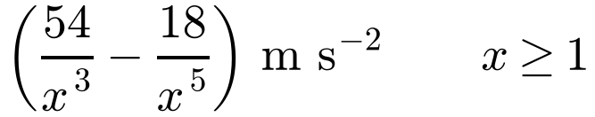
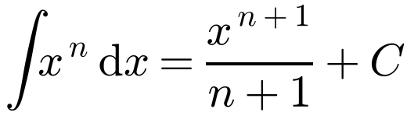
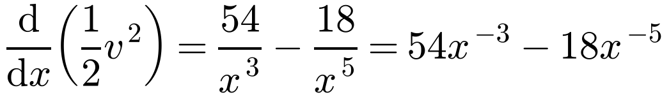
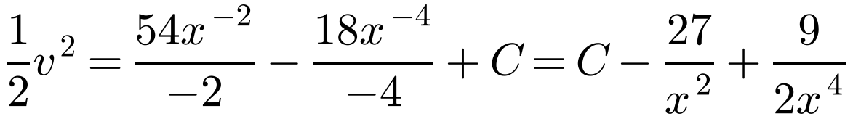
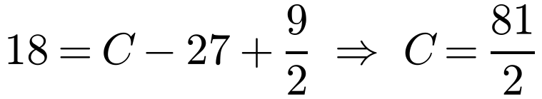
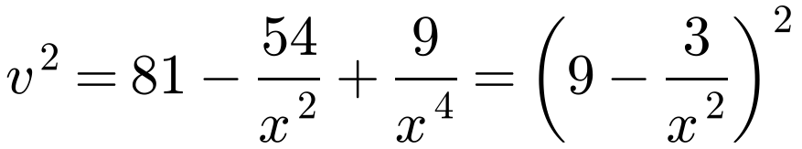
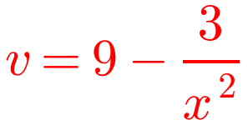
Acceleration Varying with Displacement
Write the acceleration as powers of x before integrating
A particle P is moving along the positive x-axis in the direction of x increasing. When OP = x m, the velocity of P is v m s⁻¹ and the acceleration of P is
Given that v = 6 at x = 1, find v in terms of x.
Look for a perfect square when you have to take a square root
Use the direction of motion to decide which square root to take
At x = 1, v = 6:
Multiply by 2, then factorise
P moves in the positive direction; the other root, −(9 − 3/x²), is negative for x ≥ 1
4B

Slide 6
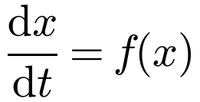
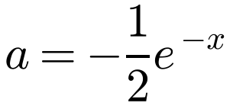
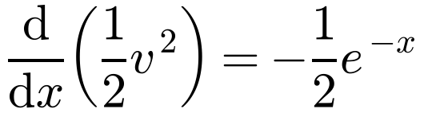
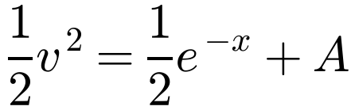
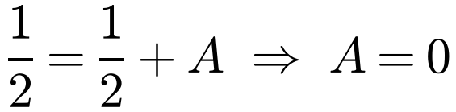

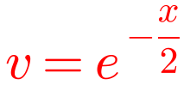
Acceleration Varying with Displacement
Two stages
Use a = d/dx(½v²) to find v in terms of x
Then write v = dx/dt and solve the differential equation
A particle P is moving along the x-axis. Initially P is at the origin O and is moving with velocity 1 m s⁻¹ in the direction of x increasing. At time t seconds, P is x m from O, has velocity v m s⁻¹ and acceleration of magnitude ½e^{−x} m s⁻² directed towards O. Find:
a) v in terms of x
b) x in terms of t.
a)
Towards O, so negative
by separating the variables
Each integration gives a new constant: use the initial conditions to find each one
At x = 0, v = 1:
v > 0 as P starts moving in the positive direction
4B

Slide 7
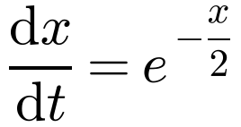
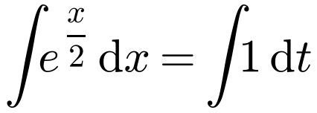
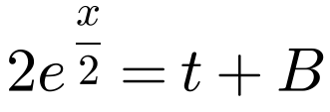
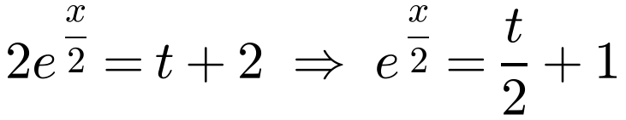
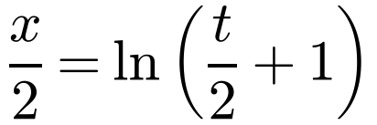
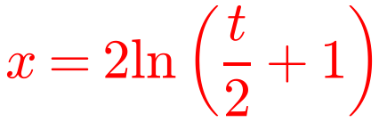
Acceleration Varying with Displacement
A particle P is moving along the x-axis. Initially P is at the origin O and is moving with velocity 1 m s⁻¹ in the direction of x increasing. At time t seconds, P is x m from O, has velocity v m s⁻¹ and acceleration of magnitude ½e^{−x} m s⁻² directed towards O. Find:
a) v in terms of x
b) x in terms of t.
b)
v = dx/dt
Separate the variables
When t = 0, x = 0: 2 = 0 + B ⇒ B = 2
Take logs: ln e^{f(x)} = f(x)
4B

Slide 8
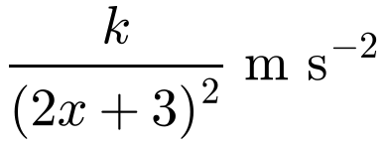
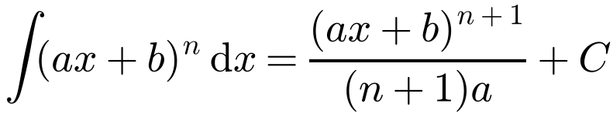
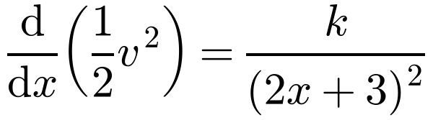
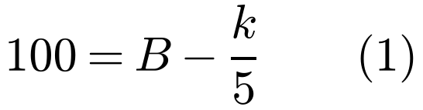
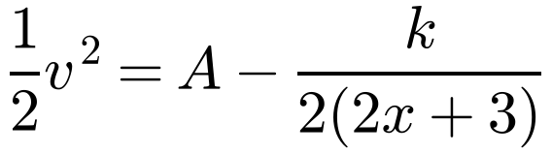
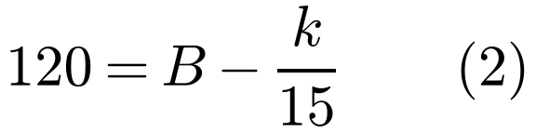
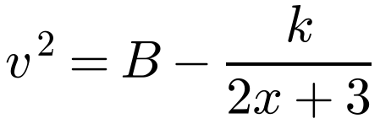
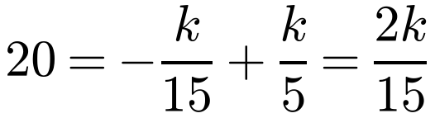
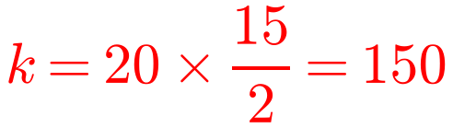
Acceleration Varying with Displacement
Unknown constants
Two conditions give a pair of simultaneous equations for the unknown constant and the constant of integration
A particle P is moving along the positive x-axis. At OP = x m, the velocity of P is v m s⁻¹ and the acceleration of P is
where k is a constant, directed away from O. At x = 1, v = 10 and at x = 6, v = √120.
a) Find the value of k.
b) Show that the speed of P cannot exceed √130 m s⁻¹.
a)
Twice an arbitrary constant is another arbitrary constant
At x = 1, v = 10:
At x = 6, v = √120:
Multiply by 2 (B = 2A):
(2) − (1):
4B

Slide 9
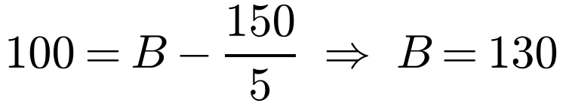
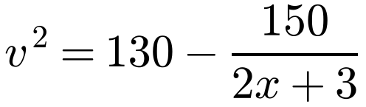
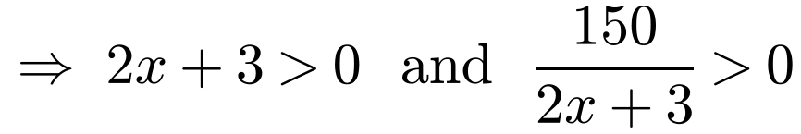
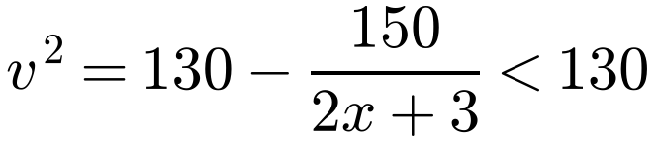
Acceleration Varying with Displacement
A particle P is moving along the positive x-axis. At OP = x m, the velocity of P is v m s⁻¹ and the acceleration of P is
b) Substitute k = 150 into (1):
where k is a constant, directed away from O. At x = 1, v = 10 and at x = 6, v = √120.
a) Find the value of k.
b) Show that the speed of P cannot exceed √130 m s⁻¹.
P moves along the positive x-axis, so x > 0
Hence
As x increases, v approaches √130 asymptotically
The speed of P cannot exceed √130 m s⁻¹
4B

