Slide 1
Kinematics
Further Mechanics 2 Chapter 4
Westie's Workshop

Slide 2
Teachings for Exercise 4A

Slide 3
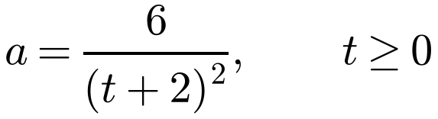
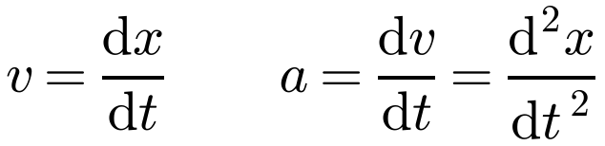

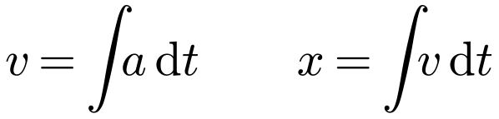
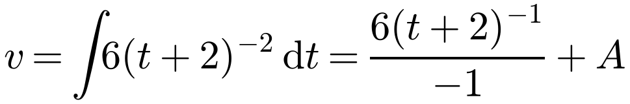
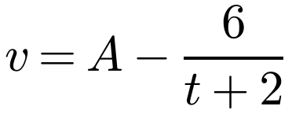
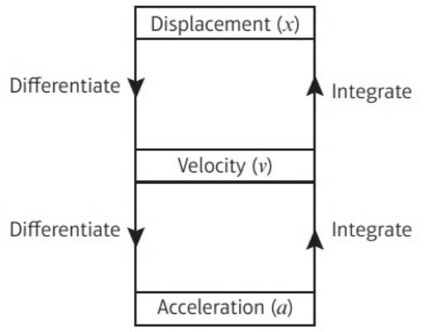
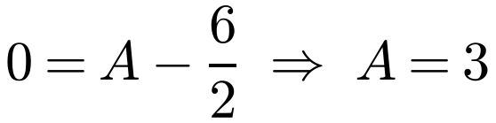
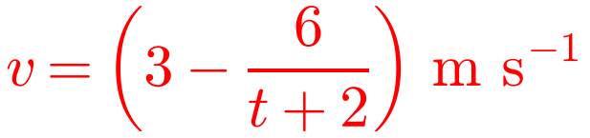
Acceleration Varying with Time
You can use calculus for a particle moving in a straight line with acceleration that varies with time
Differentiate with respect to time to go from displacement to velocity to acceleration:
A particle P starts from rest at a point O and moves along a straight line. At time t seconds the acceleration, a m s⁻², of P is given by
a) Find the velocity of P at time t seconds.
b) Show that the displacement of P from O when t = 6 is (18 − 12 ln 2) m.
a)
Integrate with respect to time to go the other way:
Write as a power to integrate
Always include a constant of integration
P starts from rest
When t = 0, v = 0
4A

Slide 4
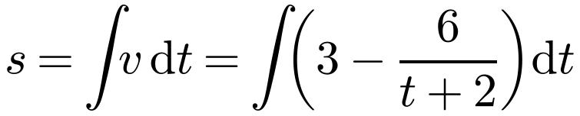




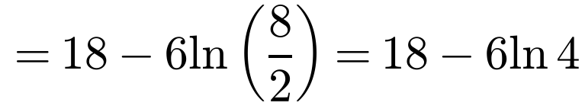

Acceleration Varying with Time
A particle P starts from rest at a point O and moves along a straight line. At time t seconds the acceleration, a m s⁻², of P is given by
b)
Integrate v to get the displacement s
Use a different letter for the new constant
a) Find the velocity of P at time t seconds.
b) Show that the displacement of P from O when t = 6 is (18 − 12 ln 2) m.
When t = 0, s = 0
P starts at O
When t = 6
ln a − ln b = ln(a/b)
ln 4 = ln 2² = 2 ln 2
The displacement of P from O when t = 6 is (18 − 12 ln 2) m, as required
4A

Slide 5
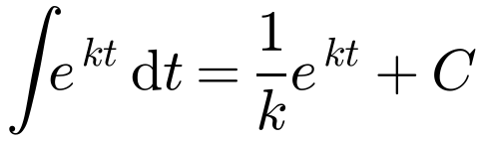
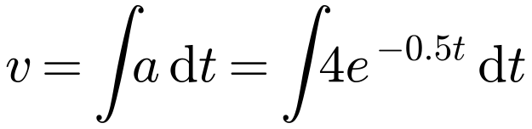


Acceleration Varying with Time
Integrating exponentials
A particle P is moving along the x-axis. At time t = 0, the particle is at the origin O and is moving with speed 2 m s⁻¹ in the direction Ox. At time t seconds, where t ≥ 0, the acceleration of P is 4e^{−0.5t} m s⁻² directed away from O.
a) Find the velocity of P at time t seconds.
b) Show that the speed of P cannot exceed 10 m s⁻¹.
c) Sketch a velocity–time graph to illustrate the motion of P.
For all real x, e^{x} > 0
If the speed gets closer and closer to a value without ever reaching it, that value is called the terminal or limiting velocity
On the v–t graph, the terminal velocity is a horizontal asymptote
a)
Divide by −0.5 (i.e. × −2)
When t = 0, v = 2: 2 = −8 + C ⇒ C = 10
b) For all t, 8e^{−0.5t} > 0
10 minus a positive number is less than 10
so 10 − 8e^{−0.5t} < 10 for all t
Hence the speed of P cannot exceed 10 m s⁻¹
4A

Slide 6
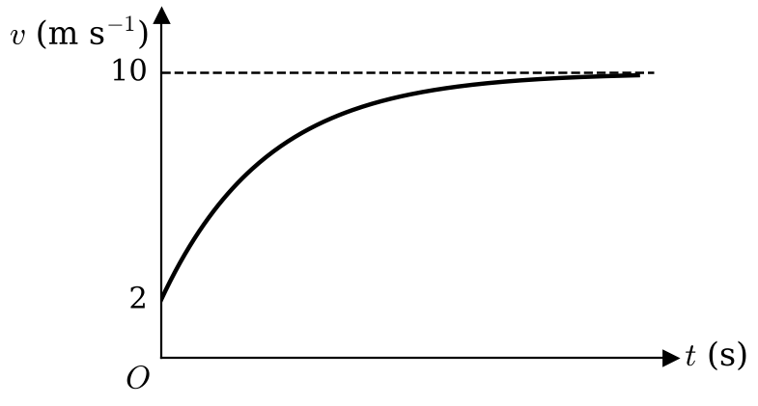
Acceleration Varying with Time
A particle P is moving along the x-axis. At time t = 0, the particle is at the origin O and is moving with speed 2 m s⁻¹ in the direction Ox. At time t seconds, where t ≥ 0, the acceleration of P is 4e^{−0.5t} m s⁻² directed away from O.
a) Find the velocity of P at time t seconds.
b) Show that the speed of P cannot exceed 10 m s⁻¹.
c) Sketch a velocity–time graph to illustrate the motion of P.
c) When t = 0, v = 2 and v increases towards 10
The line v = 10 is an asymptote: 10 m s⁻¹ is the terminal (limiting) velocity of P
4A

Slide 7
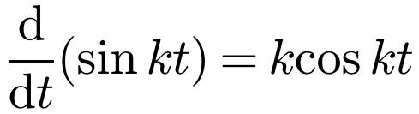
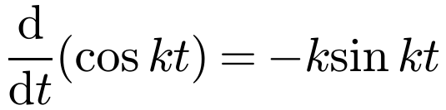
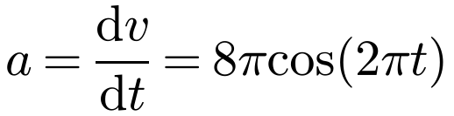
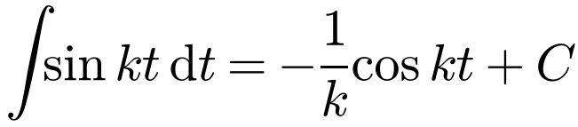
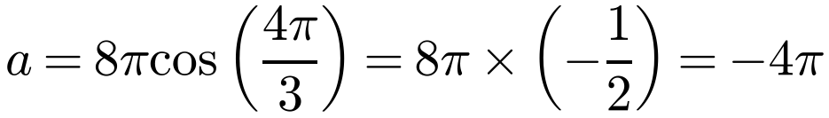
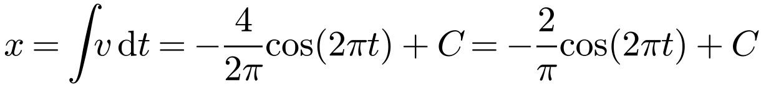
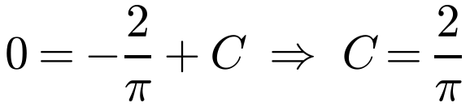
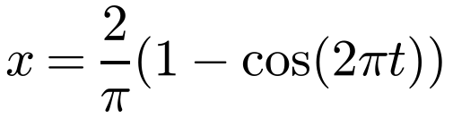
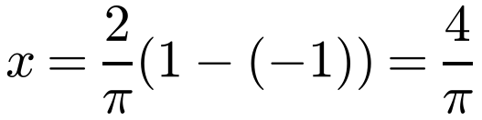
Acceleration Varying with Time
Differentiating and integrating trigonometric functions
A particle P is moving along the x-axis. At time t seconds, the velocity of P is v m s⁻¹, where v = 4 sin(2πt). When t = 0, P is at O. Find:
a) the magnitude of the acceleration of P when t = ⅔
b) the greatest distance from O attained by P during the motion.
a)
Differentiate v, with k = 2π
When t = ⅔
Angles are always measured in radians when you use calculus
The cosine of any angle lies between −1 and 1, so you can sometimes find a greatest value without calculus
The magnitude of the acceleration is 4π m s⁻²
b)
When t = 0, x = 0:
cos 0 = 1
Greatest value of x when cos(2πt) = −1:
1 − cos(2πt) lies between 0 and 2
The greatest distance from O is 4/π m
4A

Slide 8
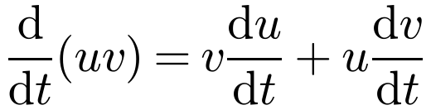
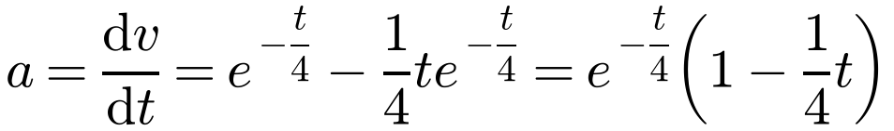
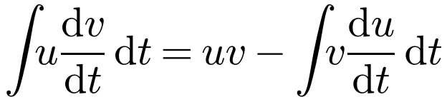
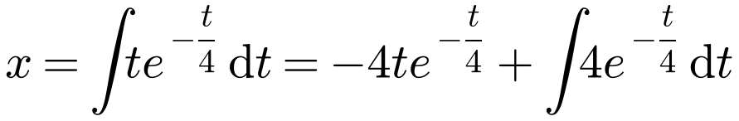
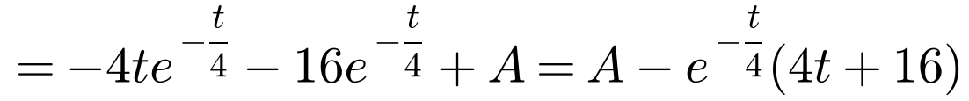
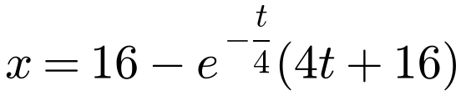
Acceleration Varying with Time
You may need the product rule or integration by parts
A particle P is moving along the x-axis. Initially P is at the origin O. At time t seconds (where t ≥ 0) the velocity, v m s⁻¹, of P is given by v = te^{−t/4}. Find the distance of P from O when the acceleration of P is zero.
Product rule
a = 0 and e^{−t/4} ≠ 0, so 1 − ¼t = 0 ⇒ t = 4
By parts: u = t, dv/dt = e^{−t/4}
First find the time when the acceleration is zero, then find the displacement at that time
When t = 0, x = 0: 0 = A − 16 ⇒ A = 16
When t = 4
When the acceleration is zero, OP = 16(1 − 2e⁻¹) m
4A

Slide 9
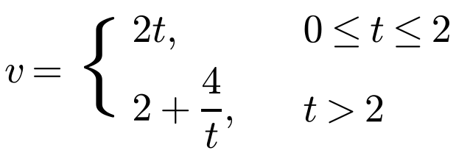
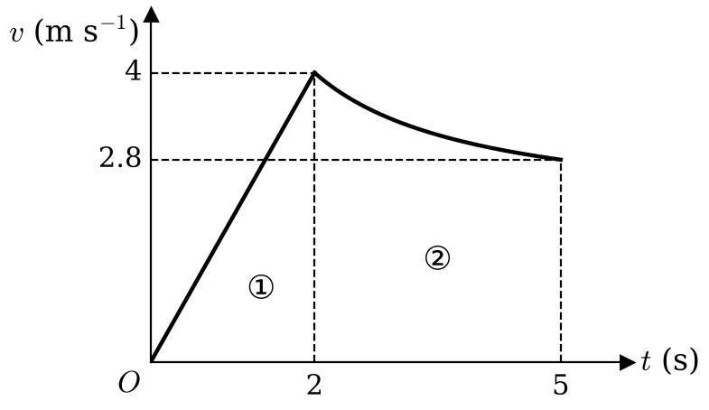
Acceleration Varying with Time
Velocity may be given by different expressions for different time intervals (piecewise)
The distance moved is the area between the v–t graph and the t-axis
Find the area for each interval separately, using a formula (e.g. ½ × base × height) or definite integration, then add
A particle is moving along the x-axis. At time t seconds the velocity of P is v m s⁻¹ in the direction of x increasing, where
When t = 0, P is at the origin O.
a) Sketch a velocity–time graph to illustrate the motion of P in the interval 0 ≤ t ≤ 5.
b) Find the distance of P from O when t = 5.
a) v = 2t: (0, 0) to (2, 4); v = 2 + 4/t: (2, 4) to (5, 2.8)
4A

Slide 10
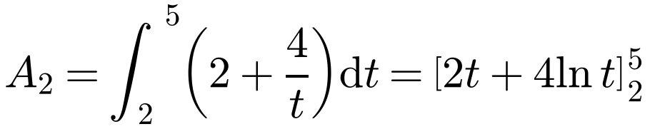

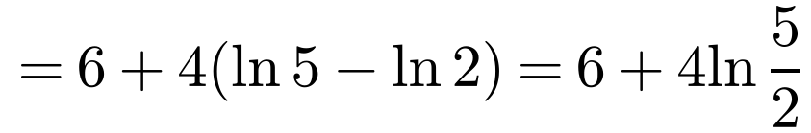
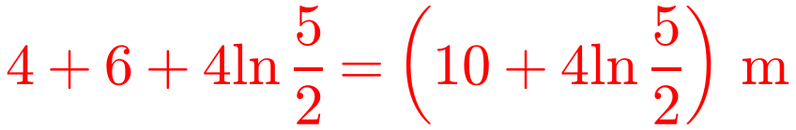
Acceleration Varying with Time
A particle is moving along the x-axis. At time t seconds the velocity of P is v m s⁻¹ in the direction of x increasing, where
b) Distance in the first 2 seconds (area ①):
Area of a triangle
A₁ = ½ × 2 × 4 = 4
Distance in the next three seconds (area ②):
Definite integration
When t = 0, P is at the origin O.
a) Sketch a velocity–time graph to illustrate the motion of P in the interval 0 ≤ t ≤ 5.
b) Find the distance of P from O when t = 5.
Distance of P from O when t = 5:
4A

Slide 11
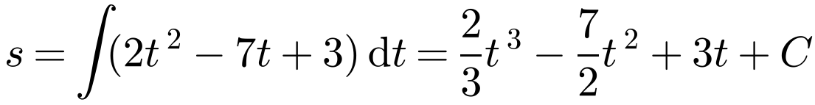
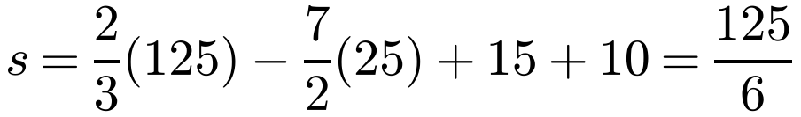
Acceleration Varying with Time
Instantaneously at rest means v = 0
Displacement is the position relative to O; distance travelled is the total length of the path
If the particle changes direction, the definite integral of v gives the displacement, not the distance
To find the distance travelled, find the area under each part of the v–t graph separately and add them (areas below the t-axis come out negative)
A particle P moves on the positive x-axis. The velocity of P at time t seconds is (2t² − 7t + 3) m s⁻¹, t ≥ 0. When t = 0, P is 10 m from the origin O. Find:
a) the values of t when P is instantaneously at rest
b) the displacement of P when t = 5
c) the total distance travelled by P in the interval 0 ≤ t ≤ 5.
Set v = 0
a) 2t² − 7t + 3 = 0
(2t − 1)(t − 3) = 0
P is instantaneously at rest when t = 0.5 and t = 3
b)
When t = 0, s = 10 so C = 10
When t = 5:
The displacement of P when t = 5 is 125/6 = 20.83 m (2 d.p.)
4A

Slide 12
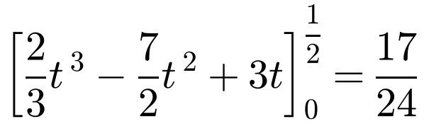
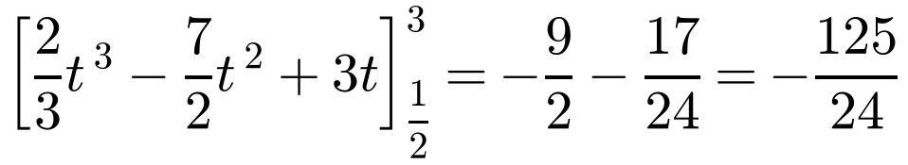
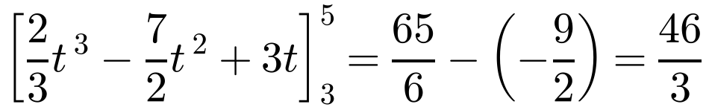
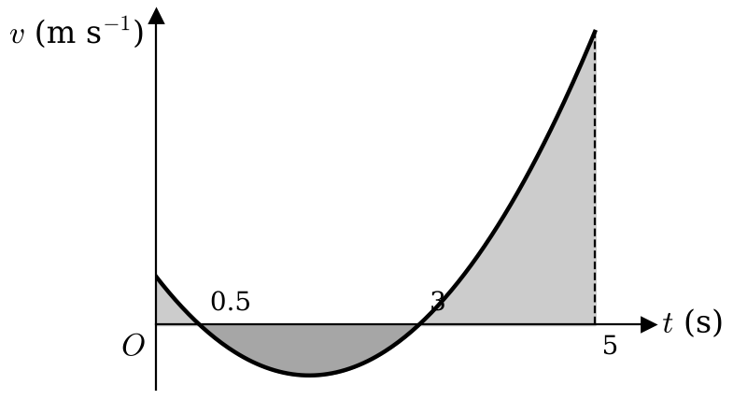
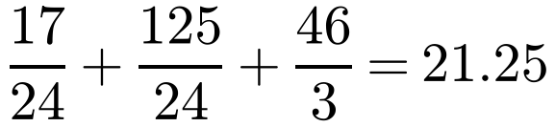
Acceleration Varying with Time
A particle P moves on the positive x-axis. The velocity of P at time t seconds is (2t² − 7t + 3) m s⁻¹, t ≥ 0. When t = 0, P is 10 m from the origin O. Find:
a) the values of t when P is instantaneously at rest
b) the displacement of P when t = 5
c) the total distance travelled by P in the interval 0 ≤ t ≤ 5.
c) P changes direction at t = 0.5 and t = 3, so integrate over each interval:
Negative: below the t-axis
Total distance travelled:
P travels 21.25 m in the interval 0 ≤ t ≤ 5
4A

