Slide 1
Further Centres of Mass
Further Mechanics 2 Chapter 3
Westie's Workshop

Slide 2
Teachings for Exercise 3E

Slide 3
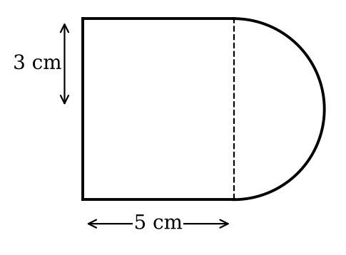
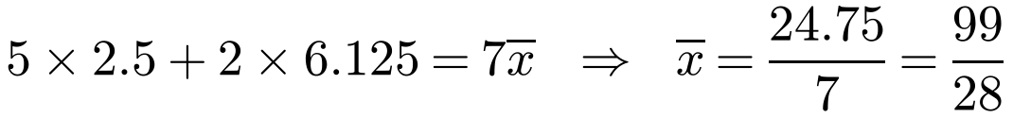
Toppling and Sliding
Composite body
Draw a diagram and use a table of masses and positions of centres of mass
Measure heights from the base of the cylinder
Hemisphere: ⅜r from its plane face
A solid uniform cylinder of radius 3 cm and height 5 cm has a solid uniform hemisphere made from the same material, of radius 3 cm, joined to it so that the base of the hemisphere coincides with one circular end of the cylinder.
a) Find the position of the centre of mass of the composite body.
The composite body is placed with the circular face of the cylinder on a rough inclined plane, which is inclined at an angle α to the horizontal. Given that the plane is sufficiently rough to prevent sliding,
b) show that equilibrium is maintained provided that tan α < 28/33.
Shape
Mass
Ratio
Height above base
Cylinder
ρπ3² × 5 = 45ρπ
5
2.5
Hemisphere
⅔ρπ3³ = 18ρπ
2
5 + ⅜ × 3 = 6.125
Composite
63ρπ
7
x̄
a) On the axis, 99/28 cm (3.54 cm) above the base of the cylinder
3E

Slide 4
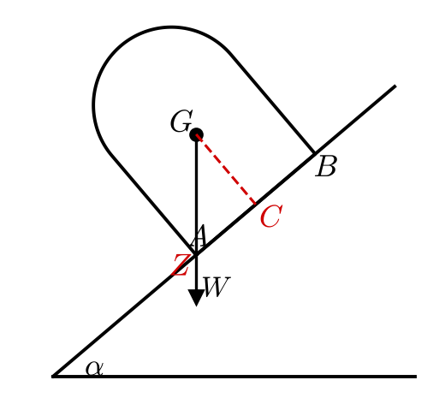
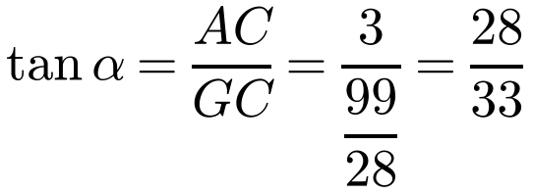
Toppling and Sliding
Toppling on an inclined plane
If a body rests in equilibrium on a rough inclined plane, the line of action of its weight must pass through the face in contact with the plane
Limiting case: G is vertically above the lowest point of contact, A
If α is larger, the weight has a turning effect about A and the body topples
The composite body is placed with the circular face of the cylinder on a rough inclined plane, which is inclined at an angle α to the horizontal. Given that the plane is sufficiently rough to prevent sliding,
b) show that equilibrium is maintained provided that tan α < 28/33.
Limiting case: G is vertically above A
The axis is perpendicular to the plane, so angle AGC = α
If tan α < 28/33, G is above a point of the contact area
Equilibrium is maintained provided tan α < 28/33
3E

Slide 5
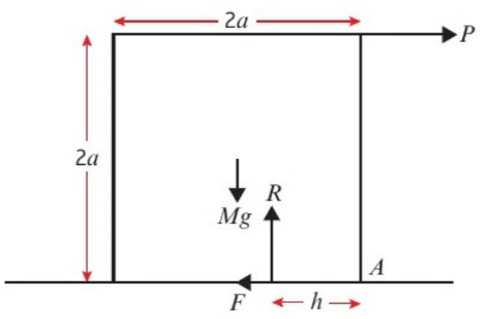
Toppling and Sliding
Sliding or toppling?
First write down the general equilibrium conditions:
resolve horizontally, resolve vertically, take moments
Then substitute each case
Sliding: is F ≤ μR possible?
Toppling: is h ≥ 0?
A uniform solid cube of mass M and side 2a rests on a rough horizontal plane. The coefficient of friction is μ. A horizontal force of magnitude P is applied at the midpoint of an upper edge, perpendicular to that edge, as shown. The reaction between the plane and the cube comprises a normal reaction force R and a friction force F and acts at a distance h from a lower edge of the cube.
Find whether the cube remains in equilibrium, or whether the equilibrium is broken by sliding or toppling, in each case. Also find F and h:
a) P = 0 b) P = ½Mg and μ = ¾ c) P = ¼Mg and μ = ⅕
A is on the bottom edge (see diagram)
Remains in equilibrium: R acts at the centre of the base
3E

Slide 6
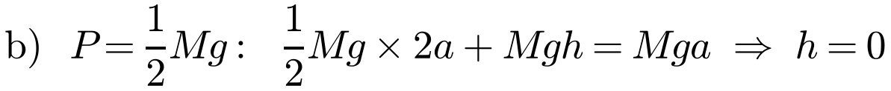
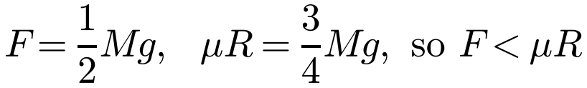
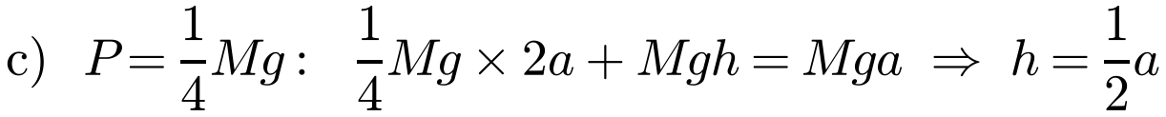
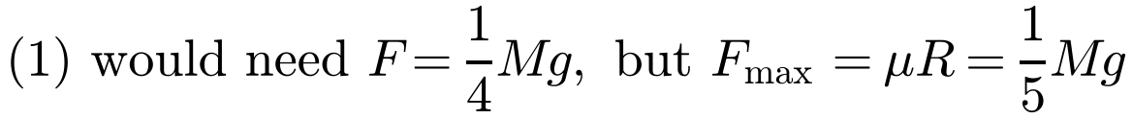
Toppling and Sliding
Limiting cases
A body is on the point of sliding when F = μR
A body is on the point of toppling when the reaction acts at the point about which turning can take place
If equilibrium needs F > μR, it cannot happen: the body slides
Using: F = P (1), R = Mg (2), 2aP + Rh = Mga (3)
h = 0, so the reaction acts at A: the cube is about to topple
Does not slide; on the point of toppling. F = ½Mg, h = 0
h = ½a, so the reaction is within the base: it does not topple
Impossible, so the cube slides (F = ⅕Mg) if P is maintained
3E

Slide 7
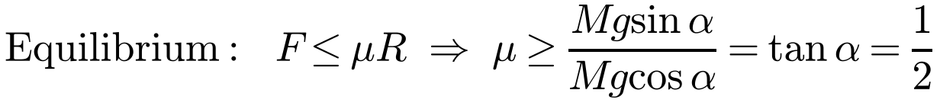
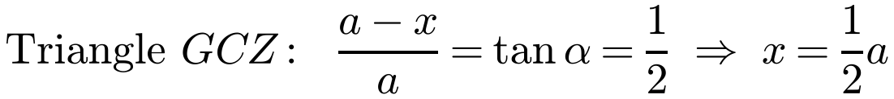
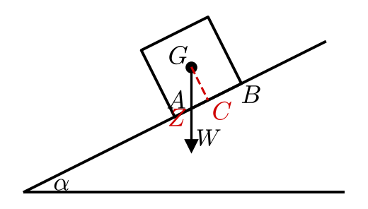
Toppling and Sliding
Sliding on an inclined plane
Resolve perpendicular to and along the plane
For equilibrium F ≤ μR, so μ ≥ tan α
Check toppling too: Z, the point vertically below G, must lie between A and B
A uniform solid cube of mass M and side 2a is placed on a rough inclined plane which is at an angle α to the horizontal, where tan α = ½. The coefficient of friction is μ. Show that if μ < ½ the cube will slide down the slope.
So if μ < ½ the cube will slide
Toppling? Let Z be x from A up the plane, C the midpoint of AB
Z is between A and B, so the cube does not topple
3E

Slide 8
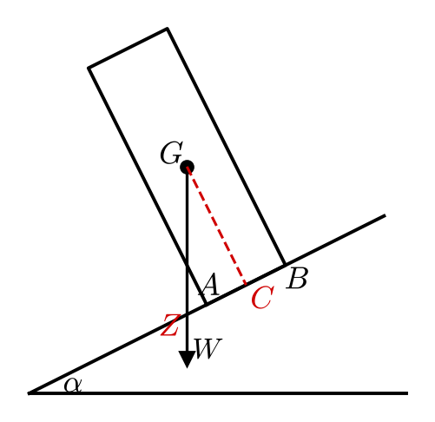
Toppling and Sliding
Toppling on an inclined plane
μ > ½ = tan α, so (as in the previous example) the cylinder will not slip
A tall body is more likely to topple
Alternative: assume the reaction acts at A and show there is still a turning moment about A
The cube in the previous example is now replaced by a cylinder of mass M with base radius a and height 6a. The cylinder is placed on the rough inclined plane, which is inclined at an angle α to the horizontal, where tan α = ½. The coefficient of friction is μ. Show that if μ > ½ the cylinder will topple about the lower edge.
μ > ½ = tan α, so the cylinder will not slip
Let Z be x from A down the plane; C the midpoint of AB
GC = 3a (half the height), CA = a, so CZ = a + x
Z is outside AB (below A), so the cylinder topples about the lower edge
3E

