Slide 1
Further Centres of Mass
Further Mechanics 2 Chapter 3
Westie's Workshop

Slide 2
Teachings for Exercise 3D

Slide 3
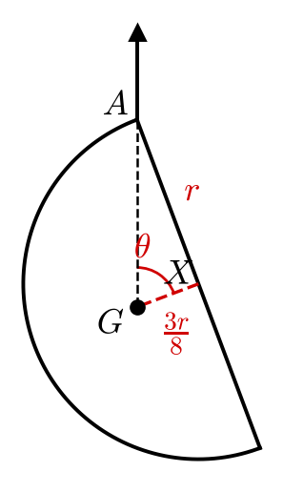
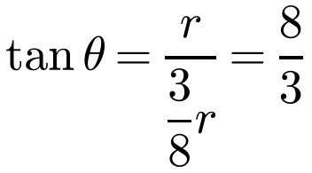
Rigid Bodies in Equilibrium
Freely suspended bodies
In equilibrium: zero resultant force in every direction and zero total moment about any point
A body suspended freely from a point rests with its centre of mass vertically below the point of suspension
Only two forces act (the weight and the force at A), so they act in the same vertical line
A uniform solid hemisphere has radius r. It is suspended by a string attached to a point A on the rim of its base. Find the angle between the axis of the hemisphere and the downward vertical when the hemisphere is in equilibrium.
G is vertically below A
X is the centre of the base
Hemisphere result
AX = r and XG = ⅜r
Angle XGA = θ is the angle between the axis and the downward vertical
θ = 69.4° (3 s.f.)
3D

Slide 4
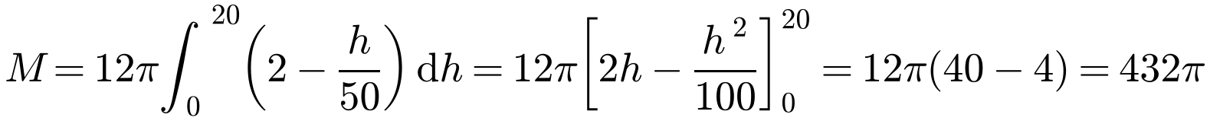
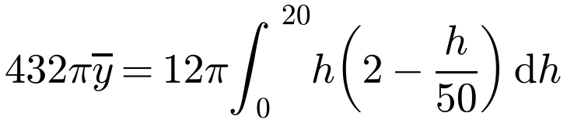
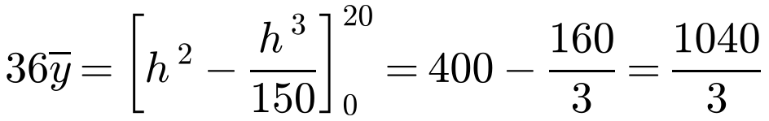
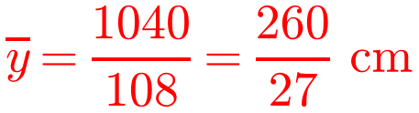
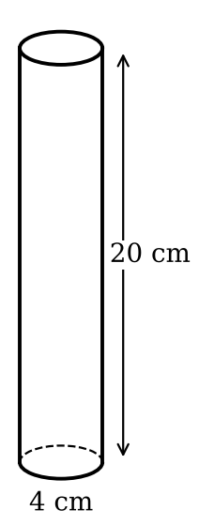
Rigid Bodies in Equilibrium
Density varying with height
Split the cylinder into thin discs of thickness δh
Mass of a disc: ρπr² δh
Integrate to find the total mass, then take moments about the base to find ȳ
Equivalent to a rod with mass per unit length 3π(2²)(2 − h/50)
A non-uniform cylinder has height 20 cm and radius 2 cm. At any height h cm above its base, the density of the cylinder is given by ρ = 3(2 − h/50) g cm⁻³. The cylinder is freely suspended from a point P that lies on the circumference of its top face. Find the angle between the downward vertical and the top face of the cylinder.
ȳ = height of the centre of mass above the base
3D

Slide 5
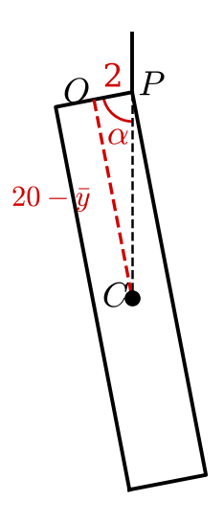
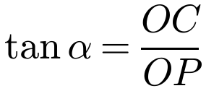
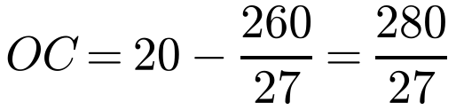
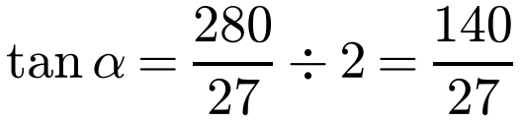
Rigid Bodies in Equilibrium
Hanging position
C, the centre of mass, is vertically below P
O is the centre of the top face, so OP = 2 cm
The density decreases with height: the cylinder is bottom-heavy, so ȳ < 10
A non-uniform cylinder has height 20 cm and radius 2 cm. At any height h cm above its base, the density of the cylinder is given by ρ = 3(2 − h/50) g cm⁻³. The cylinder is freely suspended from a point P that lies on the circumference of its top face. Find the angle between the downward vertical and the top face of the cylinder.
α = 79.1° (3 s.f.)
3D

Slide 6
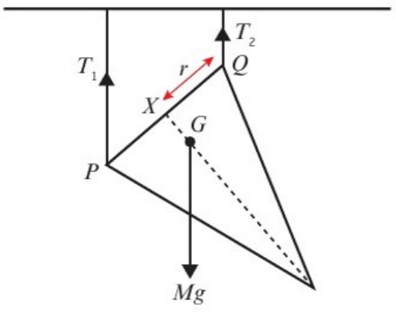

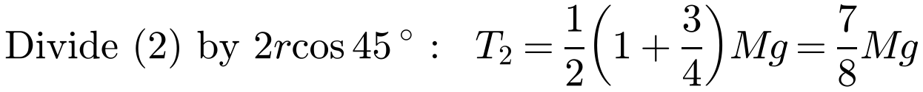
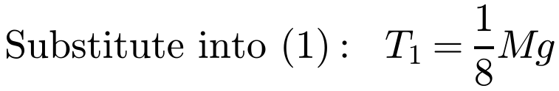
Rigid Bodies in Equilibrium
Bodies held by strings
Resolve vertically
Take moments about a point where an unknown force acts (P eliminates T₁)
Use horizontal distances for the moments of vertical forces
Cone: G is on the axis, ¼ of the height (¾r) from the base
The diagram shows a uniform solid right circular cone, of mass M with radius r and height 3r. P and Q are points at opposite ends of a diameter on the circular plane face of the cone. The cone is suspended from a horizontal beam by two vertical inelastic strings fastened at P and Q. Given that the cone is in equilibrium with its axis at an angle of 45° to the horizontal, find the values of the tensions in the strings, giving your answers in terms of M and g.
PQ = 2r, at 45° to the horizontal; horizontal distance from P to G = r cos 45° + ¾r sin 45°
Tensions are ⅛Mg (at P) and ⅞Mg (at Q)
3D

Slide 7



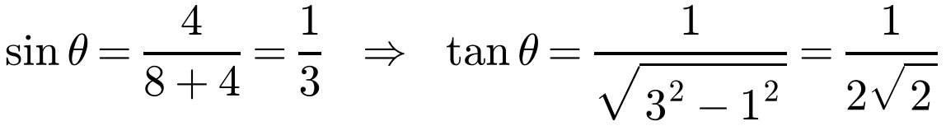
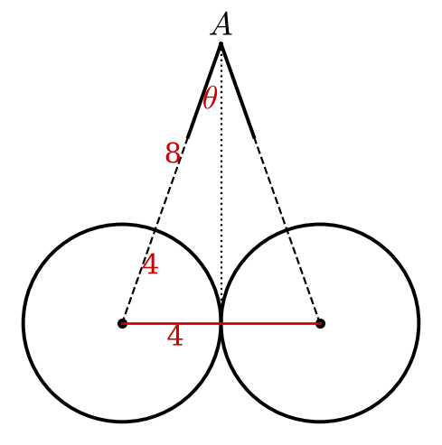
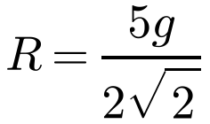
Rigid Bodies in Equilibrium
Two spheres hanging together
By symmetry the tensions are equal
Each string, extended, passes through the centre of its sphere
The reaction between smooth spheres acts along the line of centres
Two smooth uniform spheres of radius 4 cm and mass 5 kg are suspended from the same point A by identical light inextensible strings of length 8 cm attached to their surfaces. The spheres hang in equilibrium, touching each other. What is the reaction between them?
Each sphere: tension T along the string, weight 5g, reaction R
Right-angled triangle: hypotenuse 3, opposite 1
R = 17 N (2 s.f.)
3D

