Slide 1
Further Centres of Mass
Further Mechanics 2 Chapter 3
Westie's Workshop

Slide 2
Teachings for Exercise 3C

Slide 3
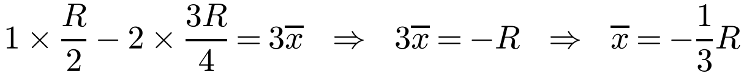
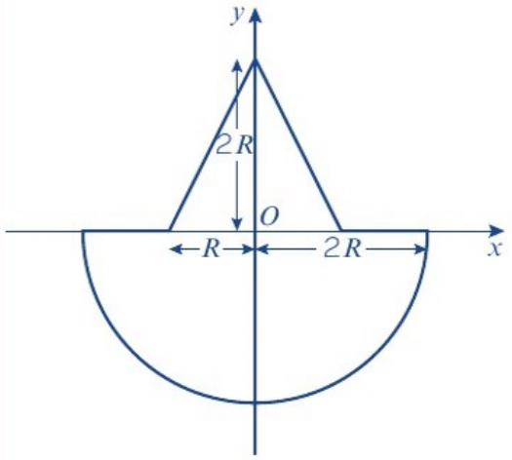
Non-Uniform Bodies
Composite bodies of different densities
Each part is uniform, but the whole body is not
Let the hemisphere have density ρ, so the cone has density 4ρ
Use the ratio of the masses to simplify
Careful with signs when taking moments about a point inside the body
A uniform solid right circular cone of height 2R and base radius R is joined at its base to the base of a uniform solid hemisphere. The centres of their bases coincide at O and their axes are collinear. The radius of the hemisphere is 2R. Find the position of the centre of mass of the composite body if the cone has four times the density of the hemisphere.
Shape
Mass
Ratio
Distance from O
Cone
⅓(4ρ)πR²(2R) = (8/3)ρπR³
1
¼(2R) = ½R
Hemisphere
⅔ρπ(2R)³ = (16/3)ρπR³
2
−⅜(2R) = −¾R
Composite
3
x̄
Centre of mass lies on the common axis. Moments about O:
Negative: on the hemisphere side of O
Centre of mass is ⅓R below O, on the common axis
3C

Slide 4
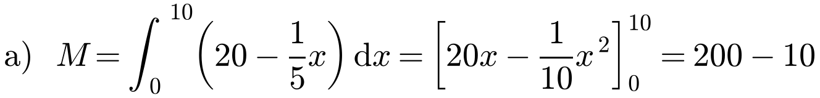
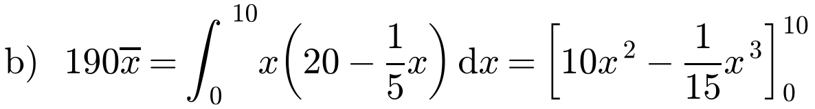
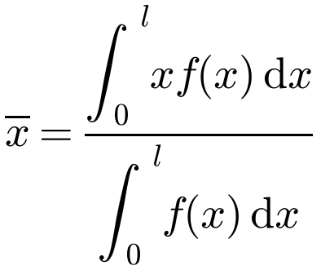
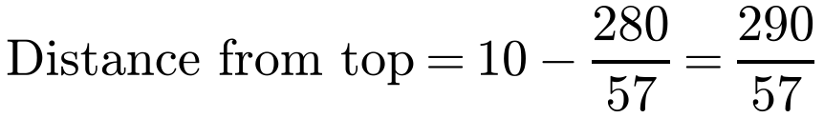
Non-Uniform Bodies
Non-uniform rods
Mass per unit length ρ = f(x), where x is the distance from one end
A small section of length δx has mass f(x) δx
Total mass: M = ∫ f(x) dx
A non-uniform telegraph pole is 10 m long. At any distance x metres from its base, the mass per unit length of the telegraph pole is given by m = 20 − ⅕x kg m⁻¹. By modelling the telegraph pole as a rod, find:
a) the mass of the telegraph pole
b) the distance of the centre of mass of the telegraph pole from its top.
M = 190 kg
x̄ measured from the base
290/57 m (5.09 m to 3 s.f.) from the top
A prism with density varying with height can be modelled as a rod in the same way
3C

