Slide 1
Further Centres of Mass
Further Mechanics 2 Chapter 3
Westie's Workshop

Slide 2
Teachings for Exercise 3B

Slide 3
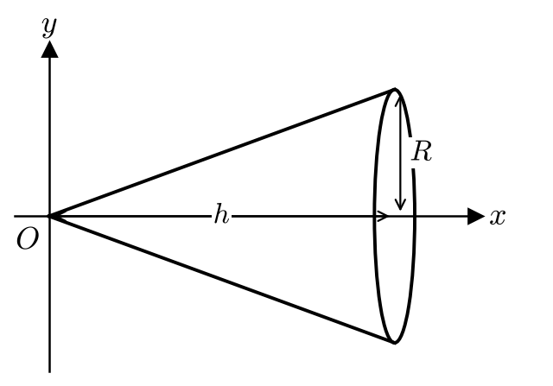
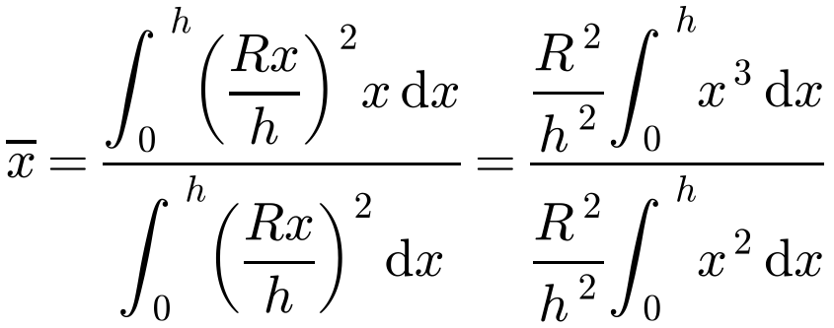
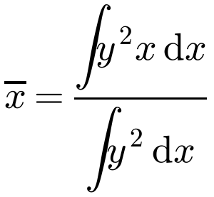
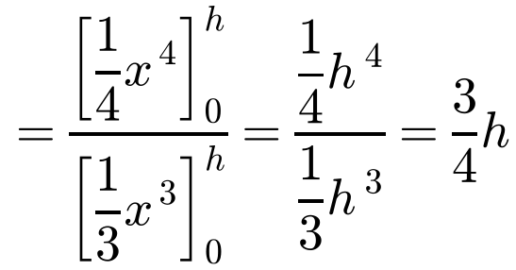
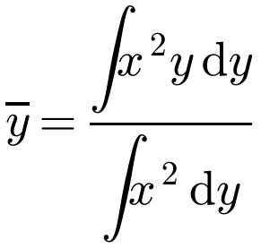
Centre of Mass of a Uniform Body
Solids of revolution
Uniform solid: centre of mass lies on every axis and plane of symmetry
Rotating about the x-axis: split into discs of radius y, thickness δx, mass ρπy² δx
Find the centre of mass of the uniform solid right circular cone with radius R and height h.
Generating line: y = (R/h)x, rotated about the x-axis
By symmetry, the centre of mass lies on the x-axis
R²/h² is constant, so it cancels
Rotating about the y-axis:
On the axis, ¾h from the vertex (¼h from the base)
ρ and π are constant, so they cancel
3B

Slide 4
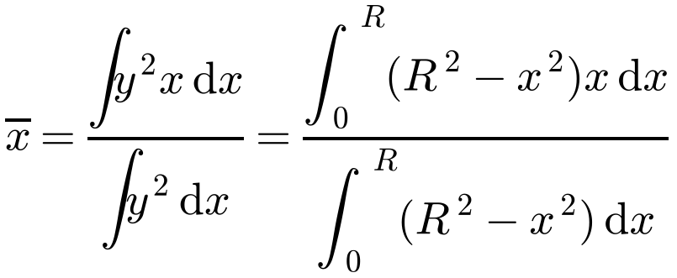
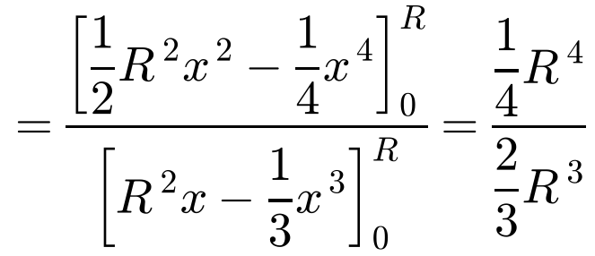
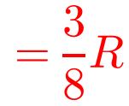
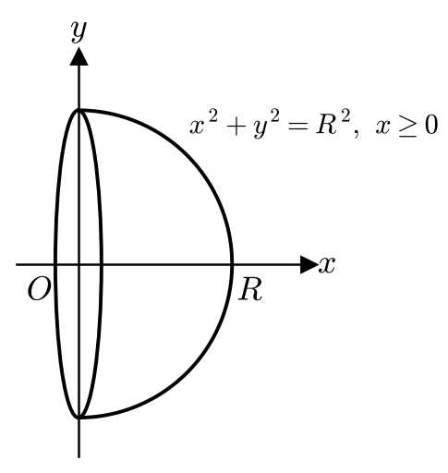
Centre of Mass of a Uniform Body
Solid hemisphere
Generated by rotating the quarter circle x² + y² = R², x ≥ 0, about the x-axis
Replace y² by R² − x²
You may be asked to prove the cone and hemisphere results; otherwise quote them
Find the centre of mass of the uniform solid hemisphere with radius R.
By symmetry, the centre of mass lies on the x-axis
On the axis, ⅜R from the plane face
3B

Slide 5
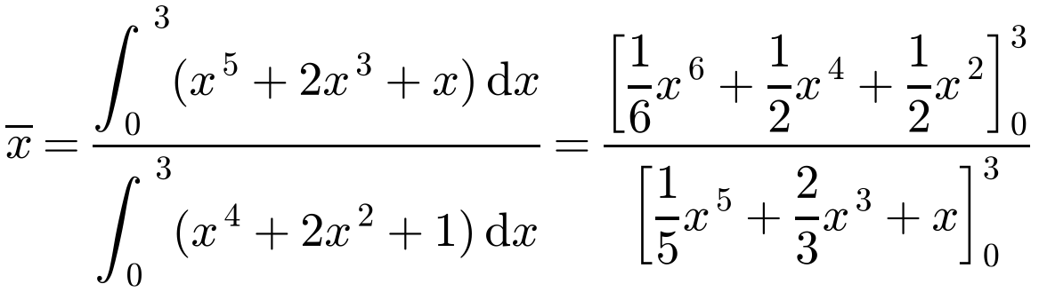
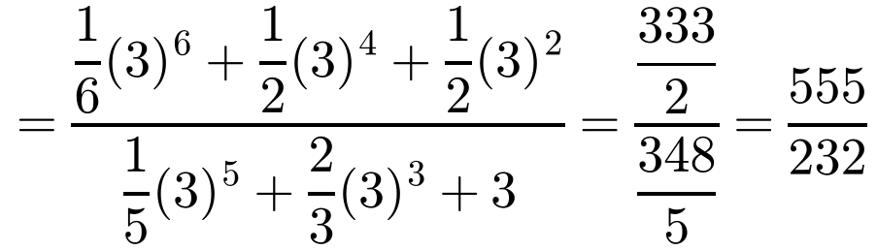
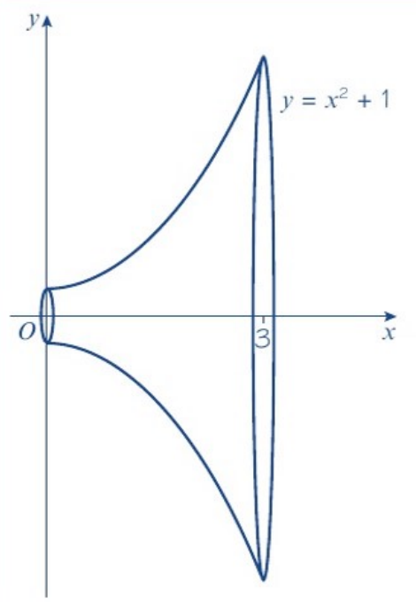
Centre of Mass of a Uniform Body
Volume of revolution
Write out the formula before substituting
Square y first: y² = (x² + 1)²
Show the integrated function with its limits, then substitute: do not use the numerical integration function on your calculator
Find the centre of mass of the uniform solid of revolution formed by rotating the finite region enclosed by the curve y = x² + 1, the x-axis and the lines x = 0 and x = 3 through 360° about the x-axis.
Centre of mass is at (555/232, 0), i.e. (2.39, 0) to 3 s.f.
3B

Slide 6
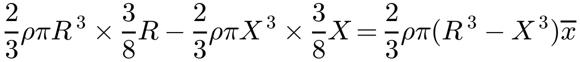
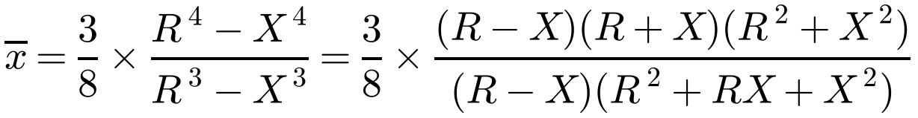
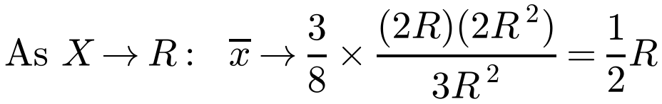
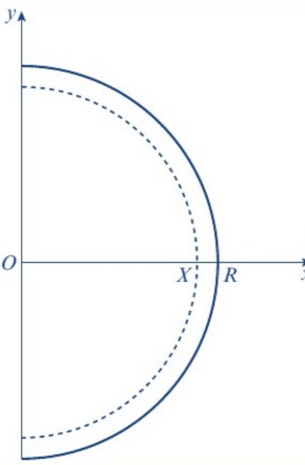
Centre of Mass of a Uniform Body
Hemispherical shell
A shell is a hollow hemisphere
Remove a solid hemisphere of radius X from a solid hemisphere of radius R
Take moments, then let X → R
The result is in the formula booklet
Find the centre of mass of the uniform hemispherical shell with radius R.
Shape
Mass
Centre of mass
Solid hemisphere, radius R
⅔ρπR³
(⅜R, 0)
Solid hemisphere, radius X
⅔ρπX³
(⅜X, 0)
Hollow shell
⅔ρπ(R³ − X³)
(x̄, 0)
Moments about the axis through O in the plane face:
On the axis, ½R from the plane face
3B

Slide 7
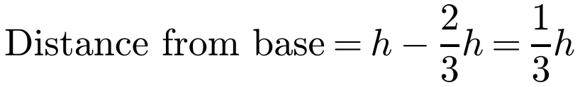
Centre of Mass of a Uniform Body
Conical shell (hollow cone)
Split the curved surface into thin triangles, each with a vertex at O and base on the circumference
The centre of mass of a triangle is ⅔ of the way from a vertex to the midpoint of the opposite side
Show that the centre of mass of the uniform hollow right circular cone with radius R and height h is at a distance ⅓h from the base along the axis of symmetry.
Each triangular strip has its centre of mass ⅔ of the distance from O to the base of the cone
So the centre of mass of the hollow cone is also ⅔ of the distance from O to the base
All the strips together are symmetrical about the axis
By symmetry, it is on the axis of symmetry
Conical shell: ⅓h from the base (⅔h from the vertex)
3B

Slide 8
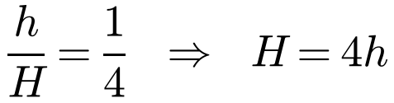
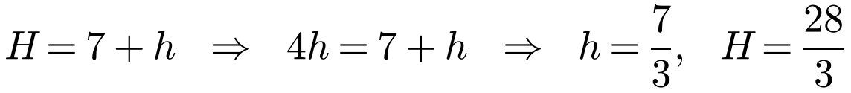
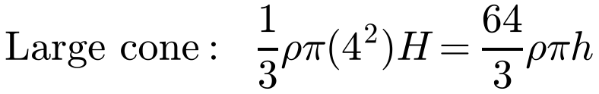
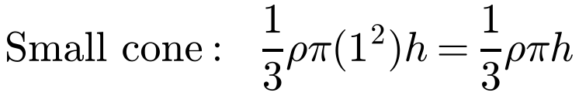
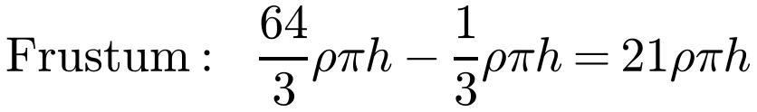
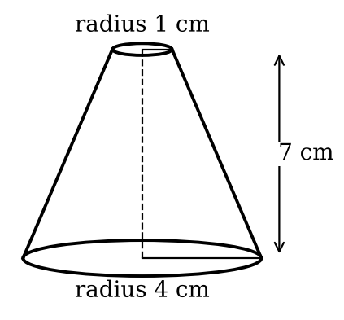
Centre of Mass of a Uniform Body
Frustum
A frustum is the part of a cone between two parallel planes
Treat it as a large cone with a small cone removed from the top
Use similar triangles to find the heights
Find the position of the centre of mass of the frustum of a right circular uniform cone, of end radii 1 cm and 4 cm, and of height 7 cm.
Let the large cone have height H and the small cone height h
Masses are in the ratio 64 : 1 : 63
3B

Slide 9
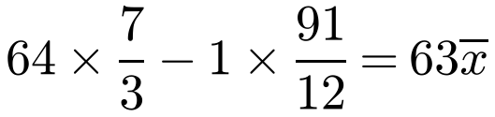
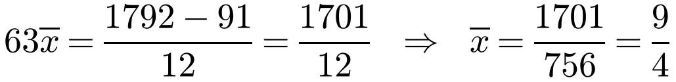
Centre of Mass of a Uniform Body
Frustum: moments
Measure distances from the base of the frustum
A cone’s centre of mass is ¼ of its height above its base
Use the ratio of masses to simplify the moments equation
Find the position of the centre of mass of the frustum of a right circular uniform cone, of end radii 1 cm and 4 cm, and of height 7 cm.
Shape
Mass ratio
Distance of centre of mass from base
Large cone
64
¼H = 7/3
Small cone
1
7 + ¼h = 91/12
Frustum
63
x̄
Taking moments about the base of the frustum:
Centre of mass is 9/4 cm (2.25 cm) above the base, on the axis
3B

