Slide 1
Further Centres of Mass
Further Mechanics 2 Chapter 3
Westie's Workshop

Slide 2
Teachings for Exercise 3A

Slide 3
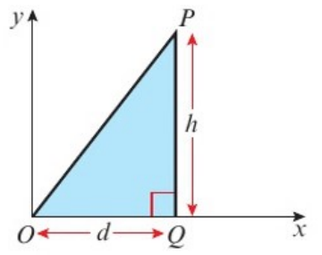
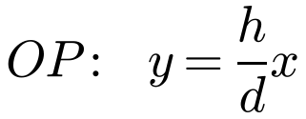
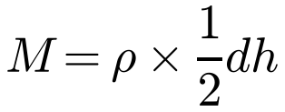
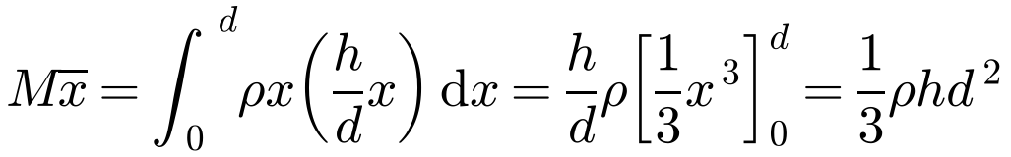
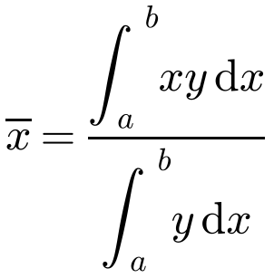
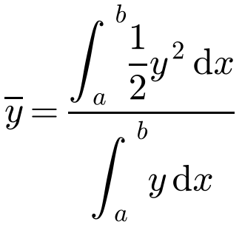
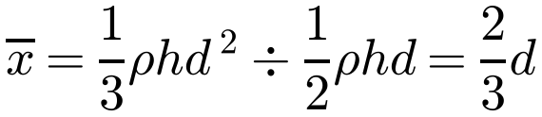
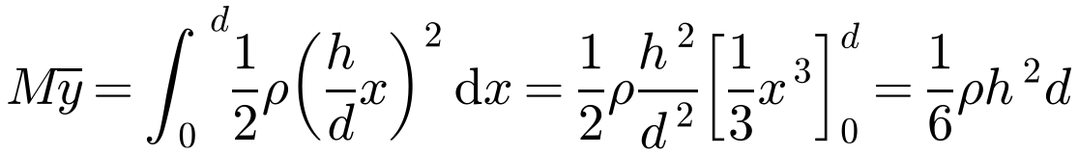
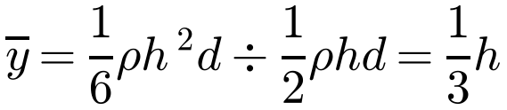
Using Calculus to Find Centres of Mass
Centre of mass of a uniform lamina
Split the lamina into thin vertical strips of width δx
A strip at x has height y, so its mass is ρy δx
Its centre of mass is at (x, ½y)
Sum the moments and let δx → 0:
Use calculus to find the position of the centre of mass of a right-angled triangular lamina OPQ with base d and height h, as shown in the diagram.
Gradient h/d, through O
The mean of the vertices (0, 0), (d, 0), (d, h)
ρ is constant for a uniform lamina, so it cancels
Centre of mass is at (⅔d, ⅓h)
3A

Slide 4
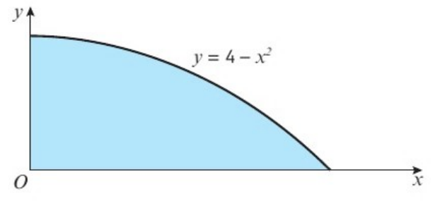
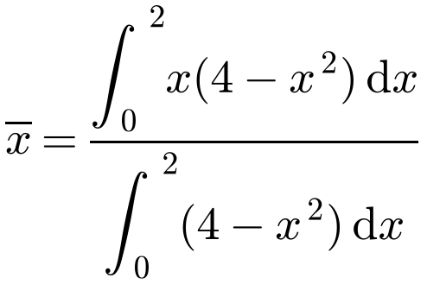
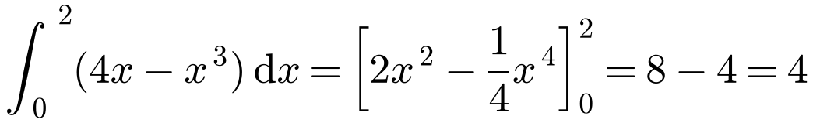
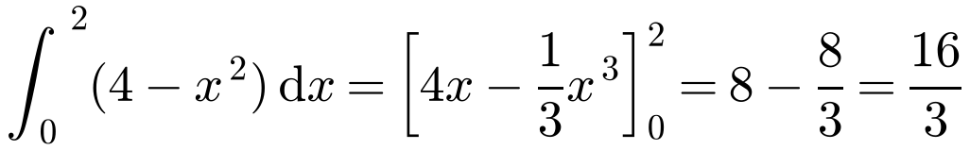
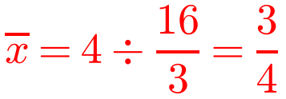
Using Calculus to Find Centres of Mass
Method
Find the limits: where does the curve meet the x-axis?
Substitute y = f(x) into the formulae
Work out the two integrals separately, then divide
Show the integrated function, the limits and the substitution: do not just use a calculator
Find the coordinates of the centre of mass of the uniform lamina bounded by the curve with equation y = 4 − x², the x-axis and the y-axis, as shown.
Curve meets the x-axis when 4 − x² = 0, so x = 2
3A

Slide 5
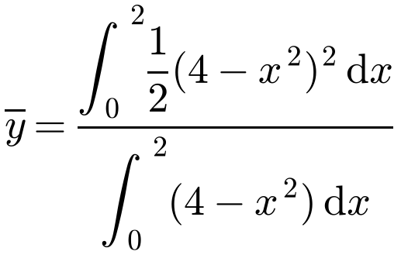
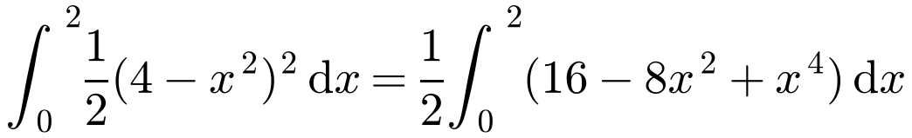
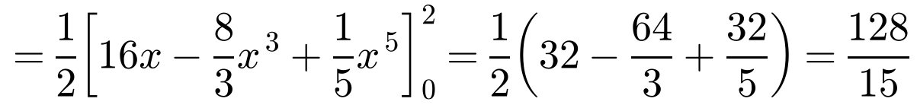
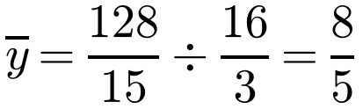
Using Calculus to Find Centres of Mass
Finding ȳ
Use ½y² in the numerator: the centre of mass of each strip is half way up it
The denominator is the same integral as before, so reuse it
Expand (4 − x²)² before integrating
Find the coordinates of the centre of mass of the uniform lamina bounded by the curve with equation y = 4 − x², the x-axis and the y-axis, as shown.
Centre of mass is at (3/4, 8/5)
3A

Slide 6

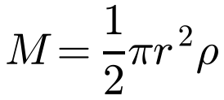
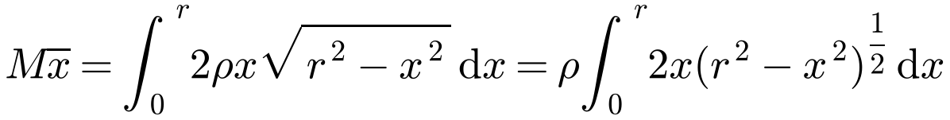
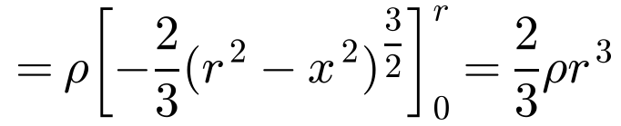
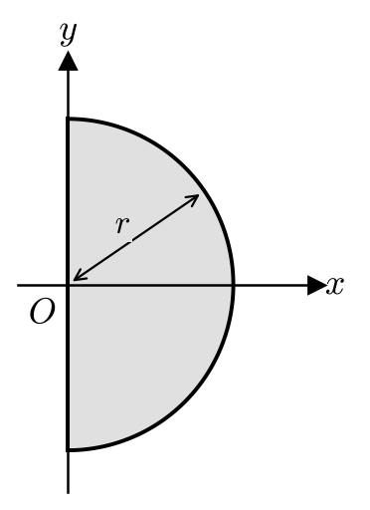
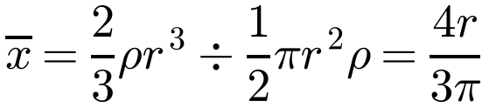
Using Calculus to Find Centres of Mass
Semicircular lamina
Put the diameter on the y-axis with O at its midpoint
By symmetry the centre of mass is on the x-axis
Each strip has length 2y, where y = √(r² − x²)
A uniform semicircular lamina has radius r cm. Find the position of its centre of mass.
By symmetry, the centre of mass lies on the x-axis
Strip: area 2y δx, mass 2ρy δx, centre of mass (x, 0)
Reverse chain rule (or substitution)
On the axis of symmetry, 4r/(3π) from the straight edge
3A

Slide 7
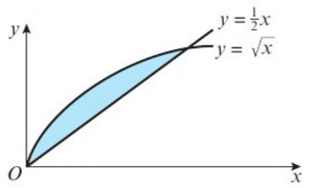
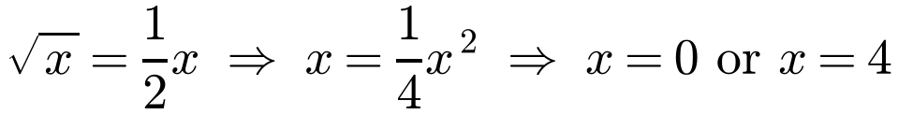
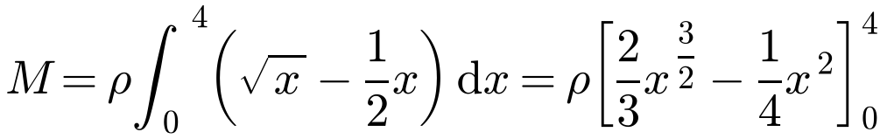
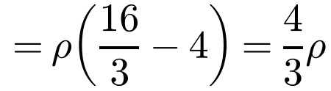
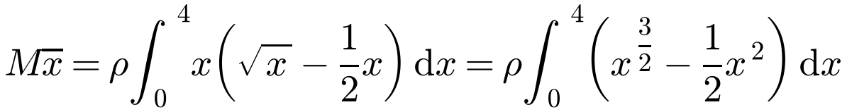
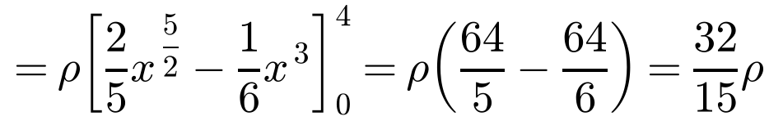
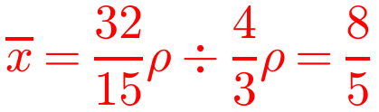
Using Calculus to Find Centres of Mass
Region between two curves
Strip from the line (y₂) up to the curve (y₁)
Mass of strip: ρ(y₁ − y₂) δx
Centre of mass of strip: (x, ½(y₁ + y₂))
The limits are where the curves meet
The diagram shows a uniform lamina occupying the shaded region bounded by the curve with equation y = √x and the straight line with equation y = ½x. Find the coordinates of the centre of mass of the lamina.
3A

Slide 8
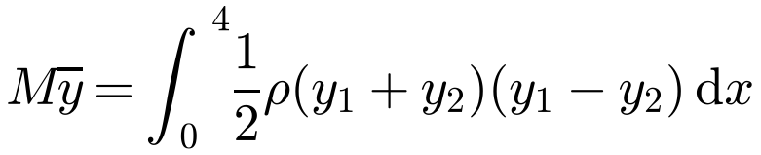
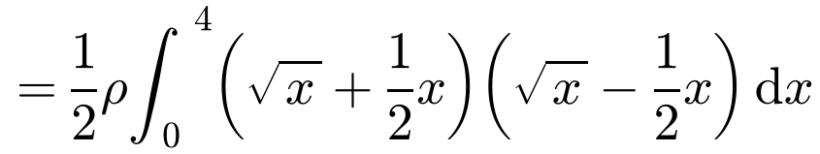
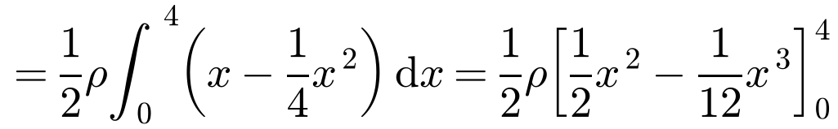
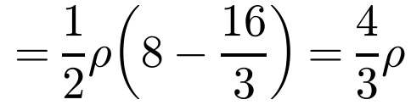
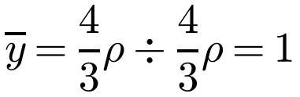
Using Calculus to Find Centres of Mass
Finding ȳ
Moment of a strip about the x-axis:
ρ(y₁ − y₂) δx × ½(y₁ + y₂)
(y₁ + y₂)(y₁ − y₂) = y₁² − y₂²
which makes the integral easy
The diagram shows a uniform lamina occupying the shaded region bounded by the curve with equation y = √x and the straight line with equation y = ½x. Find the coordinates of the centre of mass of the lamina.
Centre of mass is at (8/5, 1)
3A

Slide 9
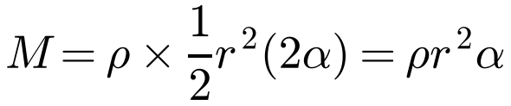
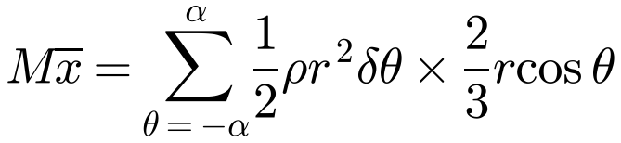
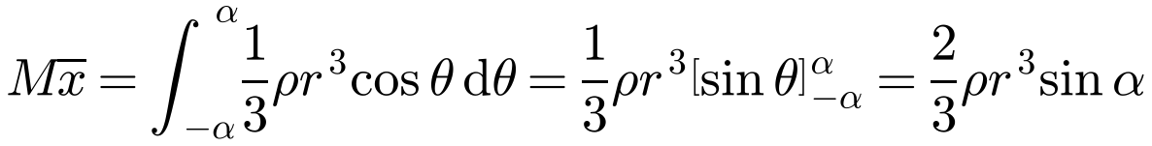
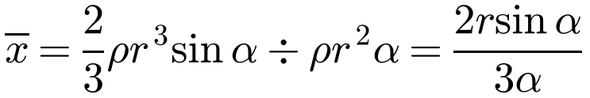
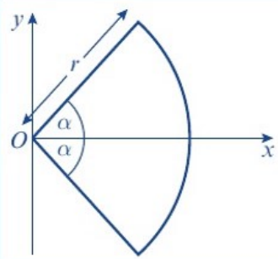
Using Calculus to Find Centres of Mass
Sector of a circle, angle 2α
Split into thin sectors of angle δθ
Each is approximately a triangle, so its centre of mass is ⅔r from O
Integrate from θ = −α to θ = α
Result is in the formula booklet, but learn the derivation
Find the centre of mass of a uniform lamina in the form of a sector of a circle, radius r and centre O, which subtends an angle 2α at O.
Element: sector angle δθ, area ½r² δθ, mass ½r²ρ δθ
R is the foot of the perpendicular from G to the x-axis
Its centre of mass G is ⅔r from O, so OR = ⅔r cos θ
On the axis of symmetry, 2r sin α / (3α) from O
3A

Slide 10

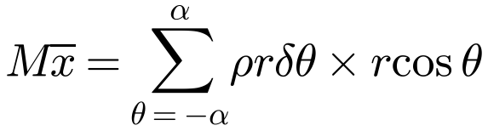
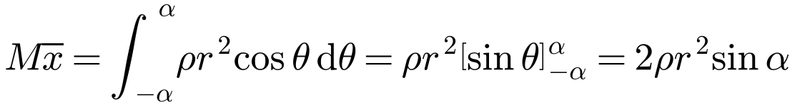
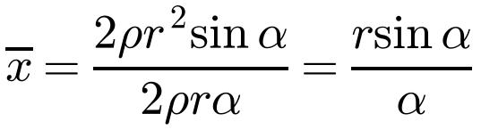
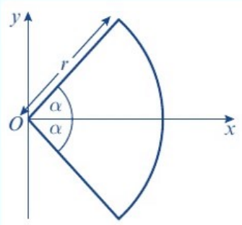
Using Calculus to Find Centres of Mass
Arc of a circle (a wire), angle 2α
ρ is now mass per unit length
An arc element of angle δθ has length r δθ
Every element is a distance r from O
Result is in the formula booklet
Find the centre of mass of a uniform wire in the form of an arc of a circle, radius r and centre O, which subtends an angle 2α at O.
Element PQ: length r δθ, mass ρr δθ
R is the foot of the perpendicular from P to the x-axis
OR = r cos θ
On the axis of symmetry, r sin α / α from O
3A

