Slide 1
Centres of Mass of Plane Figures
Further Mechanics 2 Chapter 2
Westie's Workshop

Slide 2
Teachings for Exercise 2H

Slide 3
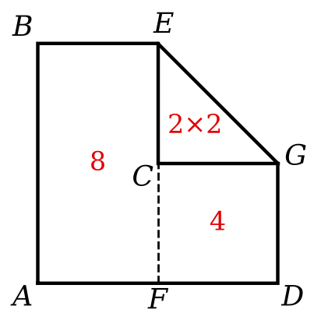
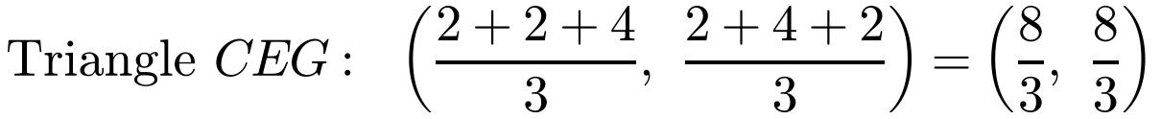
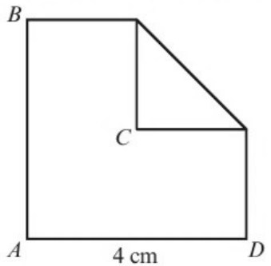
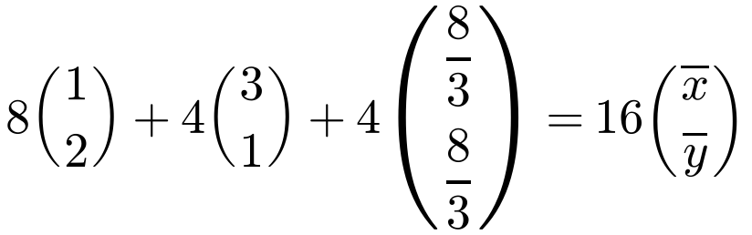
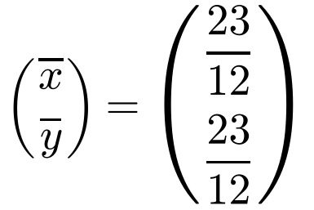
Non-uniform Composite Laminas and Frameworks
You can use the same methods for non-uniform laminas and frameworks
Model folded card as a composite lamina made of uniform parts
Where the card is folded over, there are two layers, so that part has twice the density (twice the mass for its area)
The lamina shown is made from a square piece of cardboard ABCD that has had the corner C folded to the centre of the square. Find the position of the centre of mass of the lamina.
A is the origin; AD and AB are the axes.
Rectangle ABEF: area 8, G (1, 2)
Square CGDF: area 4, G (3, 1)
Triangle CEG: area 2, double layer
Use 4 for the mass of the triangle (2 layers)
The centre of mass is at (23/12, 23/12), i.e. 23/12 cm from AB and from AD
2H

Slide 4
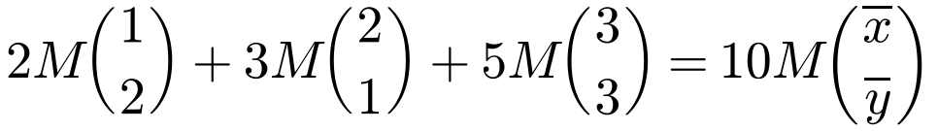
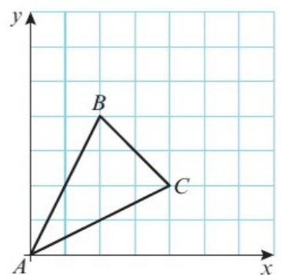
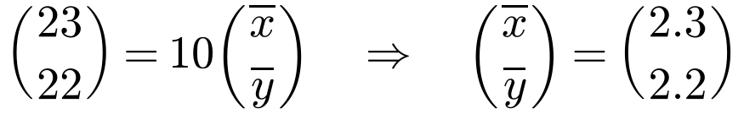
Non-uniform Composite Laminas and Frameworks
When the rods of a framework have different masses, use the given mass of each rod, not its length
Each rod still has its centre of mass at its midpoint
Multiply the mass of each piece of wire by the position of its centre of mass
The triangular framework shown is made from three pieces of uniform wire, AB, AC and BC of mass 2M, 3M and 5M respectively. Find the coordinates of the centre of mass of the framework.
From the grid: A (0, 0), B (2, 4), C (4, 2)
AB
AC
BC
Framework
Mass
2M
3M
5M
10M
x
1
2
3
x̄
y
2
1
3
ȳ
Midpoints of the rods
The centre of mass is at (2.3, 2.2)
2H

