Slide 1
Centres of Mass of Plane Figures
Further Mechanics 2 Chapter 2
Westie's Workshop

Slide 2
Teachings for Exercise 2G

Slide 3
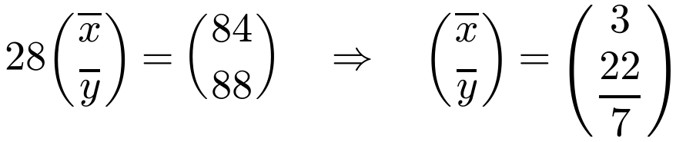
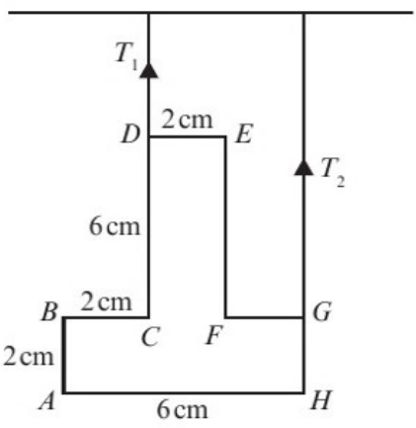


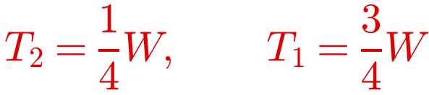
Frameworks in Equilibrium
Frameworks in equilibrium are solved with the same methods as laminas in equilibrium
With two vertical strings, resolve vertically and take moments about one of the strings
First find the centre of mass: the weight W acts there
The inverted T-shaped uniform framework of weight W shown in the diagram is freely suspended from D and G by two vertical strings, so that AH is horizontal. The strings and the framework lie in the same plane.
a) Find, in terms of W, the tensions T₁ and T₂.
A is the origin, AH along the x-axis, AB along the y-axis. Each rod: length × midpoint
G is 1 cm right of D; the G string is 4 cm right of D
2G

Slide 4
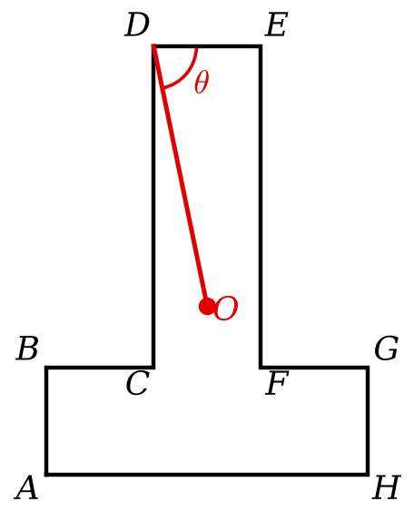
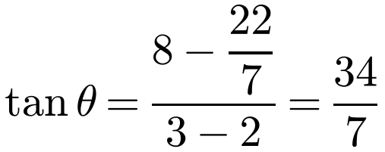
Frameworks in Equilibrium
When the string at G breaks, the framework hangs from D with its centre of mass vertically below D
Join D to the centre of mass O and mark this as the vertical
O is at (3, 22/7) and D is at (2, 8)
Note
The book’s question says the string at D breaks and it hangs from G, but its worked solution (and answer) is for hanging from D
The string at G breaks and the framework hangs freely in equilibrium from D.
b) Find the angle that DE makes with the vertical when the framework comes to rest in equilibrium.
θ = 78.4° (3 s.f.)
θ is the angle between DE and the vertical DO
2G

Slide 5
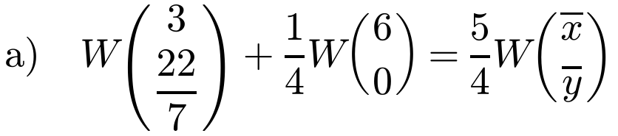
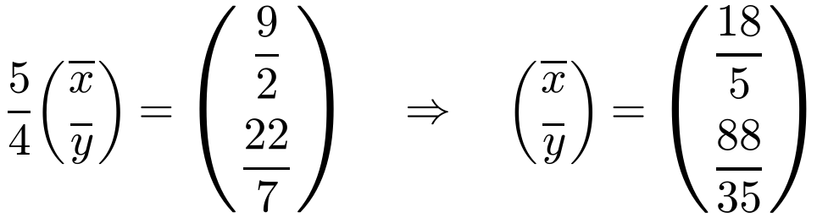
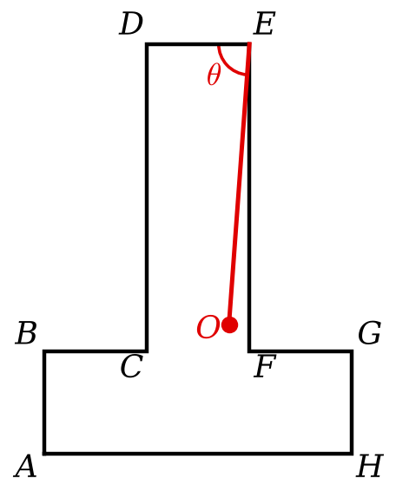
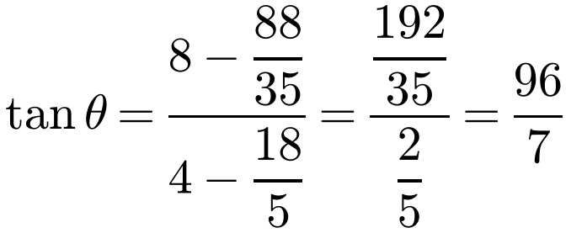
Frameworks in Equilibrium
Treat the framework as a single particle of mass W at its centre of mass, (3, 22/7)
The added mass is at H(6, 0)
E is at (4, 8): find the horizontal and vertical distances from E to the new centre of mass
Correction
The book uses 6 for the x-coordinate of E (6 is the x-coordinate of H), giving 66.4°. E is at (4, 8), so the answer is 85.8°
The inverted T-shaped uniform framework used in Example 19 has mass W kg.
a) Find the location of the centre of mass when a mass of ¼W kg is fixed at point H.
b) Find the angle that DE makes with the vertical when the system is freely suspended from E.
The centre of mass is at (18/5, 88/35)
b)
θ = 85.8° (3 s.f.)
2G

