Slide 1
Centres of Mass of Plane Figures
Further Mechanics 2 Chapter 2
Westie's Workshop

Slide 2
Teachings for Exercise 2F

Slide 3
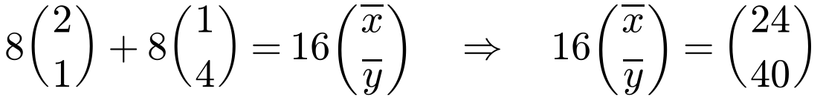

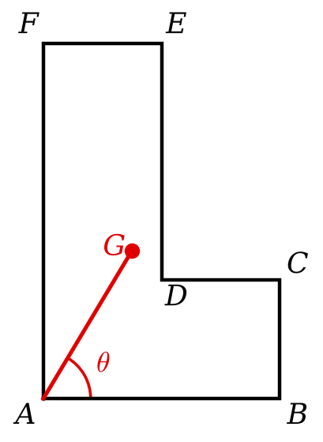
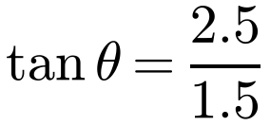
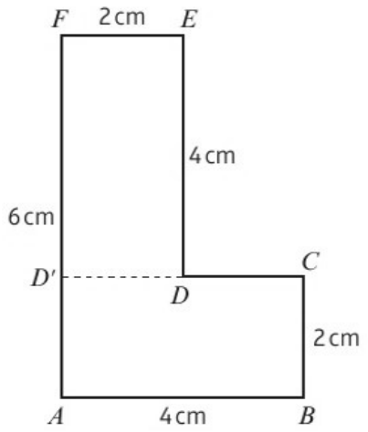
Lamina in Equilibrium
When a lamina is freely suspended from a fixed point, or pivots freely about a horizontal axis, it rests with its centre of mass vertically below the point of suspension
Only two forces act (the weight, and the tension or reaction), and both pass through the point of suspension
You do not need to draw the lamina hanging: draw a line from the point of suspension to G and mark it as the vertical
Find the angle that the line AB makes with the vertical if this L-shaped uniform lamina is freely suspended from:
a) A b) B c) E
First find the centre of mass. Split along CD′; A is the origin.
Both areas are 8
a) Suspended from A
θ is between AB and the vertical AG
θ = 59.0° (3 s.f.)
2F

Slide 4
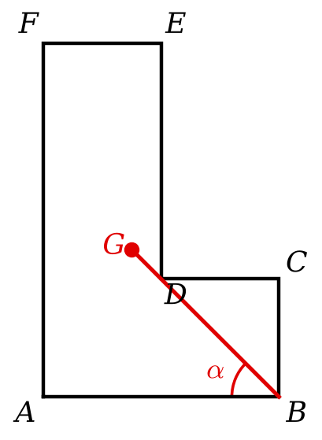
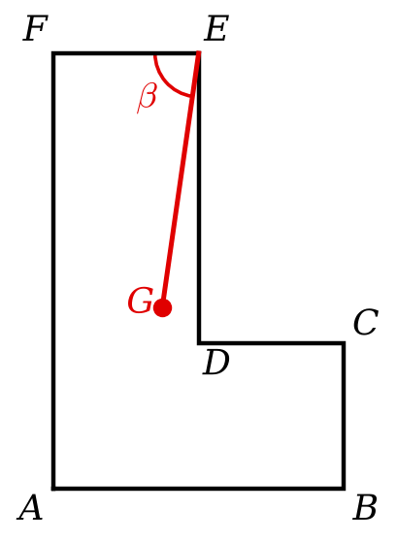
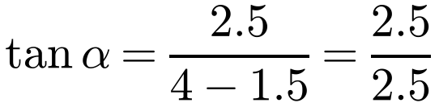
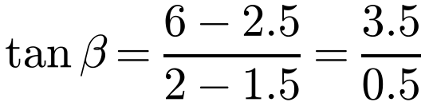
Lamina in Equilibrium
Each time, join the point of suspension to G
Then use right-angled trigonometry with the horizontal and vertical distances from the point of suspension to G
G is at (1.5, 2.5) with A as the origin
Find the angle that the line AB makes with the vertical if this L-shaped uniform lamina is freely suspended from:
a) A b) B c) E
b) Suspended from B
c) Suspended from E
α = 45°
β = 81.9° (3 s.f.)
FÊG = β (alternate angles)
2F

Slide 5
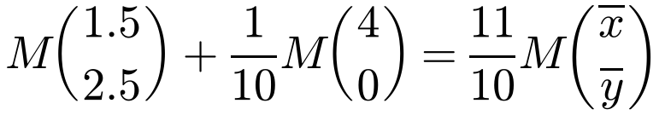
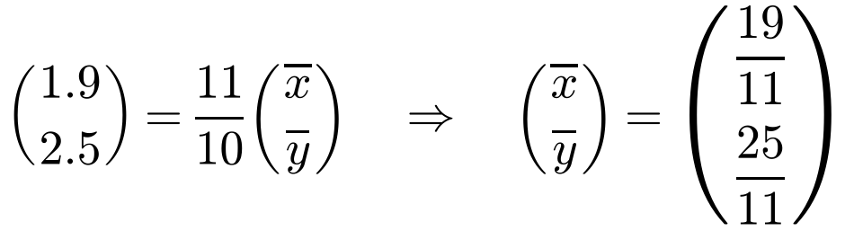
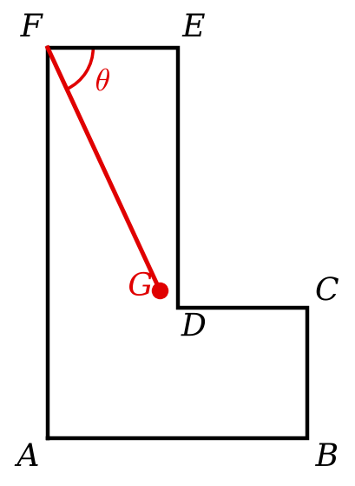
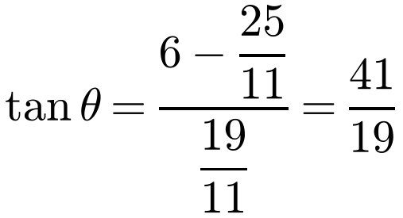
Lamina in Equilibrium
When a particle is attached, consider the lamina as a single particle whose weight acts at its centre of mass
Then combine it with the attached particle, using Σmᵢrᵢ = r̄Σmᵢ
From Example 16, the lamina has its centre of mass at (1.5, 2.5); the added mass is at B(4, 0)
The L-shaped lamina in Example 16 has mass M kg. Find the angle that FE makes with the vertical when a mass of 1/10 M kg is attached to B and the lamina is freely suspended from F.
Vertical drop over horizontal distance from F
θ = 65.1° (3 s.f.)
2F

