Slide 1
Centres of Mass of Plane Figures
Further Mechanics 2 Chapter 2
Westie's Workshop

Slide 2
Teachings for Exercise 2E

Slide 3
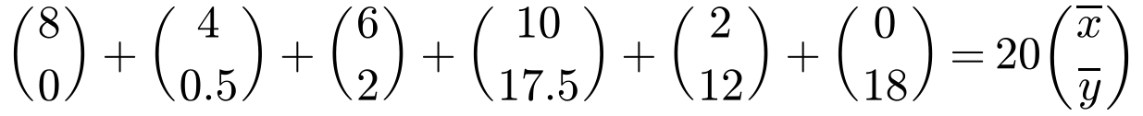
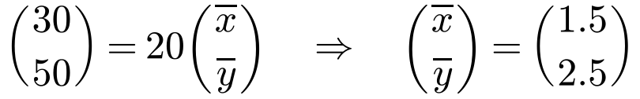
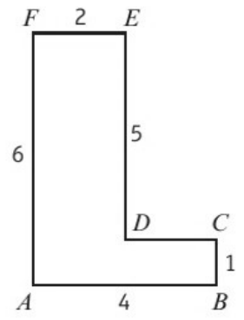
Centre of Mass of a Framework
A framework consists of a number of rods, or pieces of wire, joined together
The centre of mass of a uniform straight rod is at its midpoint
If the wire is uniform, the mass of each piece is proportional to its length
Replace each piece by a particle at its midpoint, then use Σmᵢrᵢ = r̄Σmᵢ
A framework consists of a uniform length of wire which has been bent into the shape of a letter L, as shown. Find the distance of the centre of mass of the framework from AB and AF.
Take A as the origin, with axes along AB and AF.
AB
BC
CD
DE
EF
FA
Frame
Length
4
1
2
5
2
6
20
x
2
4
3
2
1
0
x̄
y
0
0.5
1
3.5
6
3
ȳ
Length × midpoint
Distance from AF = x̄ = 1.5 units
Distance from AB = ȳ = 2.5 units
2E

Slide 4
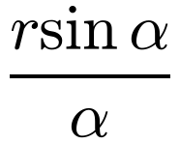
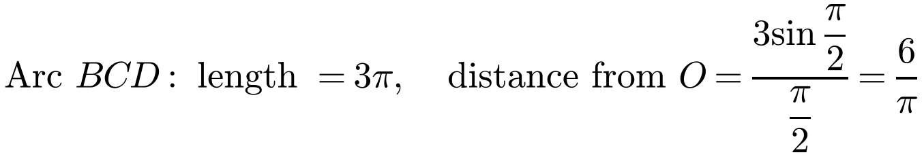
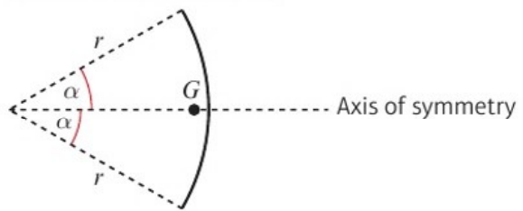
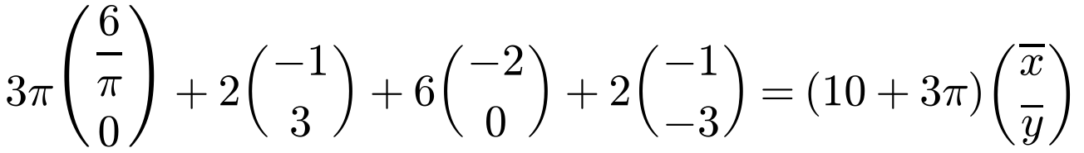
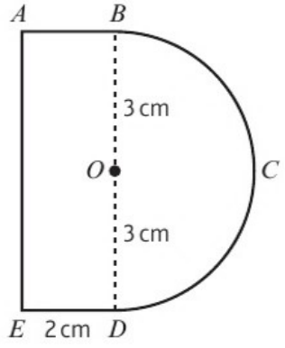
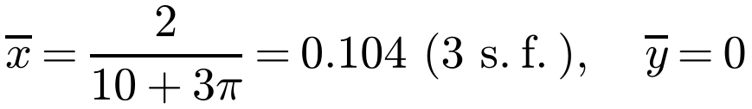
Centre of Mass of a Framework
Uniform circular arc
Radius r and centre angle 2α (α in radians): the centre of mass is on the axis of symmetry, at a distance
Find the position of the centre of mass of a framework constructed from a uniform piece of wire bent into the shape shown, where the wire BCD is a semicircle, centre O, of radius 3 cm and wire BAED forms three sides of a rectangle ABDE.
Take O as the origin, with axes along OC and OB.
Arc BCD
AB
AE
ED
Frame
Length
3π
2
6
2
10 + 3π
x
6/π
−1
−2
−1
x̄
y
0
3
0
−3
ȳ
from the centre (in the formula booklet; not the sector result)
ȳ = 0 by symmetry
G is on the axis of symmetry, 2/(10 + 3π) cm to the right of O
2E

