Slide 1
Centres of Mass of Plane Figures
Further Mechanics 2 Chapter 2
Westie's Workshop

Slide 2
Teachings for Exercise 2D

Slide 3
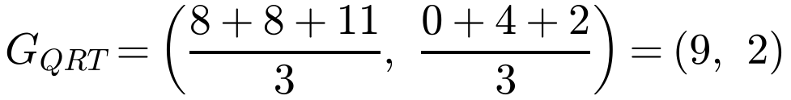
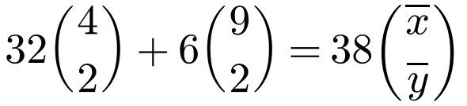
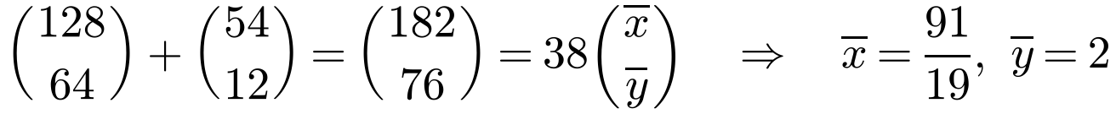
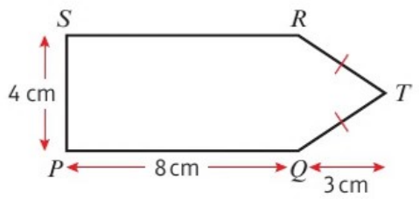
Centre of Mass of a Composite Lamina
A composite lamina is made of two or more standard uniform laminas joined together
Replace each part by a particle at its own centre of mass
For a uniform lamina, the mass of each part is proportional to its area
The centre of mass of a uniform lamina always lies on an axis of symmetry: use this to save working
A uniform lamina consists of a rectangle PQRS joined to an isosceles triangle QRT, as shown in the diagram. Find the distance of the centre of mass of the lamina from: a) PQ b) PS
Take P as the origin, with axes along PQ and PS. Q (8, 0), R (8, 4), T (11, 2)
Mean of the vertices
Rectangle
Triangle
Lamina
Area
8 × 4 = 32
½ × 4 × 3 = 6
38
x
4
9
x̄
y
2
2
ȳ
Could use symmetry
a) Distance from PQ = 2 cm
b) Distance from PS = 91/19 cm (4.79 cm)
2D

Slide 4
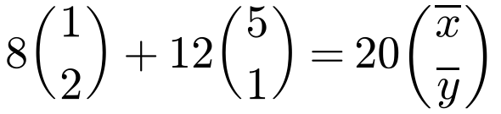
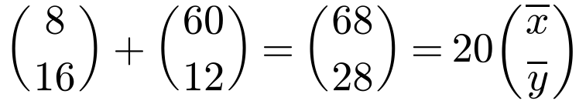
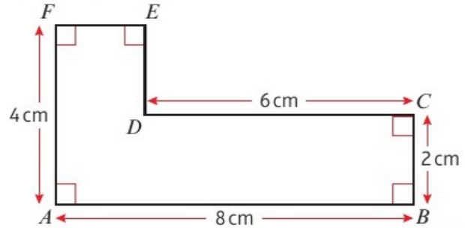

Centre of Mass of a Composite Lamina
Summarise the area and centre of mass of each part in a table
Because the lamina is uniform you only need the area of each part
There is more than one way to split the shape: any sensible split gives the same answer
The diagram shows a uniform lamina. Find the distance of the centre of mass of the lamina from: a) AF b) AB
Method 1: split along the vertical line through D. A is the origin.
Rectangle 2 × 4
Rectangle 6 × 2
Lamina
Area
8
12
20
x
1
5
x̄
y
2
1
ȳ
Using Σmᵢrᵢ = r̄Σmᵢ
a) Distance from AF = 3.4 cm
b) Distance from AB = 1.4 cm
2D

Slide 5
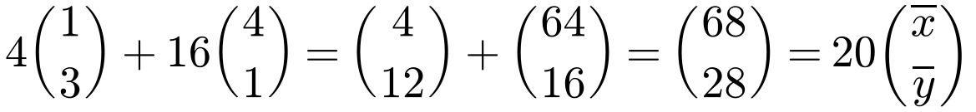
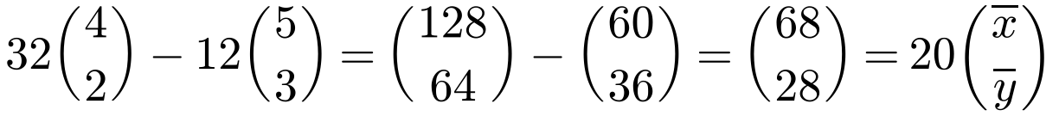
Centre of Mass of a Composite Lamina
Method 2: split horizontally
A 2 × 2 square on top of an 8 × 2 rectangle
Method 3: subtract
Start with the whole 8 × 4 rectangle and remove the 6 × 2 rectangle that is missing
Note the subtraction, since you are removing, not adding
The diagram shows a uniform lamina. Find the distance of the centre of mass of the lamina from: a) AF b) AB
Method 2
Square
Rectangle
Lamina
Area
4
16
20
x
1
4
x̄
y
3
1
ȳ
Method 3
Large rect.
Removed
Lamina
Area
32
12
20
x
4
5
x̄
y
2
3
ȳ
Both give x̄ = 3.4 and ȳ = 1.4, as before
2D

Slide 6
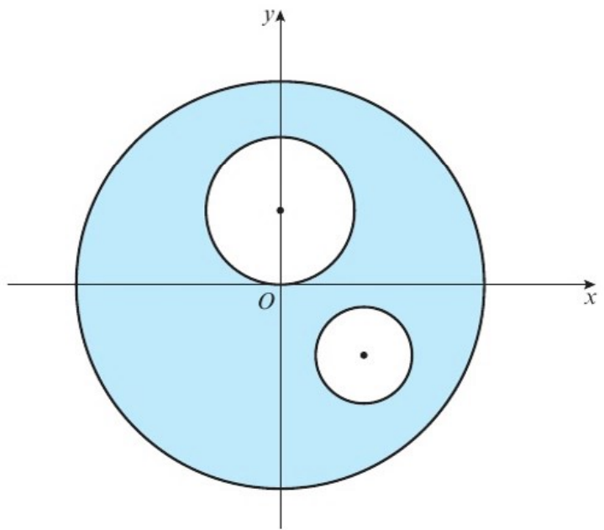
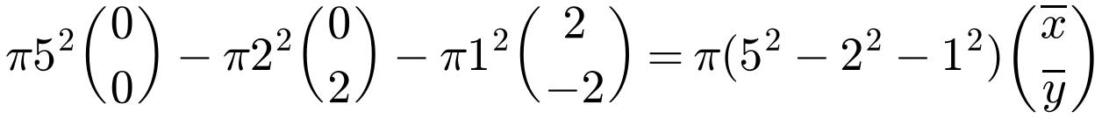
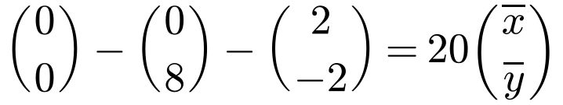
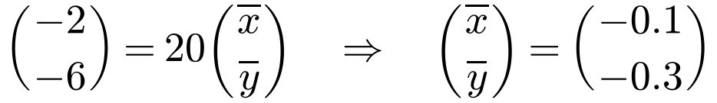
Centre of Mass of a Composite Lamina
When you remove part of a lamina, treat the removed part as having negative mass
Setting out the key information in a table helps to clarify your working
The πs cancel
A uniform circular disc, centre O, of radius 5 cm has two circular holes cut in it, as shown in the diagram. The larger hole has radius 2 cm and the smaller hole has radius 1 cm. The coordinates of the centres of the holes are (0, 2) and (2, −2) respectively. Find the coordinates of the centre of mass of the remaining lamina.
Disc
Large hole
Small hole
Remaining
Area
π × 5²
π × 2²
π × 1²
π(5² − 2² − 1²)
x
0
0
2
x̄
y
0
2
−2
ȳ
Subtract the holes
The centre of mass of the lamina is at (−0.1, −0.3)
2D

