Slide 1
Centres of Mass of Plane Figures
Further Mechanics 2 Chapter 2
Westie's Workshop

Slide 2
Teachings for Exercise 2C

Slide 3
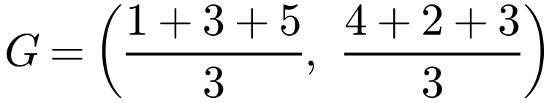
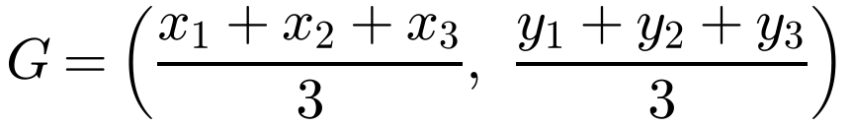
Centres of Mass of Standard Uniform Plane Laminas
A lamina is a flat object whose thickness is very small compared with its length and width
It is modelled as two-dimensional, with area but no volume. It is uniform if its mass is evenly spread over its area
If a uniform lamina has an axis of symmetry, its centre of mass lies on it
With more than one axis of symmetry, the centre of mass is where they meet (centre of a disc or rectangle)
The centre of mass of a uniform triangular lamina is at the intersection of the medians: the centroid
It is two-thirds of the way down each median from the vertex, and is the mean of the vertices:
A uniform triangular lamina has vertices A(1, 4), B(3, 2) and C(5, 3). Find the coordinates of its centre of mass.
Find the mean of the vertices
G is the point (3, 3)
2C

Slide 4
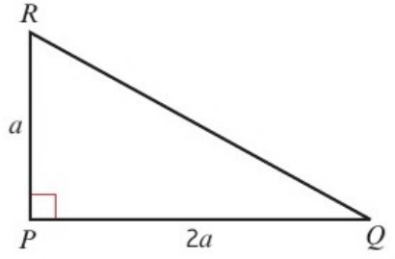
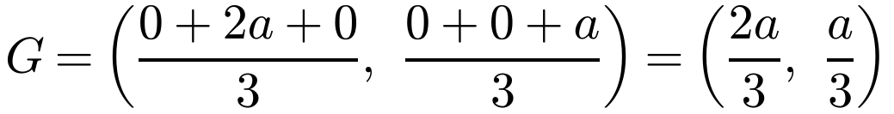
Centres of Mass of Standard Uniform Plane Laminas
When no coordinates are given, choose your own axes and origin
A right angle is a good place for the origin, with the two perpendicular sides as axes
Watch out
When you choose your own axes you must not leave your answer in coordinate form: give distances from named lines
Find the centre of mass of the uniform triangular lamina shown:
Taking P as the origin and PQ and PR as axes:
P is (0, 0); Q is (2a, 0); R is (0, a)
Mean of the vertices
The centre of mass is 2a/3 from PR and a/3 from PQ
2C

Slide 5
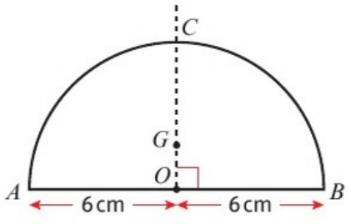
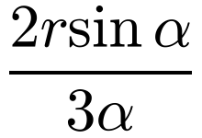
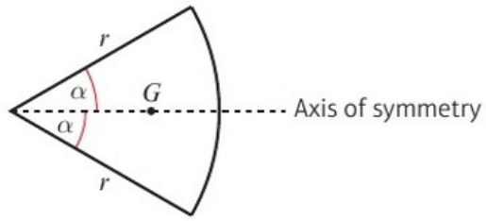
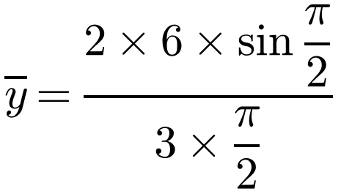
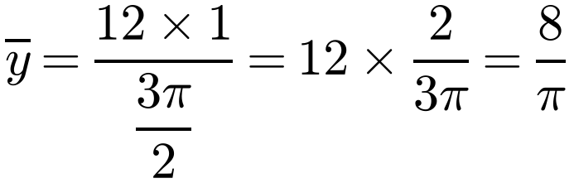
Centres of Mass of Standard Uniform Plane Laminas
Uniform sector of a circle
Radius r and centre angle 2α (α in radians): the centre of mass is on the axis of symmetry, at a distance
The diagram shows a uniform semicircular lamina of radius 6 cm with centre O.
Find the centre of mass of the lamina.
The centre of mass lies on OC, the axis of symmetry. Let OG = ȳ.
r = 6 and α = π/2 (radians!)
from the centre
This is given in the formula booklet
A semicircle is a sector with α = π/2
The centre of mass is on OC, a distance 8/π cm (2.55 cm) from O
2C

