Slide 1
Centres of Mass of Plane Figures
Further Mechanics 2 Chapter 2
Westie's Workshop

Slide 2
Teachings for Exercise 2B

Slide 3
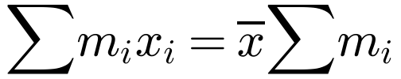
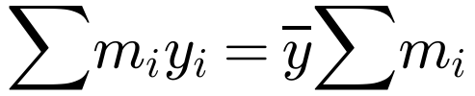


Centre of Mass of a Set of Particles Arranged in a Plane
You can find the centre of mass of particles arranged in a plane by considering the x- and y-coordinates separately
Use
Find the coordinates of the centre of mass of the following system of particles:
2 kg at (1, 2); 3 kg at (3, 1); 5 kg at (4, 3)
Total weight; g cancels
Method 1
Taking moments about the y-axis:
Taking moments about the x-axis:
Taking moments about the y-axis gives x̄
Taking moments about the x-axis gives ȳ
The centre of mass is (3.1, 2.2)
2B

Slide 4
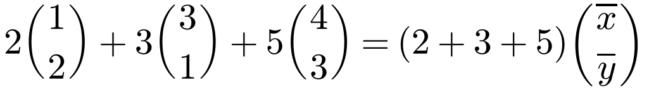
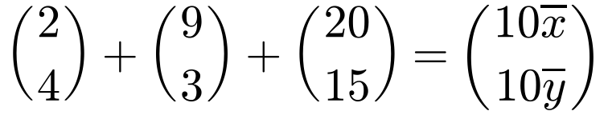
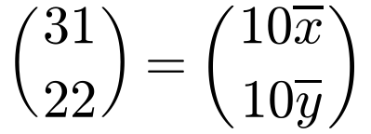
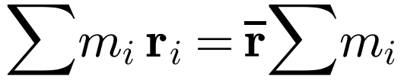
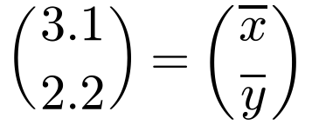
Centre of Mass of a Set of Particles Arranged in a Plane
You can reduce the working by using position vectors
If a system consists of n particles, mass m₁ with position vector r₁, mass m₂ with position vector r₂, …, mass mₙ with position vector rₙ, then
Find the coordinates of the centre of mass of the following system of particles:
2 kg at (1, 2); 3 kg at (3, 1); 5 kg at (4, 3)
Method 2
Divide both sides by 10
where r̄ is the position vector of the centre of mass of the system
The top line of the vectors is the x equation; the bottom line is the y equation
The centre of mass is at (3.1, 2.2)
2B

Slide 5
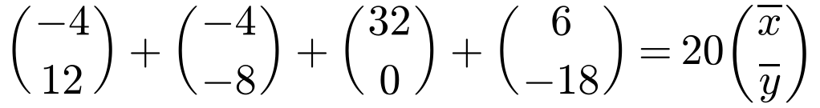
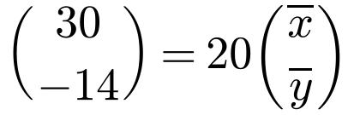
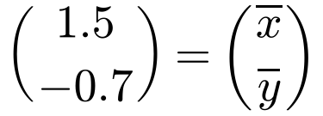
Centre of Mass of a Set of Particles Arranged in a Plane
The result applies with positive or negative coordinates
Multiply each position vector by its mass, add, and divide by the total mass
Check: the centre of mass should look sensible compared with the positions of the particles
Find the coordinates of the centre of mass of the following system of particles:
4 kg at (−1, 3); 2 kg at (−2, −4); 8 kg at (4, 0); 6 kg at (1, −3)
Simplify the LHS
The centre of mass is (1.5, −0.7)
2B

Slide 6
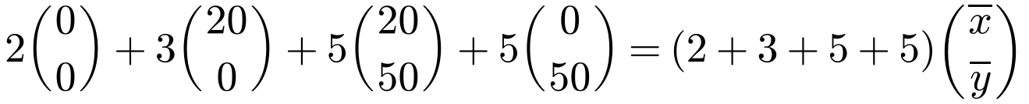
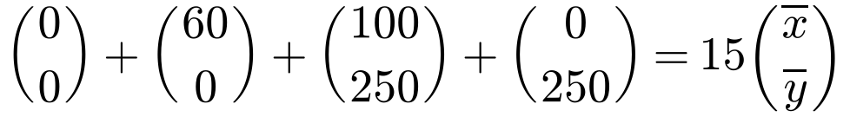
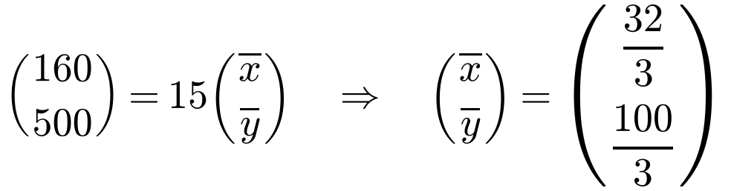
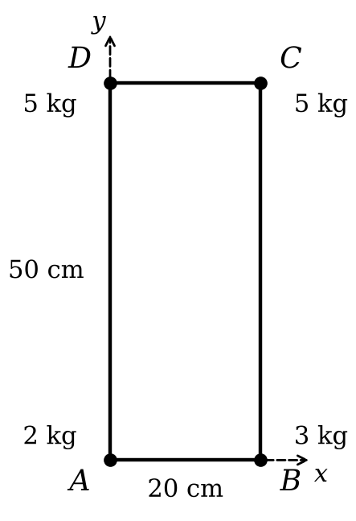
Centre of Mass of a Set of Particles Arranged in a Plane
If a question does not specify axes or coordinates you will need to choose your own axes and origin
Choose A as the origin, with AB and AD as axes
Give the final answer as distances, not coordinates
A light rectangular plate ABCD has AB = 20 cm and AD = 50 cm. Particles of masses 2 kg, 3 kg, 5 kg and 5 kg are attached to the plate at the points A, B, C and D respectively. Find the distance of the centre of mass of the loaded plate from:
a) AD b) AB
a) Distance from AD = x̄ = 32/3 cm (= 10.7 cm)
Inside the rectangle: sensible
b) Distance from AB = ȳ = 100/3 cm (= 33.3 cm)
2B

Slide 7
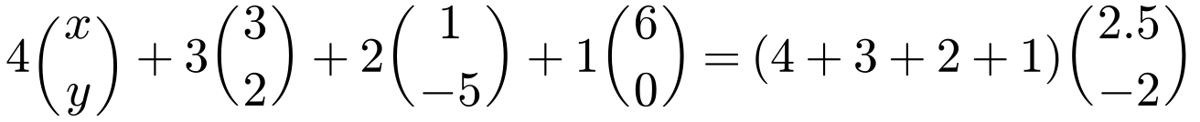
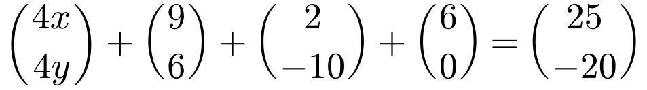
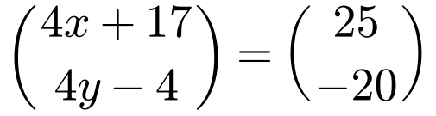

Centre of Mass of a Set of Particles Arranged in a Plane
You can use the same equation to find an unknown position
Put the known centre of mass on the right-hand side
Equate the i and j components (top and bottom lines) and solve
Particles of masses 4 kg, 3 kg, 2 kg and 1 kg are placed at the points (x, y), (3, 2), (1, −5) and (6, 0) respectively. Given that the centre of mass of the four particles is at the point (2.5, −2), find the values of x and y.
Equate components
x = 2, y = −4
2B

Slide 8
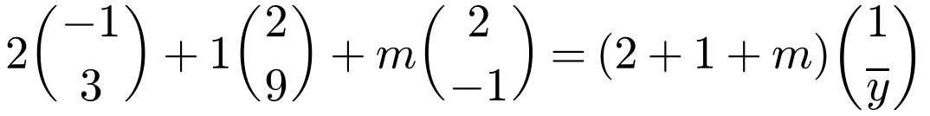
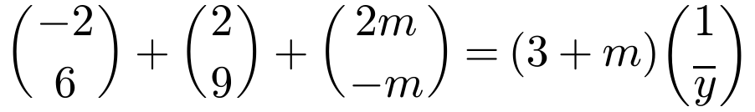
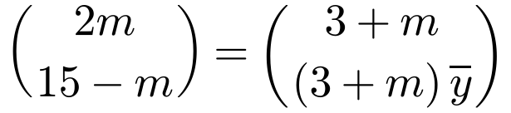
Centre of Mass of a Set of Particles Arranged in a Plane
You can also find an unknown mass
The total mass now contains the unknown, (3 + m)
Solve whichever equation has only one unknown first, then substitute
Three particles of masses 2 kg, 1 kg and m kg are situated at the points (−1, 3), (2, 9) and (2, −1) respectively. Given that the centre of mass of the three particles is at the point (1, ȳ), find:
a) the value of m b) the value of ȳ.
Equate components
a) m = 3
ȳ = 2
2B

