Slide 1
Centres of Mass of Plane Figures
Further Mechanics 2 Chapter 2
Westie's Workshop

Slide 2
Teachings for Exercise 2A

Slide 3
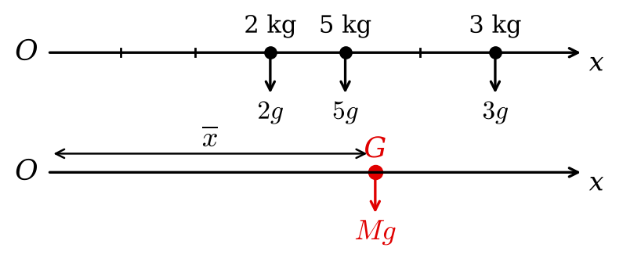


Centre of Mass of a Set of Particles on a Straight Line
You can find the centre of mass of a set of particles arranged along a straight line by taking moments
The centre of mass, G, is the point where the whole weight of the system can be considered to act
Draw two diagrams: the weights of the individual particles, and the total weight Mg acting at G
Equate the total weights, then equate the moments of the two systems about O
Notice that g cancels every time
A system of 3 particles, with masses 2 kg, 5 kg and 3 kg are placed along the x-axis at the points (3, 0), (4, 0) and (6, 0) respectively. Find the centre of mass of the system.
Compare the total weights
Taking moments about O:
Moments about O
The centre of mass is (4.4, 0)
2A

Slide 4

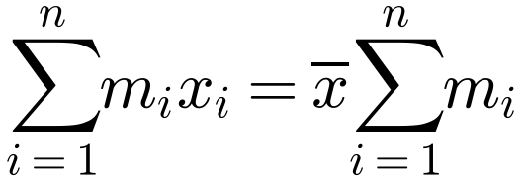
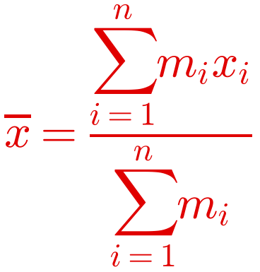
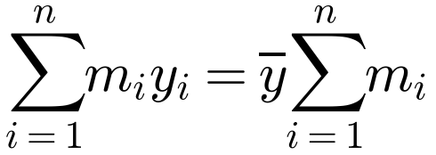
Centre of Mass of a Set of Particles on a Straight Line
The general result
There is no need to include g in the working, as it always cancels
This result holds for positive and negative coordinates
The same result applies to particles placed along the y-axis:
A system of n particles, with masses m₁, m₂, …, mₙ are placed along the x-axis at the points (x₁, 0), (x₂, 0), …, (xₙ, 0) respectively. Find the centre of mass of the system.
Moments about O
Key result: learn this
2A

