Slide 1
Circular Motion
Further Mechanics 2 Chapter 1
Westie's Workshop

Slide 2
Teachings for Exercise 1E

Slide 3
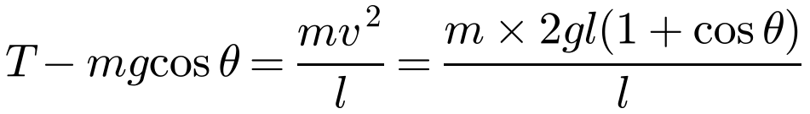
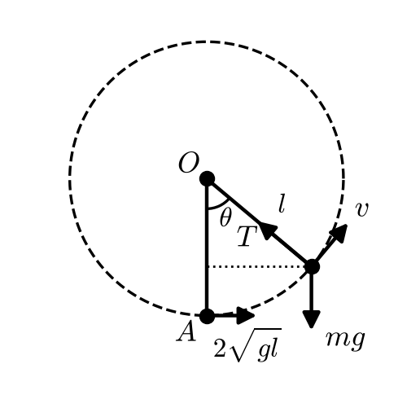

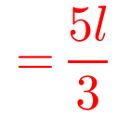
Objects Not Constrained on a Circular Path
Some objects are not constrained to stay on the circle, e.g. a particle on a string, or on the outside of a sphere
As soon as the contact force (tension or normal reaction) becomes zero, the object moves freely under gravity as a projectile
A particle P of mass m is attached to one end of a light inextensible string of length l. The other end of the string is attached to a fixed point O. The particle is hanging in equilibrium at point A, directly below O, when it is set in motion with a horizontal speed 2√(gl). When OP has turned through an angle θ and the string is still taut, the tension in the string is T. Find:
a) an expression for T
b) the height of P above A at the instant when the string goes slack
c) the maximum height above A reached by P before it starts to fall to the ground again.
a) Let A be the zero level for P.E.
At A: P.E. = 0, K.E. = ½ × m × (2√(gl))² = ½m × 4gl
At angle θ: P.E. = mgl(1 − cos θ), K.E. = ½mv²
∴ 2mgl = mgl(1 − cos θ) + ½mv²
Energy is conserved
v² = 2gl(1 + cos θ)
Resolve parallel to OP
b) String slack: T = 0, so cos θ = −2/3
Height above A = l(1 − cos θ)
1E

Slide 4
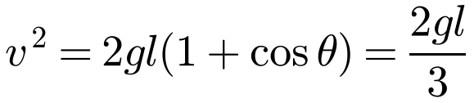
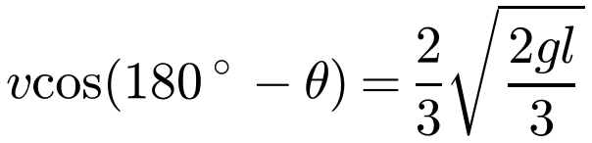
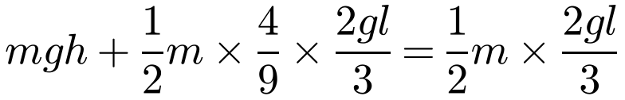
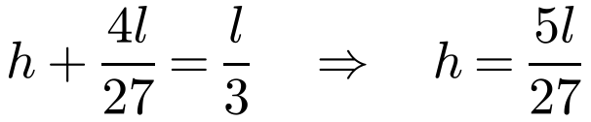
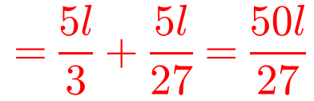
Objects Not Constrained on a Circular Path
Once the string is slack, P is a projectile
The horizontal component of its velocity does not change
At the maximum height the vertical component of the velocity is zero
Watch out: P is not necessarily above A when it is at its maximum height
A particle P of mass m is attached to one end of a light inextensible string of length l. The other end of the string is attached to a fixed point O. The particle is hanging in equilibrium at point A, directly below O, when it is set in motion with a horizontal speed 2√(gl). When OP has turned through an angle θ and the string is still taut, the tension in the string is T. Find:
a) an expression for T
b) the height of P above A at the instant when the string goes slack
c) the maximum height above A reached by P before it starts to fall to the ground again.
c) When the string becomes slack:
The velocity is perpendicular to OP, so its horizontal component is
Let the extra height before it begins to fall be h:
Conservation of energy
Total height above A
1E

Slide 5
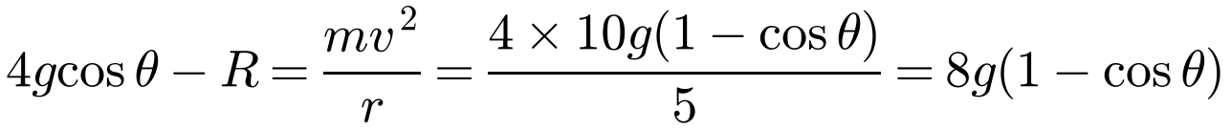
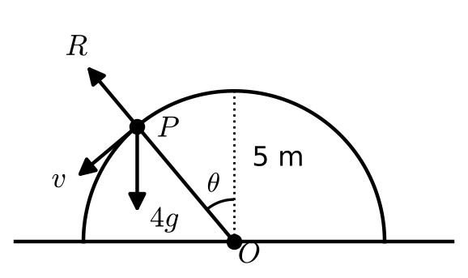

Objects Not Constrained on a Circular Path
On the outside of a sphere the normal reaction acts away from the centre
The weight component towards the centre minus R gives the mass × acceleration towards the centre
The particle leaves the surface when R = 0
A smooth hemisphere with radius 5 m and centre O is resting in a fixed position on a horizontal plane with its flat face in contact with the plane. A particle P of mass 4 kg is slightly disturbed from rest at the highest point of the hemisphere. When OP has turned through an angle θ and the particle is still on the surface of the hemisphere the normal reaction of the sphere on the particle is R. Find:
a) an expression for R
b) the angle between OP and the upward vertical when the particle leaves the surface of the hemisphere
c) the distance of the particle from the centre of the hemisphere when it hits the ground.
a) Let the horizontal plane be the zero level for P.E.
At the top: K.E. = 0, P.E. = 4 × g × 5 = 20g
At angle θ: K.E. = ½mv² = 2v², P.E. = 20g cos θ
∴ 20g = 2v² + 20g cos θ
Energy is conserved
v² = 10g(1 − cos θ)
Resolve parallel to PO
b) R = 0 when cos θ = 2/3
θ = arccos (2/3) = 48.2° (3 s.f.)
1E

Slide 6
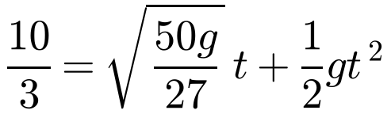
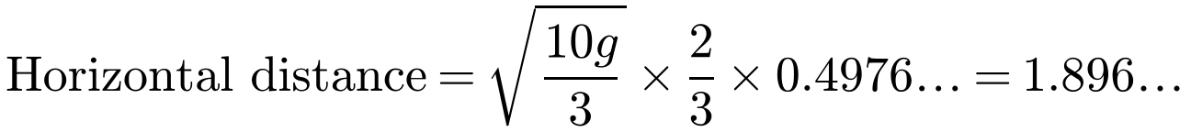
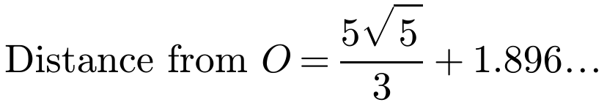
Objects Not Constrained on a Circular Path
After leaving the surface, P is a projectile
Initial speed √(10g/3), directed at angle arccos (2/3) below the horizontal
Use s = ut + ½at² vertically to find the time, then horizontal distance = horizontal speed × time
Add the horizontal distance of P from O when it leaves
A smooth hemisphere with radius 5 m and centre O is resting in a fixed position on a horizontal plane with its flat face in contact with the plane. A particle P of mass 4 kg is slightly disturbed from rest at the highest point of the hemisphere. When OP has turned through an angle θ and the particle is still on the surface of the hemisphere the normal reaction of the sphere on the particle is R. Find:
a) an expression for R
b) the angle between OP and the upward vertical when the particle leaves the surface of the hemisphere
c) the distance of the particle from the centre of the hemisphere when it hits the ground.
c) When P leaves the hemisphere:
s = ut + ½at² (down)
No horizontal acceleration
= 5.6 m (2 s.f.)
1E

