Slide 1
Circular Motion
Further Mechanics 2 Chapter 1
Westie's Workshop

Slide 2
Teachings for Exercise 1D

Slide 3
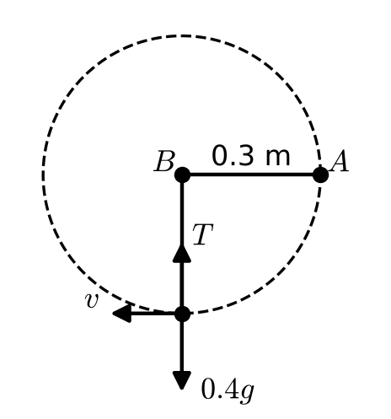
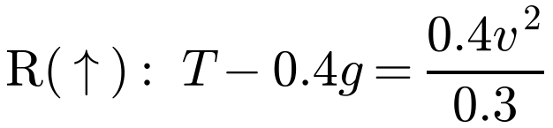
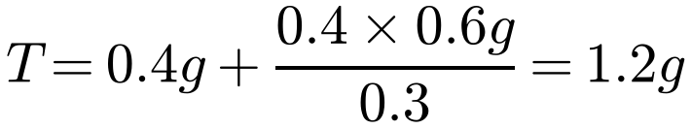
Objects Moving in Vertical Circles
In a vertical circle the particle gains height, so it loses kinetic energy: its speed is not constant
Acceleration: rω² or v²/r towards the centre, and dv/dt along the tangent
The force towards the centre does no work, so if gravity is the only other force, K.E. + P.E. is constant
A particle of mass 0.4 kg is attached to one end A of a light rod AB of length 0.3 m. The rod is free to rotate in a vertical plane about B. The particle is held at rest with AB horizontal. The particle is released. Calculate:
a) the speed of the particle as it passes through the lowest point of the path,
b) the tension in the rod at this point.
Let the speed at the lowest point be v m s⁻¹ and the tension in the rod be T N.
Choose a zero level for P.E.
a) Take the lowest point as the zero level for P.E.
Falls 0.3 m from rest
P.E. lost = 0.4 × g × 0.3, K.E. gained = ½ × 0.4 × v²
Conservation of energy
∴ 0.4 × g × 0.3 = ½ × 0.4 × v²
v² = 0.6g = 5.88
v = 2.4 m s⁻¹ (2 s.f.)
b) At the lowest point, towards the centre:
Acceleration v²/r towards the centre
T = 11.8 N (3 s.f.)
1D

Slide 4
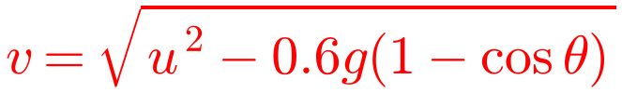
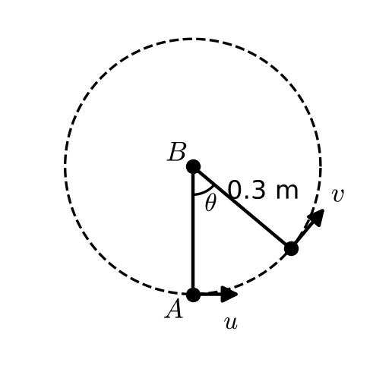

Objects Moving in Vertical Circles
A rod can be in tension or in thrust, so it can support the particle at the top
A particle on a light rod (or a bead on a smooth wire) performs complete circles if its speed > 0 at the top of the circle
Height above the lowest point when the rod makes angle θ with the downward vertical:
r − r cos θ = r(1 − cos θ)
A particle of mass 0.4 kg is attached to one end A of a light rod AB of length 0.3 m. The rod is free to rotate in a vertical plane about B. The rod is hanging vertically with A below B when the particle is set in motion with a horizontal speed of u m s⁻¹. Find:
a) an expression for the speed of the particle when the rod is at an angle θ to the downward vertical through B
b) the minimum value of u for which the particle will perform a complete circle.
a) Take the lowest point as the zero level for P.E.
At the lowest point: K.E. = ½ × 0.4 × u² = 0.2u², P.E. = 0
At angle θ: K.E. = ½ × 0.4 × v² = 0.2v²
P.E. = 0.4 × g × 0.3(1 − cos θ)
Total energy is the same at both points
∴ 0.2u² = 0.2v² + 0.12g(1 − cos θ)
b) We need v > 0 when θ = 180°
cos 180° = −1
⇒ u² − 0.6g(1 − cos 180°) > 0
u² > 0.6g × 2
1D

Slide 5
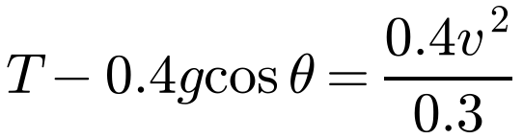
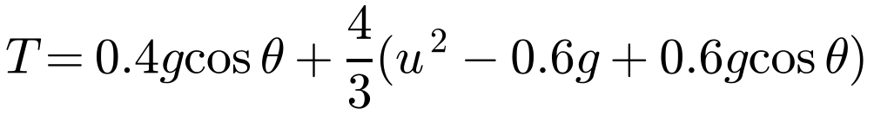
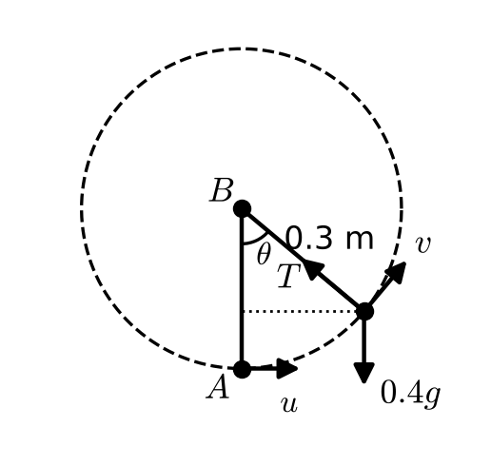
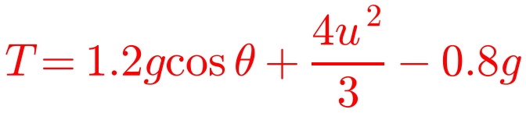
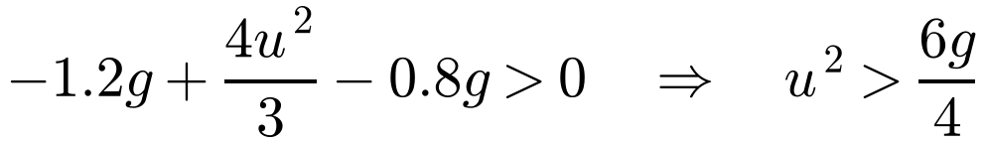
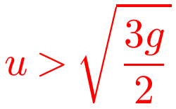
Objects Moving in Vertical Circles
A string can only pull: it must stay taut
A particle on a light inextensible string performs complete circles if the tension > 0 at the top of the circle
So the speed at the top must be large enough to keep the string taut
Resolve towards the centre and substitute for v² from the energy equation
A particle A of mass 0.4 kg is attached to one end of a light inextensible string of length 0.3 m. The other end of the string is attached to a fixed point B. The particle is hanging in equilibrium when it is set in motion with a horizontal speed of u m s⁻¹. Find:
a) an expression for the tension in the string, in terms of u, when it is at an angle θ to the downward vertical through B
b) the minimum value of u for which the particle will perform a complete circle.
a) As before, with P.E. = 0 at the lowest point:
0.2u² = 0.2v² + 0.12g(1 − cos θ)
Resolving towards the centre:
Use a = v²/r
Express v² in terms of u²
b) We need T > 0 when θ = 180°
1D

