Slide 1
Circular Motion
Further Mechanics 2 Chapter 1
Westie's Workshop

Slide 2
Teachings for Exercise 1C

Slide 3
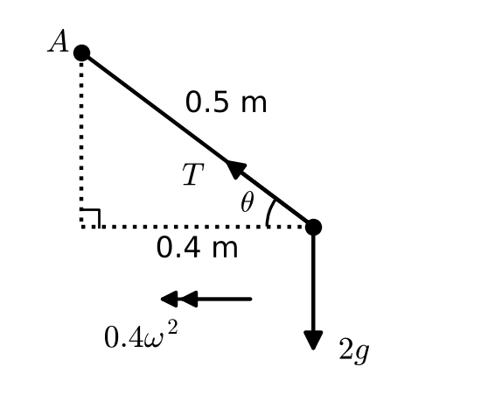
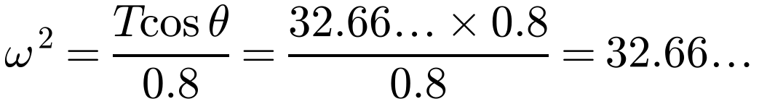
Three-Dimensional Problems with Objects Moving in Horizontal Circles
Conical pendulum: as the particle moves round the circle, the string traces out the surface of a cone
Draw a diagram and name the forces and lengths you need
Resolve vertically (no vertical acceleration) and horizontally (towards the centre, acceleration rω²)
A particle of mass 2 kg is attached to one end of a light inextensible string of length 50 cm. The other end of the string is attached to a fixed point A. The particle moves with constant angular speed in a horizontal circle of radius 40 cm. The centre of the circle is vertically below A. Calculate the tension in the string and the angular speed of the particle.
Let the tension be T and the angular speed ω.
Let the string make angle θ with the horizontal.
Resolve T into components
R(↑): T sin θ = 2g
Towards the centre
R(←): T cos θ = 2 × 0.4 × ω²
A 3, 4, 5 triangle
cos θ = 4/5 and sin θ = 3/5
T = 2g × 5/3 = 32.66…
T = 32.7 N (3 s.f.)
ω = 5.7 rad s⁻¹ (2 s.f.)
1C

Slide 4
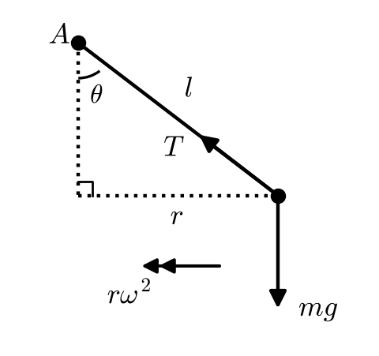
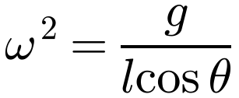
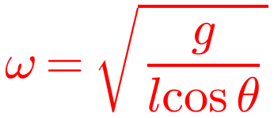
Three-Dimensional Problems with Objects Moving in Horizontal Circles
The radius of the circle is not always given: find it from the right-angled triangle
Here the radius is l sin θ
Divide through by common factors to simplify an equation before substituting
A particle of mass m is attached to one end of a light inextensible string of length l. The other end of the string is attached to a fixed point A. The particle moves with constant angular speed in a horizontal circle. The string is taut and the angle between the string and the vertical is θ. The centre of the circle is vertically below A. Find the angular speed of the particle.
Let the tension be T and the angular speed ω.
Right-angled triangle
The radius of the circle is l sin θ
R(↑): T cos θ = mg
R(←): T sin θ = m × l sin θ × ω²
Divide by sin θ
⇒ T = mlω²
Substitute into the first equation
mlω² cos θ = mg
1C

Slide 5
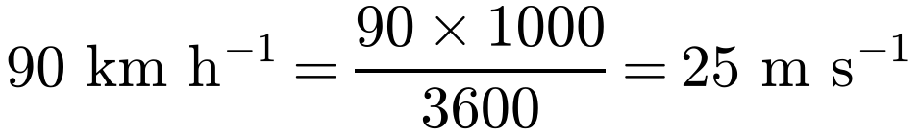
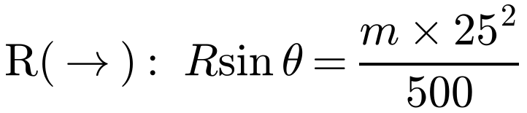
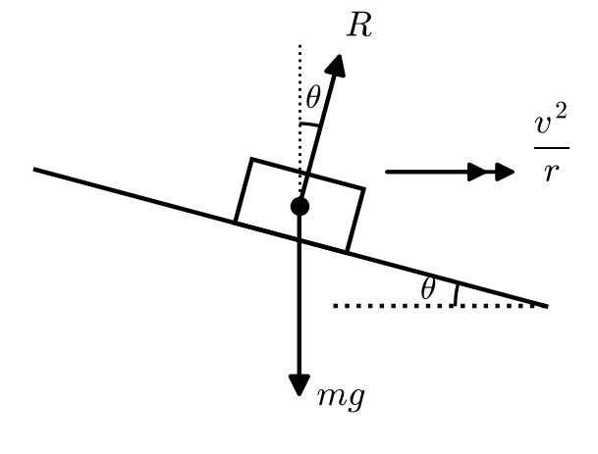
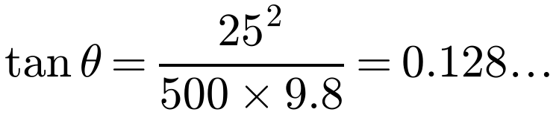
Three-Dimensional Problems with Objects Moving in Horizontal Circles
On a banked surface with no friction, the force towards the centre comes from the horizontal component of the normal reaction
Resolve vertically and horizontally, not parallel and perpendicular to the slope
Divide one equation by the other to eliminate R
A car travels round a bend of radius 500 m on a road which is banked at an angle θ to the horizontal. The car is assumed to be moving at constant speed in a horizontal circle and there is no tendency to slip. If there is no frictional force acting on the car when it is travelling at 90 km h⁻¹, find the value of θ.
Let the mass of the car be m and the normal reaction R.
Resolve the normal reaction
R(↑): R cos θ = mg
Towards the centre
Divide the second equation by the first
θ = 7.3° (2 s.f.)
1C

Slide 6
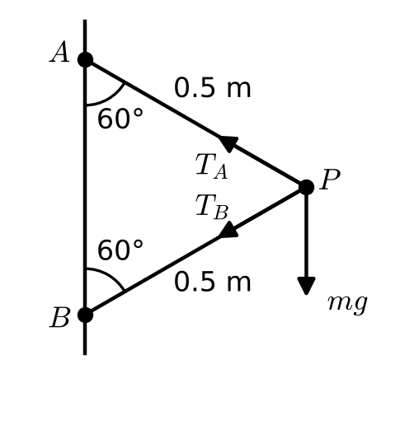
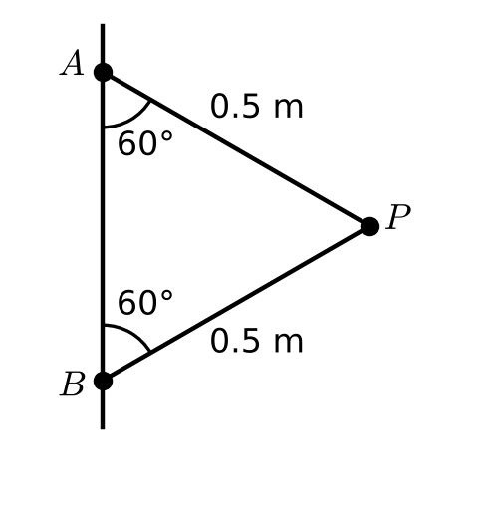
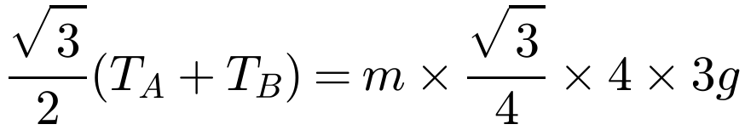
Three-Dimensional Problems with Objects Moving in Horizontal Circles
With two strings, show both tensions on the diagram
Resolve vertically and horizontally to get two simultaneous equations in T_{A} and T_{B}
The diagram shows a particle P of mass m attached by two strings to fixed points A and B, where A is vertically above B. The strings are both taut and P is moving in a horizontal circle with constant angular speed 2√(3g) rad s⁻¹. Both strings are 0.5 m in length and inclined at 60° to the vertical.
a) Calculate the tensions in the two strings.
Equilateral triangle
a) Radius = 0.5 cos 30° = √3/4 m
R(↑): T_{A} cos 60° = T_{B} cos 60° + mg
∴ T_{A} − T_{B} = 2mg (1)
R(←): T_{A} cos 30° + T_{B} cos 30° = mrω²
∴ T_{A} + T_{B} = 6mg (2)
T_{A} = 4mg N and T_{B} = 2mg N
Solve (1) and (2)
1C

Slide 7
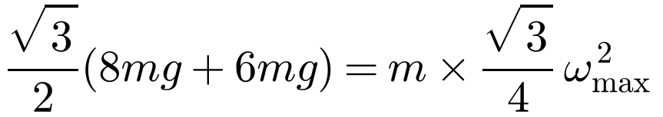
Three-Dimensional Problems with Objects Moving in Horizontal Circles
Don’t repeat work from part a
Everything up to the point where ω was substituted still applies:
T_{A} − T_{B} = 2mg and
T_{A} cos 30° + T_{B} cos 30° = mrω²
The string snaps if T_{A} > 8mg
The diagram shows a particle P of mass m attached by two strings to fixed points A and B, where A is vertically above B. The strings are both taut and P is moving in a horizontal circle with constant angular speed 2√(3g) rad s⁻¹. Both strings are 0.5 m in length and inclined at 60° to the vertical.
a) Calculate the tensions in the two strings.
The strings will break if the tension in them exceeds 8mg N. The angular speed of the particle is increased until the strings break.
b) State which string will break first.
c) Find the maximum angular speed of the particle before the string breaks.
b) T_{A} − T_{B} = 2mg, so the upper string always has the greater tension
The upper string (AP) breaks first
c) Let the maximum angular speed be ω_{max}.
At this speed T_{A} = 8mg, so from (1) T_{B} = 6mg
28g = ω_{max}²
1C

Slide 8
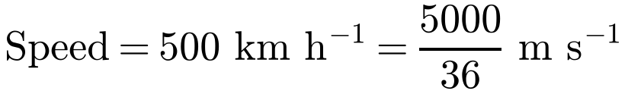
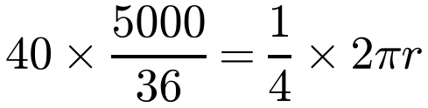
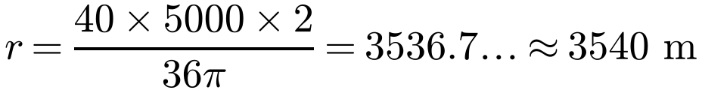
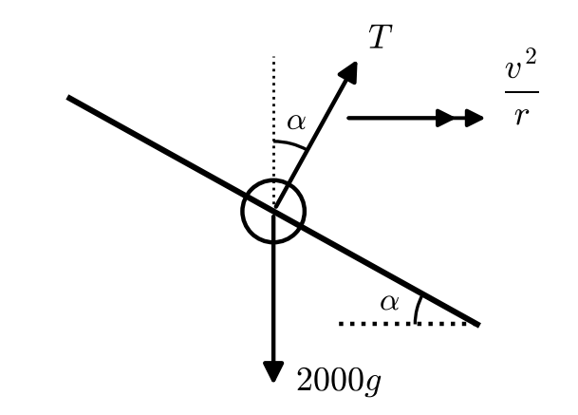
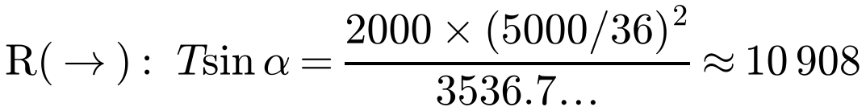
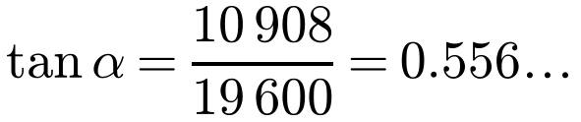
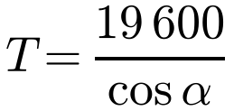
Three-Dimensional Problems with Objects Moving in Horizontal Circles
When an aircraft banks, the lift force acts perpendicular to the wings
Its vertical component balances the weight; its horizontal component provides the acceleration towards the centre of the circular arc
An aircraft of mass 2 tonnes flies at 500 km h⁻¹ on a path which follows a horizontal circular arc in order to change course from due north to due east. The aircraft turns in the clockwise direction from due north to due east. It takes 40 seconds to change course, with the aircraft banked at an angle α to the horizontal. Calculate the value of α and the magnitude of the lift force perpendicular to the surface of the aircraft’s wings.
A quarter of a circle in 40 s
R(↑): T cos α = 2000g = 19 600
α = 29° (2 s.f.)
T = 22 400 N (3 s.f.)
1C

Slide 9
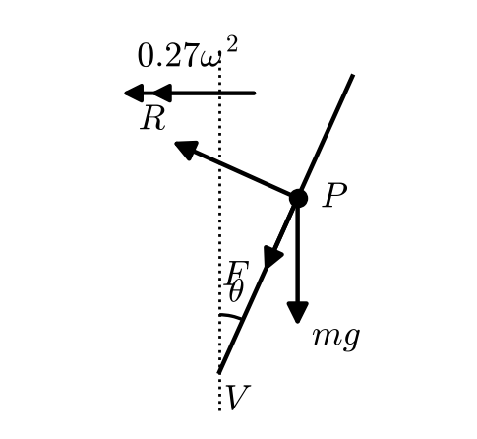
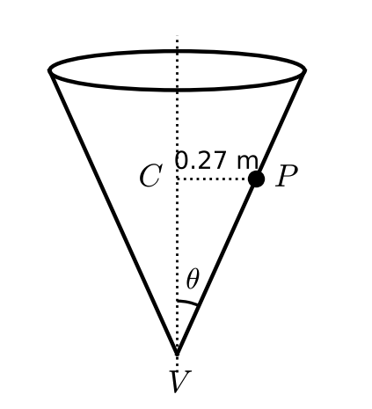
Three-Dimensional Problems with Objects Moving in Horizontal Circles
Draw a cross-section showing the three forces on the particle
For the greatest ω the particle is about to slip up the cone, so friction acts down towards V
Limiting friction: F = μR
In this question use g = 9.81 m s⁻².
A hollow right circular cone is fixed with its axis of symmetry vertical and its vertex V pointing downwards. A particle, P of mass 25 g moves in a horizontal circle with centre C, and radius 0.27 m, on the rough inner surface of the cone. P remains in contact as it moves with constant angular speed, ω, and does not slip. The angle between VP and the vertical is θ, such that tan θ = 0.45. The coefficient of friction between the particle and the cone is 0.15. Find the greatest possible value of ω.
(R↑): R sin θ = 0.025 × 9.81 + F cos θ
Towards the centre
(R→): R cos θ + F sin θ = 0.025 × 0.27ω²
Using F = μR means F = 0.15R
R sin θ − 0.15R cos θ = 0.24525 (1)
R cos θ + 0.15R sin θ = 0.00675ω² (2)
1C

Slide 10
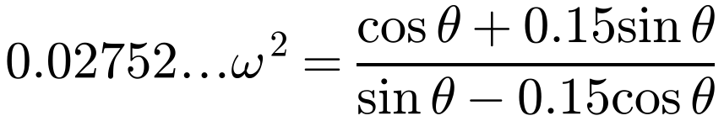
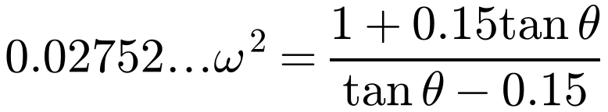
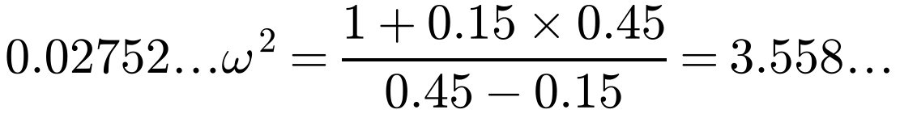
Three-Dimensional Problems with Objects Moving in Horizontal Circles
Divide one equation by the other to eliminate R
Divide the numerator and denominator by cos θ to get an expression in tan θ
Then use tan θ = 0.45
From the previous slide:
R sin θ − 0.15R cos θ = 0.24525 (1)
R cos θ + 0.15R sin θ = 0.00675ω² (2)
Dividing (2) by (1):
Divide top and bottom by cos θ
tan θ = 0.45
ω = 11.4 rad s⁻¹ (3 s.f.)
1C

