Slide 1
Circular Motion
Further Mechanics 2 Chapter 1
Westie's Workshop

Slide 2
Teachings for Exercise 1B

Slide 3
Acceleration of an Object Moving on a Horizontal Circular Path
An object moving in a circle at constant speed is accelerating, because the direction of its velocity is changing
The acceleration is directed towards the centre of the circle and has magnitude
rω² or v²/r
Measure r in metres to get the acceleration in m s⁻²
A particle is moving on a horizontal circular path of radius 20 cm with constant angular speed 2 rad s⁻¹. Calculate the acceleration of the particle.
Using a = rω²
Acceleration = rω²
The radius must be in metres
= 0.2 × 2²
= 0.8 m s⁻² towards the centre of the circle
1B

Slide 4
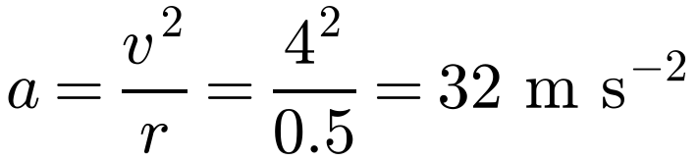
Acceleration of an Object Moving on a Horizontal Circular Path
Newton’s second law, F = ma, still applies
The resultant force on the particle acts towards the centre of the circle
Write down the formula for the acceleration first
Make sure lengths are in metres and masses are in kg before substituting
A particle of mass 150 g moves in a horizontal circle of radius 50 cm at a constant speed of 4 m s⁻¹. Find the force towards the centre of the circle that must act on the particle.
Acceleration in terms of speed and radius
150 g = 0.15 kg
F = ma = 0.15 × 32
= 4.8 N
1B

Slide 5
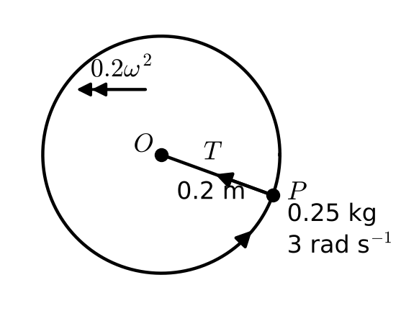
Acceleration of an Object Moving on a Horizontal Circular Path
Identify the force that provides the acceleration towards the centre
Here it is the tension in the string
Resolve towards the centre and use F = ma with a = rω²
One end of a light inextensible string of length 20 cm is attached to a particle P of mass 250 g. The other end of the string is attached to a fixed point O on a smooth horizontal table. P moves in a horizontal circle centre O at constant angular speed 3 rad s⁻¹. Find the tension in the string.
Let the tension in the string be T N.
Resolve towards O
T = mrω²
= 0.25 × 0.2 × 3²
= 0.45 N
1B

Slide 6
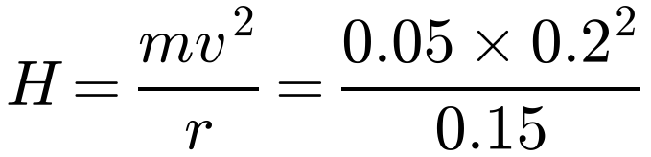
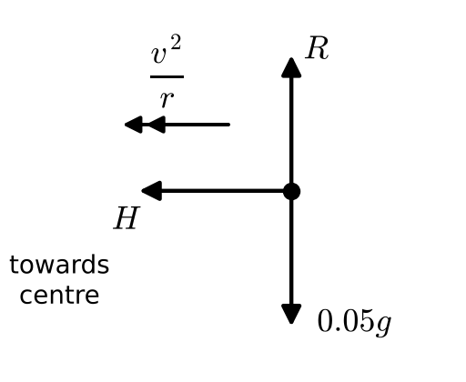
Acceleration of an Object Moving on a Horizontal Circular Path
If a question just says “speed”, it means linear speed
Forces on the bead: weight 0.05g N, the normal reaction R and the horizontal force H
The force towards the centre is the horizontal component of the reaction of the wire on the bead
A smooth wire is formed into a circle of radius 15 cm. A bead of mass 50 g is threaded onto the wire. The wire is horizontal and the bead is made to move along it with a constant speed of 20 cm s⁻¹. Find the horizontal component of the force on the bead due to the wire.
Side view of the bead:
Let the horizontal component of the force be H.
Resolve towards the centre
= 0.013 N (2 s.f.)
1B

Slide 7
Acceleration of an Object Moving on a Horizontal Circular Path
On a rotating disc, friction provides the force towards the centre
If the particle does not slip, it moves in a circle with the same angular speed as the disc
Remember to convert g to kg and cm to m
A particle P of mass 10 g rests on a rough horizontal disc at a distance 15 cm from the centre. The disc rotates at constant angular speed of 1.2 rad s⁻¹, and the particle does not slip. Calculate the force due to the friction acting on the particle.
Let the frictional force be F N.
Resolve towards the centre
F = mrω²
= 0.01 × 0.15 × 1.2²
= 0.00216 N
1B

Slide 8
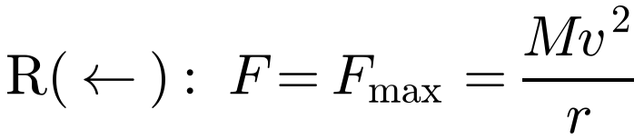
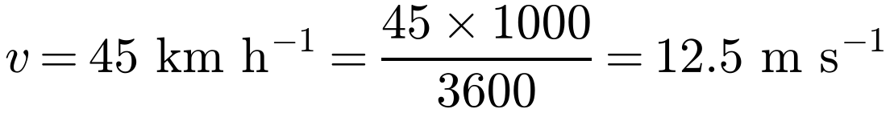
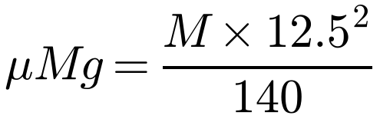
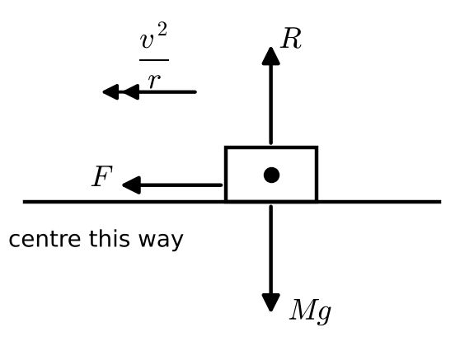
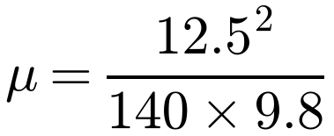
Acceleration of an Object Moving on a Horizontal Circular Path
At the greatest speed the car is on the point of slipping, so F = F_{max} = μR
Mark the forces on a diagram and resolve horizontally (towards the centre) and vertically
Convert km h⁻¹ to m s⁻¹
A car of mass M kg is travelling on a flat road round a bend which is an arc of a circle of radius 140 m. The greatest speed at which the car can travel round the bend without slipping is 45 km h⁻¹. Find the coefficient of friction between the tyres of the car and the road.
R(↑): R = Mg
Resolve towards the centre
M cancels: the answer does not depend on the mass
= 0.11 (2 s.f.)
1B

