Slide 1
Decision Analysis
Decision 2 Chapter 8
Westie's Workshop

Slide 2
Teachings for Exercise 8B

Slide 3
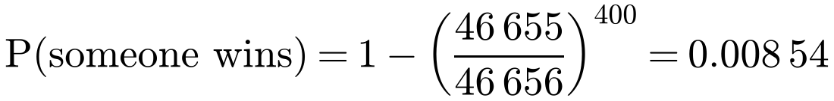
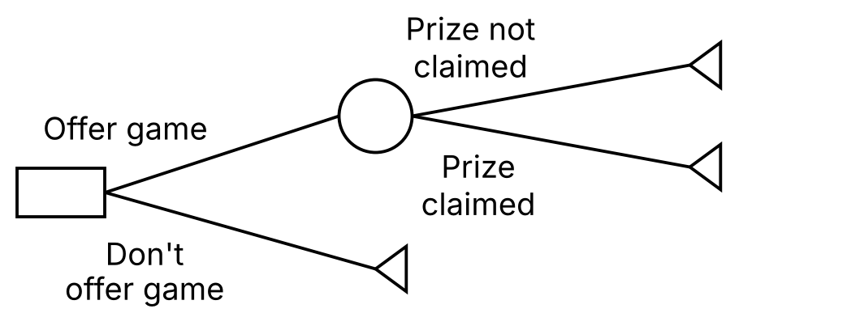




Utility
Using the EMV as a basis for decisions can lead to unfortunate results
The EMV is the average return: over many occasions the school expects to make 100 × £382.92 = £38 292 from 100 fetes
But on a single occasion, the risk of a large loss is high
When an average return is not appropriate, and the risk of a loss is to be avoided, use the expected utility, E(U), instead
A school fete runs a dice game: six dice are thrown, the charge is £1 for each attempt and the prize is £2000 for six sixes in a single throw. You expect 400 attempts during the day, and at most one prize is awarded.
On each throw: P(win) = 1/6⁶ = 1/46 656
Profit if no-one wins: 400. Profit if someone wins: 400 − 2000 = −1600
EMV = 0.991 46 × 400 + 0.008 54 × (−1600) = 382.92
Using the EMV criterion, the school should offer the game
8B

Slide 4
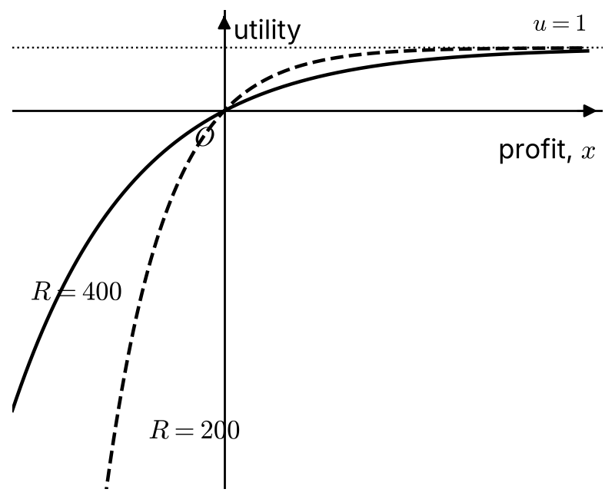
Utility
A utility function is a function of the pay-offs in a decision tree. It determines the relative value to the individual or organisation of each pay-off
Utility is measured in utils
Utility functions for risk-averse organisations increase slowly with potential profits, but reduce quickly with potential losses
One form is u(x) = 1 − e^{−x/R}, where x is the profit and R > 0
R controls the curvature: smaller values of R increase the curvature and model an increased aversion to risk
For a profit, u is between 0 and 1. For a loss, u is negative, and it falls much more quickly when R is small: a loss of 600 gives −3.48 when R = 400, but −19.1 when R = 200
8B

Slide 5



Utility
You only use the utility function to convert the pay-offs
Then calculate the expected utility E(U) at each chance node using the utilities you have just found, in the same way as an EMV
Utilities can be negative as well as positive
A school has to decide whether to offer the dice game described on the previous slide. For a pay-off of £x, the school determines that its utility function is u(x) = 1 − e^{−x/R}.
Calculate the school’s expected utility, given that: a) R = 400 b) R = 200. In each case, interpret the results.
a) u(x) = 1 − e^{−x/400}
u(400) = 1 − e⁻¹ = 0.632, u(−1600) = 1 − e⁴ = −53.6, u(0) = 0
E(U) = 0.991 46 × 0.632 + 0.008 54 × (−53.6) = 0.169 utils
The large value of R gives a small positive E(U) of 0.169 utils, which indicates that an organisation that is happy to take risks might favour offering the game.
8B

Slide 6



Utility
You only use the utility function to convert the pay-offs
Then calculate the expected utility E(U) at each chance node using the utilities you have just found, in the same way as an EMV
Utilities can be negative as well as positive
A school has to decide whether to offer the dice game described on the previous slide. For a pay-off of £x, the school determines that its utility function is u(x) = 1 − e^{−x/R}.
Calculate the school’s expected utility, given that: a) R = 400 b) R = 200. In each case, interpret the results.
b) u(x) = 1 − e^{−x/200}
u(400) = 1 − e⁻² = 0.865, u(−1600) = 1 − e⁸ = −2980, u(0) = 0
E(U) = 0.991 46 × 0.865 + 0.008 54 × (−2980) = −24.6 utils
The smaller value of R gives a negative E(U) of −24.6 utils, which indicates that an organisation that is not happy to take risks should not offer the game.
8B

Slide 7
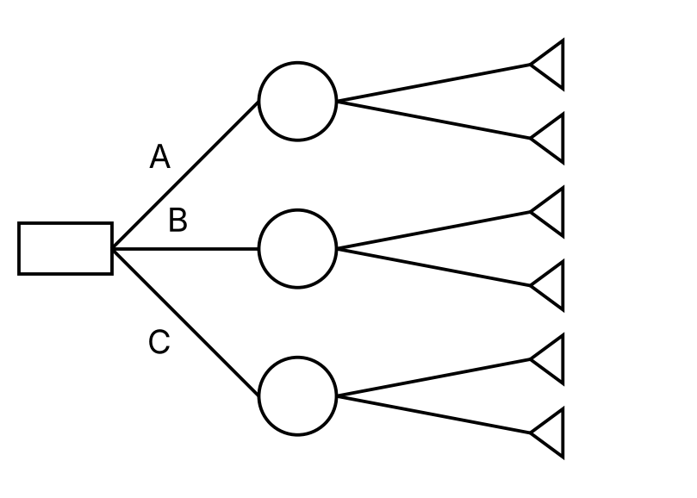

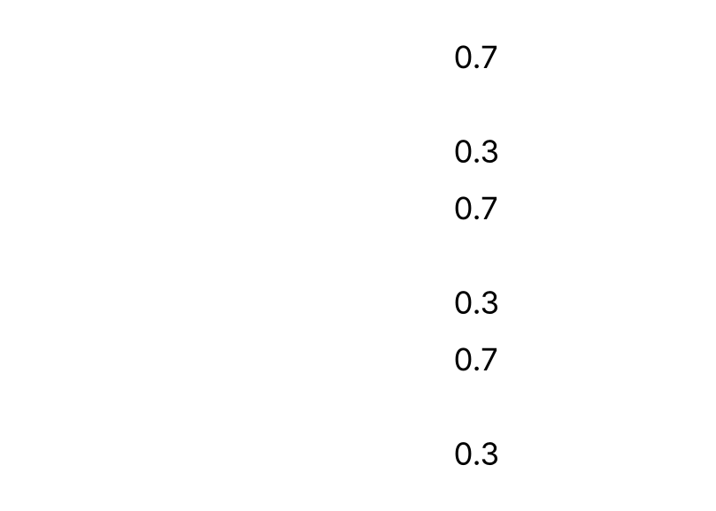


Utility
Using the EMV criterion
Find the EMV at each chance node
Choose the option with the largest EMV
A company can choose one of three business options A, B or C. The profits in pounds associated with each outcome are shown on the decision tree.
a) Using the decision tree, calculate the optimal EMV to determine the best choice.
A: 0.7 × 750 + 0.3 × (−550) = 360
B: 0.7 × 400 + 0.3 × (−200) = 220
C: 0.7 × 500 + 0.3 × (−300) = 260
The optimal EMV is £360, which makes option A the best choice using the EMV criterion
8B

Slide 8

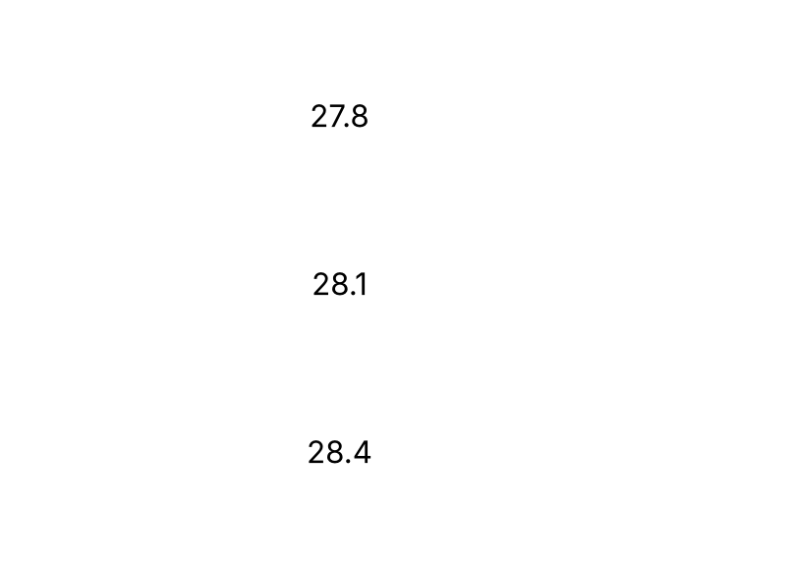

Utility
Using expected utility
Rewrite the decision tree, replacing each pay-off with its utility
Calculate the expected utility at each chance node
u(x) = √(x + 600) changes rapidly as x approaches −600: it represents an aversion to negative pay-offs approaching −600. This is why option A is no longer favoured
For a profit of £x, the company’s utility is given by √(x + 600).
b) Using expected utility as the criterion, determine the optimal choice.
u(750) = √1350 = 36.7, u(−550) = √50 = 7.07
u(400) = √1000 = 31.6, u(−200) = √400 = 20
u(500) = √1100 = 33.2, u(−300) = √300 = 17.3
E(U): A 27.8, B 28.1, C 28.4
The optimal expected utility is 28.4 utils, so option C is the best choice using expected utility
8B

Slide 9
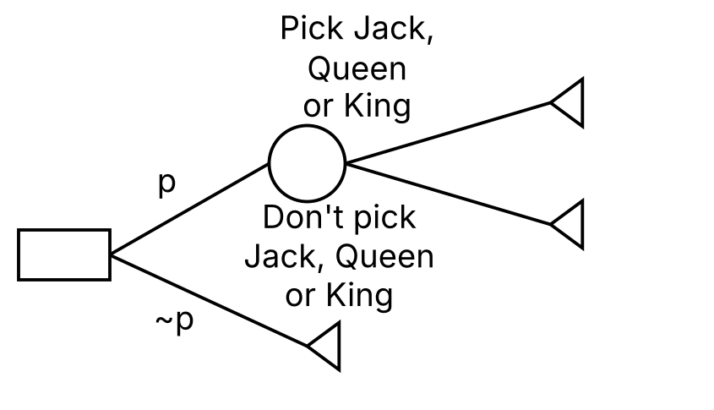
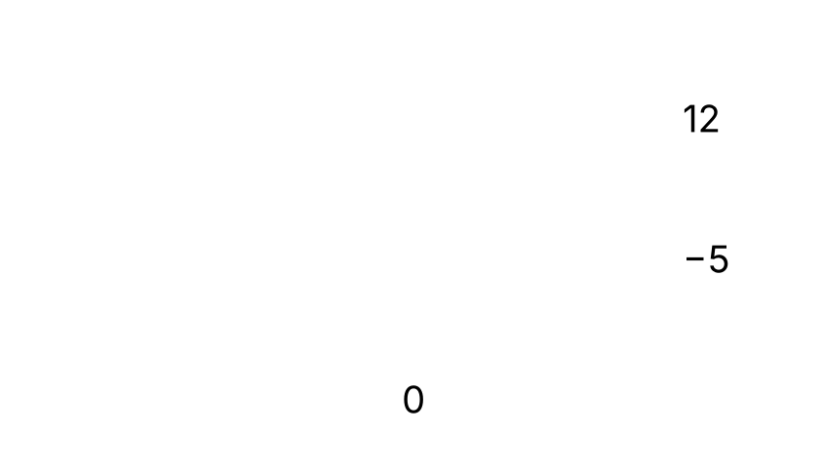



Utility
A standard pack has 52 cards, 12 of which are a Jack, Queen or King
P(J, Q or K) = 12/52 = 3/13
Tim is considering whether to play a card game. If he picks a Jack, Queen or King, at random from a standard pack of playing cards, then he wins a prize. If he picks any other card, then he loses £5.
a) Draw a decision tree and state Tim’s best course of action using the EMV criterion, given that the prize on offer is £12.
EMV of playing = 3/13 × 12 + 10/13 × (−5) = −14/13 ≈ −1.08
The EMV of playing is negative, so using the EMV criterion Tim should not play the game
8B

Slide 10

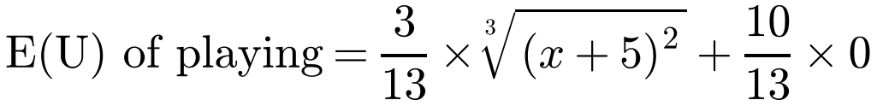
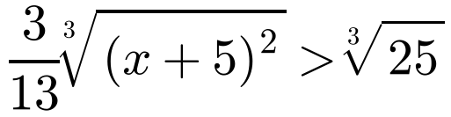
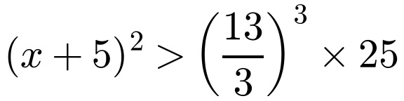
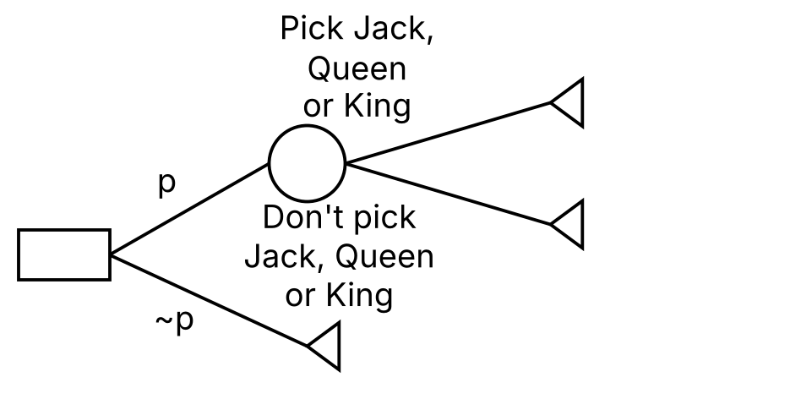

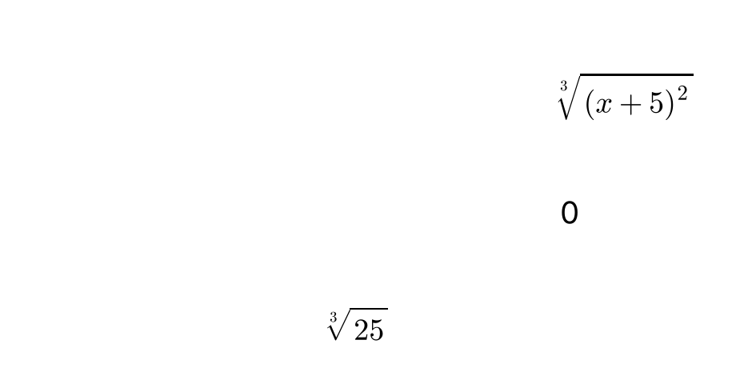
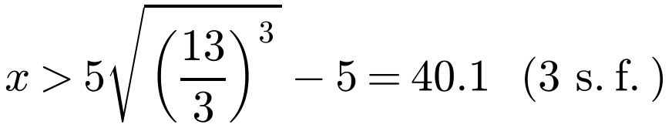
Utility
The utility function is defined in terms of the total amount of money Tim has, not his winnings or losses
Find the minimum prize x for which the expected utility of playing is at least the utility of not playing
Tim only has £5. He uses utility = ∛(money²) to reflect his risk aversion.
b) Calculate the minimum prize amount that would make it worthwhile for Tim to play the game.
Let the prize be £x. If Tim plays and wins he has £(x + 5);
if he plays and loses he has £0; if he does not play he has £5
The prize should be at least £40.10 to make it worthwhile for Tim to play
8B

