Slide 1
Decision Analysis
Decision 2 Chapter 8
Westie's Workshop

Slide 2
Teachings for Exercise 8A

Slide 3
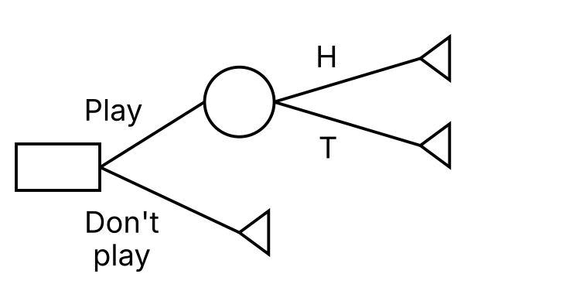
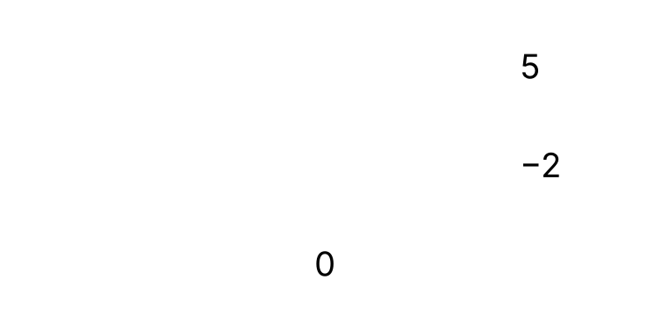
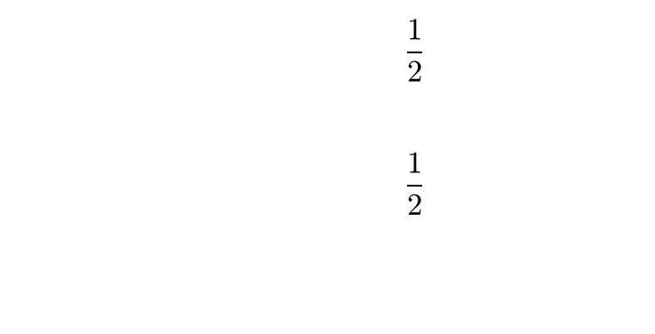
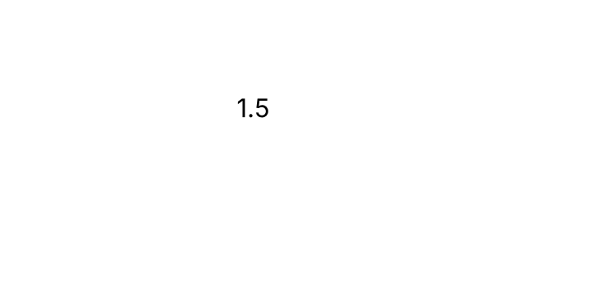
Decision Trees
In a decision tree:
• boxes represent decision nodes
• triangles represent end (pay-off) nodes
• circles represent chance nodes
Annotating the tree:
• probabilities of each outcome go on the branches
• the pay-off for each end node is written next to it
• the expected value of each event is written inside its chance node: the expected monetary value (EMV)
A player tosses a coin and wins £5 for heads, or loses £2 for tails. Draw a decision tree for the decision whether or not to play.
A decision node comes immediately before a decision: play or don’t play. A chance node comes before an event: the coin toss.
Pay-offs: +5 for heads, −2 (a loss) for tails, and 0 if the player does not play, as the tree ends there
EMV of playing = 5 × ½ + (−2) × ½ = 1.5
8A

Slide 4
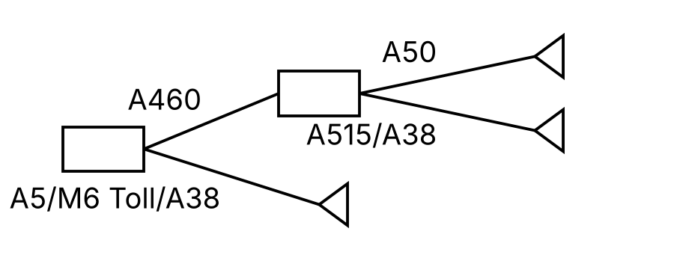
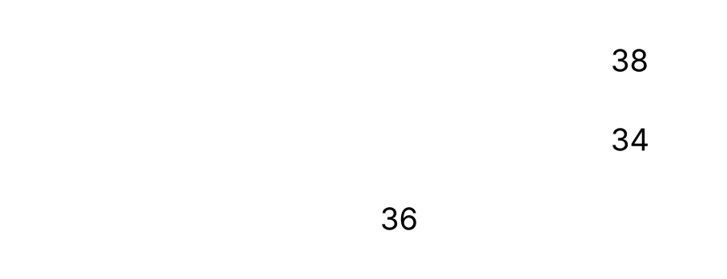
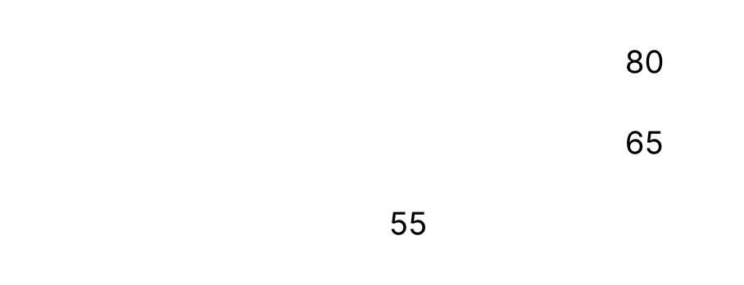
Decision Trees
A decision tree with no chance nodes just compares the pay-offs of each set of decisions
Here there are two decisions: A460 or A5 at the start, then A50 or A515/A38
The nature of the problem determines the pay-offs
If Carol wants to minimise distance, the pay-offs are distances; to minimise time, they are times
Carol plans to travel from Cannock to Derby by car. One option is to take the A460 to Uttoxeter and then take the A50: 38 miles, around 1 hour 20 minutes. A second option is the A5 to the M6 Toll road then the A38: 36 miles, around 55 minutes. A final option is the A460 to Rugeley, then the A515, then the A38 at Alrewas: 34 miles, around 1 hour 5 minutes.
a) Use a decision tree to choose the best option for Carol based purely on: i) the distance to travel ii) the time needed to complete the journey.
i)
Using distance (miles), the best option is the A460 to the A515 and then the A38 (34 miles)
ii)
Using time (minutes), the best route is the A5 to the M6 Toll road and then the A38 (55 minutes)
8A

Slide 5
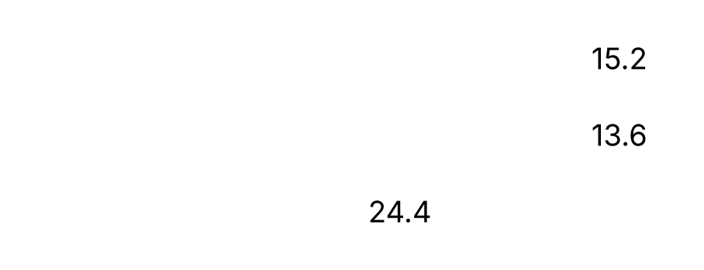
Decision Trees
You might need to carry out calculations to find each pay-off
Cost = 0.4 × distance, plus £10 for the M6 Toll road
Write a conclusion based on all of the available analysis
The cost of driving is estimated at 40p per mile. There is an additional cost of £10 for using the M6 Toll road.
b) Comment on the best option overall.
A460/A50: 0.4 × 38 = £15.20
A460/A515/A38: 0.4 × 34 = £13.60
A5/M6 Toll/A38: 0.4 × 36 + 10 = £24.40
Using cost, the best route is the A460 to the A515 and then the A38 (£13.60)
Carol’s final decision will depend on how important it is to save around 10 minutes of journey time (55 min instead of 65 min) at the expense of almost £11 in cost (£24.40 instead of £13.60).
8A

Slide 6
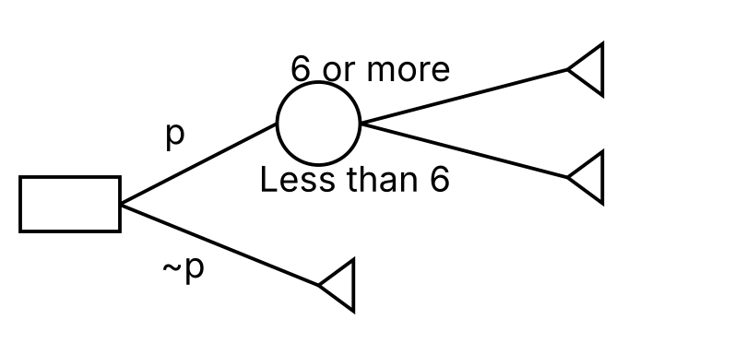
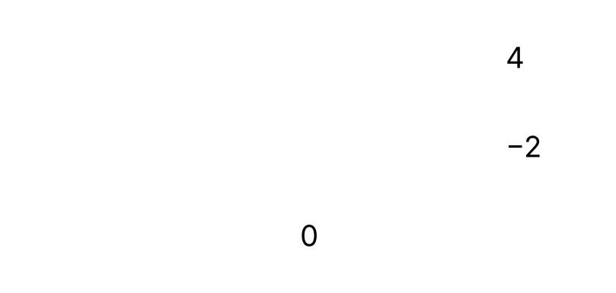
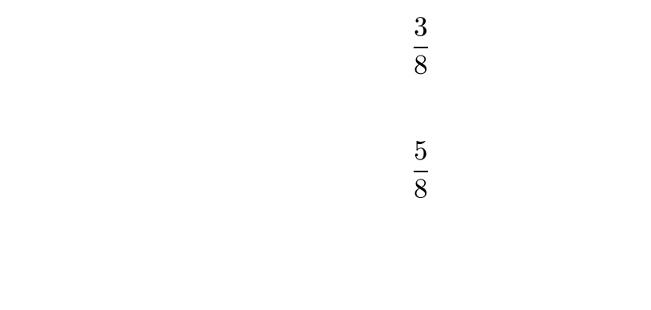

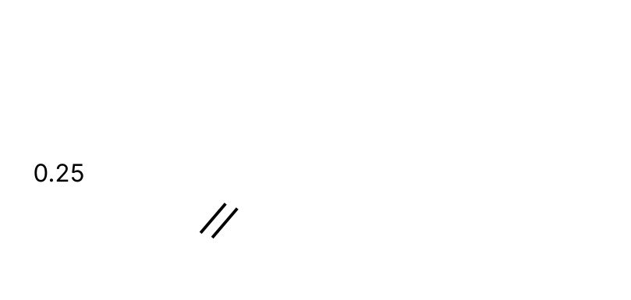
Decision Trees
An optimal strategy based on the EMV criterion is a set of decisions chosen so as to optimise the EMV
p represents the decision to play and ~p the decision not to play
Show the optimal strategy by drawing a double line through the non-optimal decision at each decision node, and writing the optimal value inside the decision node
James is trying to decide whether or not to play a game using two fair tetrahedral dice. The sides of the dice are numbered from 1 to 4. If he scores a total of 6 or more then he wins £4; otherwise he loses £2.
a) Draw a decision tree to model James’s possible decisions and outcomes.
b) Determine whether James should play the game and state his EMV.
a) Winning scores: (4, 2), (2, 4), (3, 3), (4, 3), (3, 4), (4, 4)
P(6 or more) = 6/16 = 3/8, P(less than 6) = 5/8
EMV of playing = 3/8 × 4 + 5/8 × (−2) = 0.25
b) Playing gives a positive EMV of £0.25, so James should play
8A

Slide 7
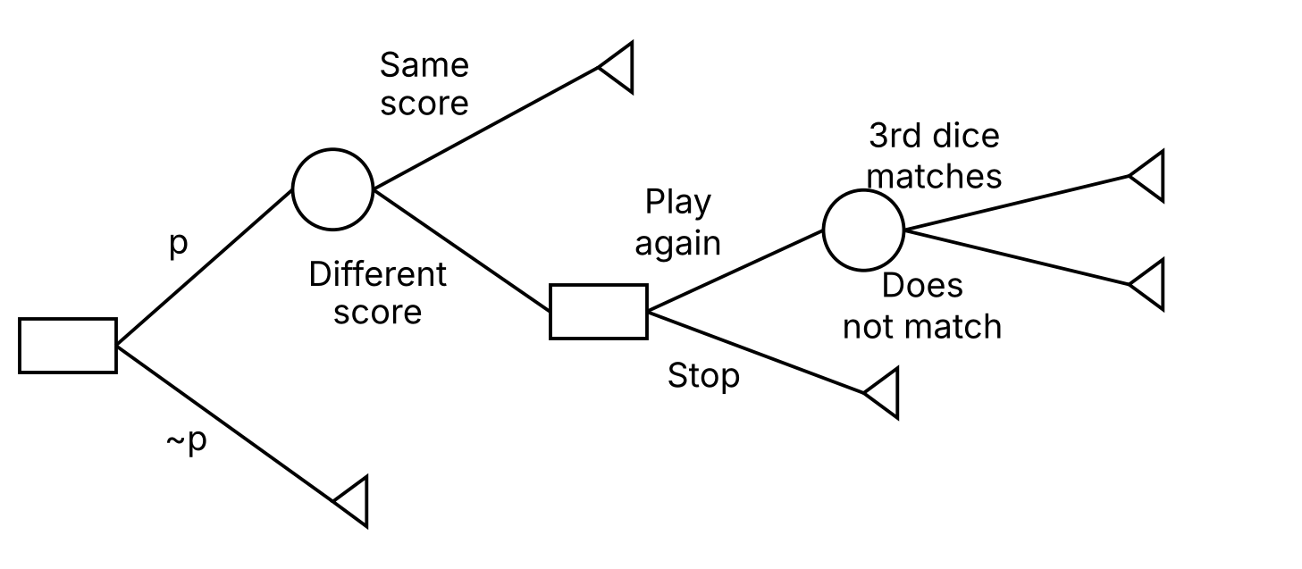
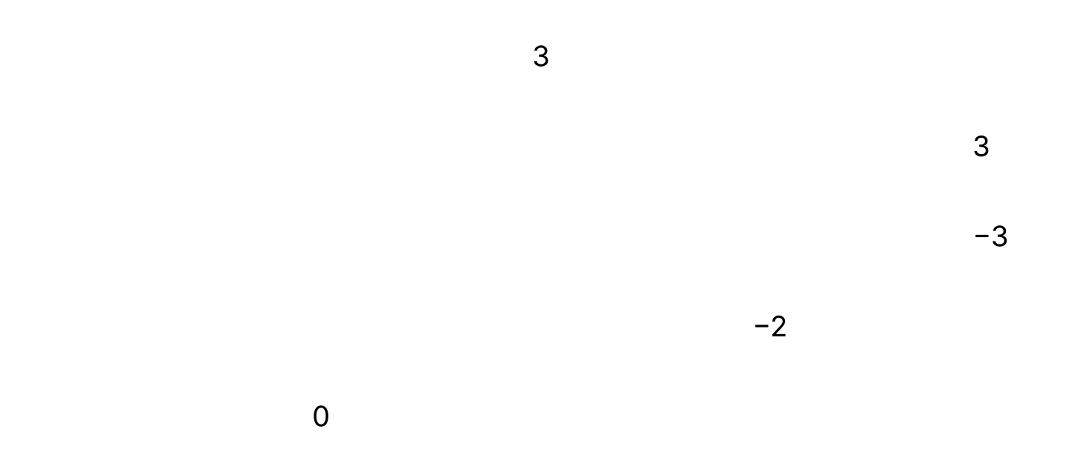
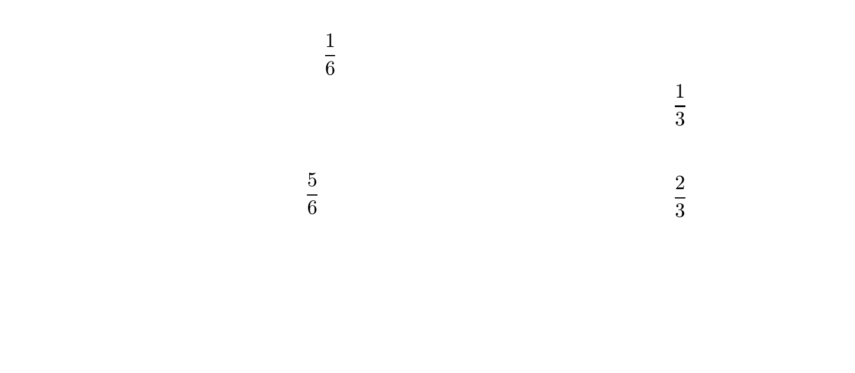
Decision Trees
Build the tree in stages:
1. structure: decisions and outcomes
2. pay-offs
3. probabilities
4. EMVs, from right to left
After losing the first event there is a second decision, so add a second decision node at the end of the losing outcome
Pay-off = winnings − amount paid
Jess pays £2 to play a game. She rolls two dice and if they both show the same score, she wins £5; otherwise she loses. If she loses, she can pay a further £1 to roll a third dice. If the score on the third dice matches the score on either of the first two dice, then she wins £6; otherwise she loses.
a) Draw a decision tree to model the decisions and possible outcomes.
b) Find the best strategy for Jess as indicated by the decision tree.
Same score: 5 − 2 = 3. 3rd dice matches: 6 − 2 − 1 = 3. Does not match: −2 − 1 = −3. Stop: −2
P(same score) = 6/36 = 1/6. The third dice is only rolled if the first two are different, so P(it matches one of them) = 2/6 = 1/3
8A

Slide 8


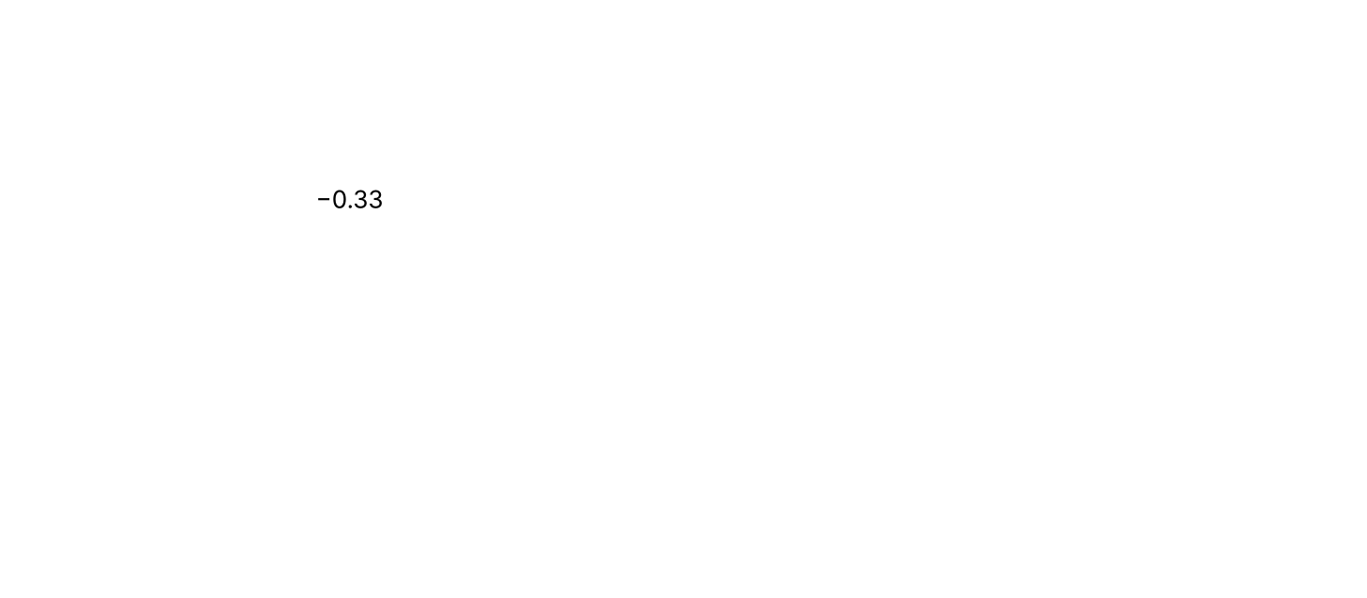
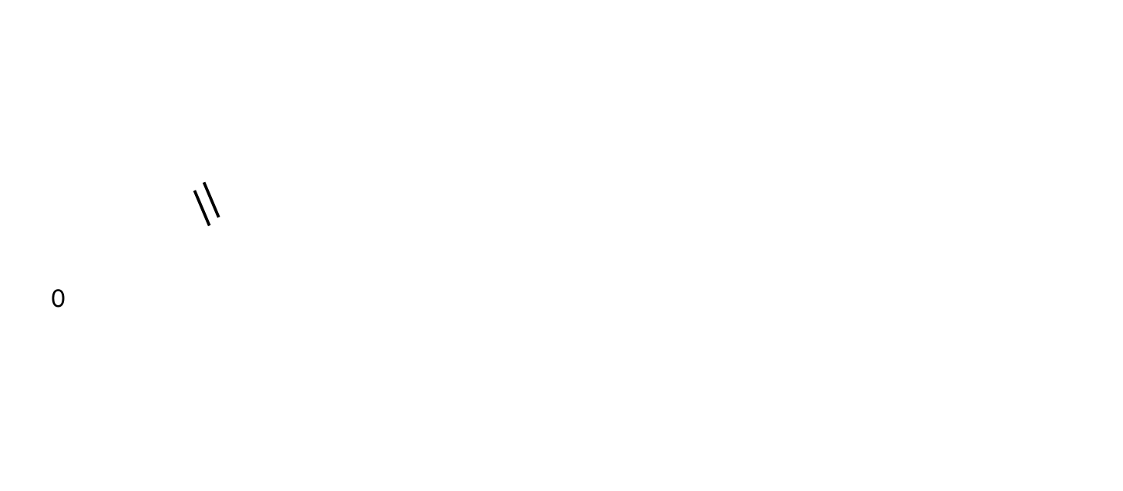
Decision Trees
Work from right to left
At a chance node, write the EMV
At a decision node, choose the best option, write its value in the box and put a double line through the other option
Do not cross out outcomes leading from chance nodes: these are chance events you cannot control
Jess pays £2 to play a game. She rolls two dice and if they both show the same score, she wins £5; otherwise she loses. If she loses, she can pay a further £1 to roll a third dice. If the score on the third dice matches the score on either of the first two dice, then she wins £6; otherwise she loses.
b) Find the best strategy for Jess as indicated by the decision tree.
EMV = 1/3 × 3 + 2/3 × (−3) = −1
Play again (−1) is better than stop (−2)
EMV = 1/6 × 3 + 5/6 × (−1) = −0.33
Not playing (0) is better than playing (−0.33)
b) The best strategy is not to play, since the EMV of playing is less than the £0 for not playing. However, if Jess does play and loses at the first attempt, she should pay £1 and roll the third dice.
8A

Slide 9
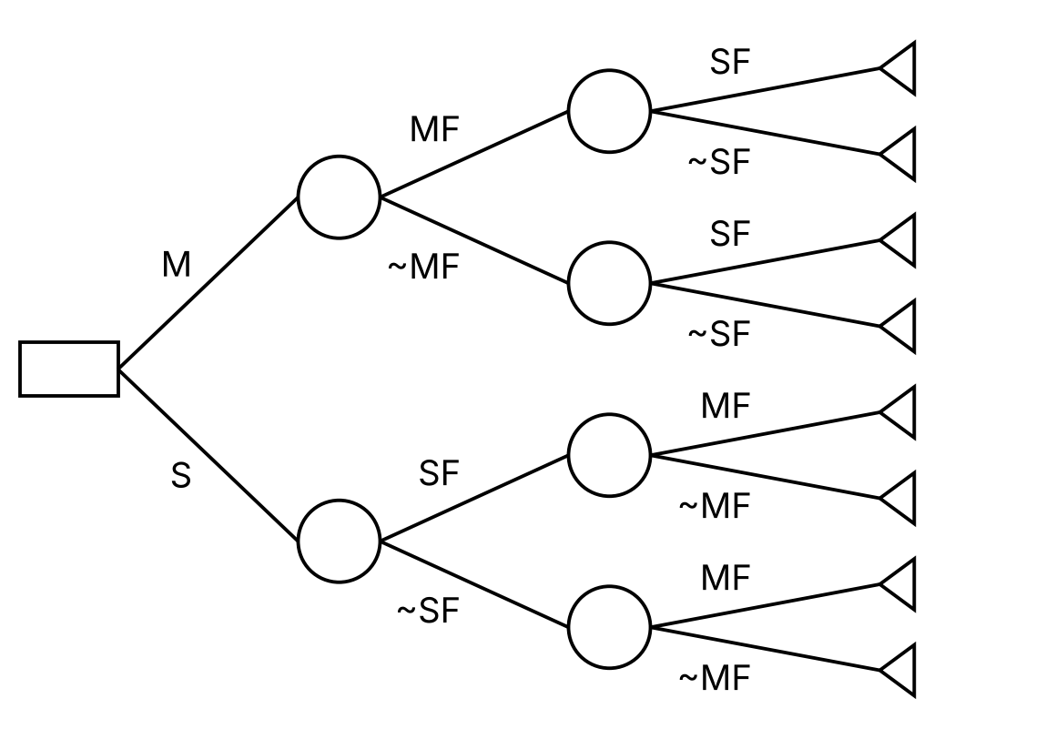

Decision Trees
Use clear notation:
M: revise Mechanics
MF: Mechanics questions are favourable
~MF: Mechanics questions are not favourable
and similarly S, SF, ~SF for Statistics
The pay-offs are Jack’s expected total marks
e.g. both favourable: 45 + 35 = 80
Jack has time for one revision session before an exam in Mechanics and Statistics (50 marks each). He will revise either Mechanics or Statistics.
If the Mechanics questions go in his favour he expects 45 marks, otherwise 30. If the Statistics questions go in his favour he expects 35 marks, otherwise 25.
If he revises Mechanics: 70% chance the Mechanics questions are favourable, 20% chance the Statistics questions are favourable.
If he revises Statistics: 60% chance the Statistics questions are favourable, 60% chance the Mechanics questions are favourable.
Use a decision tree to determine how Jack should devote his revision time.
8A

Slide 10
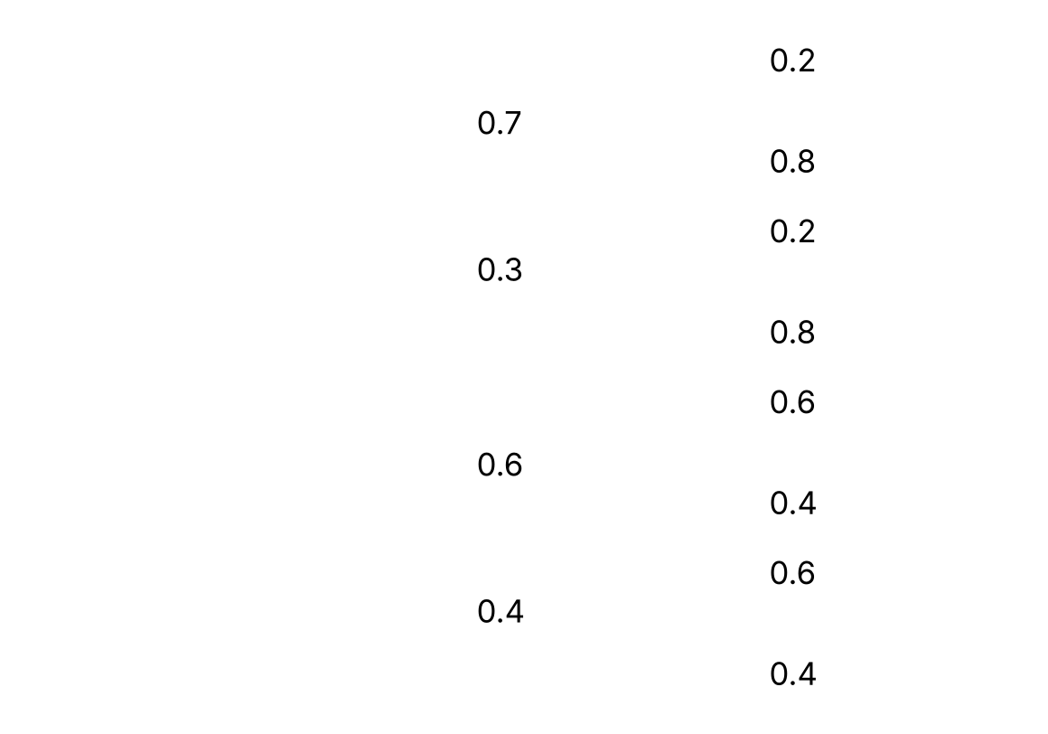
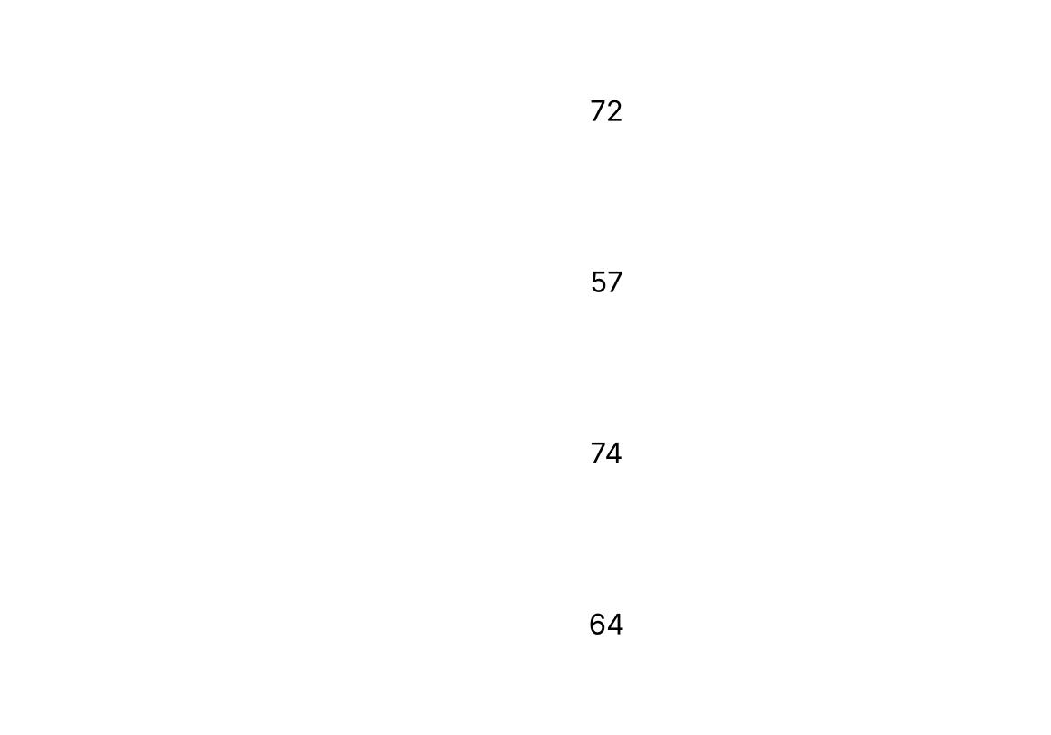
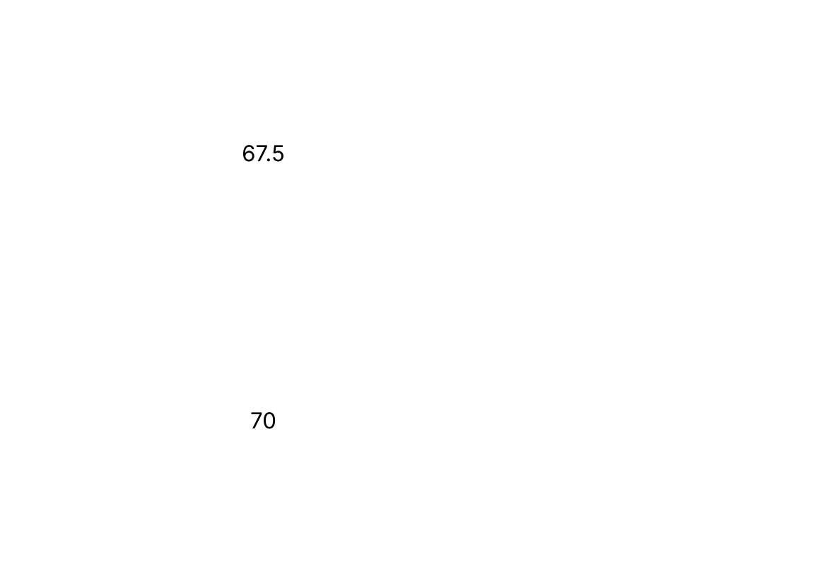
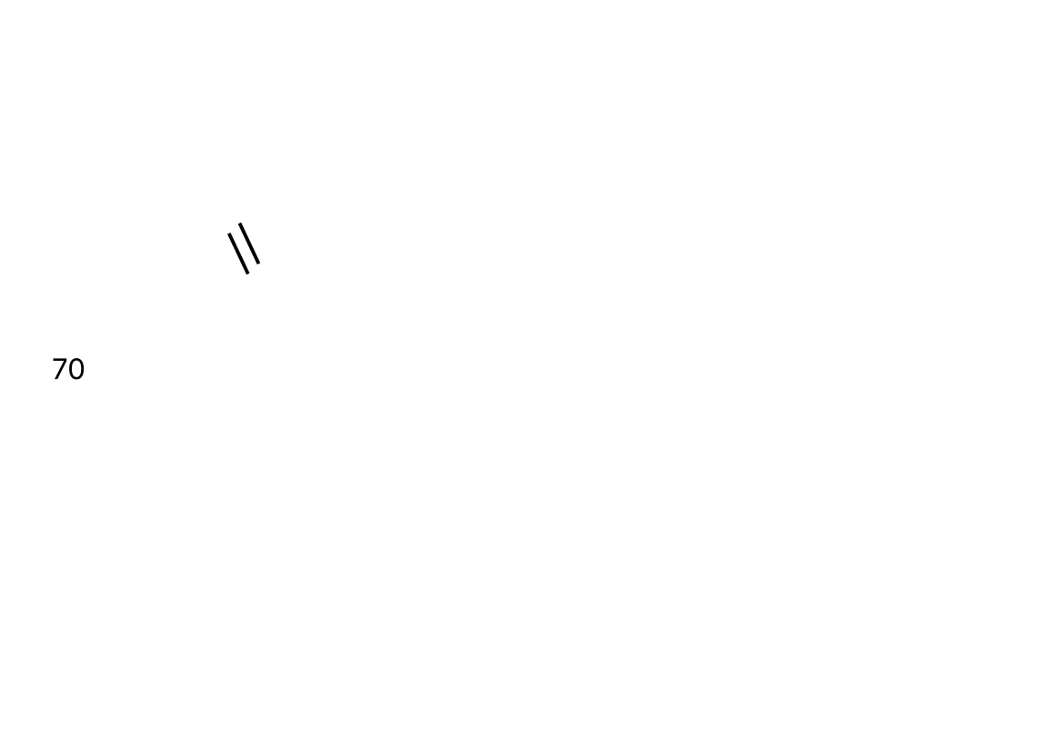
Decision Trees
Put the probabilities on the branches, then calculate the expected values from right to left
e.g. 0.2 × 80 + 0.8 × 70 = 72
0.7 × 72 + 0.3 × 57 = 67.5
0.2 × 80 + 0.8 × 70 = 72
0.2 × 65 + 0.8 × 55 = 57
0.6 × 80 + 0.4 × 65 = 74
0.6 × 70 + 0.4 × 55 = 64
M: 0.7 × 72 + 0.3 × 57 = 67.5
S: 0.6 × 74 + 0.4 × 64 = 70
Since 70 > 67.5, Jack should revise Statistics to optimise his expected marks
(The textbook writes 69 in the decision node; it should be 70.)
8A

